Slide 1
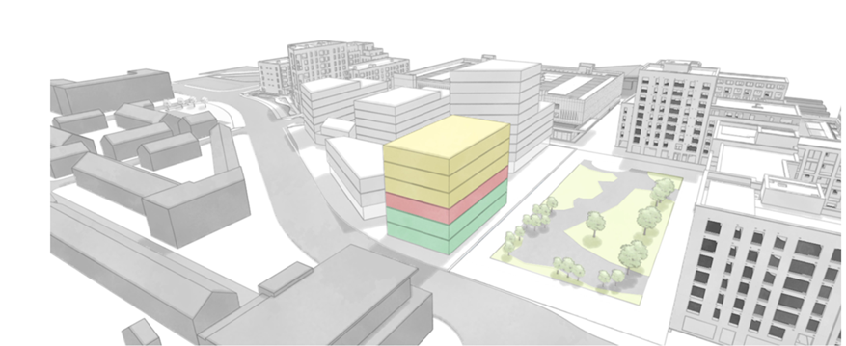
Adamstown Civic Building

Slide 2
Contents
Site Location-Aerial View
Site Layout-Quadrant H
Planning Scheme Requirements
Community Space
Delivery of the Adamstown Civic Building
Next Steps…
Key Stakeholders
Adamstown Civic Building

Slide 3
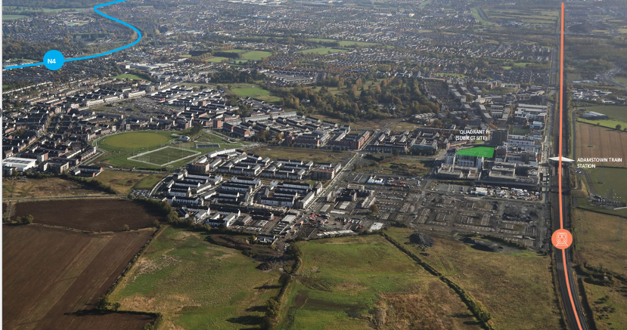
Site Location-Aerial View

Slide 4
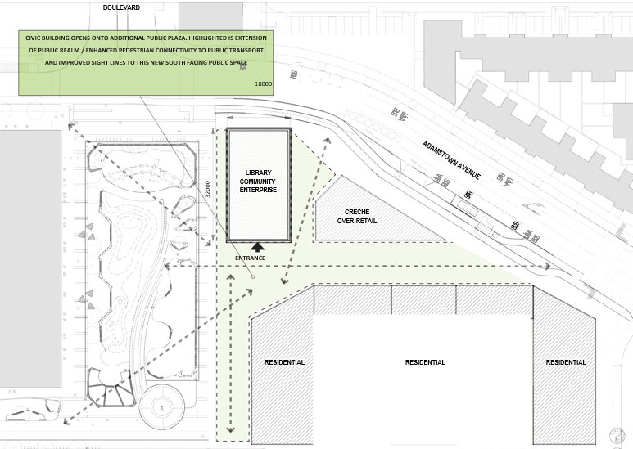
Site Layout-Quadrant H
Situated in Quadrant H adjacent to the Plaza, the site is conveniently located close to a variety of shops, residential areas, and the Primary Healthcare Centre, in the heart of the town centre.

Slide 5
Adamstown Planning Scheme Requirements
The Planning Scheme stipulates the inclusion of a 1,000sqm library (Phase 6) and a 1,500sq enterprise centre (Phase 8).
The library and enterprise centre are seen as cornerstones supporting community growth and engagement.
Feedback from the Elected Members on the current community offerings sparked a rethink on what this building could achieve.
The focus shifted to ensure the civic building is designed to offer an adaptable, and inclusive environment, supporting a diverse range of activities for all ages and fosters a multi-generational space for the whole community.

Slide 6
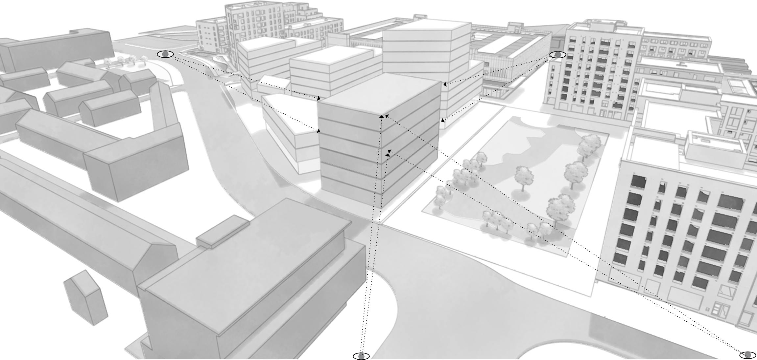
Key Stakeholders
Development Managers: Evara
Appointed Design Team: Henry J. Lyons
SDCC input from Planning, Libraries, Economic, Enterprise and Tourism Departments.

Slide 7
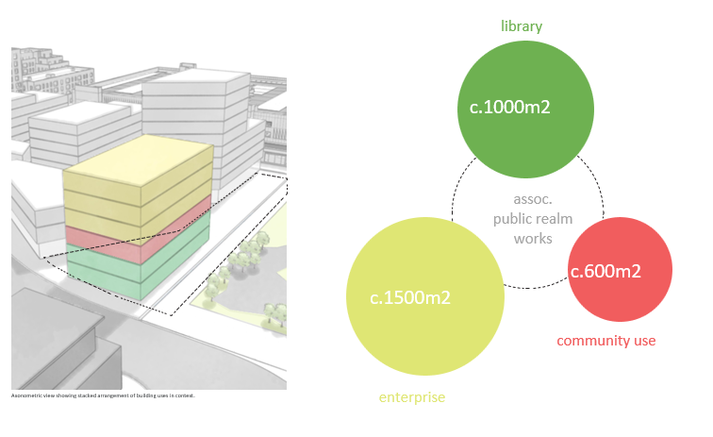
Six-storey civic building, with spaces designed to work symbiotically with the library, encouraging cross-use and collaboration.
A vibrant, inclusive space for all.
Strategically situated in the core of the town centre, the civic building will open onto communal outdoor space, featuring a modern, functional public realm.
Enhances the streetscape & improves pedestrian connectivity to nearby public transport.
Creates an accessible area for community activity and events.

Slide 8
Community Space
The community space will function as a flexible, multi-use environment, designed to complement and enhance the functions of the new public library.
With a focus on fostering collaboration, learning and community engagement, the design will ensure a flexible layout that supports a wide variety of uses.
A first of its kind for SDCC, setting a new standard for civic spaces that bring together culture, innovation and community.

Slide 9
Delivery of the Civic Building
The development of the SDCC-owned civic building will be supported by a combination of funding sources.
Library: URDF funding towards the library has been secured.
Community: c600sqm community use will form part of a community equivalent package in lieu of the swimming pool/leisure centre which will not be constructed.
Enterprise Centre: Economic, Enterprise and Tourism Department of SDCC will support the Enterprise Centre, backed by a mix of funding resources.
Each element-the library, community spaces, and enterprise centre- will come together to create a vital, multi-functional resource for the whole community.

Slide 10
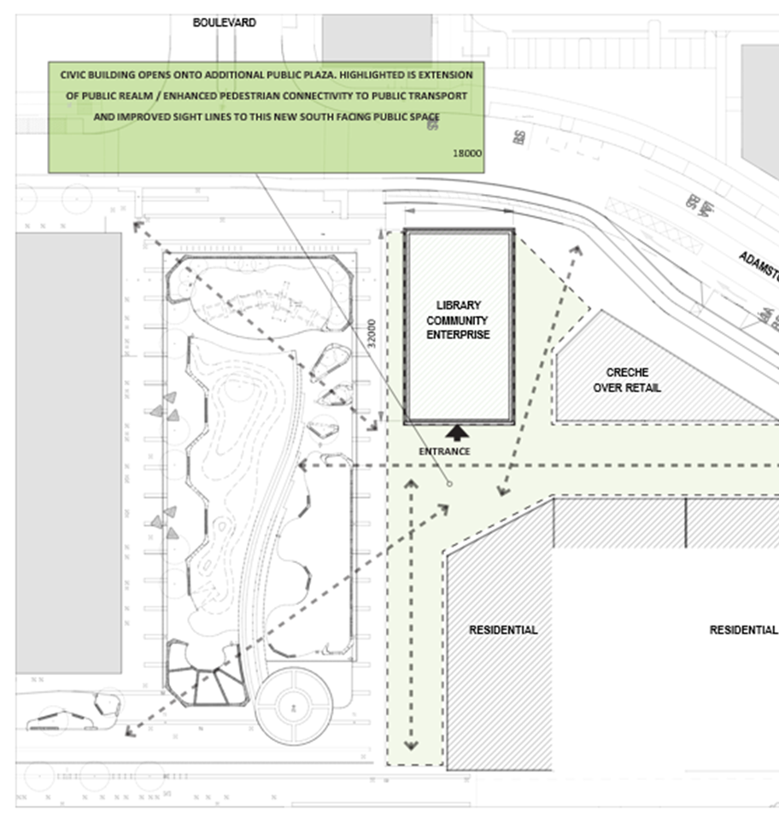
Next Step….
Pre-planning Meeting
Planning Application

