Slide 1
Balgaddy Housing Update
Q1 2025 Report
Housing Maintenance & Estate Management

Slide 2
Response Maintenance Q1 2025
64
50
44
29

Slide 3
Allocations and Relets Q1 2025
Pre - Works | Work in Progress | Ready for Allocation | Allocated | Total
0 | 3 | 2 | 1 | 6
Allocations for Q1
7

Slide 4
Housing Maintenance Operations Balgaddy
Response Maintenance and Property Management
187 Work Orders completed in Q1 2025 by Direct Labour, Electrical, Mechanical and Response Maintenance Contractors.
Property Condition Surveys – Identify condition and maintenance requirements
Properties surveyed on 5-year cycle
Contract has commenced
Balgaddy included in year two surveys
Outcome of surveys will determine future planned maintenance programmes
Allocations and Relets 2024

Slide 5
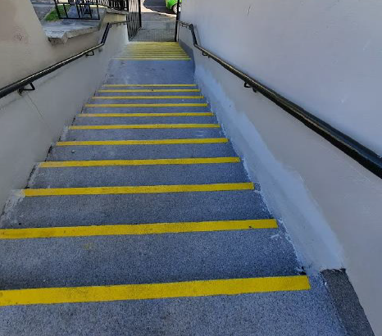
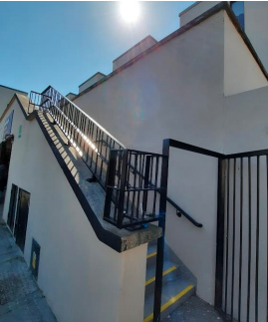
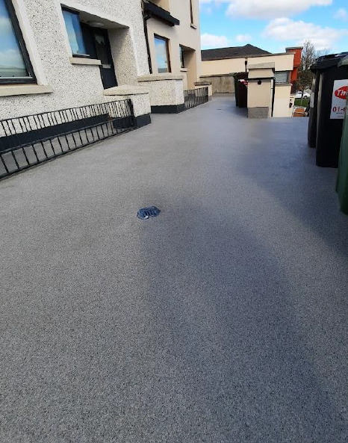
Planned Maintenance 1-
Balgaddy
Family Child Centre
Extensive maintenance works completed stairs to the
Balgaddy Child & Family Centre.
Drainage Works carried out at children’s play area.
Energy Efficiency Retrofit Programme
Works were completed at fifteen locations
within Tor An Rí Walk.
Safety Works Programme
176 units have been completed with an additional
178 issued to contractor. These are having
fire detection systems upgraded to LD2 standard.

Slide 6
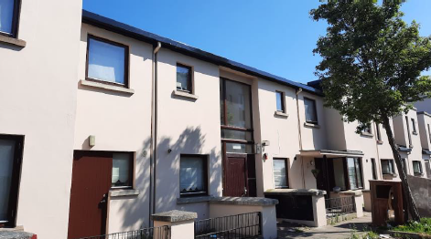
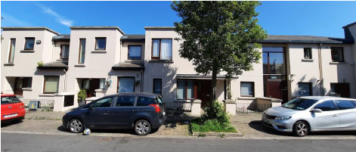
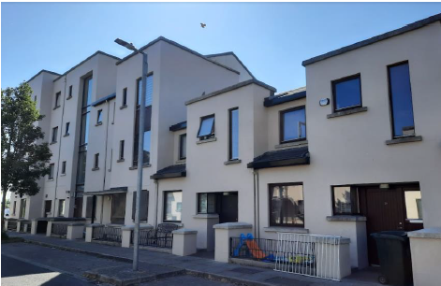
Planned Maintenance 2
Painting Programme
66 Units complete to date on Méile An
Rí Road and Park
29 Units in progress on Buirg An Rí Glen

Slide 7
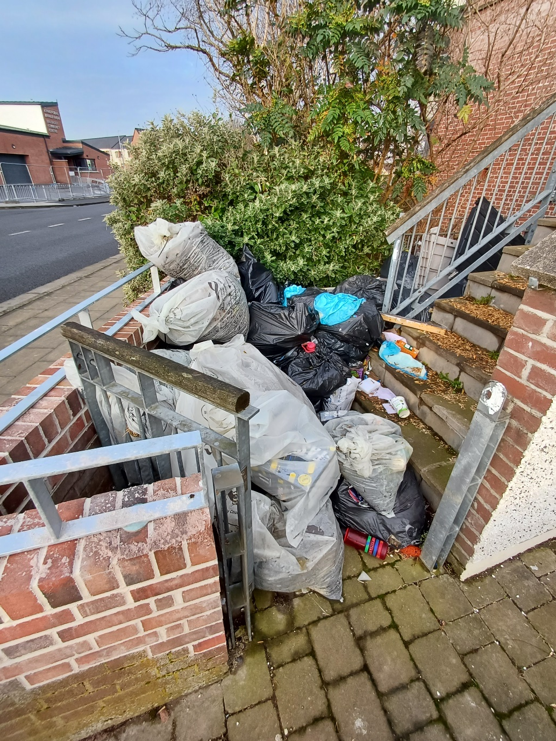
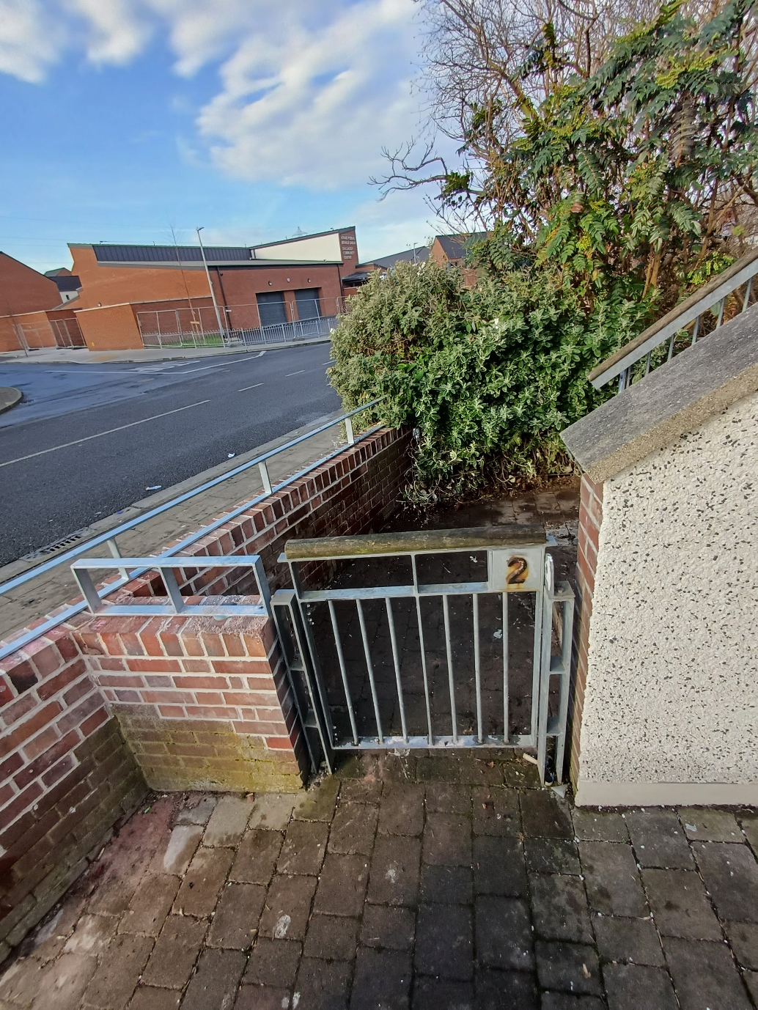
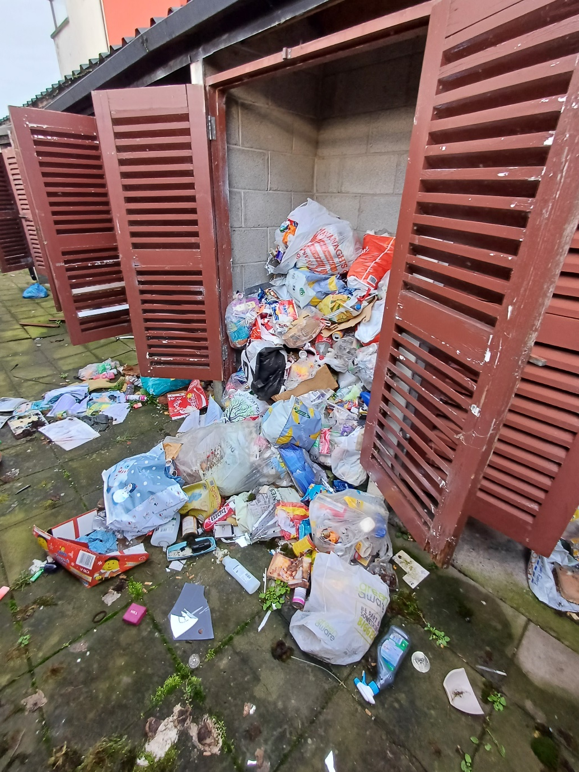
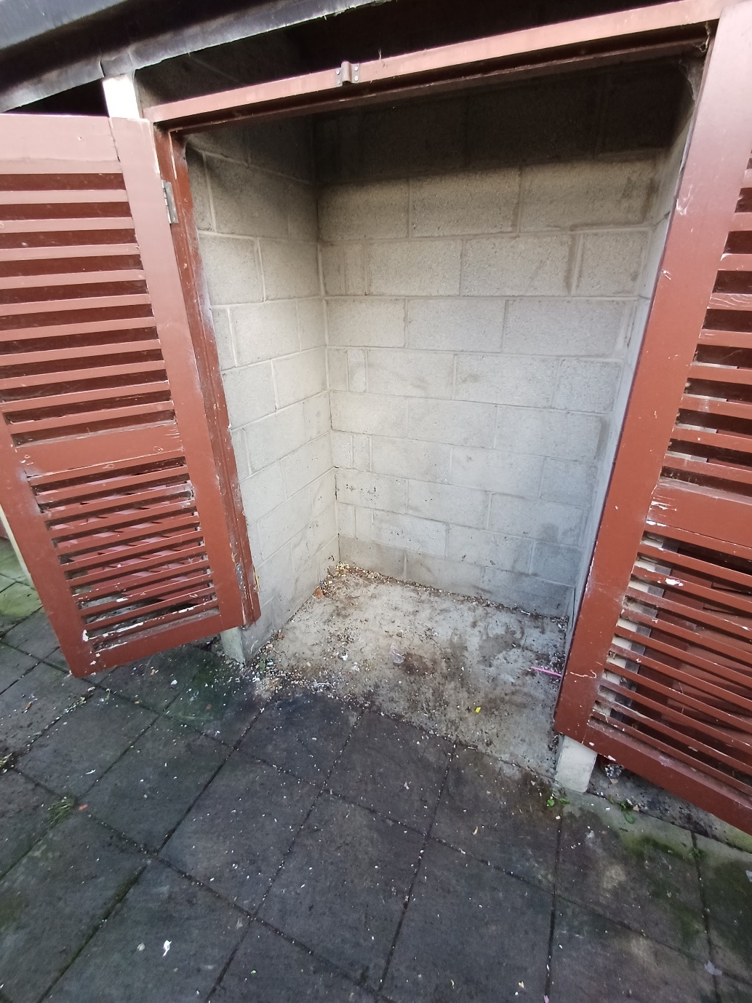
-
Balgaddy Advanced Maintenance Works
Completion of meter cover upgrade
Continued upgrade of bin storage areas
Clean-up of communal areas took place on 8th March during Q1
2
4

Slide 9
Estate Management Initiatives
Following up on a number of complaints, intimidation and drug dealing in the wider Balgaddy estate. Actions available to the Council and the Gardaí are being taken by AGS and Anti Social Community Safety Officers.
Quarterly meetings ongoing with Community Development Team to share information
Estate Management represented on the Balgaddy Action Group and Higher Level Working group – meetings taking place quarterly.
Estate management and housing maintenance liaising with residents regarding planned works to be carried out in Balgaddy.
Joint housing maintenance and estate management approach continue were communal areas are monitored to ensure items do not accumulate. Records are kept and notification/warning letters to issue as appropriate.
Anti-Social Behaviour Community Safety Officers following up on issues regarding arson attacks, feuding and vacant dwellings.
Meetings have taken place with Senior Gardaí to examine ways to combat anti-social behaviour in the estate.

Slide 10
Estate Management Initiatives Contd.
A Day of Action – meeting with the Waste Enforcement section and further discussion with An Garda Síochána to take place in the coming weeks to put the necessary preparations in place.
Tenancy Audit commenced in Balgaddy – 80 plus houses complete to date.
Garda / estate management weekly clinic takes place Thursday mornings in the Bush Centre, plans to relocate to the community centre.
School talks to be delivered by council staff and the Gardai – meeting with Principal and Home School Liaison Officer Junior and Senior Devine Mercy 2025. Date to be agreed to talk to 5th and 6th classes before end of term.
Family Fun Day to take place 26th July 2025 supported by the estate management team.

Slide 11
Balgaddy Higher Level Working Group
Independent Chair Liam Casey (Former Inspector Ronanstown Garda Station)
Tusla, DLETB and Partnership representative appointed.
2 meetings have taken place in 2025 to date.
Updates
Meeting with Tusla and AGS to take place week of 3rd June to look at options and possible programmes around early intervention supports in the Balgaddy area. SDCC, ETB and Crosscare to identify potential funding for early intervention workers and extra youth workers for Balgaddy area specifically.
Construction works continues on the closing out of a few remaining items to allow for handover of the centre to the Council and Architectural Services are working closely with the contractor to have these closed out as soon possible. Community Section have been working on the establishment of a new Regional Board of Management to manage the operations of the Balgaddy, Neilstown and Rowlagh Community Centres. Memorandum and Articles for the new company have been submitted to the CRO to have the company incorporated.
It was agreed to look at the possibility of organising a tour of the new community centre and to hold meetings in the Balgaddy area twice per annum
SDCC estate management team commenced Tenancy checks.
An Garda Siochána door knocking exercise is ongoing –chance for residents to share information and discuss ongoing anti social issues.

Slide 12
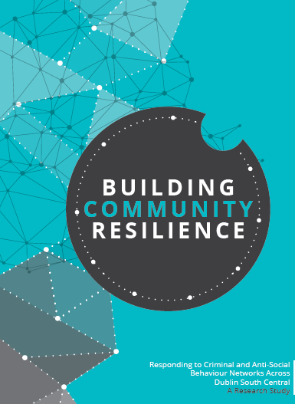
Balgaddy Working Group
The Balgaddy working Group was established to implement the recommendations outlined in the Community Crime Impact assessment undertaken in March 2021. Group meets on a quarterly basis. The membership consists of:
Estate Management and Community Development Teams from SDCC
An Garda Siochana (Ronanstown)
North Clondalkin Community Development Programme
Co- Ordinator from Clondalkin Drugs Task Force
Ronanstown Crosscare
Chair of Local Policing Forum
DDETB
Tusla
South Dublin Partnership
Meeting Dates for 2025
20th February 2025
13th May 2025
9th September 2025
9th December 2025

