Slide 1
Revised National Planning Framework - Update
LUPT SPC 29th May 2025 Hazel Craigie, Senior Planner

Slide 2
Update
Revised NPF status
- Ministerial Letter
- Work Underway

Slide 3
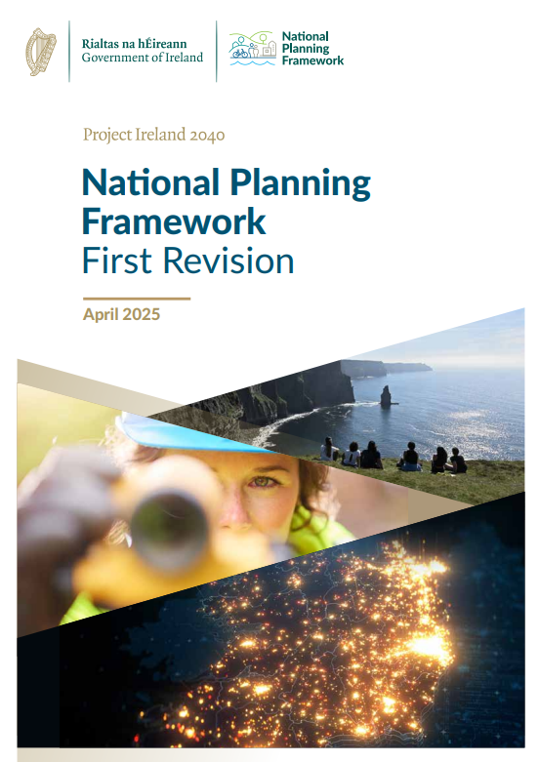
Revised National Planning Framework (NPF)
Government approval in early April
Approved by both Houses of Oireachtas on 30th April
Revises the NPF 2018-2040
Sets new targets for housing at a national level
Sets comprehensive policy context for planning

Slide 4
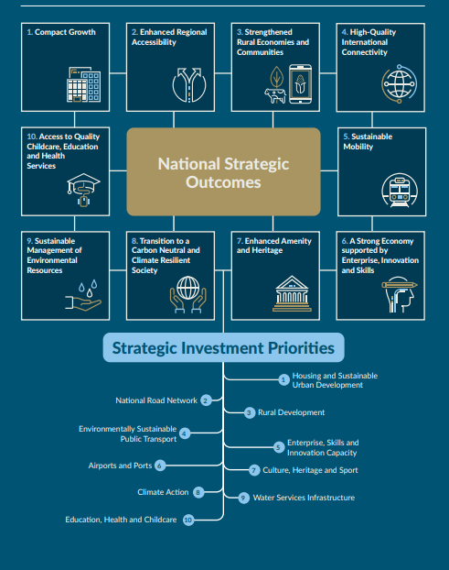
8 National Strategic Outcomes
Compact Growth, descriptive:
‘…All our urban settlements contain many potential development areas, centrally located and frequently publicly owned…Activating these strategic areas and achieving effective density and consolidation, rather than more sprawl of urban development, is a top priority’

Slide 5
Ministerial Letter to CEs, 16th May 2025
Need to urgently accelerate housing delivery
County Development Plans to be reviewed to align with revised NPF
Most suitable locations to take account of where delivery likely to occur and where infrastructure and services are available, or may be readily provided
Further policy direction to issue updating housing growth requirements for each LA
Minister recognises importance of public participation for transparency in land and zoning matters and the statutory requirements for environmental assessment
Housing Activation Office will assist with identification and addressing of barriers to delivery of infrastructure through:
Alignment of funding; Coordination of infrastructure delivery providers

Slide 6
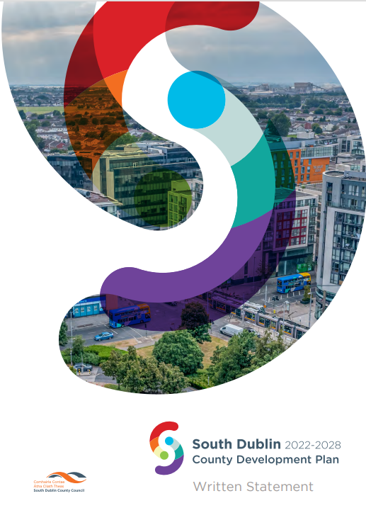
Review of Land Capacity
990 hectares identified in adopted core strategy with capacity for 42,500 units
Excluding longer term lands, 428 ha were identified to meet the current CDP targets up to 2028 of 15,576 units
Approaching half way through the plan period and 46% of this target has been delivered (up to Q1 2025) Housing Supply Monitor
Planning Dept reviewing capacity of all zoned undeveloped lands taking account of new policy on density
Will then consider whether further zoning is needed
If need identified, an assessment based on deliverability, infrastructure capacity and sustainable planning criteria
Liaison with infrastructure providers

Slide 7
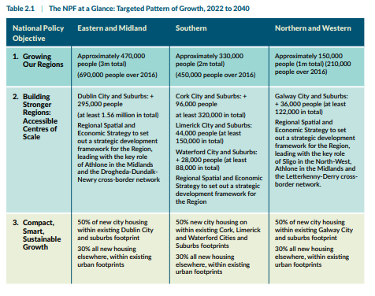
Revised NPF Population Targets
Population projected to grow to 6.1 million by 2040
950,000 additional people 2022 to 2040
EMRA additional 470,000
Dublin City & Suburbs target growth – 296,000 (2022-2040)
Targets for each LA awaited

