Slide 1
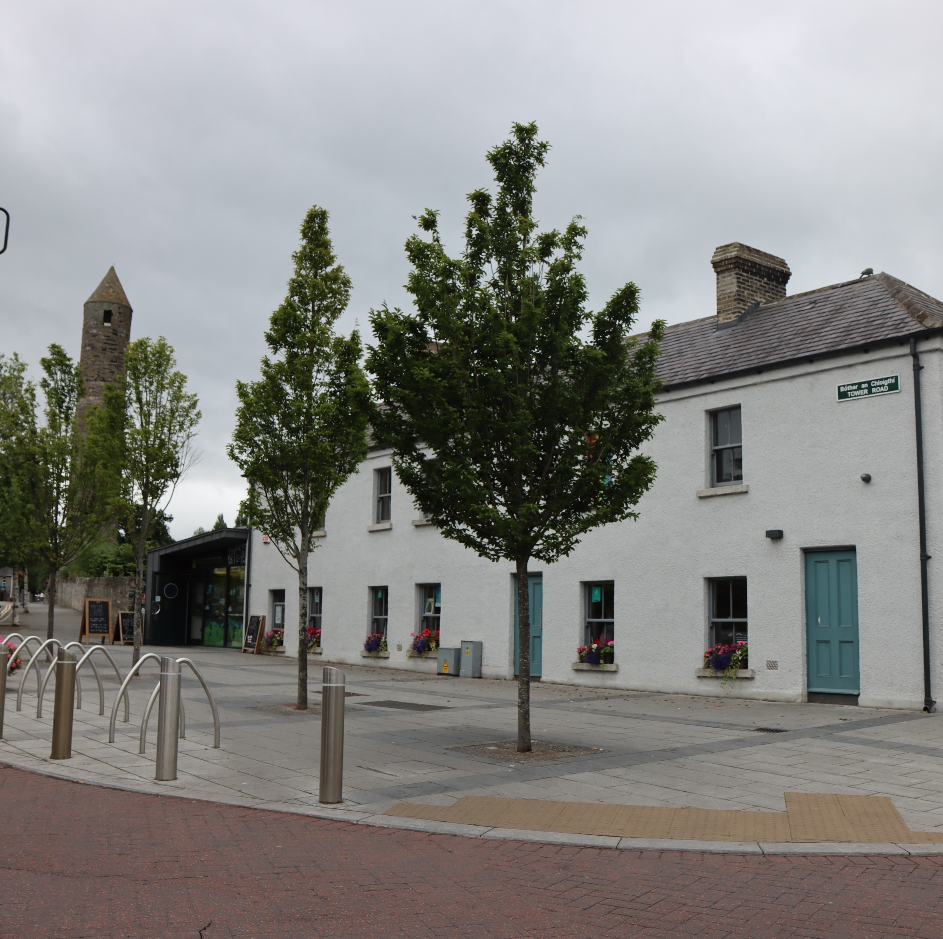
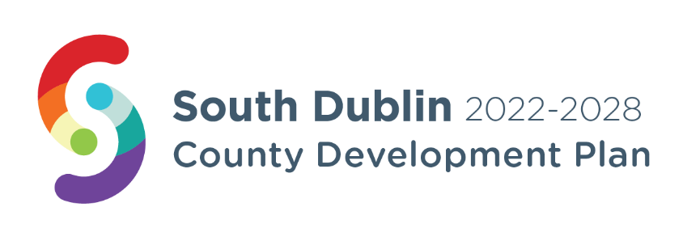
Clondalkin Local Planning Framework (Local Area Plan) Update
LUPT SPC 29th May 2025

Slide 2
Update
Implications of new Planning Act
- Work to date
- Timelines

Slide 3
Implications – Planning and Development Act 2024
Govt timelines for commencement of Plans section of Act indicate Q2 2025
Local Area Plan no longer an option
Will be brought forward as a Variation to the CDP
Will be described as ‘Clondalkin Local Planning Framework’

Slide 4
Work to Date and Ongoing
Pre draft consultation over, 3 separate processes undertaken in addition to conservation walk abouts, reports from each available online Clondalkin LAP – SDCC
Conservation Plan being reviewed
ACA Appraisals for the three ACAs in progress, these will form a template for other ACA appraisals in the county
Draft Local Transport Plan being reviewed, reflects feedback from public consultations
Work of urban design consultants received
GI study undertaken
Currently reviewing all of the different elements of work in preparation of the Draft Local Planning Framework (the Variation)

Slide 5
Timelines and Next Steps
2025
June
August
October
December
Variation to go on display August to late September
Consideration of the Variation at December Council Meeting
Briefing for ACM members in June
CE Report to Councillors in October

