Slide 1

Social Housing Delivery
Clondalkin Newcastle Rathcoole Saggart ACM
21st May 2025

Slide 2
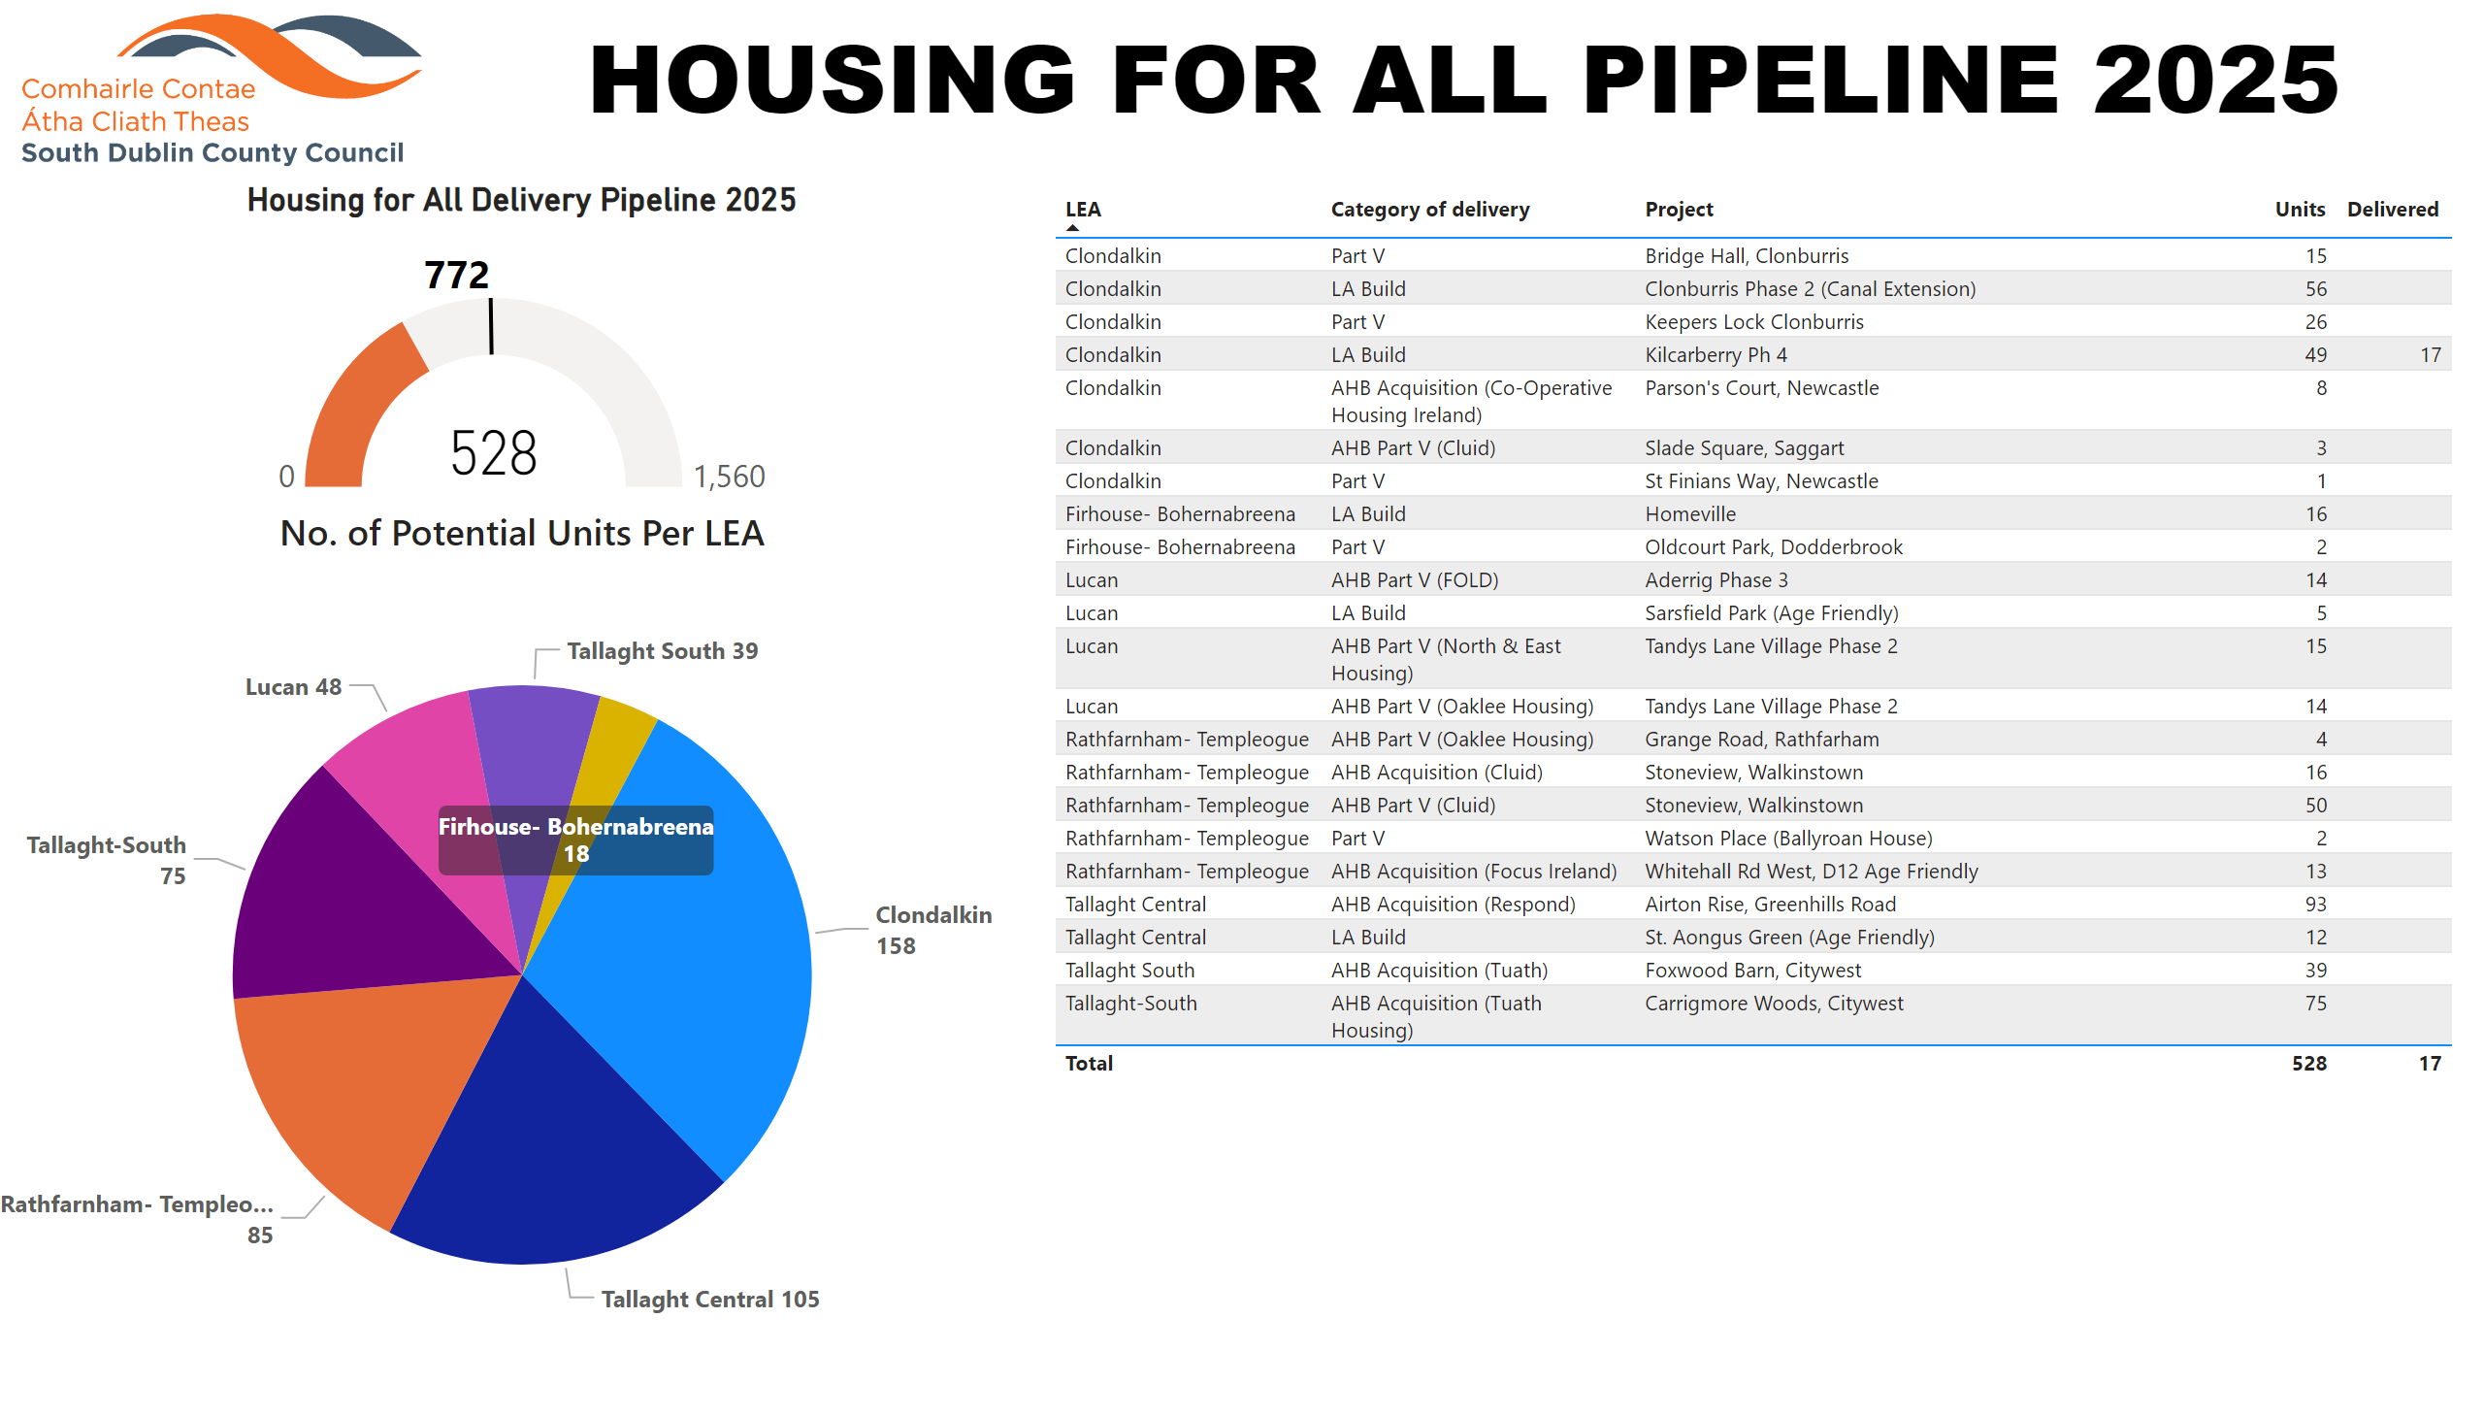
2025
Notes:
textbox
No alt text provided
Potential Units
No alt text provided
image
No alt text provided
Housing for All Delivery Pipeline 2025
No alt text provided
No. of Potential Units Per LEA
No alt text provided

Slide 3

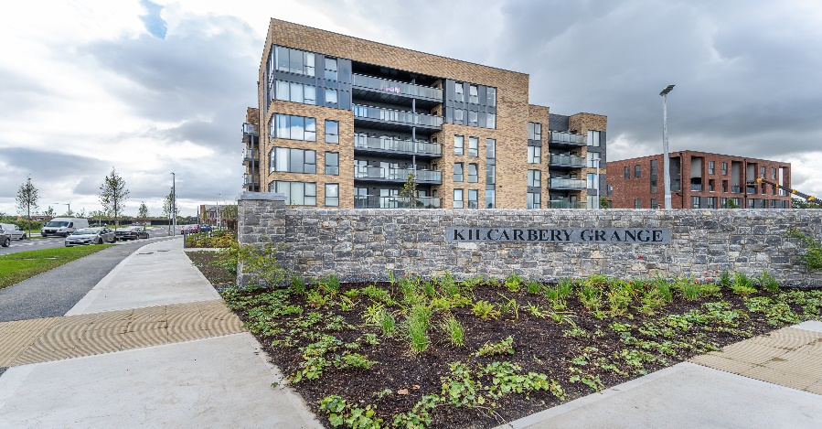
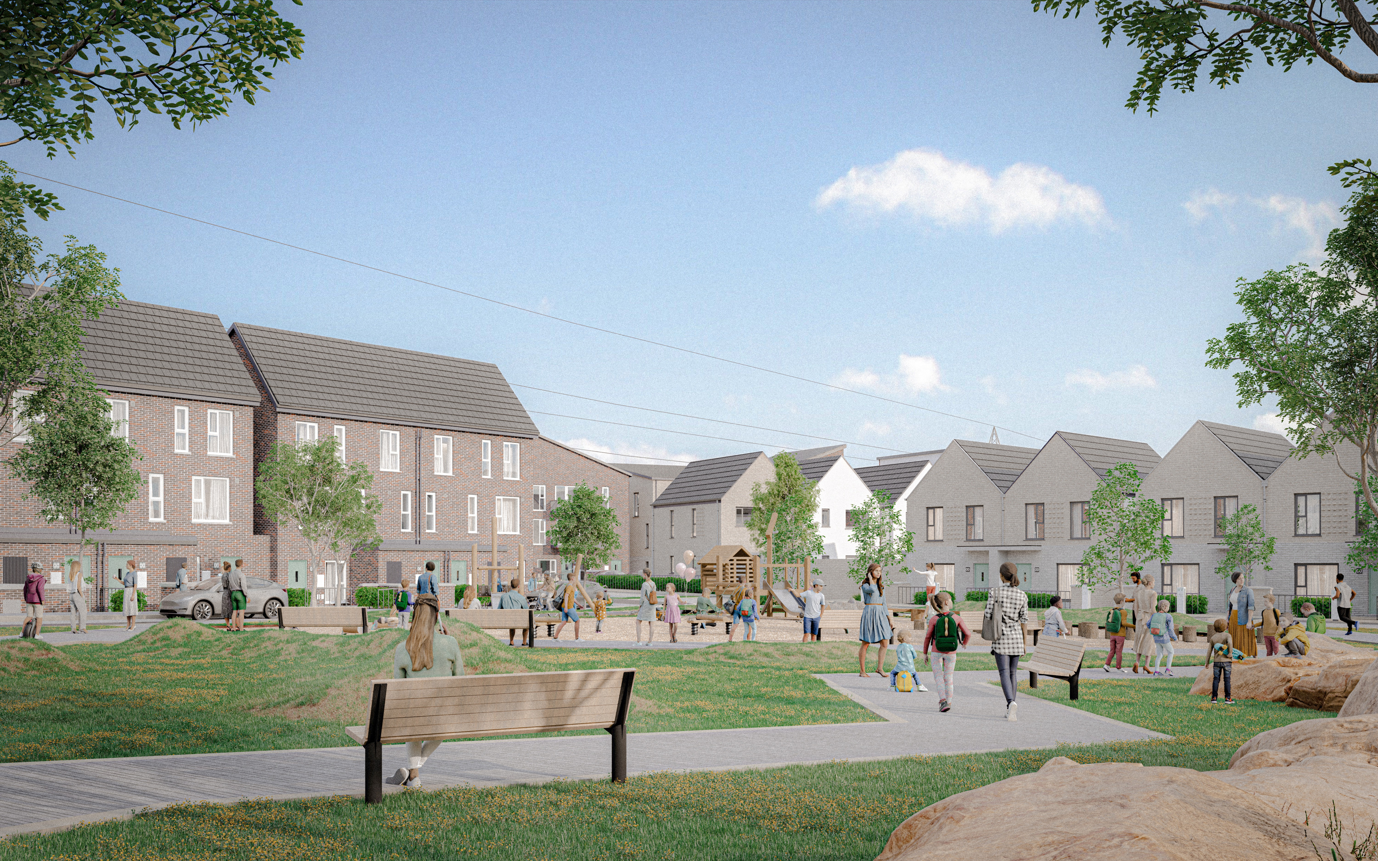
Large Development Sites
Kilcarbery Grange: 1,034 homes with 30% social (310 homes)
Phases 1, 2 and 3 of this project are now complete, with delivery of 280 social homes to date. Construction on phase 4 well advanced and will complete in mid 2025.
Clonburris: Phases 1 & 2 comprising 382 homes (149 social), Phases 3,4,5 with potential for 1,275 homes
Construction of Phase 2 – Canal Extension is well advanced and remains on track for completion by November 2025.
The tender process for Phase 1 – Kishogue, involving the construction of 266 social, affordable, and cost rental homes, closed on 22 November 2024. The tender assessment has been completed, and the contract award is imminent. On-site works are expected to begin in Q2 2025.
Following a presentation to the Council in November 2024, plans for approximately 1,275 social and affordable homes across Phases 3, 4, and 5 will shortly be submitted to An Bord Pleanála under a Part 10 planning application.
Preparations are also underway to begin the procurement process for Phase 6 – Kishogue District Centre, with a targeted start date in early 2026.
Rathcoole: Number of homes & tenure mix to be confirmed
Architect led design team have been appointed to progress the masterplan through to Part 10 planning application to An Bord Pleanála.
Kilcarbery Grange, Clondalkin
Clonburris – Stage 3 - 5

Slide 4
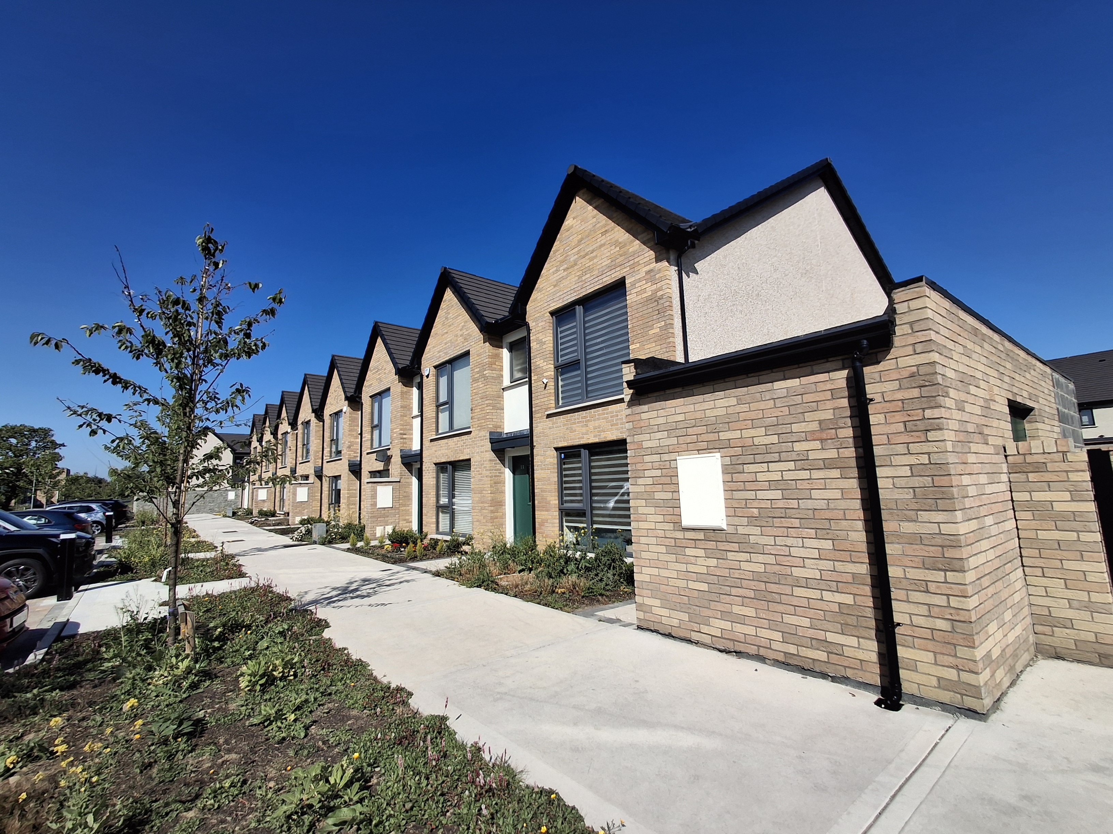
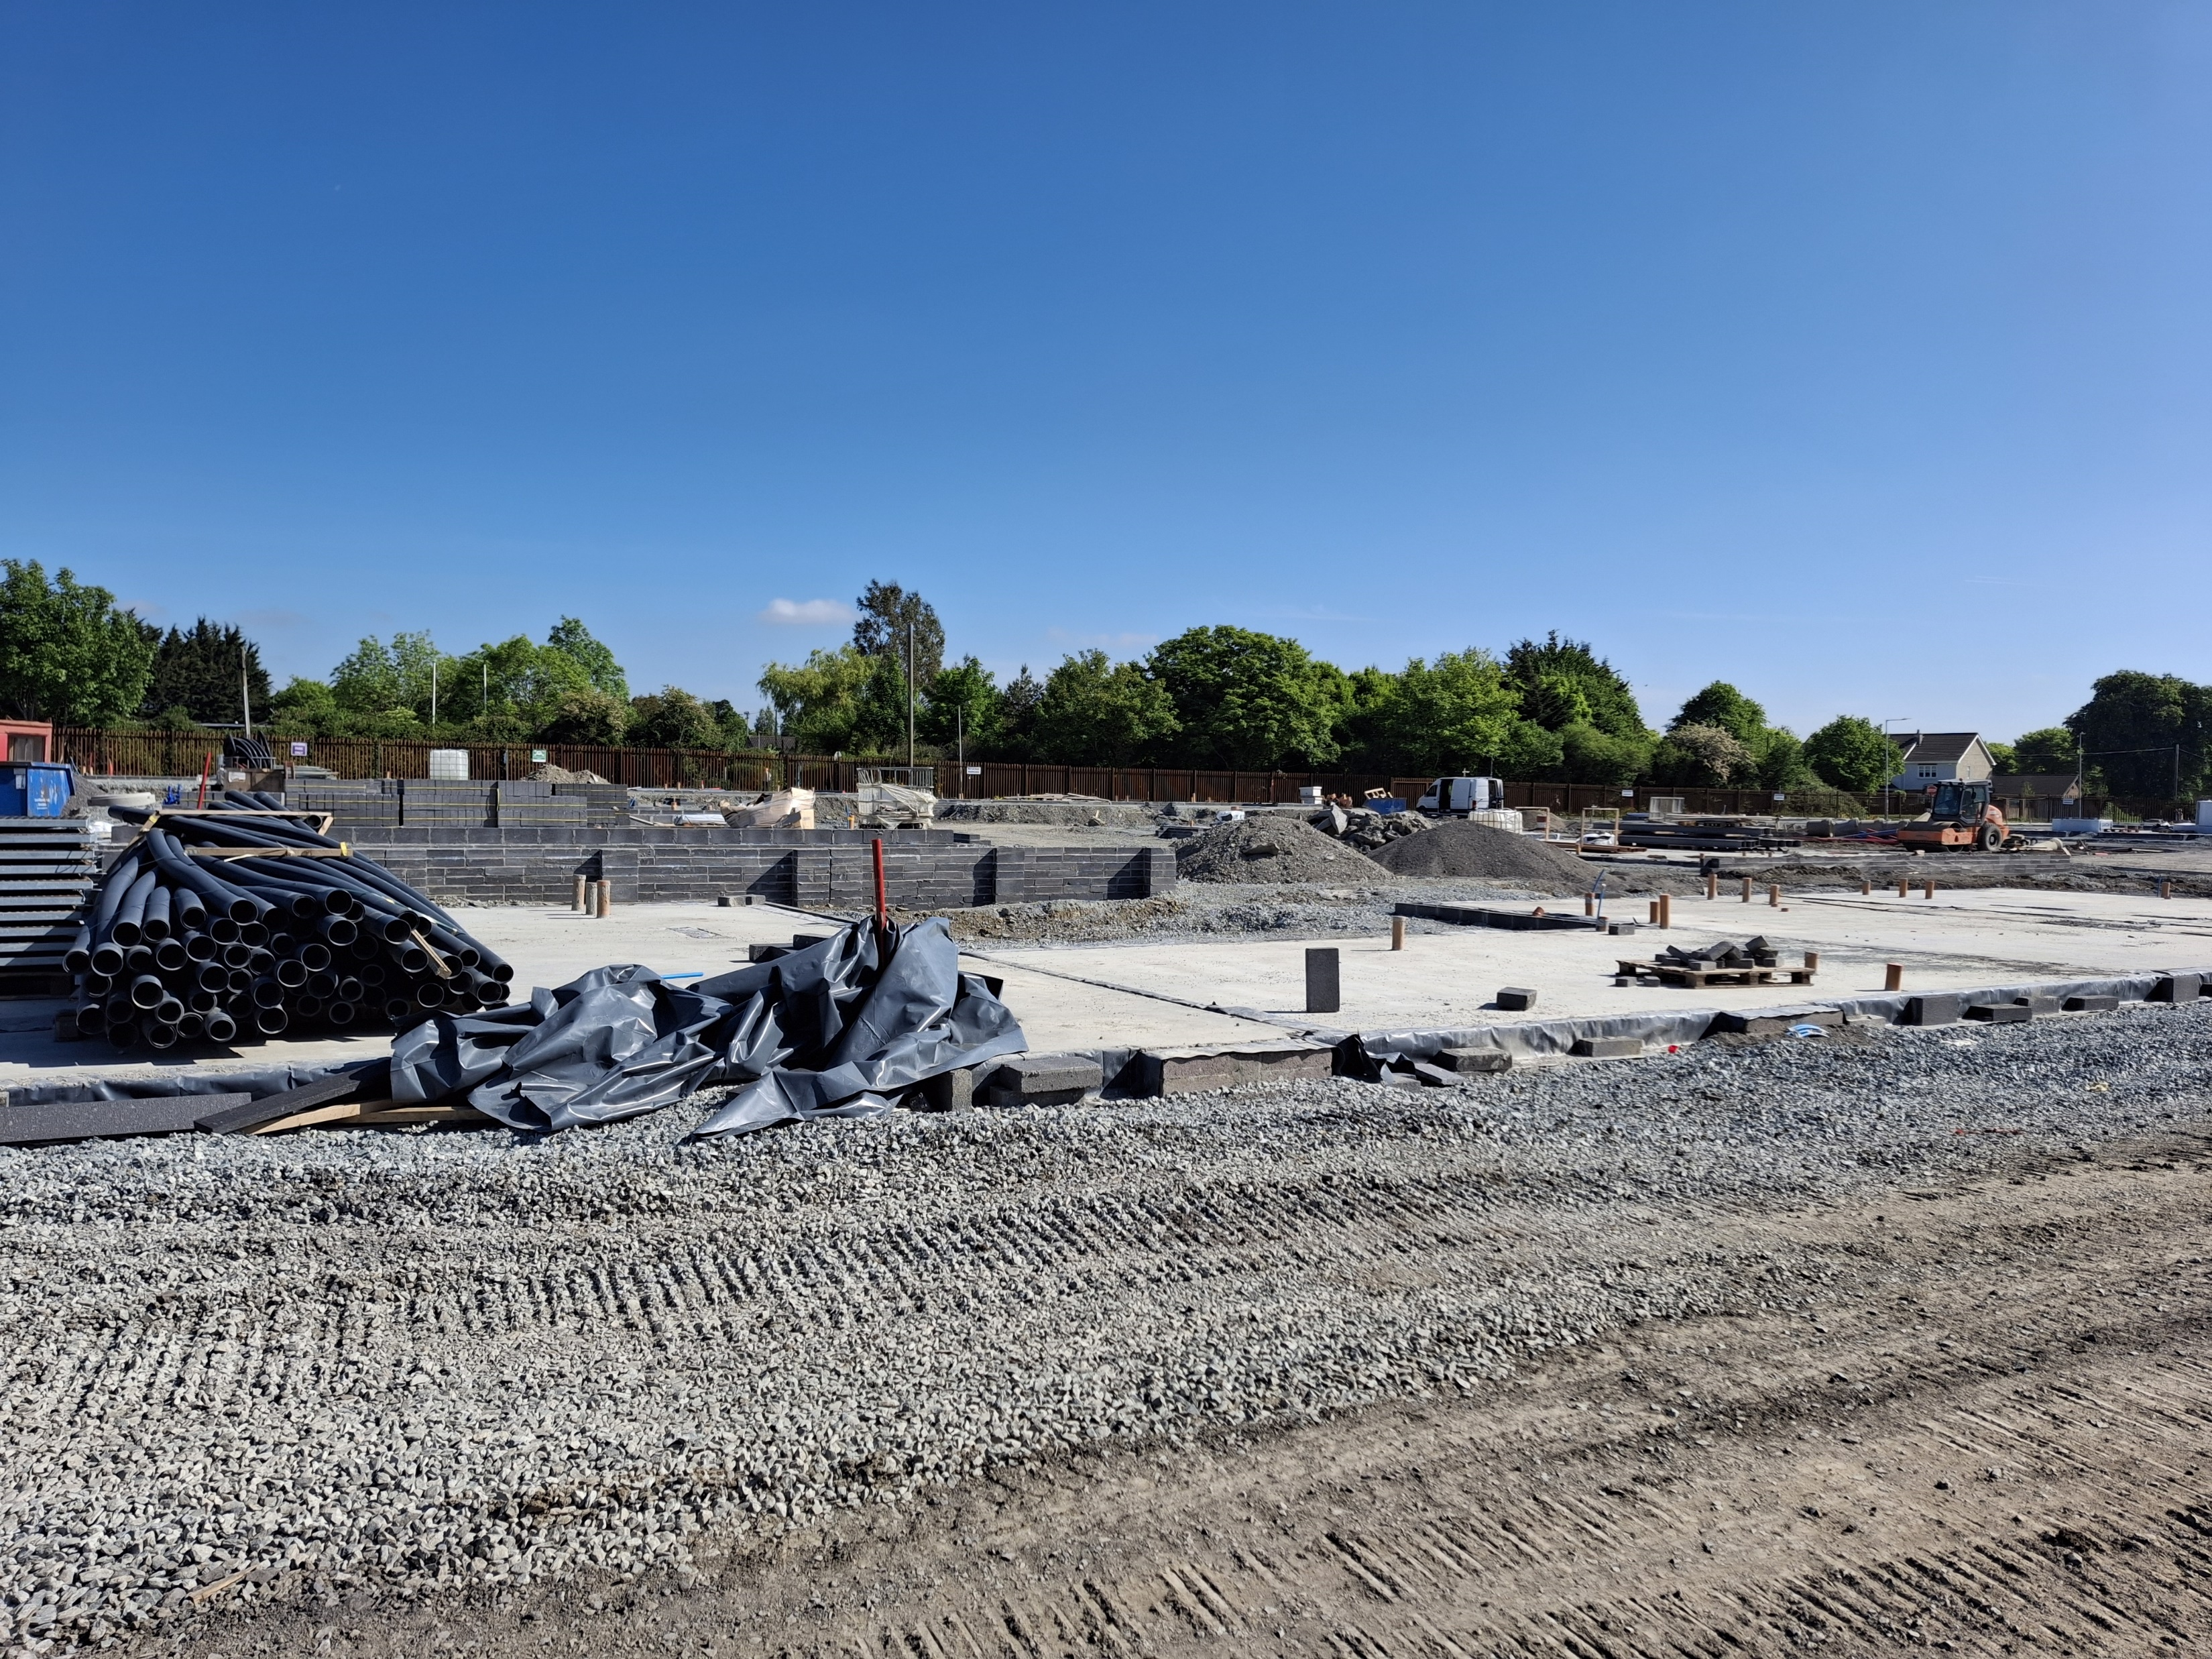
Own Build Developments
LEA | Project | Units | Status
Clondalkin | Lindisfarne | 19 | Substantially complete December 2024. UE commissioning to complete
 | Canal Bank Extension | 56 | On-site – phased delivery from November 2025. Mixed Tenure Scheme – 60 Affordable Purchase units
 | Kilcarbery Grange | 47 | On-site – 280 delivered to date. Balance to be delivered by mid 2025
 | Alpine Heights (Age-Friendly) | 13 | Contractor appointed. Awaiting start date.
 | Deansrath – Melrose | 27 | Contractor appointed. Awaiting start date.
 | Kilcarbery Phase 5 | 18 | Construction commenced on site in December 2024, Includes 70 affordable purchase homes.
Kilcarbery Grange
Kilcarbery Grange, Phase 5

Slide 5
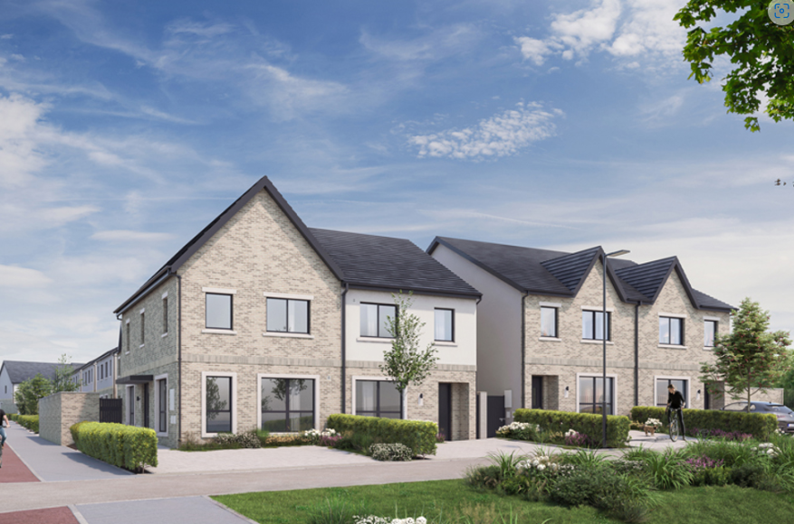
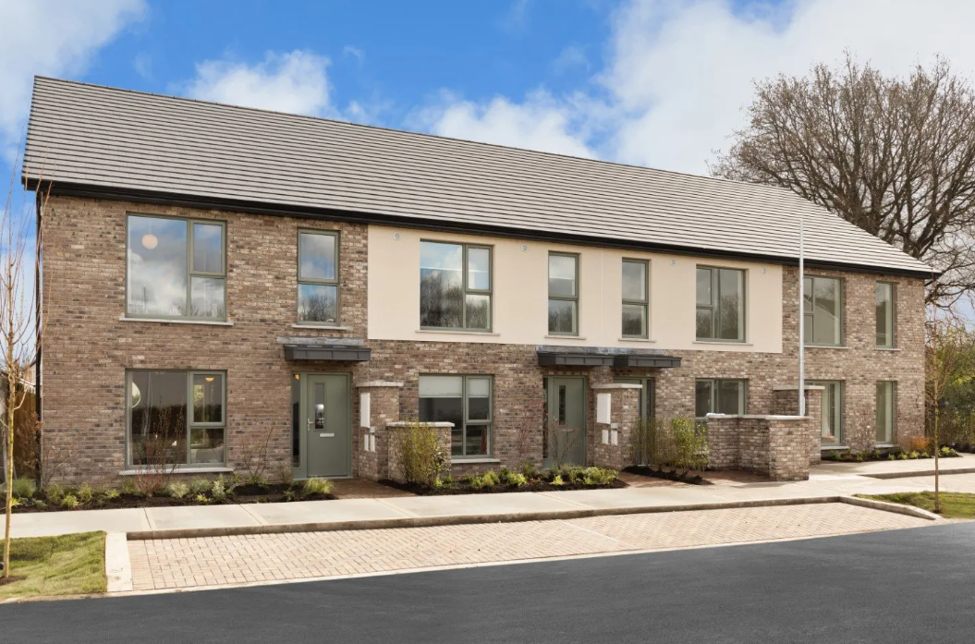
Approved Housing Bodies – Part V Delivery
LEA | Project | Units | Status
Clondalkin | Parsons Court, Newcastle. CHI | 8 | On-site – completion Q2.2025
 | Gordon Park, Part V | 3 | On-site – Completion Q3.2025
 | Keepers Lock, Clonburris Part V | 26 | On-site – phased completion from November 2025. 26 Affordable Purchase agreed under PV
 | Mill Road, Saggart Part V | 26 | Part V negotiations complete. Completion Q2.2025
 | Parkleigh, Sevenmills Part V | 15 | Part V negotiations complete. Completion Q3.2025
 | St Johns Road, Clondalkin Part V | 5 | Part V negotiations ongoing
 | Main Street, Saggart Part V | 3 | Part V negotiations ongoing
 | Graydon, Newcastle Part V | 5 | Part V negotiations ongoing
 | Lockhouse Way, Sevenmills Part V | 57 | Part V negotiations ongoing
Graydon, Newcastle
Keepers Lock, Clonburris

Slide 6
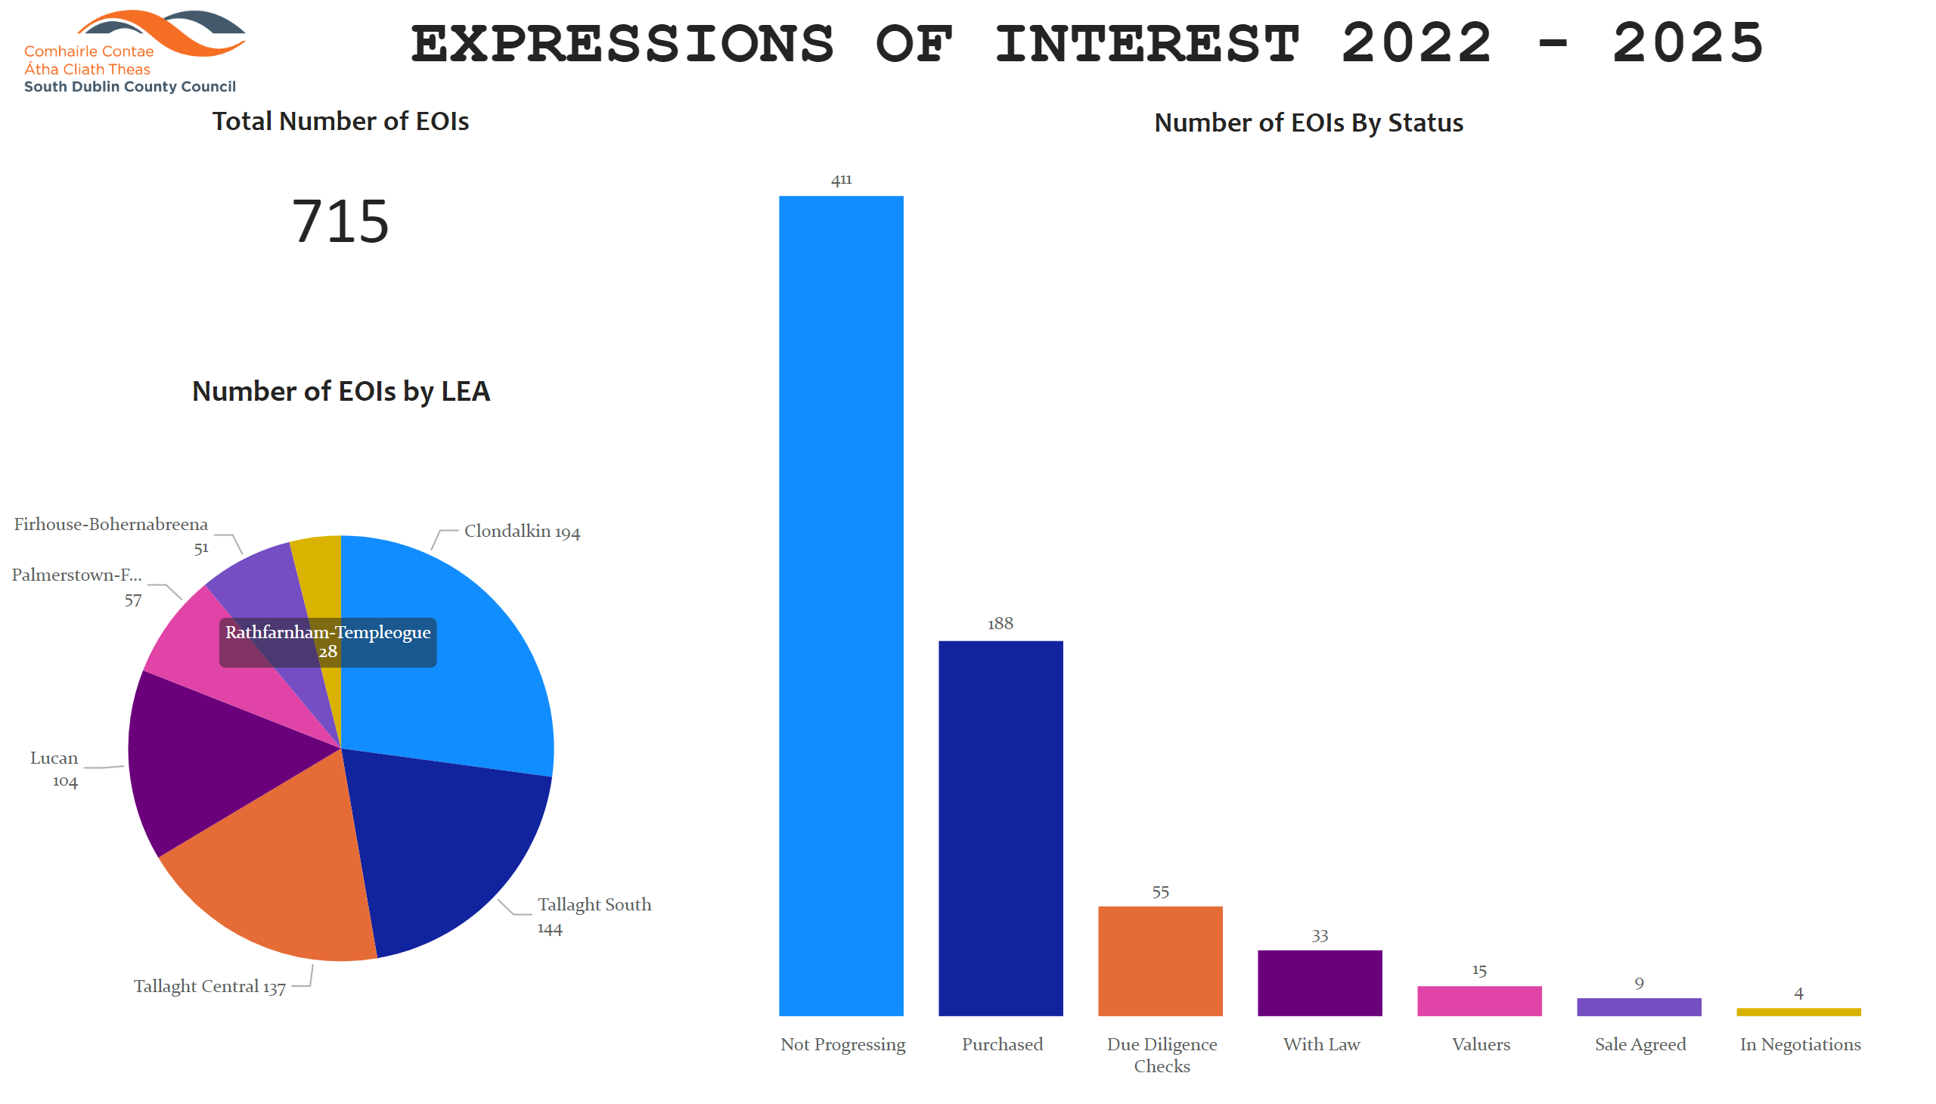
Overview
Notes:
Total Number of EOIs
No alt text provided
Number of EOIs by LEA
No alt text provided
Number of EOIs By Status
No alt text provided
image
No alt text provided
textbox
No alt text provided

