Slide 1
Social & Affordable Housing Update
Council Meeting
12th May 2025

Slide 2
Housing Delivery Action Plan 2022-2026
Progress under HDAP maintained in 2024
774 new build social homes delivered (target 718)
Since HDAP commencement in 2022, a total of 1,815 new-build social homes have been delivered
On track to meet 2025 social housing delivery target of 772 new homes across all delivery streams (own build, Part V & AHBs)

Slide 3
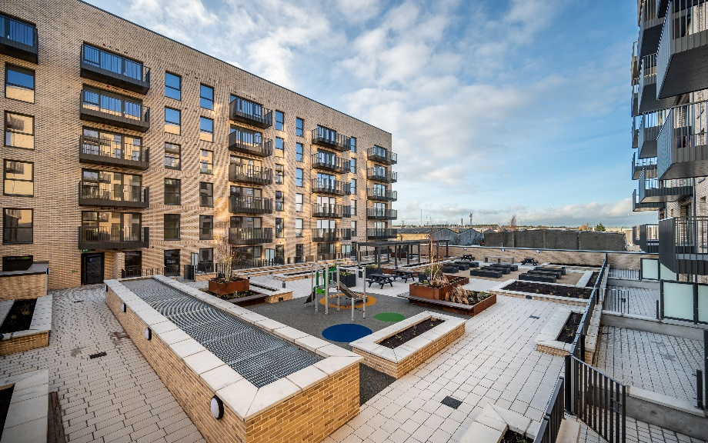
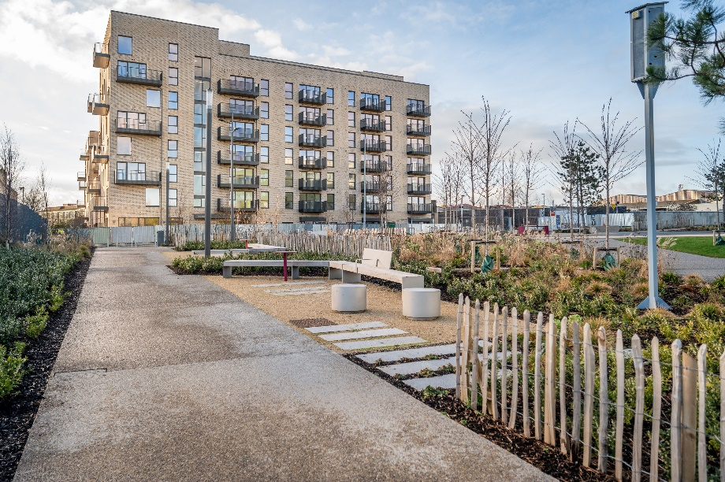
Innovation Square Cost Rental Apartments
Our first cost rental development (133 apartments at Belgard) is now complete
Cost rental designation request submitted to DHLGH
Management & maintenance arrangements being finalised
Launch & advertising next month (June 2025) followed by tenanting

Slide 4
Innovation Square Cost Rental Apartments
Rents set based on cost rental model including:
All-in development cost
DHLGH Affordable Housing Fund subsidy
Cost of funding (SDCC self-financing with interest rate of up to 2%)
Projected maintenance, management, void costs
Apartment Type | No. | Market Rent | Cost Rent | Discount
Studio | 3 | €1,650 | €1,025 | 37.9%
1-bed | 64 | €1,850 | €1,315 | 28.9%
2-bed | 63 | €2,200 | €1,515 | 31.1%
3-bed | 3 | €2,500 | €1,665 | 33.4%

Slide 5
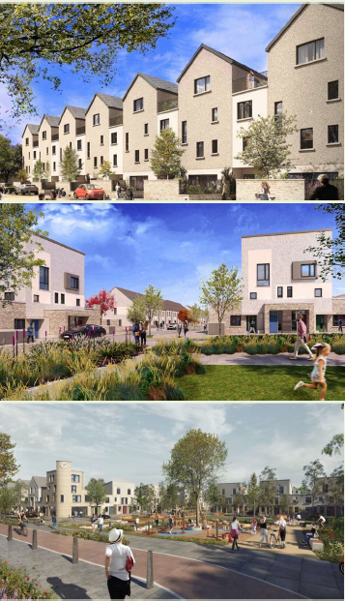
The Foothills- Mixed Tenure Development
620 homes (372 affordable purchase, 125 social, & 123 private) across three phases & including community/sports facility, parklands, infrastructure & playing pitches
Enabling works/site clearance undertaken Dec 2024-March 2025
Development Agreement terms now finalised following protracted process and negotiation due to market challenges since tender process
AHF application currently with DHLGH
Construction expected to start 9th June with delivery of initial homes & community/sports facility by Q4 2026

Slide 6
Clonburris SDZ: 2,410 Social & Affordable Homes
Phase 1-Kishoge SW (283 homes): Contractor to start on site Q3 2025 following temporary relocation of existing Traveller accommodation residents
Phase 2-Canal Extension (116 homes): currently on site & due for completion by Nov 2025. 60 affordable homes to be launched for sale this month
Phases 3, 4, & 5-Kishoge SW & NW (1,252 homes): Part X planning application will be submitted to An Bord Pleanála this month
Phase 6-Kishoge Urban Centre (640 homes): Two-stage restricted procurement process commencing this month with project partner to be appointed by year end
PPP Site (118 homes): Part 8 approval in Nov 2024 with project being managed by Dublin City Council under s.85 arrangements

Slide 7
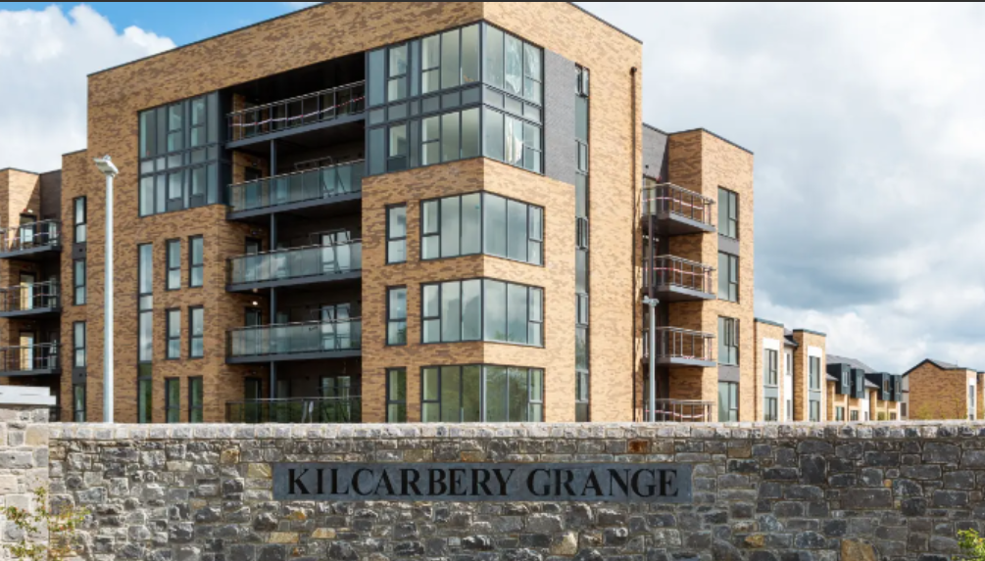
Affordable Purchase Opportunities
New marketing partnership with DNG
May 2025: Launch of 60 homes for sale in Canal Extension, Clonburris
June/July 2025: Launch of a further 96 homes for sale in Kilcarbery & Swift Banks, Saggart
Q4 2025: Launch of 25 Part V affordable homes in Keeper’s Lock, Clonburris
2026: Launch of affordable purchase homes in The Foothills & Kishogue SW

Slide 8
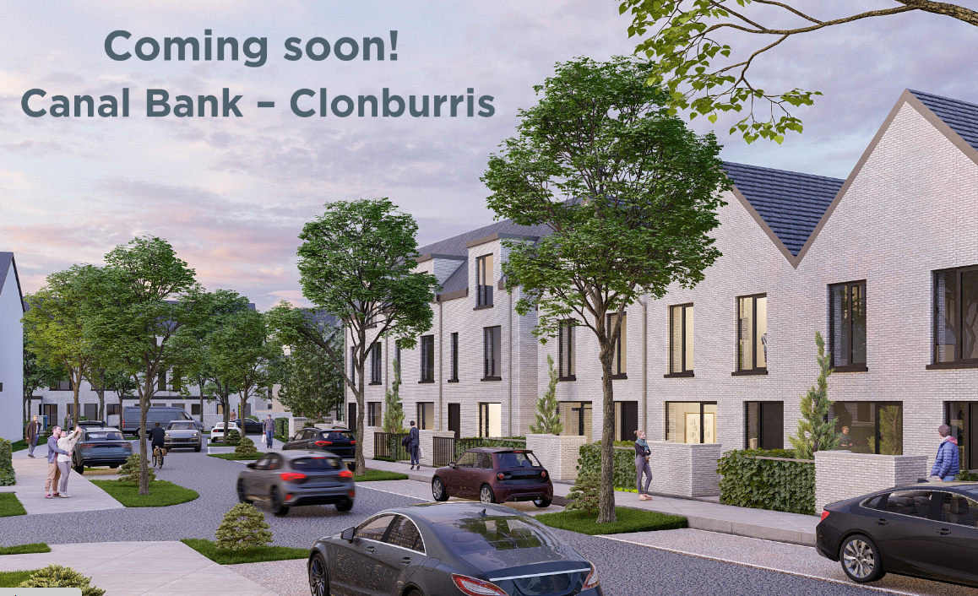
Affordable Purchase: Canal Bank, Clonburris
60 new homes being launched for sale under Affordable Purchase Scheme on 29th May 2025
First SDCC directly contracted delivery of affordable purchase homes
Minimum prices to be advertised with final price based on applicants’ individual purchasing power
Pricing will be confirmed and details circulated to elected members

