Slide 1
Social Housing Delivery
Rathfarnham Templeogue Firhouse Bohernabreena ACM
13th May 2025

Slide 2
2025
Notes:
Housing for All Delivery Pipeline 2025
No alt text provided
No. of Potential Units Per LEA
No alt text provided
textbox
No alt text provided
Potential Units
No alt text provided
image
No alt text provided

Slide 3
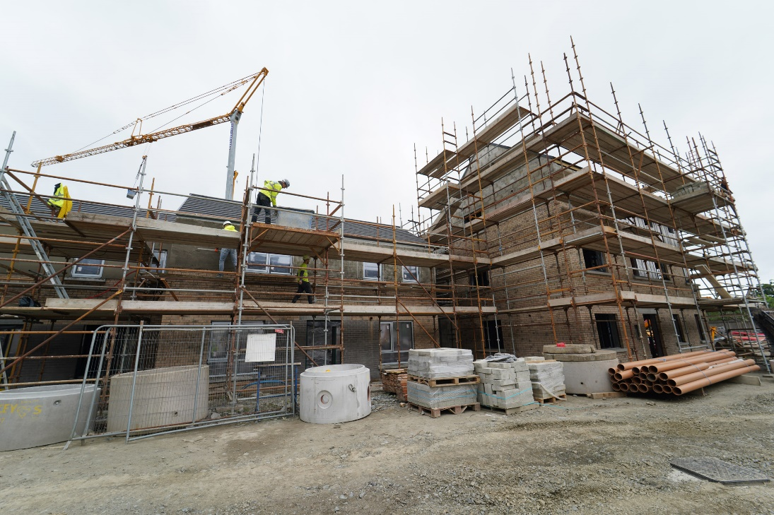
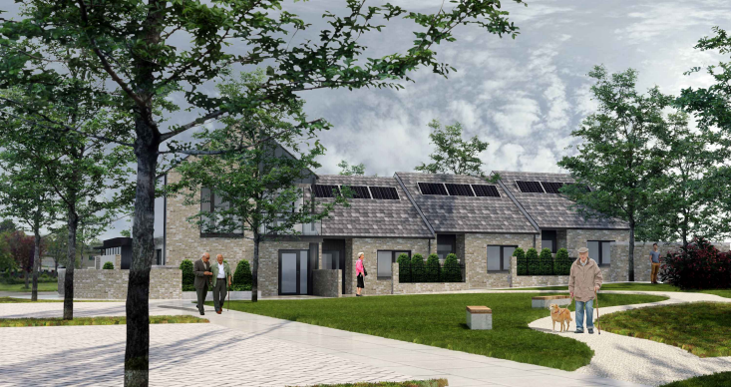
Own Build Developments
LEA | Project | Units | Status
Firhouse – Bohernabreena | Homeville | 16 | On-site – completion May 2025
Rathfarnham – Templeogue | Pearse Brothers Park | 10 | Contractor appointed.
Homeville, Knocklyon
Pearse Brothers Park

Slide 4
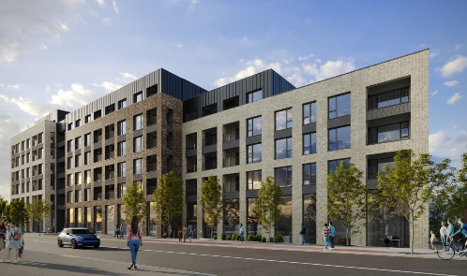
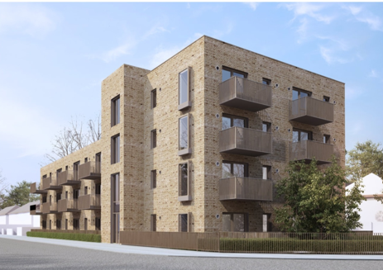
Social Housing Investment Programme
AHB & Part V Delivery
LEA | Project | Units | Status
Firhouse - Bohernabreena | Dodderbrook, Oldcourt (Part V) | 2 | On-site – completion Q2.2025
 | St. Winnows, Stocking Lane (Part V) | 24 | On-site – completion Q4.2025
 | Mortons / Firhouse Inn (Part V) | 16 | Completion Q4.2026
Rathfarnham – Templeogue | Whitehall Road West (AHB) Focus Ireland | 13 | On-site – delivery from Q4.2025. Age Friendly Development
 | Stoneview, Walkinstown House (Part V / AHB) Cluid Housing | 65 | On site. Due for delivery Q2 2025.
 | Stone Park Hall, Rathfarnham (Part V ) | 5 | On site. Due for delivery Q4.2025
 | Watsons Place (Part V) | 2 | Part V agreed. Delivery Q2 2025
 | Grange Road, Rathfarnham (Part V) | 4 | Part V agreed, Delivery Q2.2025
Stoneview,
Walkinstown House,
Dublin 12
Cromwellsfort Place, Dublin 12

Slide 5
Overview
Notes:
Total Number of EOIs
No alt text provided
Number of EOIs By Status
No alt text provided
image
No alt text provided
textbox
No alt text provided
Number of EOIs by LEA
No alt text provided

