Slide 1
Community Development Grants
Tallaght ACM
28th April 2025

Slide 2
Community Development Grants Programme
The Community Grants Programme is run on an annual basis and offers a range of funding and supports to community groups throughout the county.
The programme is aimed at providing financial assistance to Community and Voluntary Groups who are responding to locally identified needs within their communities.

Slide 3
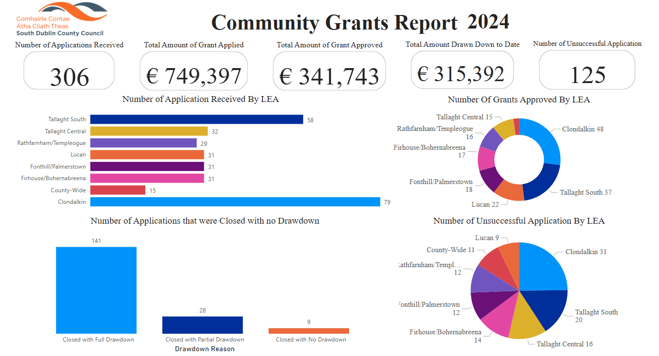
Community Development Grants Administered in 2024

Slide 4
Community Development grant figures for 2024

Slide 5
Community Development – Breakdown of Funding Category Applied For

Slide 6
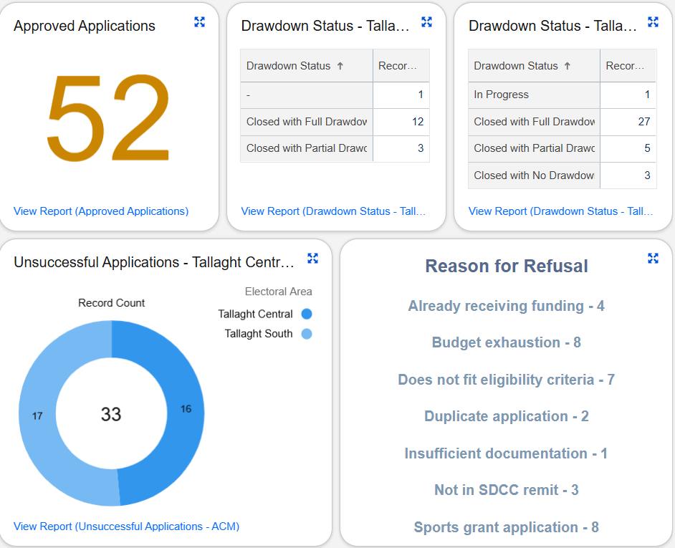
Community Grants Administered in 2024
Figures on approved applications and drawdowns.
Figures on unsuccessful applications, along with reasons for refusal.

Slide 7
Grant applications broken down into group type, with notes on new applicants and repeat applicants.

Slide 8
2024 Community Infrastructure Fund (CIF) & Management Support Fund (MSF) Grant Figures

Slide 9
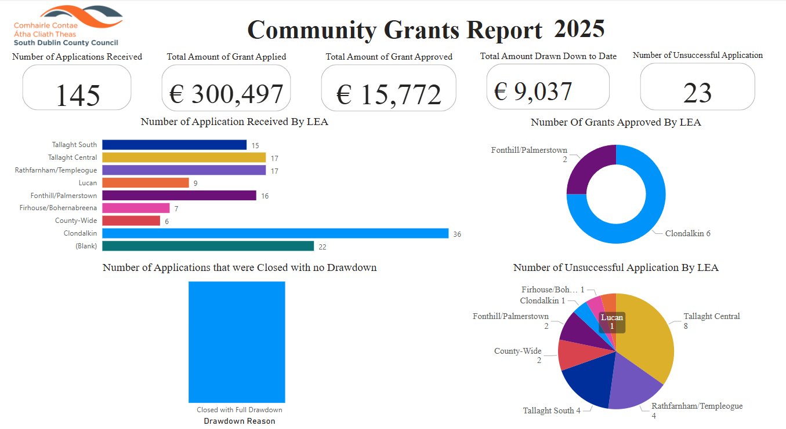
2025 Community Grants Report - February to date

Slide 10
Thank you

