Slide 1
Proposed Extension of Duration to the Tallaght Town Centre Local Area Plan 2020 -2026 (LAP)
April Council Meeting
14th April 2025

Slide 2
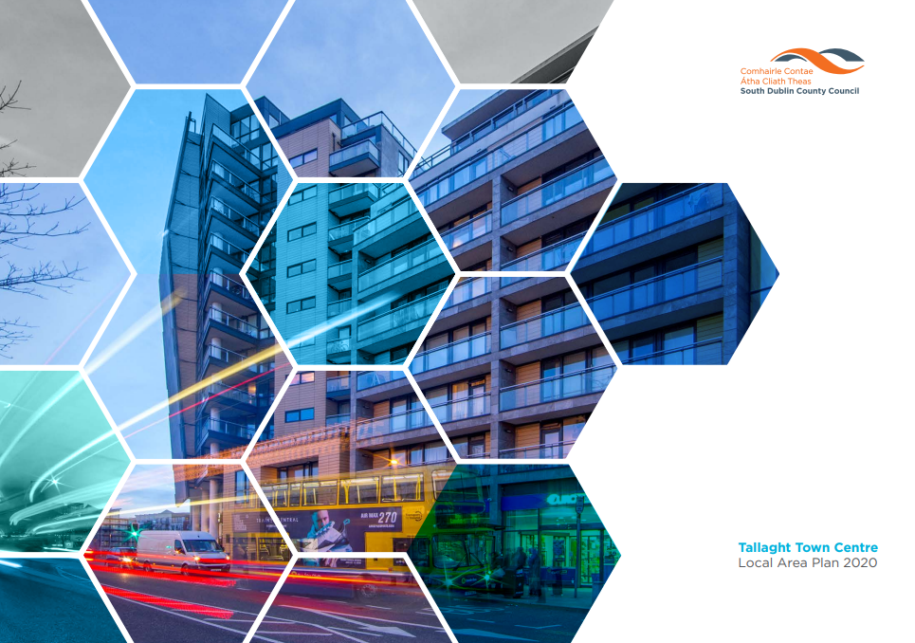
Local Area Plan Context
Tallaght Town Centre Local Area Plan made on 8th June 2020 – for 6 years.
The current LAP expiring in 2026
Recommended approach is to extend the 6-year duration (2020-2026) of the plan
Extension of the duration of the LAP brought to February SPC and Tallaght ACM in March
If it expires in 2026 the specific policies and urban design led approach associated with Tallaght Town Centre will lapse, and there will be no local planning framework with policies and objectives for Tallaght Town Centre

Slide 3
Process to Extend
Under Section 19 of the Planning and Development Act 2000 (as amended), option to extend LAP is available, subject to:
Timing – not more than 5 years after making LAP (more than 12 months before expiring)
Extension – further period not exceeding 5 years
Resolution by Council

Slide 4
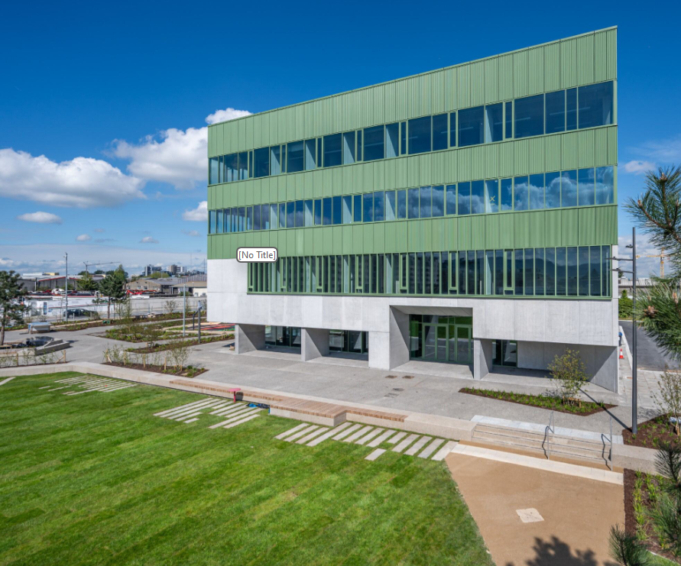
Process to Extend
Under Section 19 of the Planning and Development Act 2000 (as amended), for resolution, Chief Executive required to prepare:
an opinion that the Local Area Plan remains consistent with the objectives and core strategy of the relevant development plan (i.e. SDCC County Development Plan 2022-2028)
an opinion that the objectives of the LAP have not been substantially secured
Confirmation that the sending and publishing of notices to commence the review of the LAP may be deferred and the period for which they may be deferred.

Slide 5
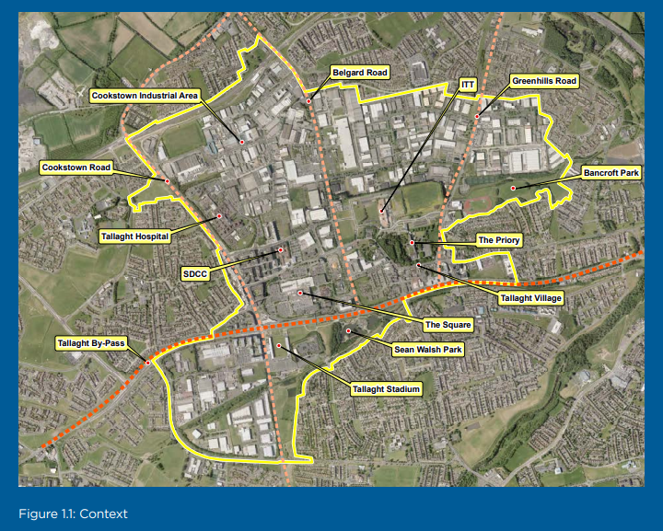
LAP Boundary

Slide 6
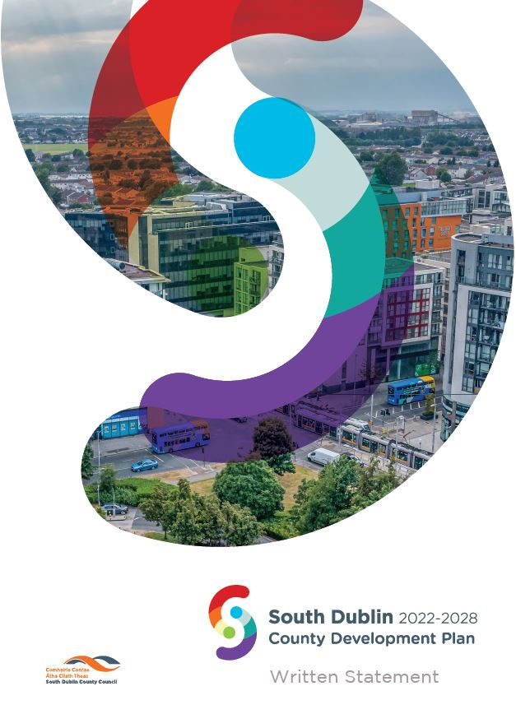
(i) Consistency with Development Plan and Core Strategy
The Tallaght Town Centre LAP and Development Plan are aligned with each other with regard to the land use zonings applied to Tallaght Town Centre area. No zoning changes occurred as part of the Development Plan Process.
The LAP is integrated into the Development Plan, and its faciliation is set out in the Core Strategy under Strategic Development Areas, and through the Development Plan through various Objectives to ensure implementation of a Plan Led Vision.

Slide 7
(i) Consistency with Development Plan
Overarching LAP Objectives – p.9 of LAP | Consistency with DP – Chapters and Select Policies Examples
Deliver a quality-built environment: | Aligns with Chapter 3 Natural, Cultural and Built Heritage, Chapter 5 Quality Design and Placemaking and 12 Implementation and Monitoring of the SDCC Development Plan.
Deliver a network of connected neighbourhoods: | Aligns with Chapter 5 Quality Design and Placemaking, Chapter 7 Sustainable Movement and Chapter 12 Implementation and Monitoring of the SDCC Development Plan, notably - EDE9 Objective 2: To continue to develop Tallaght as a vibrant and sustainable County Town at the top of the County’s settlement and retail hierarchy and improve Tallaght’s importance in regional retail terms.
Promote Tallaght’s role as the Capital of the County: | Aligns with Core Strategy, Chapter 5 Quality Design and Placemaking , 8 Community Infrastructure and Open Space and Chapter 9 Economic Development of the SDCC Development Plan
Deliver sustainable residential communities: | Aligns with Chapter 5 Quality Design and Placemaking , Chapter 7 Sustainable Movement and Chapter 8 Community Infrastructure and Open Space of the SDCC Development Plan, notably - SM3 Objective 12: To work with the NTA to secure the expansion of the bus network, including distinct new bus networks as necessary, to serve new development and regeneration areas within the South Dublin County area including Tallaght.
Respect, protect and promote our heritage and architectural features | Aligns with Chapter 3 Natural, Cultural and Built Heritage, Chapter 5 Quality Design and Placemaking and Chapter 12 Implementation and Monitoring of the SDCC Development Plan.
Proactively plan for climate change | All Chapters of the SDCC Development Plan include climate actions and a climate audit of the objectives. The objectives in the Tallaght LAP align with these and with the recognition in the CDP of the innovation which is the Tallaght District Heating project.
Mitigate climate change | All chapters, particularly Chapter 7 Sustainable Movement and E5 SLO 1: To prioritise the development of low carbon district heating networks in the identified areas of potential for Low Carbon District Heating at Tallaght, Grange Castle / Clonburris and Clondalkin in line with Policy E5 and supporting objectives in the written statement.
Implementation of LAP | Supported by Core Strategy – in particular EDE4 Objective 11: To support the regeneration of the Tallaght LAP lands in a co-ordinated and sustainable manner in accordance with the Tallaght Town Centre LAP 2020 or any superseding plan whilst ensuring the lands particularly Cookstown, remain a sustainable employment area to ensure environmentally short journeys to places of employment and to ensure the residential impact of the REGEN zoning does not instigate the decline in the employment capacity and sustainability of the area.
The LAP Overarching Objectives are consistent and integrated into the Development Plan Chapters.

Slide 8
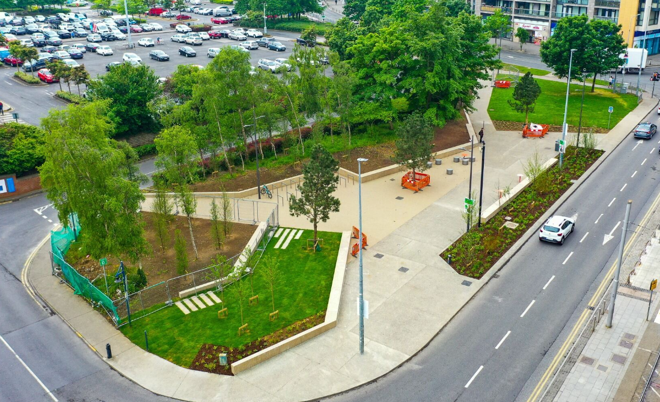
(ii) Securing the Objectives of the LAP
The Tallaght Town Centre LAP is broken down into a number of Sections, each of which has associated objectives.
These objectives are in addition to the Overarching Objectives outlined on previous slide.
These objectives are essential to ensure the development and growth of Tallaght Town Centre through a Plan Led approach.

Slide 9
(ii) Securing the Objectives of the LAP
Chapter/Section | Secured – Examples | Unsecured - Examples
Urban Framework - UF1 – UF7 | Delivery of a o-ordinated urban framework is ongoing through development management. | Partially secured elements of these Objectives, however some unsecured such as UF4 for new developments in blocks, which would apply to Cookstown
Access and Movement - AM1 – AM4 | Good progress with ongoing delivery e.g. Airton Road, Cookstown Road, public realm links | Unsecured elements include AM4 with regard public transport opportunities and the integration with streets and routes, this relies on Cookstown Development Area to progress.
Public Open Space - OS1 – OS7 | Ongoing / Partially secured through Public Realm Scheme/Site by Site | Unsecured – Notably in Cookstown Area.
Neighbourhoods – 8 Development Areas | Applied to each Development Area on a site by site or area based approach | Applied to each Development Area on a Site by Site or Area Based Approach, area with little activity and unsecured objective implementation is Cookstown
Economic Development and Regeneration - ED1 – ED14 | Significant Progress notably, Innovation Centre(ED1) and Tallaght 4th Stand (ED11). | Remaining Objectives ongoing and require implementation on a site by site basis, or as per latest Tourism Strategy
Residential Development - RE1 – RE10 | LAP and DP Objectives applied alongside National Section 28 Guidelines to all appropriate Residential Development – Ongoing | Ongoing on a site by site basis, subject to landowner and proposals
Community Facilities - CF1 – CF12 | CF6 – Continuing to Support HSE to develop Healthcare in the Town Centre | Unsecured – Community Centre (CF11) Education (CF2 & 3)continuing to liaise with key stakeholders
Architectural Conservation and Archaeological Heritage - HC1 – HC3 | Ongoing application of objectives through development management | Unsecured – These are ongoing Objectives, achieved on a site by site basis or place specific basis
Climate Change: Mitigation and Adaptation - CC1 – CC6 | Ongoing - CC4 Partially Secured – New Public Space delivery – Public Realm in Tallaght | Remaining Objectives unsecured, as these require additional Green Infrastructure Provision and Flood Risk Mitigation – Site by Site Basis
Implementation and Sequencing - IS1 | Sequencing of regeneration ongoing through development management decisions | Unsecured – as full Plan not implemented

Slide 10
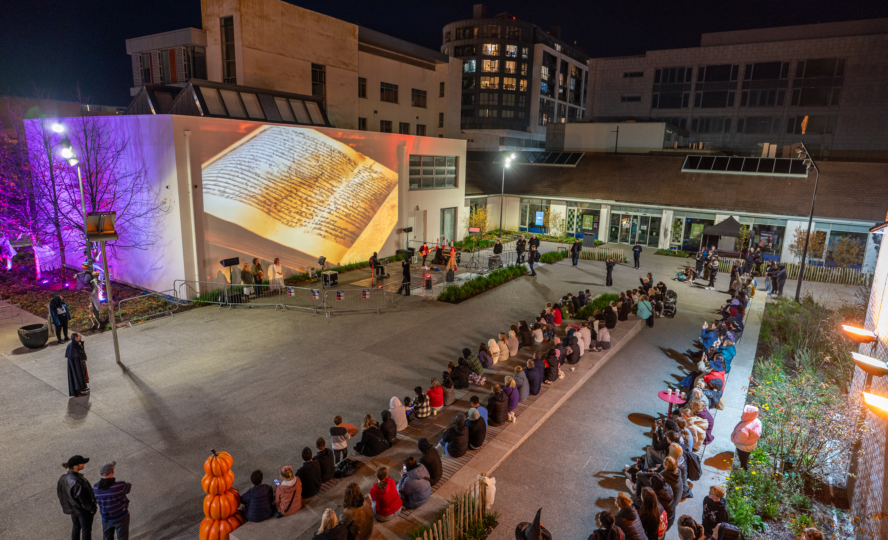
(ii) Securing the Objectives of the LAP
The Tallaght Town Centre LAP objectives relate to the whole area of the Town Centre.
Much of area has yet to be regenerated and therefore many objectives not achieved.
The LAP converts Objectives into a ‘Vision’ with key projects underpinning the Plan Led approach. These can be found on the next slide.
Some positive interventions have been achieved to date, such as the Public Realm, Innovation Centre, Housing etc.

Slide 11
Achieving the ‘Vision’ of the LAP
LAP Key Vision | Current Status | RAG Rating
Delivery of between 3,000 and 5,000 new homes | Ongoing Delivery – c1,599 homes permitted, c543 completed and c715 under construction
Delivery of a mix of new employment spaces | Ongoing Delivery – forms part of individual planning applications
Development of Tallaght Stadium’s Fourth Stand | Completed project
Redevelopment, enhancement of the Square Shopping Centre | Not delivered to date. Permission granted in 2020 for mixed use commercial extension to the south of the Square Shopping Centre.
Provision of cycling and pedestrian infrastructure links | Ongoing Delivery – Active travel routes designs progressing within and around LAP. Enhanced public realm for pedestrians in Town Centre and Airton Road extension under construction.
Provision of new schools | Ongoing liaising with Department of Education and Skills on a quarterly basis.
Improvements to the street network including extensions to Airton Road and Cookstown Road. | Ongoing Delivery – Airton Road extension under construction, part of Cookstown Road improved and preliminary design underway for further sections of Cookstown Road.
Enhancement of existing green spaces | Ongoing Delivery – Additional astro pitch in Sean Walsh Park.
Creation of a network of public open spaces | Significant Progress - including public realm improvements on link from The Square to Innovation Centre, Parthalan Place, open space at Innovation Centre and enhanced area at Luas
Development of new transport interchange at the Square | Significant Progress – part of public realm upgrade completed and permission in place for BusConnects
Enhanced bus services across the centre | Planning permission in place for Bus Connects project and ongoing liaosing with NTA on implementation of BusConnects
District heating system (HeatNet) | Achieved – District Heating in place

Slide 12
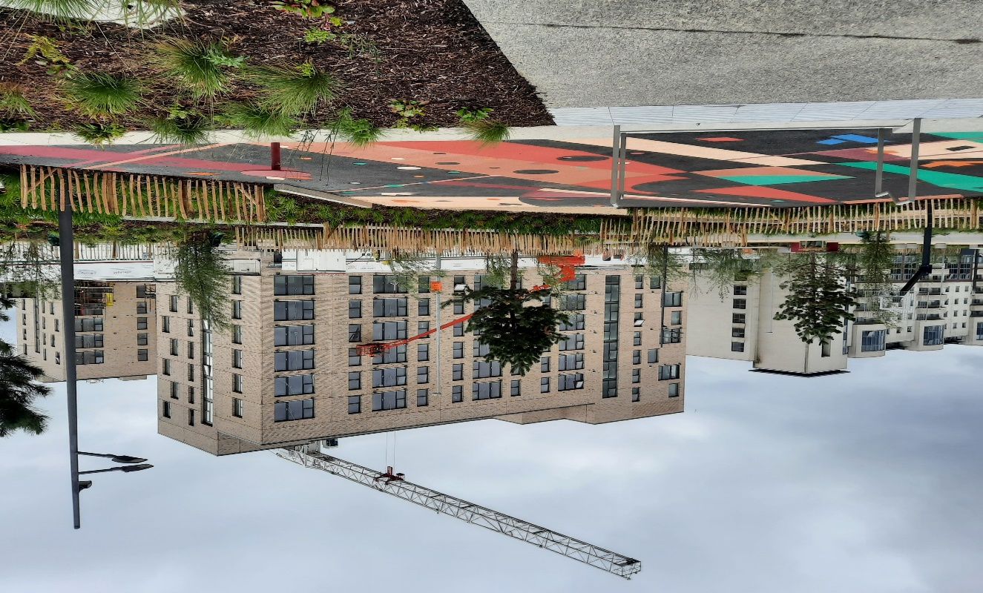
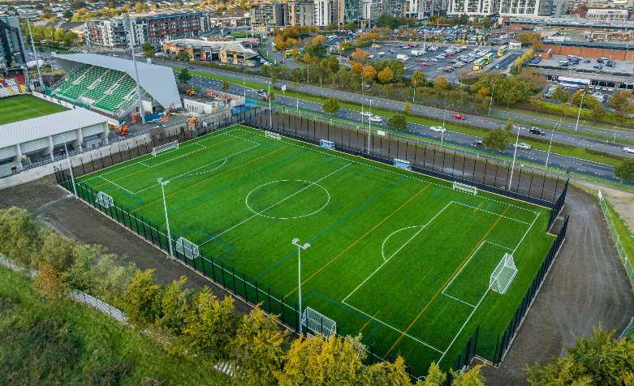
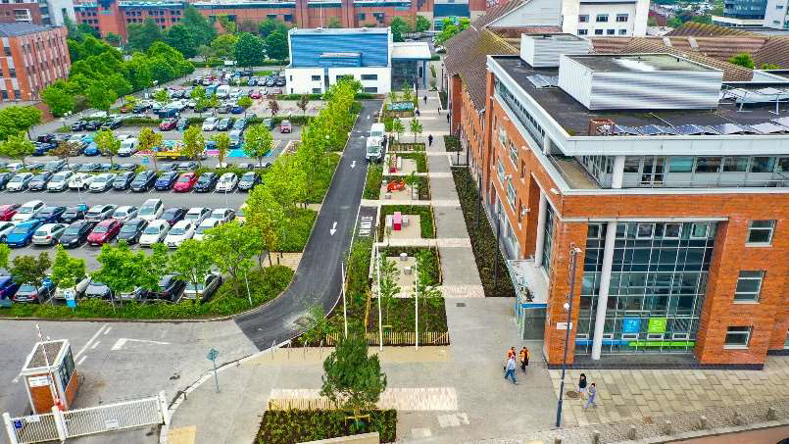
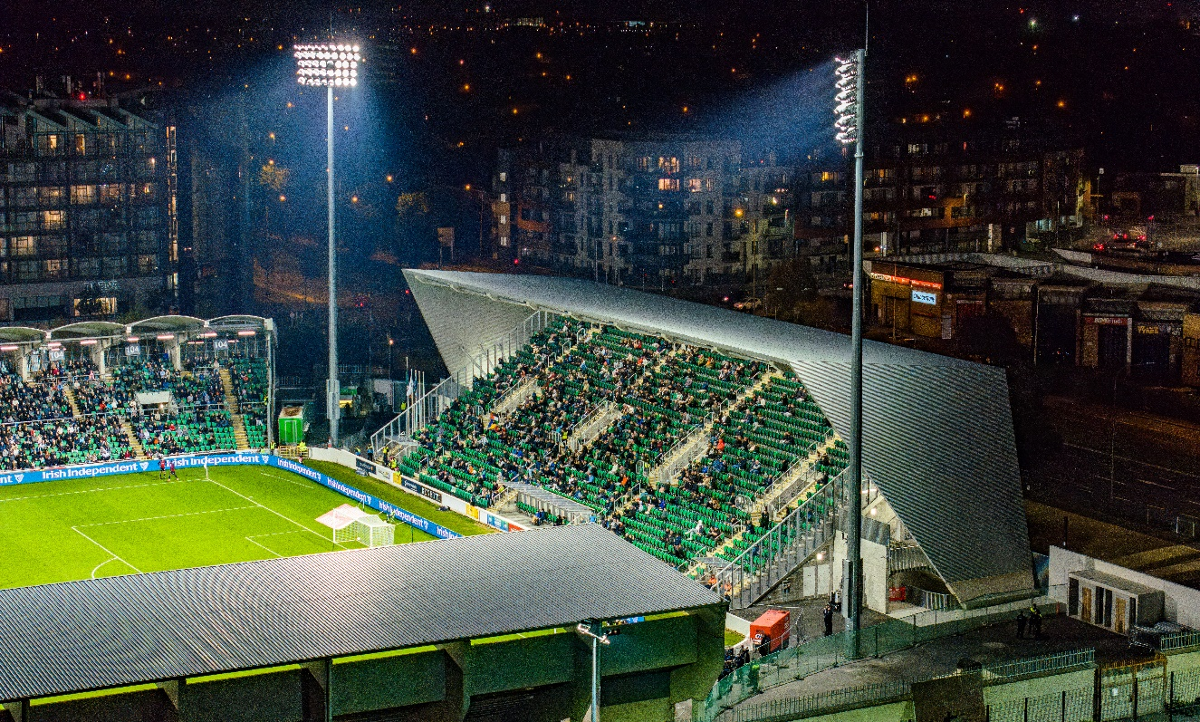
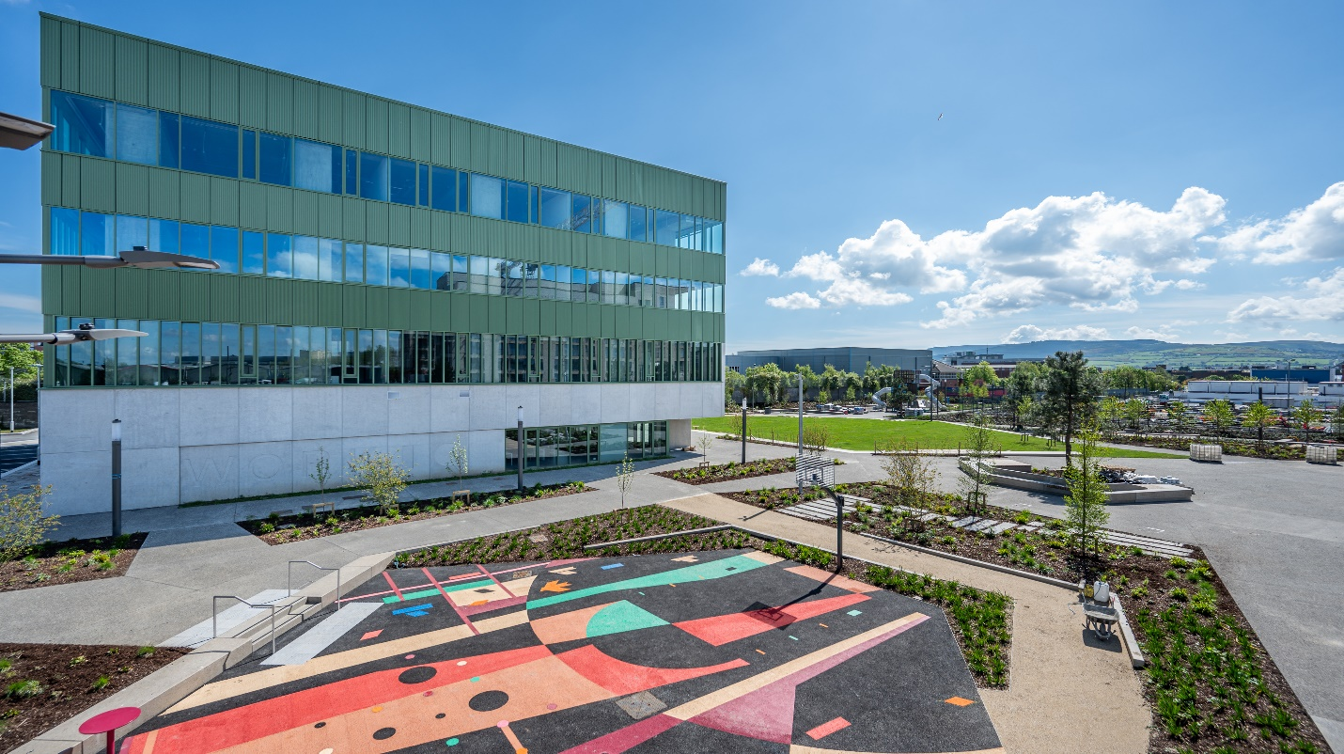
Progress
Parthalan Place
Sports Facilities
Belgard Cost Rental
Tallaght Stadium
Work IQ / Innovation Quarter
Public Realm

Slide 13
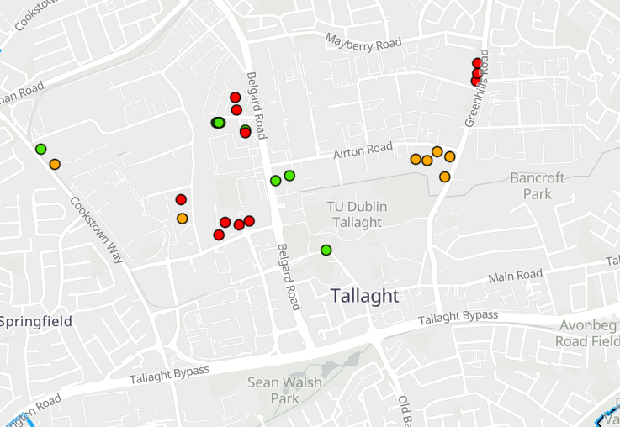
Housing Update
Green
– Completed
Orange
- Under Construction
Red
– Permitted, not commenced
Source: SDCC Housing Supply Monitor

Slide 14
(iii) Defer Timelines
LAP duration extension decision is within 5 years of making the Plan
Extension is to align with expiry of Development Plan in 2028

Slide 15
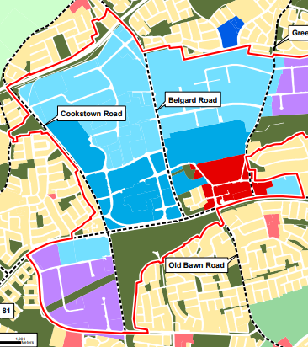
Changing Planning Context
The current LAP for Tallaght has a lifespan of 6 years, from 2020 to 2026
The current County Development Plan has a lifespan of 6 years, from 2022 to 2028
Government has introduced the new Planning and Development Act, 2024, which will be enacted shortly, changing the nature of area plan options from LAPs to Urban Area Plans, Priority Area Plans, or Combined Area Plans.
The new Act also has changed Development Plans from a 6-year cycle to a 10-year cycle
Extension of LAP will align the plans to ensure coherent approaches to development and no gap in bespoke policy for Tallaght

Slide 16
Conclusion
Significant achievements and progress
LAP not progressed to be considered ‘substantially achieved’
Meets criteria of Planning and Development Act 2000 (as amended) for extension
Recommended resolution by the Chief Executive
‘That this Council approve the procedure to defer the sending of a notice under section 20(3)(a)(i) of the Planning and Development Act 2000 (as amended), that is, notices for making, amending or revoking the Local Area Plans in accordance with Section 19(1)(d) of the Planning and Development Acts 2000 (as amended) for the Tallaght Town Centre Local Area Plan for a further period, up to the expiry of the current South Dublin County Development Plan 2022-2028’
Resolution

