Slide 1
Climate Action Plan 2024 - 2029 Annual Report
Meeting of South Dublin County Council
11th April 2025

Slide 2
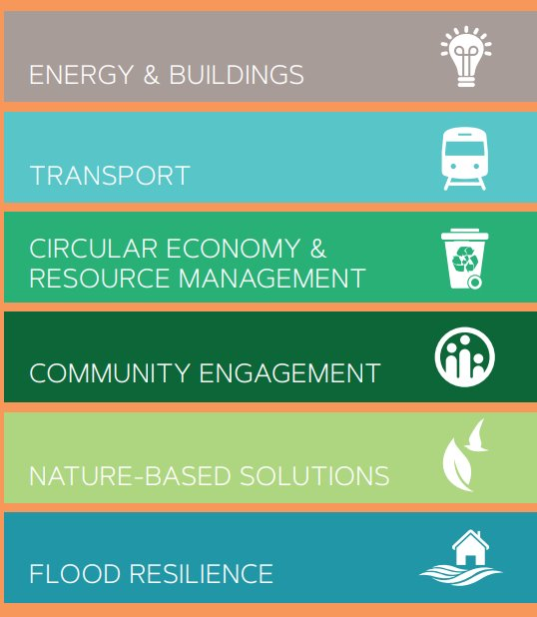
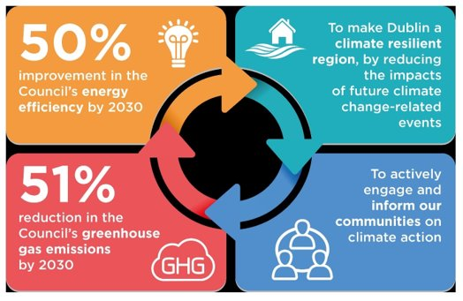
Our Climate Action Targets
Climate Action Plan Targets
129 Actions across 6 Action Areas
6 Action Areas in SDCC’s CAP
6 Action Areas in SDCC’s CAP

Slide 3
Energy & Buildings
Energy Management Team Established
Progressing ISO50001 Certification
6 SEUs account for 85% of SDCC energy use
Progressing Energy Performance Contracts
DeliverEE Pathfinder: PV Framework and Arthurstown tenders issued Match 2025
Public Lighting: 70% of stock upgraded to energy efficient LEDs to date
 | SEU Group
SEU 1 | Public Lighting | 38%
SEU 2 | Fleet | 17%
SEU 3 | Leisure Centres | 16%
SEU 4 | Corporate Buildings | 11%
SEU 5 | Libraries | 1.5%
SEU 6 | Tallaght Stadium | 1.5%
 | Total for ISO 50001 Implementation | 85%

Slide 4
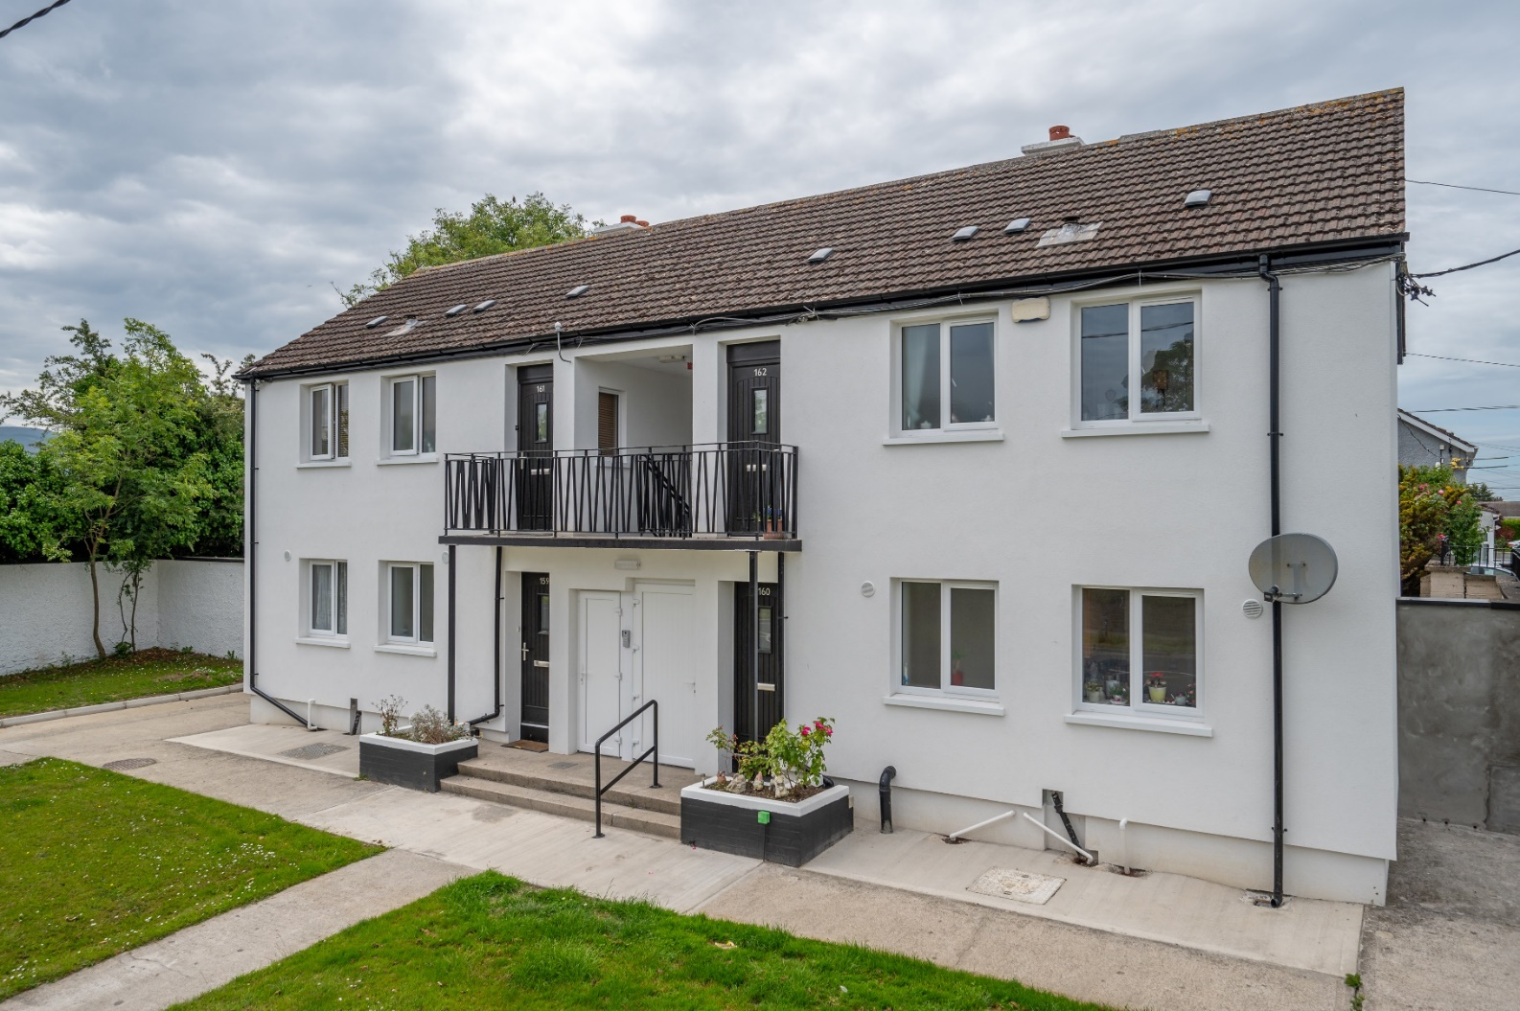
Energy & Buildings
Retrofitting the Council’s housing stock: Social Housing Upgrades: 97 homes upgraded to B2 standard under the Energy Efficiency Retrofit Programme in 2024
Tallaght District Heating:
TUD Main Campus, TUD Sport Centre, SDCC County Hall, Work IQ and the 133 Cost Rental apartments at Innovation Square are now all connected to the network and heat supply has been reliable and consistent
New Network pipes are now in place in the Airton Road extension project through the main road project

Slide 5
6 Action Areas in SDCC’s CAP
6 Action Areas in SDCC’s CAP

Slide 6
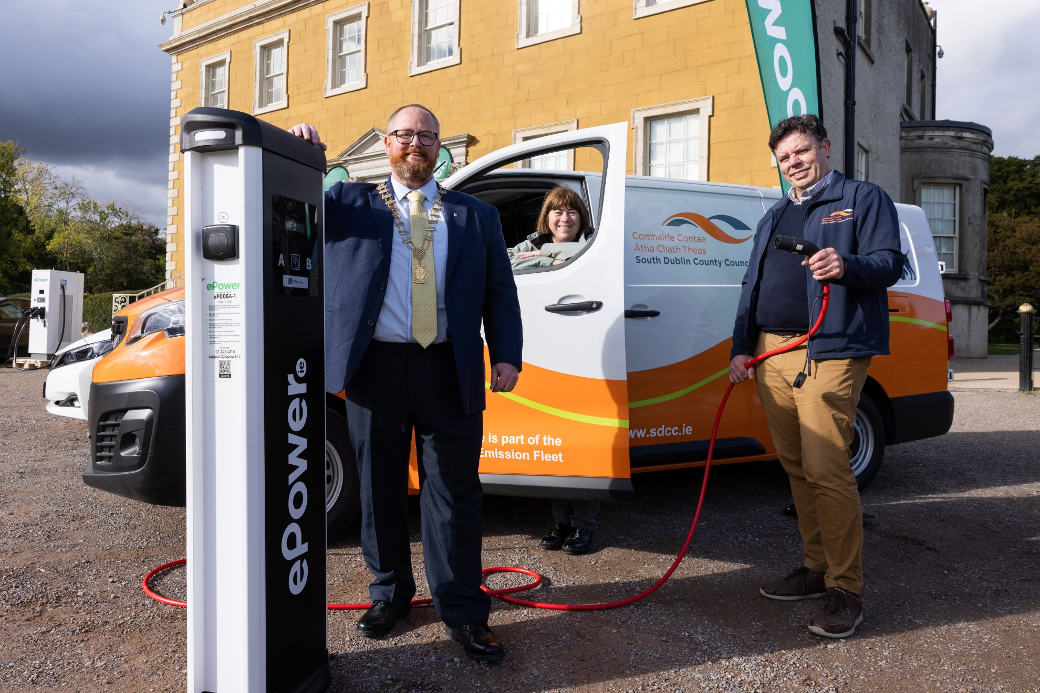
Transport
Sustainable Fleet:
HVO Trial launched August 2024
21 vehicles using HVO at end of 2024 (51 end of March 2025)
Three new EV’s added to SDCC Fleet
EV Charging Strategy – ePower appointed to undertake rollout of public EV charging points at 19 locations in SDCC
Active Travel – 22.5km of new and upgraded cycle lanes delivered
The Council continues to facilitate the delivery of public transport routes, in partnership with the NTA and others.
Staff Mobility – SDCC awarded NTA Smarter Travel Mark (Silver)

Slide 7
6 Action Areas in SDCC’s CAP
6 Action Areas in SDCC’s CAP

Slide 8
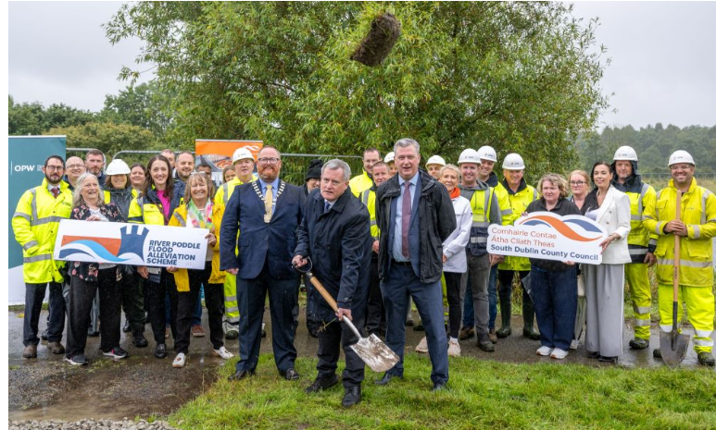
Flood Resilience
Flood Alleviation Schemes
Poddle Flood Alleviation Scheme
36-month programme
€12 million investment
work commenced April 2024
Whitechurch Flood Alleviation Scheme
27-month programme
€2 million investment
Work commenced April 2023
River Camac - Stage 1 - Emerging Options

Slide 9
6 Action Areas in SDCC’s CAP
6 Action Areas in SDCC’s CAP

Slide 10
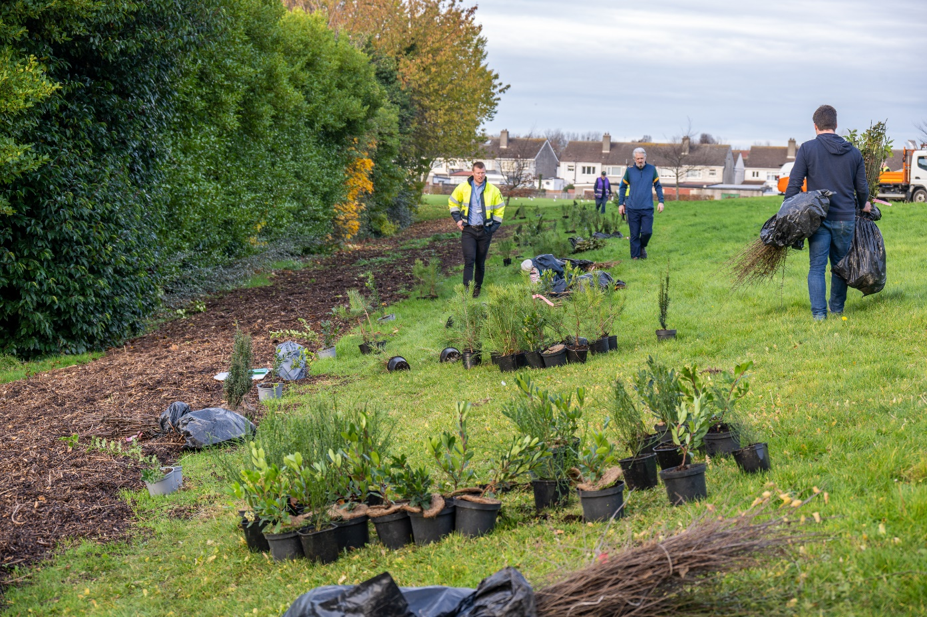
Nature-based Solutions
SDCC has approximately 61,000 trees recorded on Arbotrack – 18, 632 tons of CO²e sequestered to date.
3651 trees planted
Ongoing support and development Mini-Woodlands – 18,882 saplings planted across 5 sites in 2024
Hectares of biodiverse meadowlands increased to 195ha in 2024

Slide 11
6 Action Areas in SDCC’s CAP
6 Action Areas in SDCC’s CAP

Slide 12
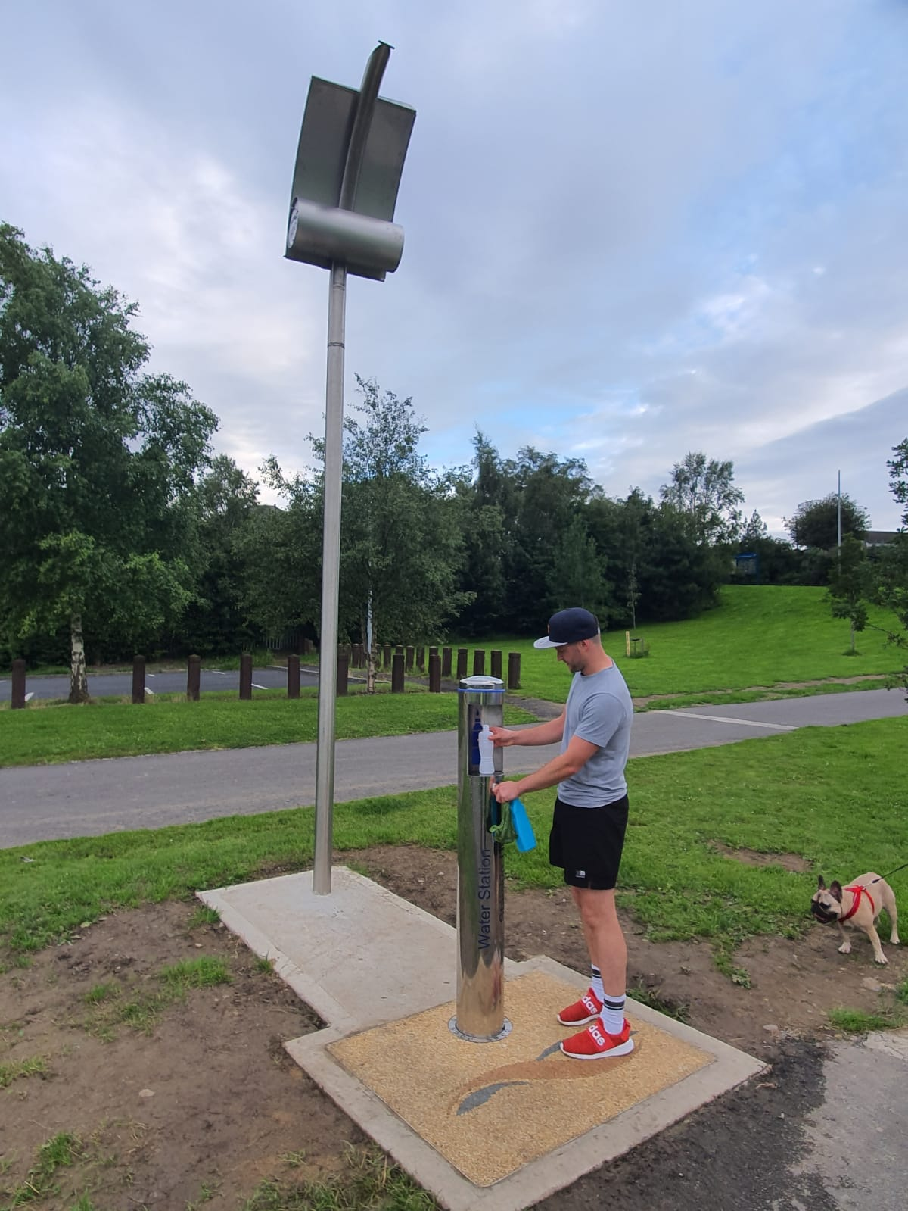
Circular Economy & Resource Management
Over 5100t of glass and aluminium collected at Bring Centres and Ballymount Civic
Paint reuse scheme established in Q3 2024 at Civic Amenity Site – 1 tonne of waste paint diverted for reuse.
10,198 environmental inspections (RMCEI Plan) completed in 2024
Drinking Water Fountains:
30 fountains
216,060 litres of water dispensed to date
432,120 plastic bottles have been saved from going to landfill

Slide 13
6 Action Areas in SDCC’s CAP
6 Action Areas in SDCC’s CAP

Slide 14
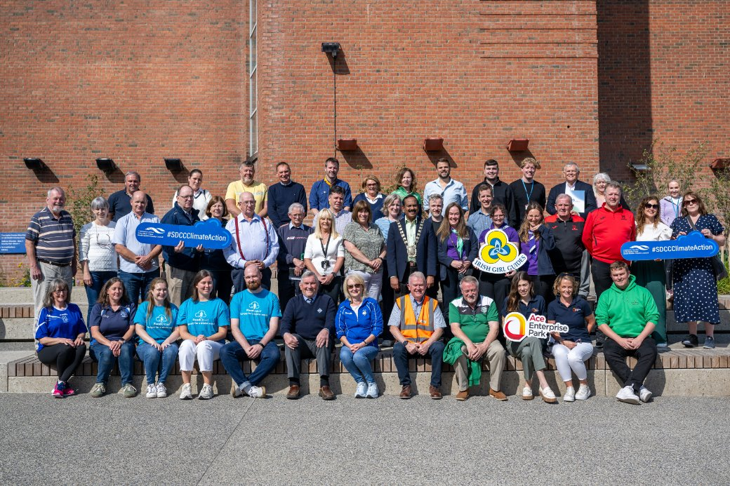
Community Engagement
Environmental education programme delivered to schools across South Dublin – ​
135 schools participating in Green-Schools in 2024/2025 ​
22 Green-School flags awarded in 2024
EcoWeek – 81 workshops delivered to schools in March 2024 ​
Community Climate Action Fund – Allocated Fund €1.169m to 28 local groups and organisations over an initial 18-month period.
Dublin Climate Action Week 2024 delivered with other DLAs, CARO & Codema
www.southdublinclimate.ie

Slide 15
6 Action Areas in SDCC’s CAP
6 Action Areas in SDCC’s CAP

Slide 16
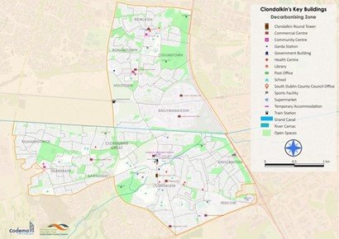
Clondalkin Decarbonising Zone
Delivering the DZ Local Engagement Plan with Codema
Stakeholder Mapping ​
Councillor/Staff Briefings (May, June & July 2024 & March 2025) ​
On-street, in-person engagement ​
Community Climate Action Survey – 244 responses
Community Events:
DCAW – 4 Youth Conferences
Climate Fest at Round Tower Visitor Centre
Wider Community Events (approx. 10)
Visioning Workshops
Workshops present the Decarbonising Zone, it’s purpose and its aims
6 workshops – 66 attendees
2 DZ Consultation Group Workshops
community members from visioning workshops / survey outreach / in-person engagement - 24 attendees in total
Implementation Plan will be complete Q2 2025

Slide 17
Clondalkin DZ Project Timeline

Slide 18
Looking ahead 2025 Implementation Plan
Focus on the delivery of SDCC’s strategic and priority actions -
Decarbonising of SDCCs Buildings, Fleet Transition, Clondalkin Decarbonising Zone, Public Lighting Programme, District Heating, Active Travel, Social Housing Retrofit, Flood Resilience Schemes, Biodiversity Action Plan, Community Engagement.
Monitor the delivery of the Climate Action Plan, in accordance with national and sectoral requirements, to ensure progress to meet the overarching 2030 targets.
Continue to deliver the Community Climate Action Programme in partnership with local groups across the County.
Continue to maximise the draw down of external funding sources and work with the other Dublin local authorities, Codema – Dublin’s Energy Agency and the Dublin Climate Action Regional Office (CARO)

