Slide 1
Social Housing Delivery
Lucan Palmerstown North Clondalkin Area Committee Meeting
25th March 2025

Slide 2
2024
HOUSING FOR ALL – DELIVERY 2024
Notes:
image
No alt text provided
Potential Units
No alt text provided
textbox
No alt text provided
No. of Potential Units Per LEA
No alt text provided
Housing for All Delivery Pipeline 2024
No alt text provided

Slide 3
2025
Notes:
image
No alt text provided
Potential Units
No alt text provided
textbox
No alt text provided
No. of Potential Units Per LEA
No alt text provided
Housing for All Delivery Pipeline 2025
No alt text provided

Slide 4
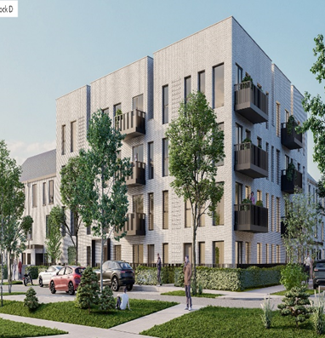
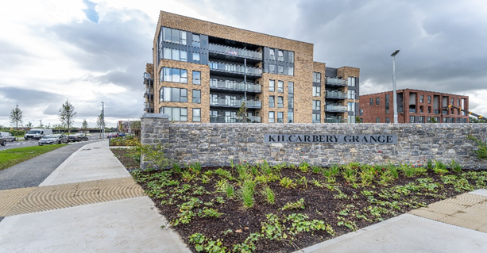
Large Development Sites
Kilcarbery Grange: 1,034 homes with 30% social (310 homes)
Phases 1, 2 and 3 of this project are now complete, with delivery of 261 social homes to date. Construction on phase 4 well advanced and will complete in mid 2025.
Clonburris: Phases 1 & 2 comprising 382 homes (149 social), Phases 3,4,5 with potential for 1,430* homes
Construction at Phase 2 – Canal Extension is advanced and on programme to complete by November 2025. The tender process for construction of 266 social, affordable, and cost rental homes at Phase 1 – Kishogue, closed on the 22nd November 2024. Tender assessment is complete with contract award imminent. Anticipated on-site date in Q1 2025. Following presentation to the Council in November 2024, plans for approximately 1275 social and affordable homes at phases 3, 4 and 5 will shortly be submitted to An Bord Pleanála under a Part 10 planning application.
Clonburris Phase 1
Kilcarbery Grange

Slide 5
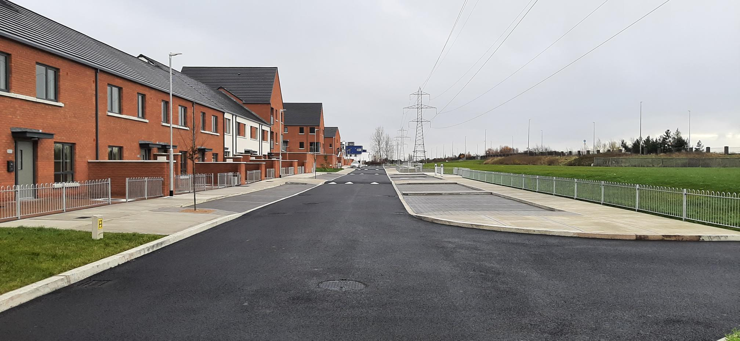
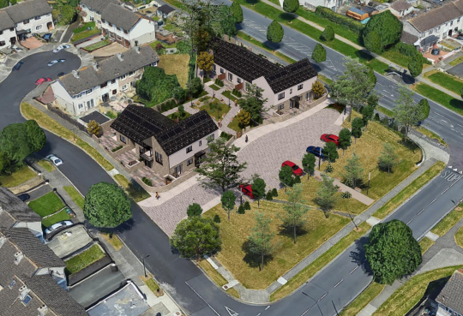
Own Build Developments
LEA | Project | Units | Status
Palmerstown- Fonthill | Omer Walk, Balgaddy | 69 | Complete Q4.2024.Tenanting commenced
Palmerstown- Fonthill | St Ronan’s Crescent (Age Friendly) | 9 | Contractor appointed. Start on site in March 2025.
Lucan | Sarsfield Park (Age-Friendly) | 5 | Contractor on-site. Due for completion December 2025
Omer Walk, Balgaddy
St Ronan's Crescent Age Friendly Scheme

Slide 6
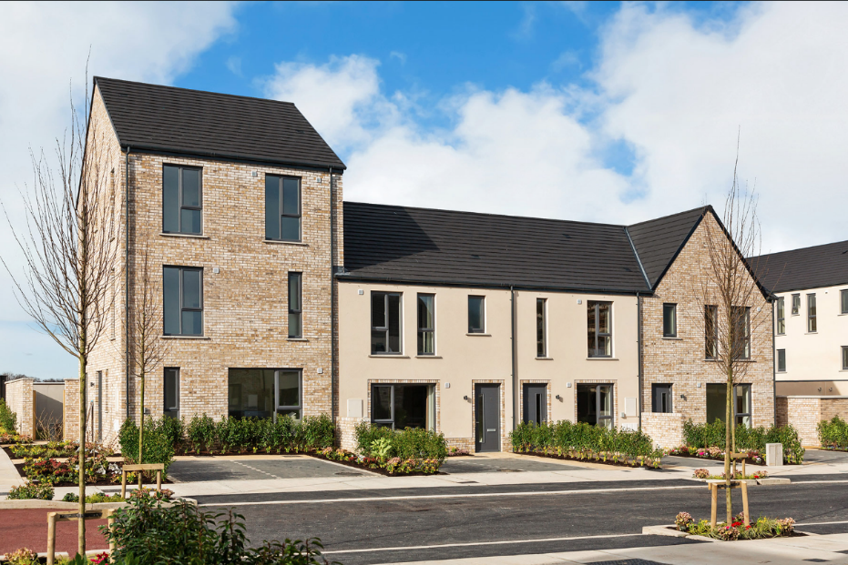
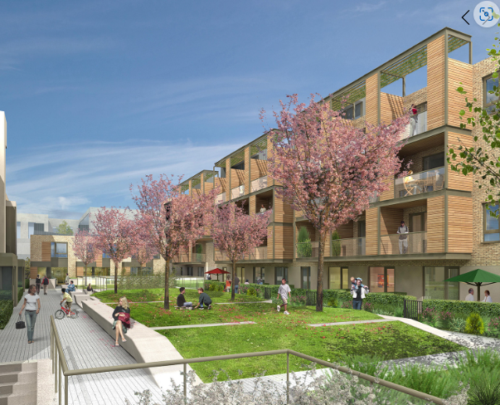
Approved Housing Bodies – Social Housing Investment Programme
LEA |  | Units | Status
Lucan | The Crossings, Adamstown Oaklee Housing | 30 | Complete – delivered August 2024
 | Hallwell, Lucan Oaklee Housing | 64 | Complete – delivered December 2024
 | Aderrig, Adamstown Cluid Housing | 23 | Complete – delivered October 2024
 | St Helen’s Plaza, Adamstown Tuath Housing | 80 | On-site – phased delivery from Q1.2026
 | Somerton, Adamstown Cluid Housing | 68 | On-site – phased delivery from Q1.2026 Age Friendly Development
 | Tandy’s Lane, Adamstown North & East Housing Association | 15 | On site. Phased delivery from Q2.2025
 | Tandy’s Lane, Adamstown Oaklee Housing | 29 | On site. Phased delivery from Q2.2025
 | Aderrig, Adamstown Fold | 14 | On-site – completion Q2.2025
 | Adamstown District Centre Tuath Housing | 44 | On-site – completion Q1.2026
Aderrig, Phase 3
Adamstown District Centre

Slide 7
Overview
Notes:
Number of EOIs by LEA
No alt text provided
image
No alt text provided
textbox
No alt text provided
Total Number of EOIs
No alt text provided
Number of EOIs By Status
No alt text provided

