Slide 1
Headed Item 2:
Update on Speed Limit Review
Land Use Planning and Transportation Strategic Policy Committee
Date: 13 March 2025

Slide 2
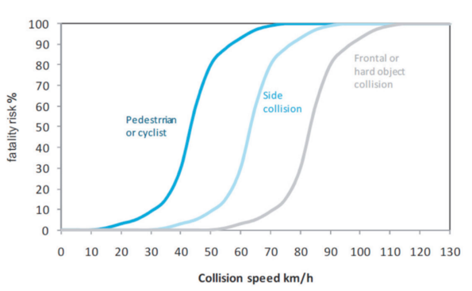
Speed Limit Review
Collision Speed – Fatality Risk

Slide 3
Speed Limit Review
Phase 1 Rural Speed Limits
Recommendations:
Phase 1: The existing 80km/h speed limit on rural roads shall be reduced to 60km/h.
Actioned: SDCC has complied with Phase 1 of the Speed Limit review for Rural Roads.
All 80km/h signs on Rural Roads in SDCC replaced with a speed limit of 60km/h.
All new speed sign locations added to the National Speed Limit Database.
The new speed limit became operational on 7 February 2025.

Slide 4
Speed Limit Review
Phase 2 Urban Speed Limits
Urban Recommendations:
A 30km/h limit should apply, for all city or town centres, residential roads and locations where there is a significant presence of vulnerable/active road users.
Exceptions may be permitted for the following: -
Pedestrian zones and shared space/zones whereby a speed limit of 20km/h would apply.
National, Regional, arterial roads and key public transport routes where limits up to 50km/h.
Transition zones on National, Regional, arterial roads and key public transport routes where limits up to 60km/h.
Urban arterial roads with a high design speed such as motorways, certain dual carriageways and roads with limited access where higher limits may apply.

Slide 5
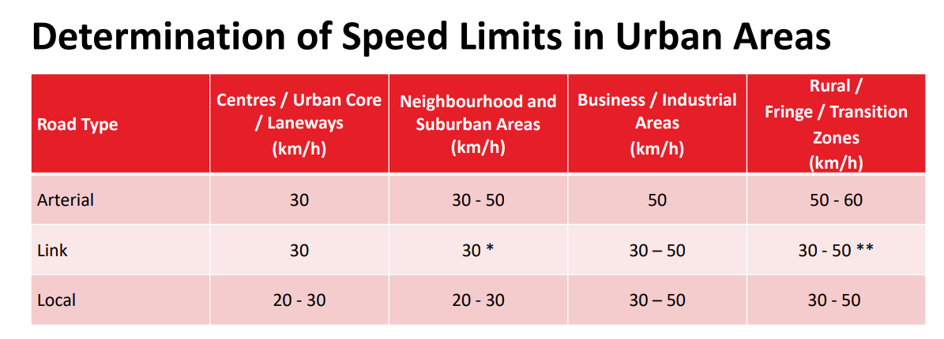
Speed Limit Review
Phase 2 Urban Speed Limits

Slide 6
Speed Limit Review
Phase 2 Urban Speed Limits
Urban Speed Limit Implementation:
Step 1:
Identify Urban Speed Zones. This is the urban road network and traffic zone within which Urban Speed Limits should be set.
Step 2:
Identify locations where a speed limit other than 30km/h should apply within the Urban Speed Zone.
Step 3:
Implementation of Urban Speed Limits in Urban Areas through Bye-law process.

Slide 7
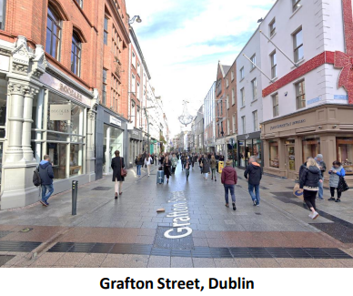
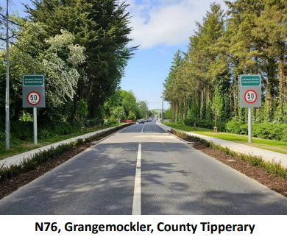
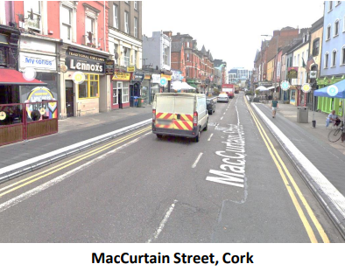
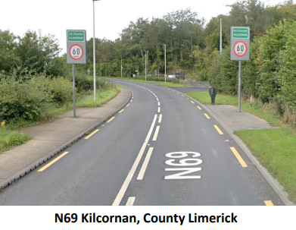
Speed Limit Review
Phase 2 Urban Speed Limits
Urban Speed Limits - Illustrative Examples
20km/h Speed Limits
50km/h Speed Limits
30km/h Speed Limits
60km/h Speed Limits

