Slide 1
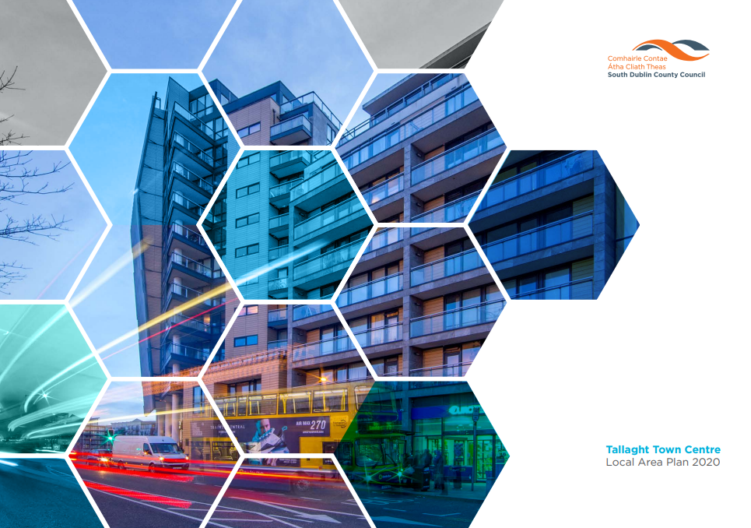

Slide 2
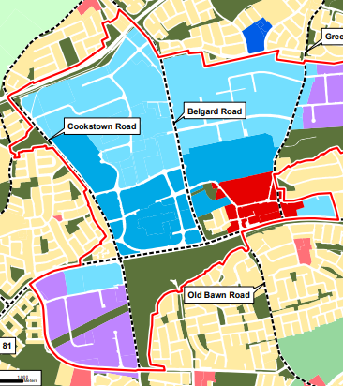
Tallaght Town Centre Local Area Plan (LAP)
The elected members of South Dublin County Council resolved to make the Tallaght Town Centre Local Area Plan on 8th June 2020 and the Plan has effect from 20th July 2020.
Vision:
“An inclusive and vibrant Town Centre, a connected and accessible place with an attractive built environment for families of all kinds, workers, visitors and tourists. A place where people can live, work, visit and have fun in lively and liveable spaces.”

Slide 3
Context
The current LAP for Tallaght has a lifespan of 6 years, from 2020 to 2026
The current County Development Plan has a lifespan of 6 years, from 2022 to 2028
Government has introduced the new Planning and Development Act, 2024, which will be enacted shortly, changing the nature of LAPs to Urban Area Plans, Piority Area Plans, or Combined Area Plans.
The Act also has changed Development Plans from a 6 year cycle to a 10 year cycle

Slide 4
Need for an Extension of the current LAP
The current LAP expires in 2026
Therefore between 2026 and 2028 (end of the current Development Plan), the specific policies associated with Tallaght Town Centre will lapse and become more generic
Lost 2 Years at the start of the process to Covid (2020-2022)
More difficult to influence development within Tallaght
Lose momentum with regard the progress to date:
Public Realm
Innovation Centre
4th Stand
Housing Delivery
Continued growth of TUD Campus
Engagement with Dept of Education on School delivery for Tallaght

Slide 5
Process to Extend
The process set out in Section 19 of the Planning and Development Acts 2000 (as amended) provides that the members can resolve to extend the life of a Local Area Plan following receipt from the Chief Executive of:
(i) an opinion that the Local Area Plan remains consistent with the objectives and core strategy of the relevant development plan,
(ii) an opinion that the objectives of the LAP have not been substantially secured, and
(iii) Confirmation that the sending and publishing of notices to commence the review of the LAP may be deferred and the period for which they may be deferred.

Slide 6
Future LAPs and new CDP – Next Steps
The current LAP will be extended up to 2028
The LAP and CDP will lapse together
New 10 Year Development Plan
This will present an opportunity for specific policies and objectives for Tallaght, which can include the option to undertake a new LAP (under new Act this will be either a Priority Area Plan or Urban Area Plan)

