Slide 1
South Dublin E-Scooter Campaign 2025 Presented by Orlaith Maguire Road Safety Officer 27th February 2025
Land Use Planning and Transportation Strategic policy Committee
February 2025

Slide 2
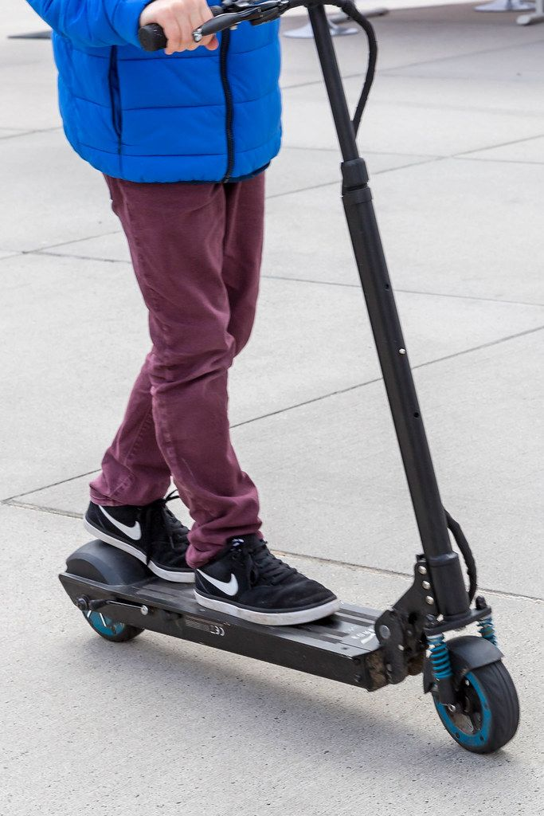
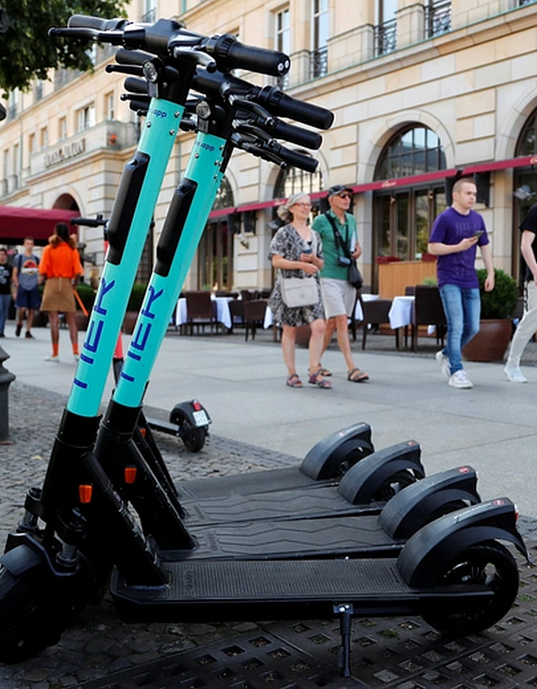
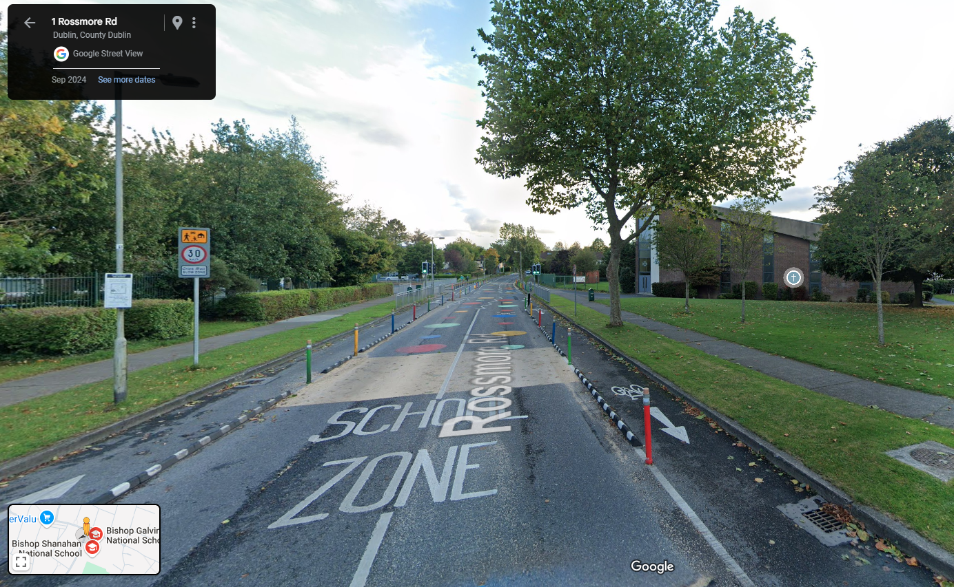
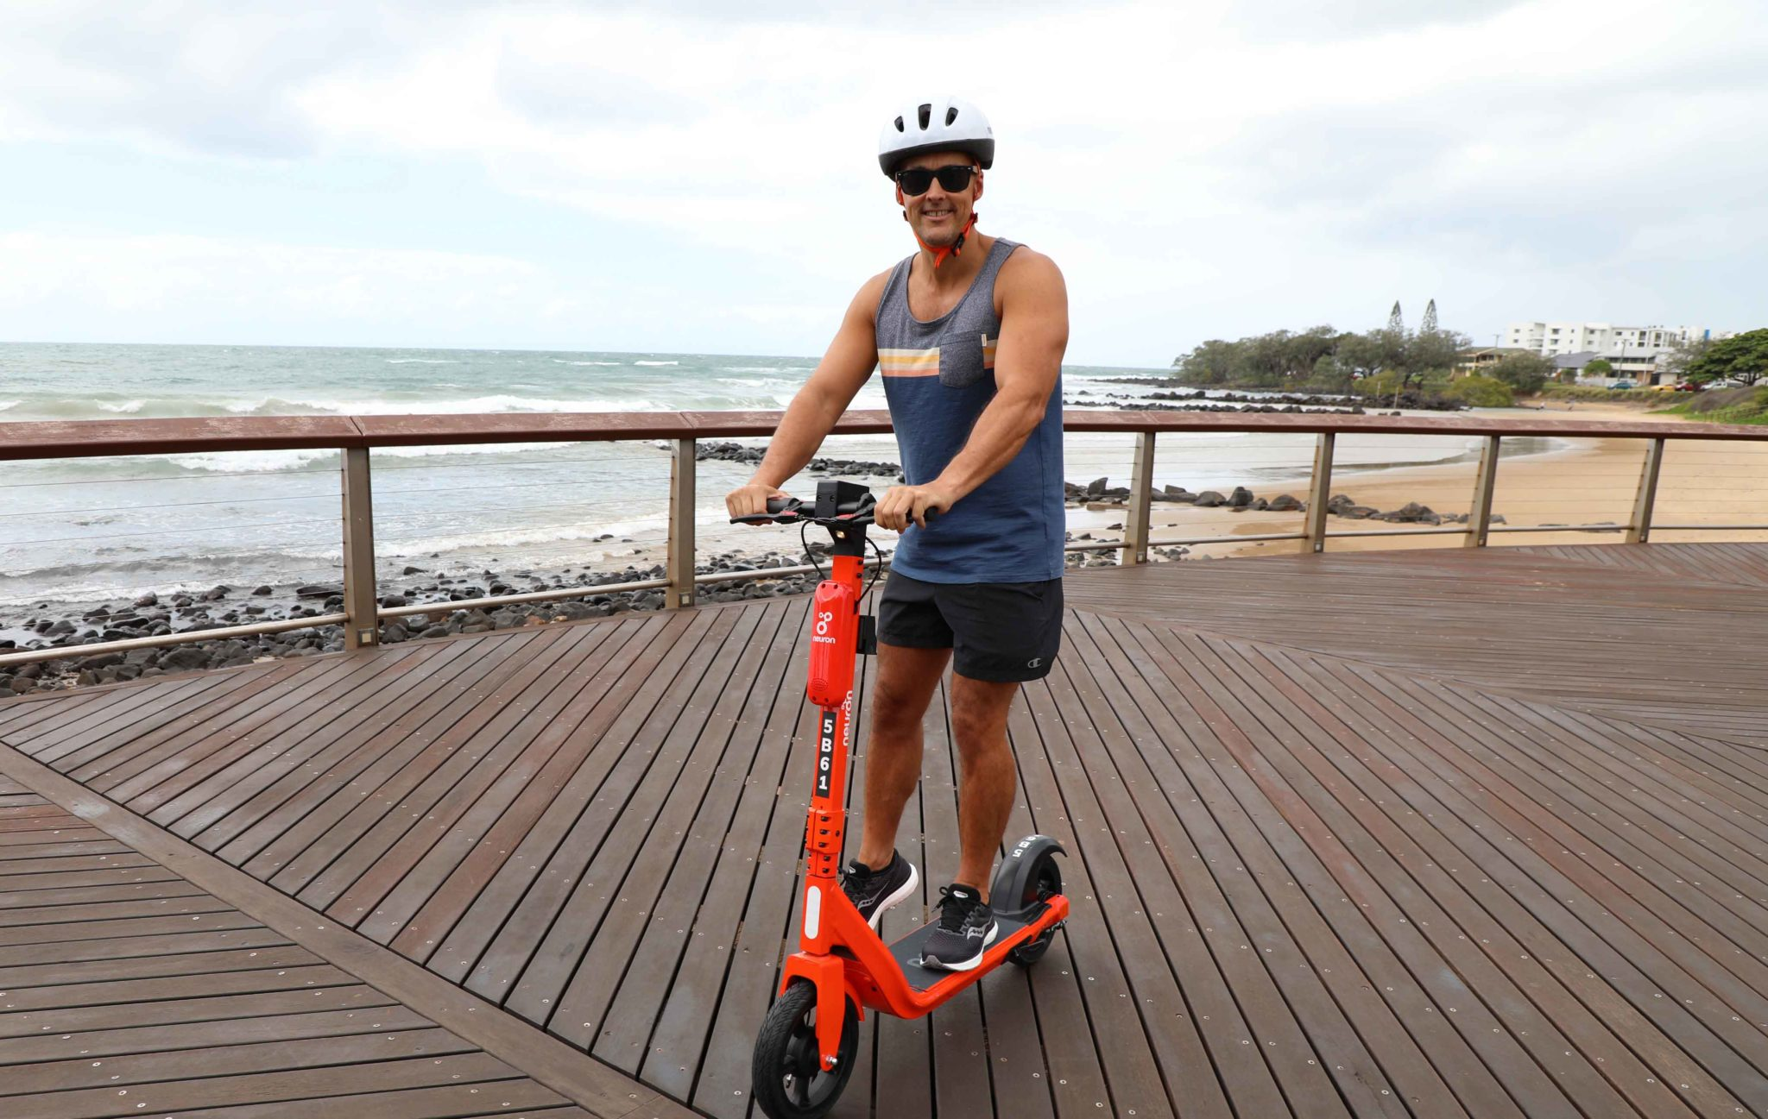
New E-Scooter Legislation
Since 20th May 2024 - New regulations under the Road Traffic and Roads Act came into effect in Irish legislation for E- scooters and e-bikes/e-mopeds.
This set out the new legal and safe technical parameters and usage of e-scooters and e-bikes.
The regulations set out the rules of the road for people choosing to use light electric vehicles which are now enforceable under Irish law.

Slide 3
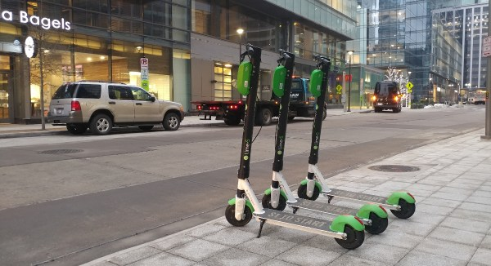
Personal Powered Transporters
A new class of vehicles called Personal Powered Transporters (PPTs) were introduced under the Road Traffic and Roads Act 2024
E-scooters are now classed as PPT and must comply with technical and usage specifications in order to be legally used on public roads
An e-scooter is a vehicle with a small standing platform and no seat, for use by one person only. An e-scooter may have two or more wheels and be propelled by an electric motor

Slide 4
E-Scooters
E-scooters are now seen as a New & Novel mode of transport
It is vital that Owners and E-Scooter Users are aware of the legal requirements to ensure the safe use of this mode of transport on public roadways
By launching our awareness campaign it afforded South Dublin County Council the opportunity to inform other Road users of the presence of Vulnerable Road Users and to provide for adequate distances of at least 1 metre clearance when overtaking an e-scooter user in speed zones that are 50 km/h or under and at least 1.5 metres in speed zones over 50 km/h and to remind Drivers that E-Scooter Users fall into the ‘Vulnerable Road User ‘ Category (VRU)
It also allowed us to highlight the Rules of the Road for E-Scooter Users and failure to follow these could lead to a Fixed Charge Notice or fine

Slide 5
E-Scooters
E-Scooters are Restricted to Maximum unladen weight 25 kgs Maximum Speed 20 km/ph Maximum Power 400 w | E – Scooters MUST have Bell / Horn Front & Rear Brakes Front & rear Lights
E-Scooters are NOT Allowed | E-Scooters Users
On Footpaths / Motorways | Must be over 16 years old
Carry Passengers or goods Have a Seat | Cannot use scooter while intoxicated Failure to obey the ‘Rules of the Road’ may incur a FINE or COURT SUMMONS

Slide 6
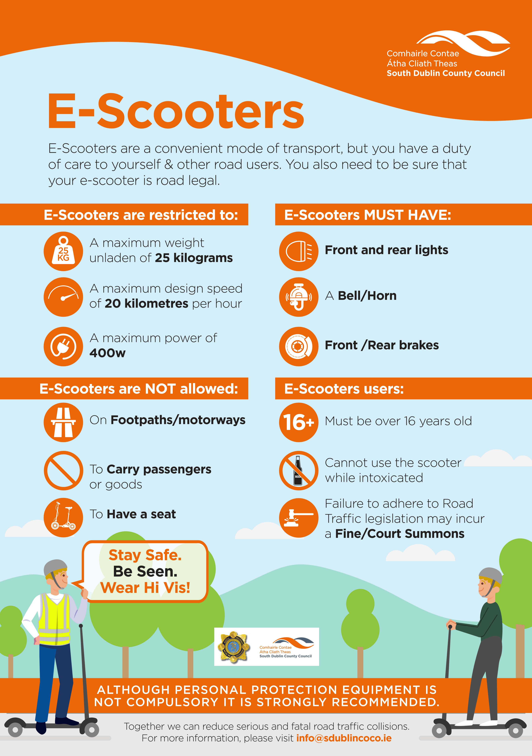

Slide 7
Fixed Charge Notices Issued
They are broken down by month below.
May-June 2024 | Jul-24 | Aug-24 | Sep-24 | Oct-24 | Nov-24 | Dec-24 | Jan-25 | Feb-25 | Total
13 | 39 | 19 | 18 | 25 | 27 | 45 | 49 | 10 | 245

Slide 8
Collisions involving E-Scooters – 2023, 2024 and 2025– To show increase/decrease on same time period last year.
Collisions involving E-scooters | 2023(Full) | 2024(Full) | Diff
Fatal and Serious Injury Collisions | 37 | 74 | +100%
Non-Serious Injury Collisions | 145 | 149 | +3%
Material Damage Collisions | 110 | 191 | +74%
Collisions involving E-scooters | 2023YTD** | 2024YTD** | 2025TD** | Diff 23/25 YTD | Diff 24/25 YTD
Fatal and Serious Injury Collisions | 3 | 10 | 3 | 0% | -70%
Non-Serious Injury Collisions | 17 | 13 | 20 | +18% | +54%
Material Damage Collisions | 7 | 14 | 18 | +157% | +29%

Slide 9
Incidents where E-Scooters detained – 2023, 2024 and 2025 – To show increase/decrease on same time period last year
Additional Information
*Figures for Fixed Charge Notices are based on incidents which occurred from 20/05/2024 to 11/02/2025, inclusive. All information contained in this report is based upon operational data from the FCPS system as was available on 12/02/2025 and is liable to change.
**2023, 2024 and 2025 YTD figures for collisions and vehicle detentions cover the time period from 01/01 to 11/02, inclusive, for each year. Figures are based upon operational data from the PULSE system as was available on 12/02/2025 and is liable to change.
Incidents where E-scooters detained | 2023(Full) | 2024(Full) | Diff
 | 66 | 186 | +182%
Incidents where E-scooters detained | 2023YTD** | 2024YTD** | 2025TD** | Diff 23/25 YTD | Diff 24/25 YTD
 | 5 | 10 | 33 | +560% | +230%

Slide 11
Thank You

