Slide 1
Lucan Demesne Park Part 8 Upgrade of Entrance & Route
Meeting of South Dublin County Council
10th March 2025

Slide 2
Overview
Proposed upgrade of entrance & route into Lucan Demesne
Construction timber boardwalk from plaza to existing river side path
Approx. 105m in length, ranging from 150mm to 900mm in elevation & generally 2m in width, widening in places up to 3m.
Removal of & rewilding of existing pathway
Associated landscaping, planting and ancillary works

Slide 3
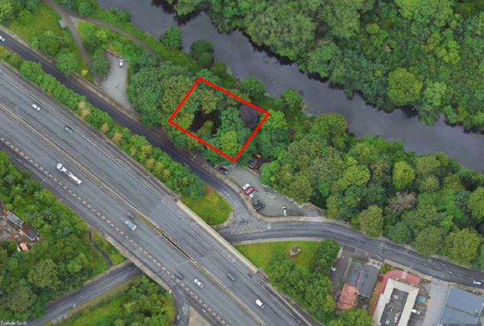
Site Location

Slide 4
Preliminary Assessments
Proposal has undergone Appropriate Assessment Screening under the Habitats Directive (92/43/EEC), an Environmental Impact Assessment Screening (EIA) and an EcIA under the EIA Directive 2014/52/EU.
The Planning Authority has made a preliminary examination of the nature, size and location of the proposed development.
Conclusion that there is no real likelihood of significant effects on the environment arising from proposed development.
Determination that an EIA is not required.

Slide 5
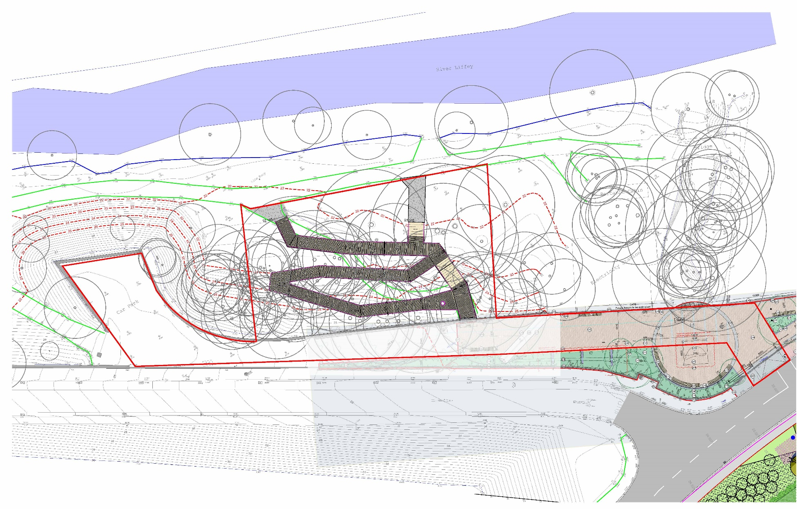
Site Boundary

Slide 6
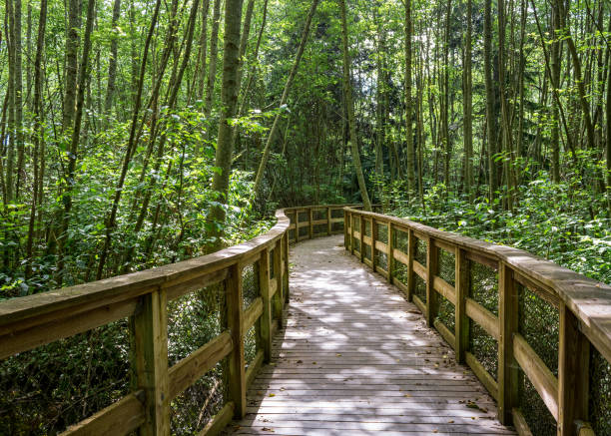
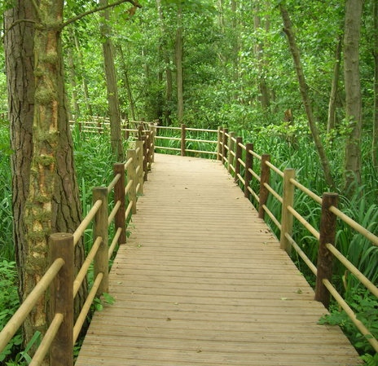
Boardwalk Inspiration Design

Slide 7
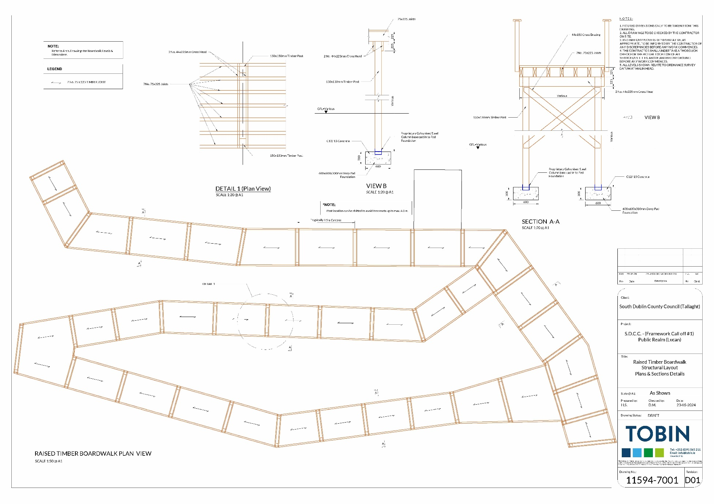
Structural Layout

Slide 8
Part 8 Consultation
Plans available online & in County Hall from 17th Jan to 28th Feb 2025
Two submissions received by closing date & noted.
1 relating to protection of Liffey water quality.
1 requesting additional details to be included at detailed design stage to maximise usability for use by kayakers and others.
Both submissions were noted and further consultation will take place at detailed design stage to ensure optimal use of the facility.
CE recommendation to proceed with Part 8 proposal
Next steps:
Go to tender & award contract
Commence works after bird nesting season Q3.

