Slide 1
Parks and Open Space Strategy
Meeting of South Dublin County Council
10th March 2025

Slide 2
Vision
“Create a multi-functional network of pleasant, sustainably-managed parks and open spaces that improve the lives of people in South Dublin and support nature”
Fundamental to quality of life in urban areas
Contribute to health and well being
Passive and active recreation provision
Provide for habitats and ecological processes
Promote community interaction
Mitigate for, and adapt to, Climate Change

Slide 3
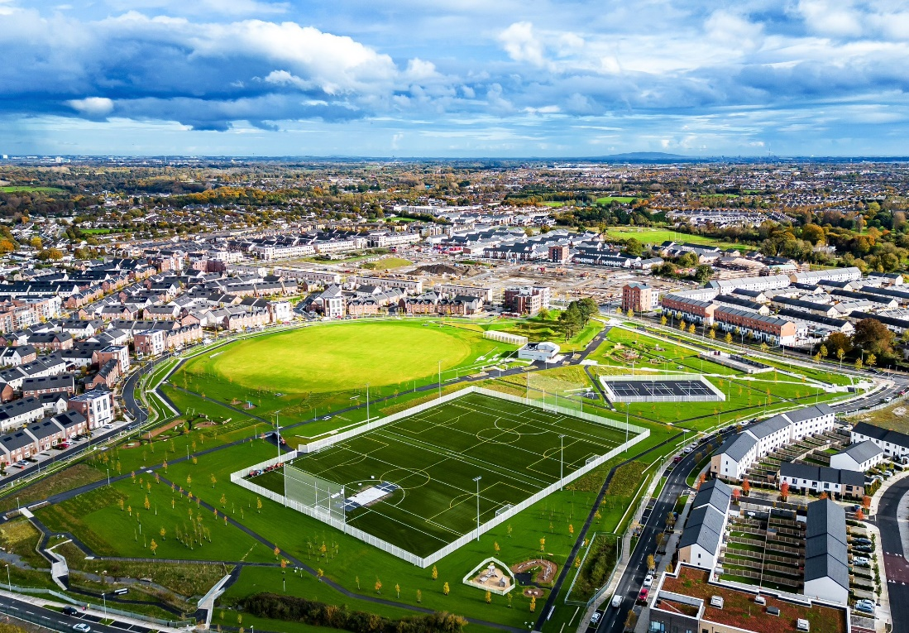
Main elements
Open Space Audit:
Quantitative: greenspace mapping and characterisation
Accessibility: assessment of distances to parks
Qualitative: assessment of the ecological, recreation, amenity and community value
Results:
An assessment of current and future requirements
A strategy statement with a clear set of priorities and actions

Slide 4
Community Engagement:
Over 4,200 responses were received on the Park Users Survey questionnaire:
Corkagh Park and Tymon Park are the most visited
The parks most visited were those closest to people’s home (80%)
Majority of respondents travel on foot to their nearest parks, followed by car. Only a low number travel by bicycle
Main reasons given for visiting the park were to exercise and to spend time outdoors. Only a low number used the park to play sports.
Majority of respondents stayed in the park for 30 minutes to 1 hour, with fewer staying between 1 to 2 hours
The most popular responses to further park enhancements were to provide/improve toilet facilities, increased personal safety and improved cleanliness. The least popular enhancements were signage and expanded opening hours.

Slide 5
Standard provision:
SDCC (& most other local authorities that set standards):
2.4ha per 1000 population
World Health Organisation:
Ideal provision of urban green space equates to 5ha per 1000 of population.
FiT standard
5.35ha per 1000
3.2ha per 1000 people of parks, public gardens, amenity greenspace and natural and semi natural open space
with a separate provision for playing fields, courts, greens tracks and trails of 1.6ha per 1000 people.
With an additional required provision of formal and informal play areas of 0.55ha per 1000 people

Slide 6
Quantity provision:
Quantity of Public Open Space:
There are currently 61 public parks distributed throughout the South Dublin urban area
3ha of parks and open spaces are provided per 1000 of population
Park types:
Regional Parks 7%
Neighbourhood Parks 11%
Local Parks 64%
Small Parks 18%

Slide 7
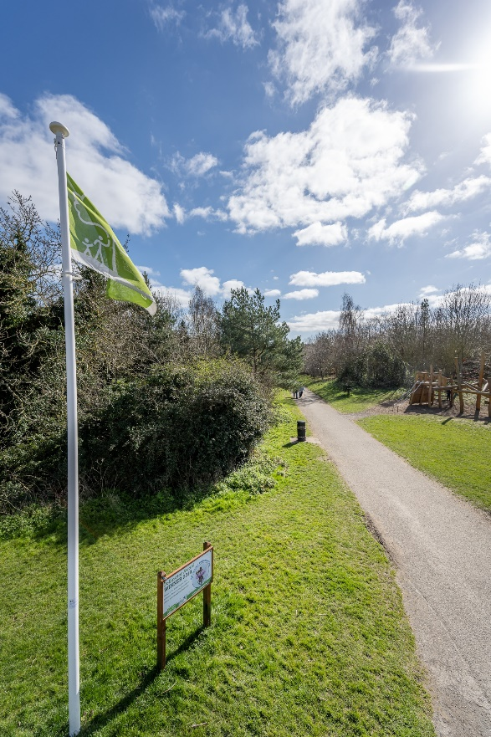
Quality provision:
Quality Standards – Green flag standard with developed biodiversity section.
Five parks in South Dublin have been awarded Green Flag status.
Going forward: locally set quality assessment for each area of open space. Scored against an expected level of quality/maintenance, potential for biodiversity and community value.

Slide 8
Outcomes:
Key Deliverables:
Deliver improvements to ecological processes and protect and enhance Green Infrastructure and restore nature (diverse habitats, ICWs, woodlands, meadowlands, trees and hedgerows, wetlands, nature restoration) – restoring nature
Deliver improvements to amenity (visitor facilities, recreational programmes and recreational facilities (Natural playspaces, Sports Pitch Strategy, 3G pitches, pavilions, teenspaces, intergenerational provision, Greenways etc.) - increasing use and dwell times
Management Plans for larger parks: OS Audits, Local GI, maintenance, amenity
Provide and update GIS on public open space and recreation provision to plan for future needs.
Improvement in access to parks and open space (physical improvements to and through parks and the facilities therein, communication and awareness)
Improvement in quality of parks and open space e.g. upgrading open spaces to park status
Provision of new parks and open spaces, examining west of the county in particular

