Slide 1
Balgaddy Housing Update
Q4 Report - Housing Maintenance & Estate Management

Slide 2
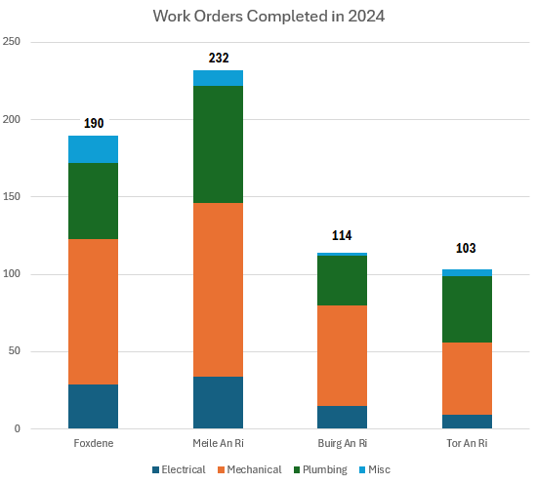
Response Maintenance 2024

Slide 3
Allocations and Relets 2024
Pre - Works | Work in Progress | Ready for Allocation | Allocated | Total
0 | 9 | 6 | 4 | 19
Allocations for 2024
34

Slide 4
Housing Maintenance Operations Balgaddy
Repairs to Vacant Properties – Reduce turnaround times
23% reduction in relet turnaround times county-wide in comparison to 2023.
Response Maintenance and Property Management
639 Work Orders completed in 2024 by Direct Labour, Electrical, Mechanical and Response Maintenance Contractors.
Clean-up of communal areas completed for 2024: 9th March, 11th May, 10th August, 2nd & 16th November.
Property Condition Surveys – Identify condition and maintenance requirements
Properties surveyed on 5-year cycle
Contract has commenced
Balgaddy included in year two surveys
Outcome of surveys will determine future planned maintenance programmes
Allocations and Relets 2024

Slide 5
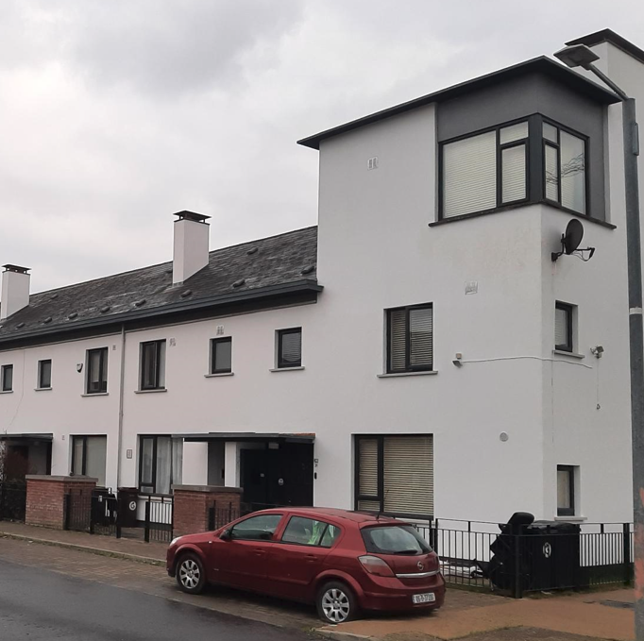
Planned Maintenance 1-
Balgaddy
Roofing Works
Works complete at two locations within Meile An Rí
Works complete at three locations within Tor An Rí
Works complete at two locations within Buirg An Rí
Energy Efficiency Retrofit Programme
Works were completed at fifteen locations
within Tor An Rí Walk.
Safety Works Programme
Works have commenced within Buirg An Rí
with 82 locations selected to upgrade fire detection
systems to LD2 standard

Slide 6
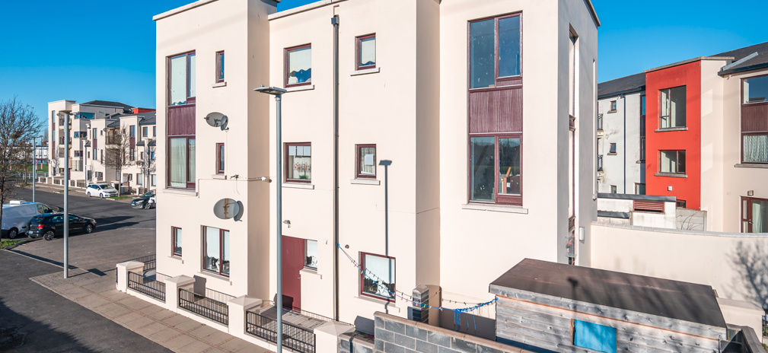
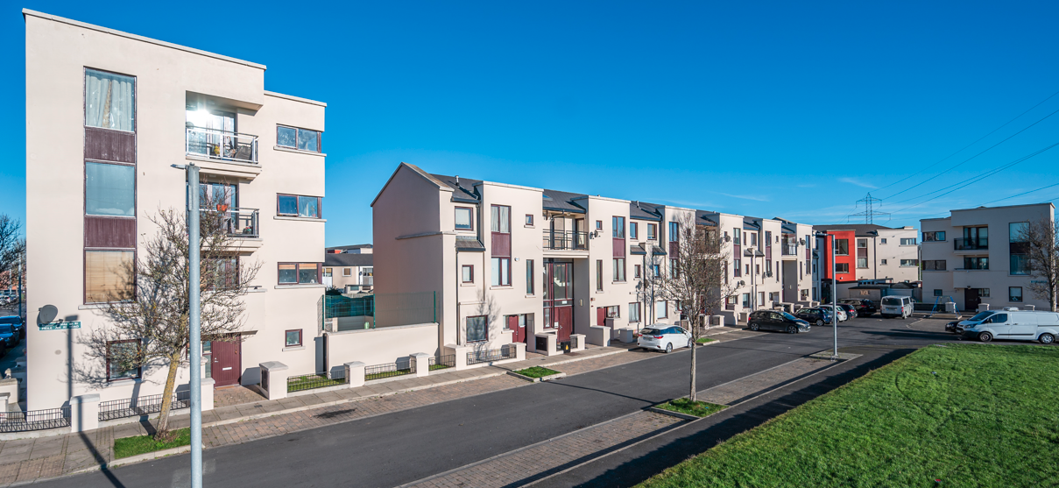
Planned Maintenance 2 –
Balgaddy
Painting Programme
99 Units complete to date
19 Units in progress
18 Units surveyed and
awaiting commencement of works

Slide 7
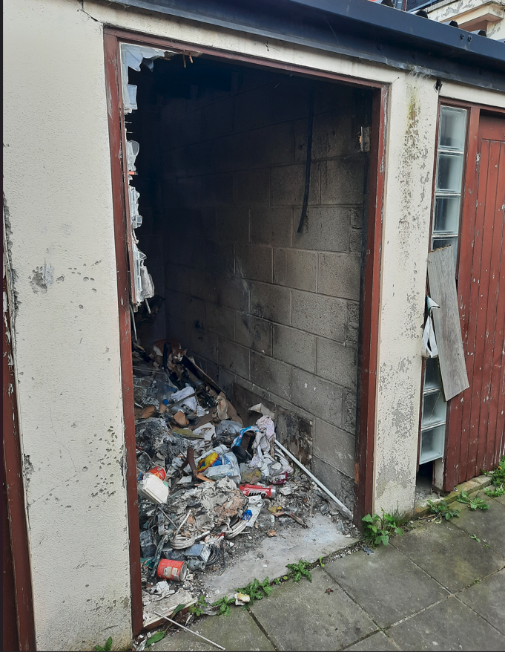
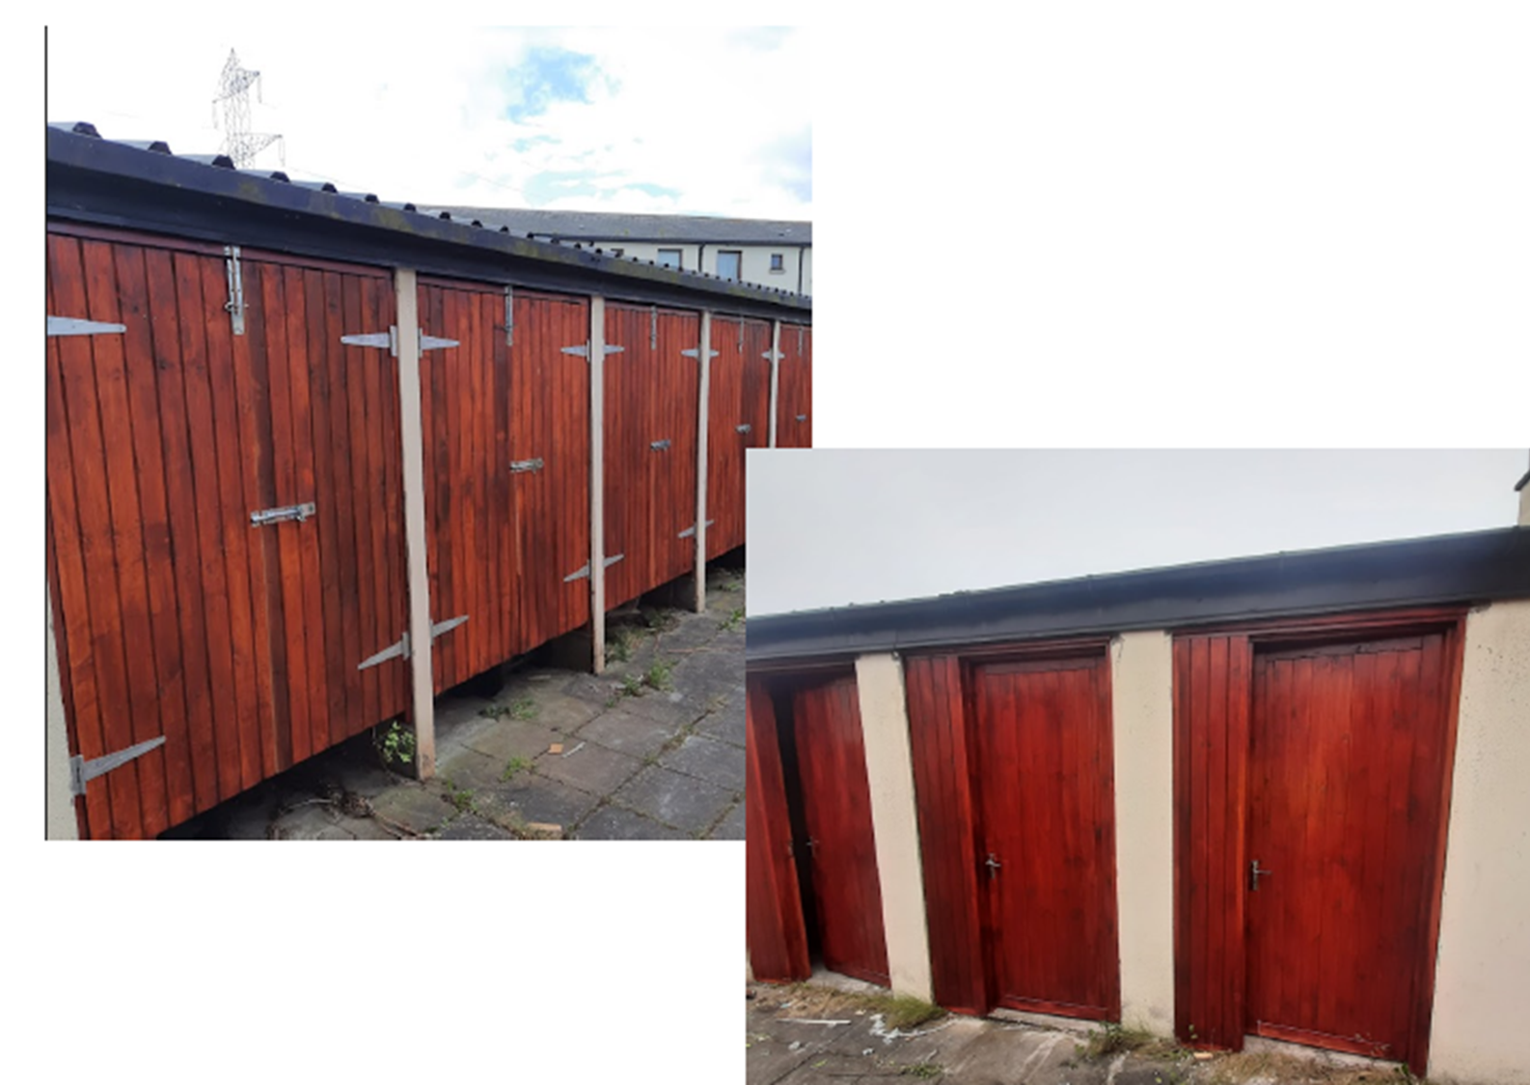
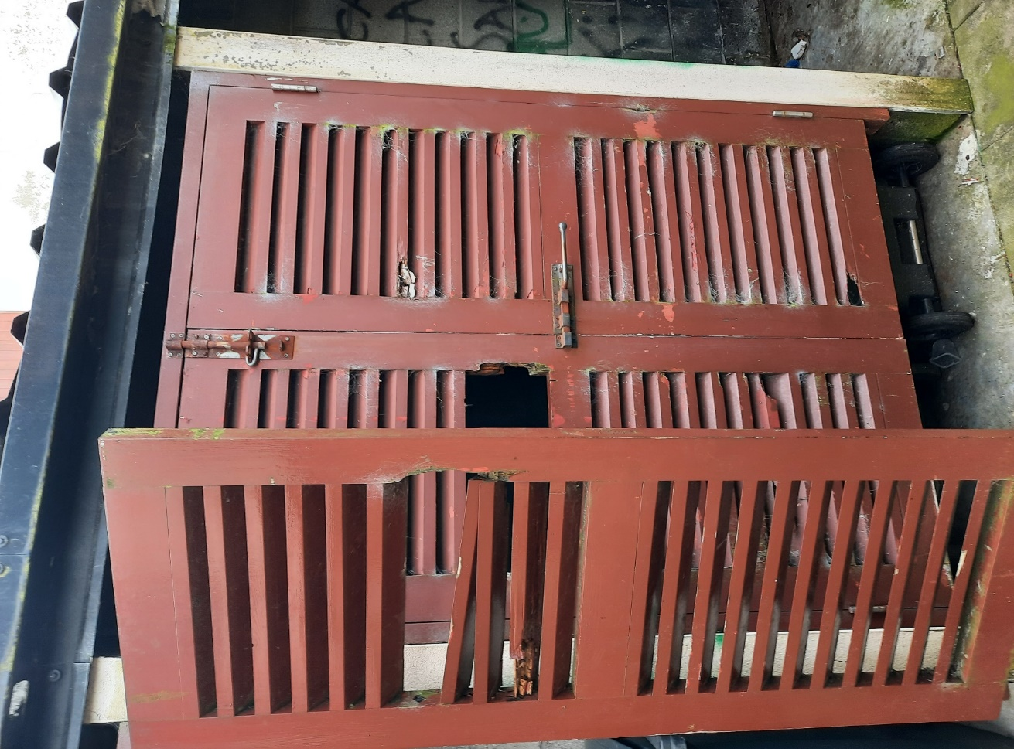
-
Balgaddy Advanced Maintenance Works
Roof repairs and associated works to be carried out above the Child and Family Centre
Completion of meter cover upgrade
Continued upgrade of bin storage areas
2
4

Slide 9
Estate Management Initiatives
Community Safety Officers and Housing Officer assigned to the Balgaddy area. Following up on a number of complaints, intimidation and drug dealing in the wider Balgaddy estate. Actions available to the Council and the Gardaí are being taken.
Quarterly meetings with Community Development Team to share information
Estate Management represented on the Balgaddy Action Group and Higher Level Working group – meetings take place quarterly.
Estate management and Housing Maintenance are currently liaising with residents regarding planned works to be carried out in Tor an Rí.
Joint housing maintenance and Estate Management approach agreed and commenced to monitor communal areas to ensure items do not accumulate. Records will be kept and notification/warning letters to issue as appropriate.
Anti-Social Team following up on issues regarding vacant dwellings in Tor an Ri.
Meetings have taken place with Senior Gardaí to examine ways to contact Anti-social behaviour in the estate.
Garda / Estate Management weekly clinic takes place Thursday mornings in the Bush Centre, plans to relocate to the community centre.

Slide 10
Estate Management Initiatives Contd.
A Day of Action to take place – further discussion with An Garda Síochána required, as well as internal departments.
SDCC will carry out a Tenancy Audit in Balgaddy in March/April.
An Garda Siochána plan to carry out a door to door exercise on all homes in the Balgaddy area to advise local people to contact the Gardai with any issues and to provide information on local services.
School talks to be delivered by Council staff and the Gardai – dates and times to be agreed.
Easter fun days being planned in the area, which the Estate Management team will support.

Slide 11
Balgaddy Higher Level Working Group
New Independent Chair Liam Casey (Former Inspector Ronanstown Garda Station)
DLETB and Partnership representative appointed. Nominations sought for Tusla - awaiting response.
4 meetings took place in 2024, and 1 meeting to date in 2025.
Updates
Construction works on the Balgaddy Community Centre continues, with expected opening in October 2025. The Community Section have established a new Regional Board of Management to manage the operations of the Balgaddy, Neilstown and Rowlagh Community Centres, all of which has received broad community approval. It was agreed to look at the possibility of organising a tour of the new community centre and to hold meetings in the Balgaddy area twice per annum
SDCC Allocations Support Team to carry out tenancy checks in the area in March / April 2024.
An Garda Siochána to carry out a door knocking exercise to all homes in Balgaddy.
The group are working on an information package of the local services and activities in the area, the Gardaí will hand these out as they call to doors.
ETB and Crosscare to identify potential funding for early intervention workers and extra youth workers for Balgaddy area specifically.

Slide 12
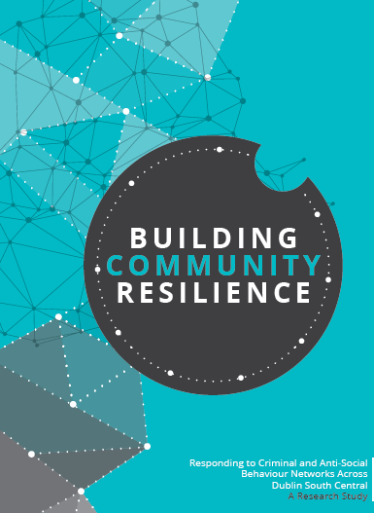
Balgaddy Working Group
The Balgaddy working Group was established to implement the recommendations outlined in the Community Crime Impact assessment undertaken in March 2021. Group meets on a quarterly basis. The membership consists of:
Estate Management and Community Development Teams from SDCC
An Garda Siochana (Ronanstown)
North Clondalkin Community Development Programme
Co- Ordinator from Clondalkin Drugs Task Force
Ronanstown Crosscare
Chair of Local Policing Forum
DDETB
Tusla (awaiting response and nomination)
South Dublin Partnership
Meeting Dates for 2025
20th February 2025
13th May 2025
9th September 2025
9th December 2025

