Slide 1
Social Housing Delivery
Tallaght Area Committee Meeting 24th February 2025

Slide 2
2024
Notes:
Housing for All Delivery Pipeline 2024
No alt text provided
No. of Potential Units Per LEA
No alt text provided
textbox
No alt text provided
Potential Units
No alt text provided
image
No alt text provided

Slide 3
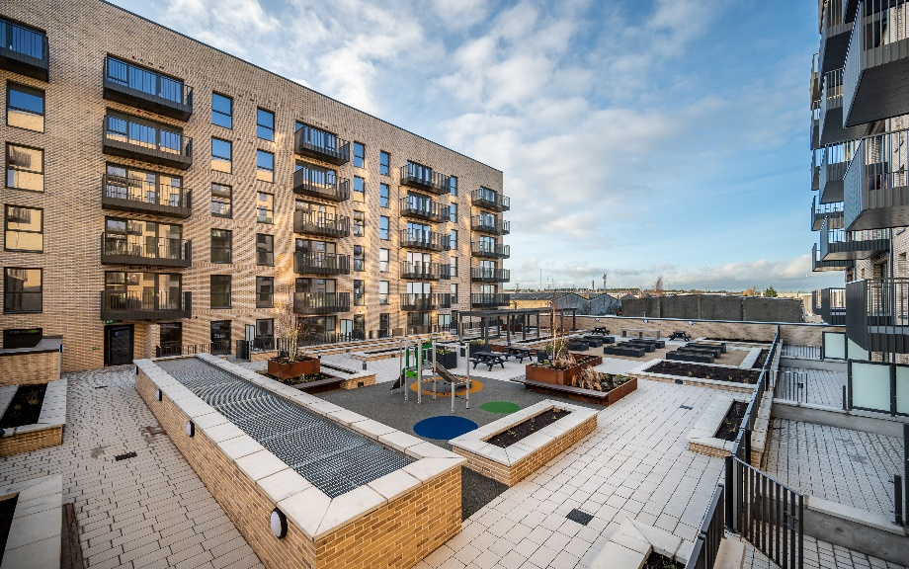
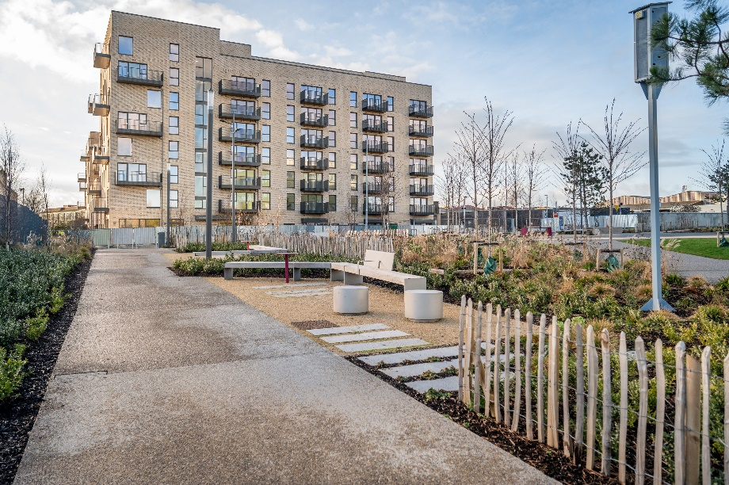
Large Development Sites
Killinarden Foothills: 620 homes (including 125 social , 123 Private & 372 affordable purchase)
Enabling works commenced in December 2024. Delivery of first homes in Phase 1 expected mid 2026.
Belgard Square North: 133 cost rental apartments
Contractor commenced on site April 2023. Substantial completion of units achieved in January 2025. Final snagging underway prior to handover.
Innovation Square,
Belgard Square North
Innovation Square,
Belgard Square North

Slide 4
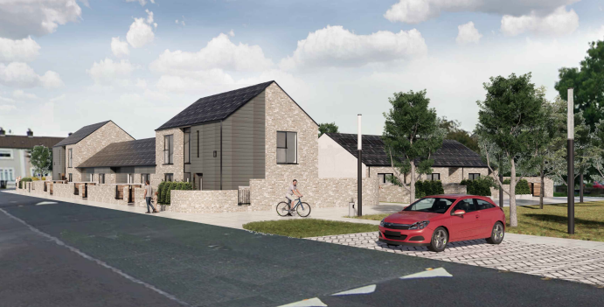
Own Build Developments
LEA | Project | Units | Status
Tallaght South | Rossfield | 16 | Enabling works commenced December 2024
Tallaght Central | St Aongus Green (Age-Friendly) | 12 | Construction commenced August 2024 – 50 week programme
St Aongus Green

Slide 5
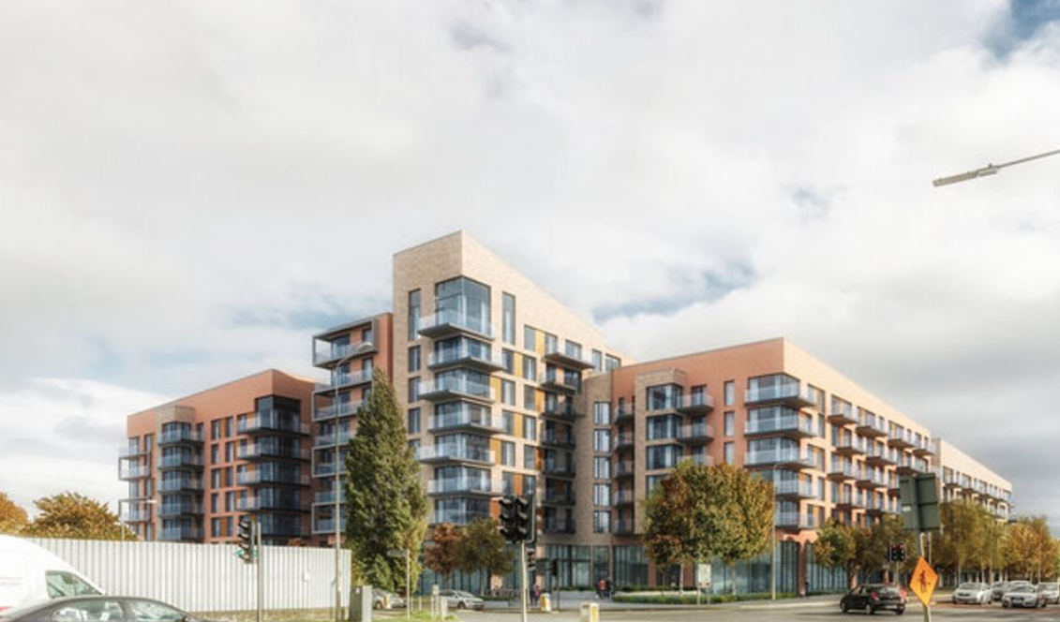
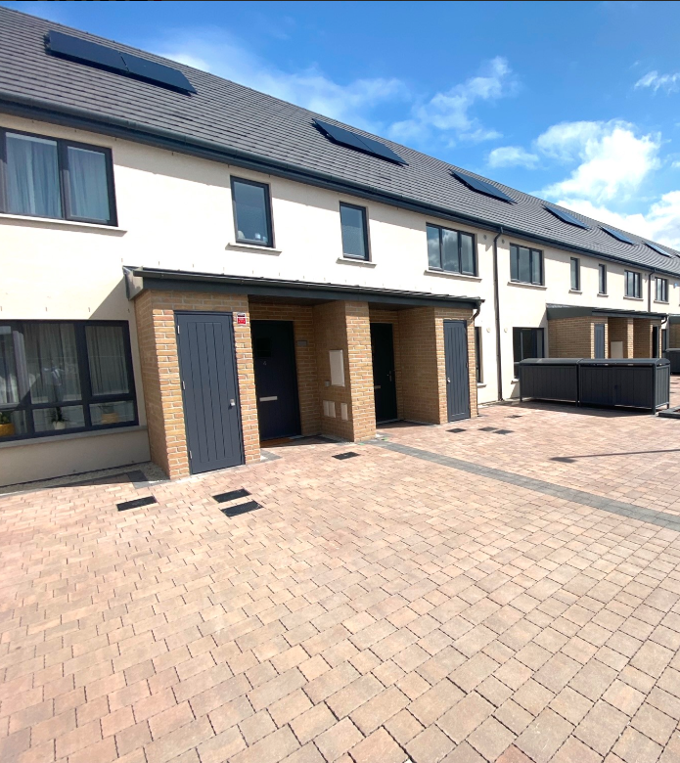
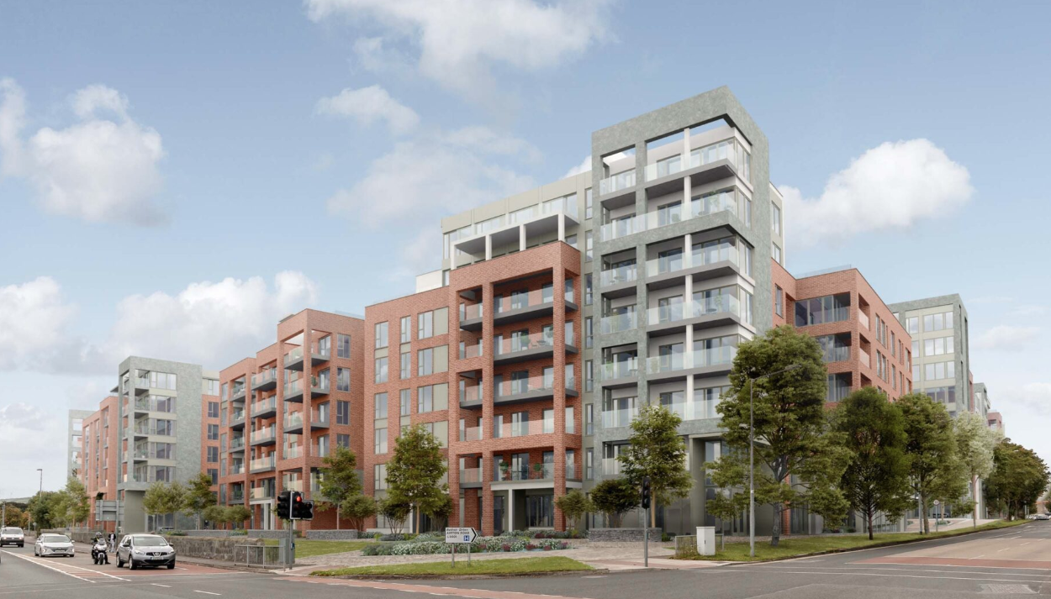
Approved Housing Bodies – Social Housing Investment Programme
LEA | Project | Units | Status
Tallaght South | Cuil Duin, Citywest Tuath Housing | 36 | Complete – delivered June 2024
 | Foxwood Barn, Citywest Tuath Housing | 69 | Complete – delivered December 2024
 | Foxwood Barn, Citywest Tuath Housing | 39 | On-site – due to deliver Q4.2025
 | Carrigmore Woods, Citywest. Tuath Housing | 137 | On-site – phased delivery from Q3.2025
Tallaght Central | Airton Plaza, Belgard Road Cluid Housing | 98 | Complete – delivered December 2024
 | Airton Rise, Greenhills Road. Respond Housing | 213 | On-site – phased delivery from Q3.2025
Airton Plaza
Foxwood Barn,
Citywest
Airton Rise, Greenhills Road

Slide 6
Overview
EXPRESSIONS OF INTEREST 2022- 2025
Notes:
textbox
No alt text provided
image
No alt text provided
Number of EOIs By Status
No alt text provided
Number of EOIs by LEA
No alt text provided
Total Number of EOIs
No alt text provided

Slide 7
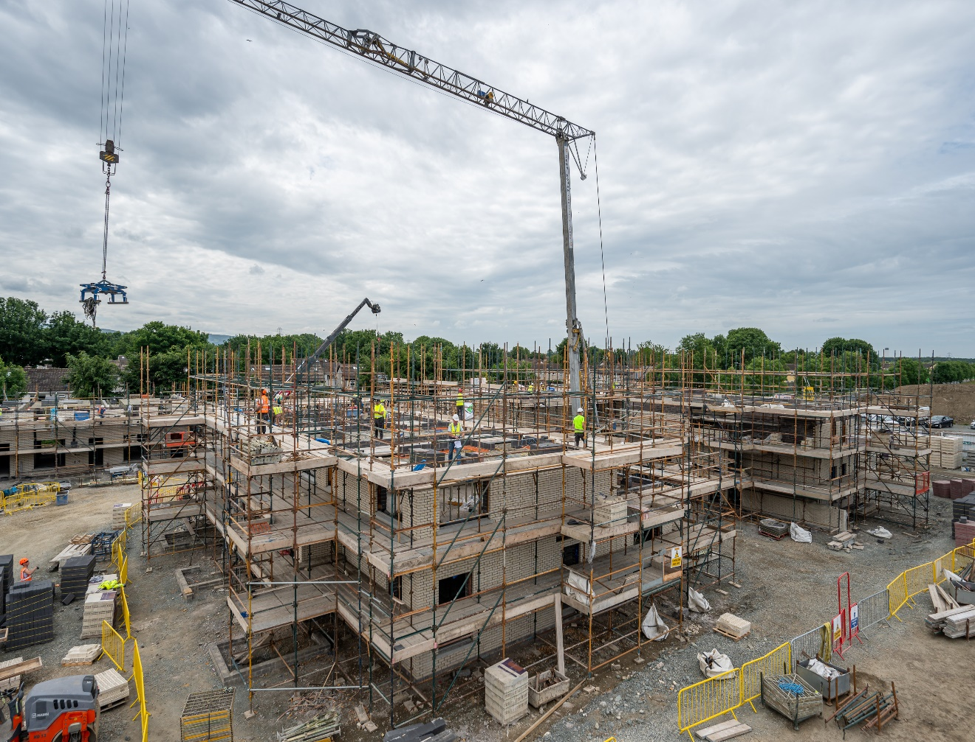
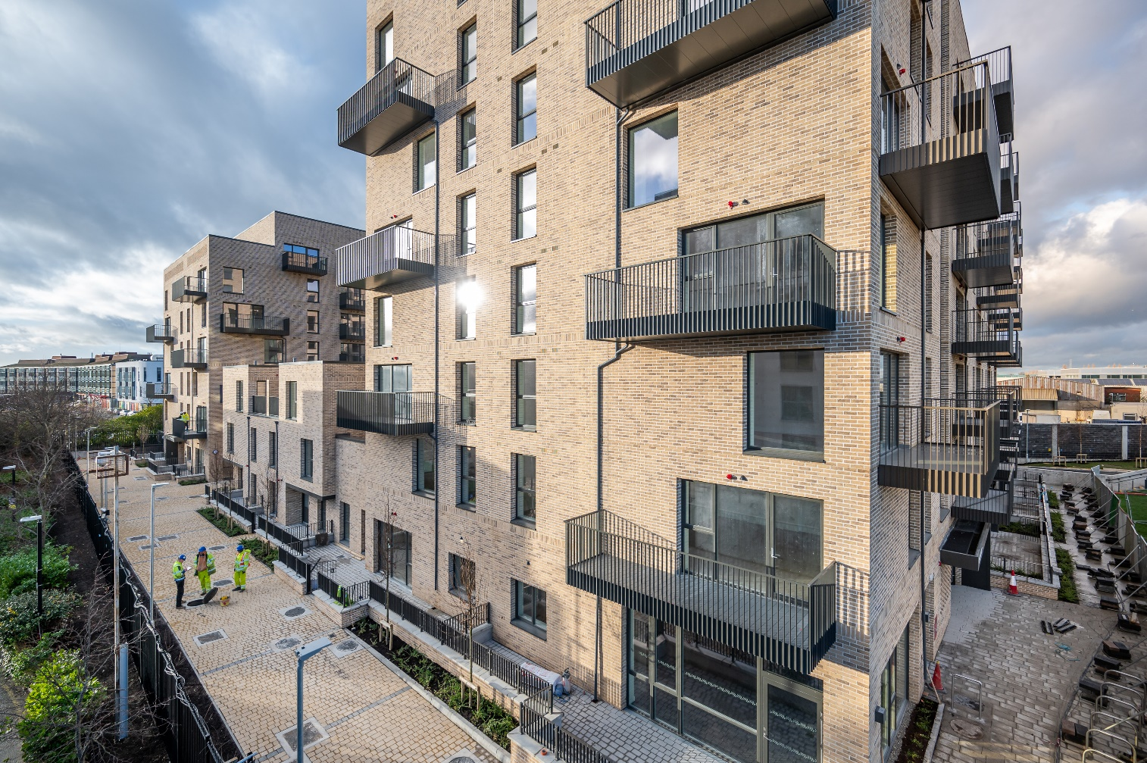
HOUSING DELIVERY 2025 – TARGETS
Programme |  | Target Units
Housing Delivery Action Plan | Social Housing Delivery Target 2025 | 772
 | Affordable & Cost Rental Delivery Target 2025 | 278
Annual Service Delivery Plan 2025 | South Dublin Own Build Homes 2025 | 138
 | Acquisitions Programme 2025 | 80

