Slide 1
Social Housing Delivery
Clondalkin Newcastle Rathcoole Saggart ACM
19th February 2025

Slide 3
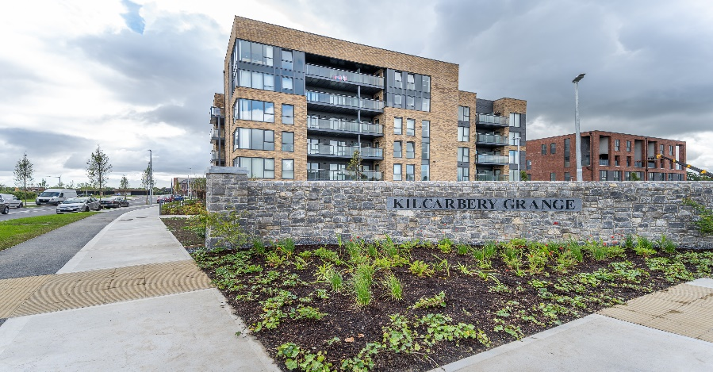
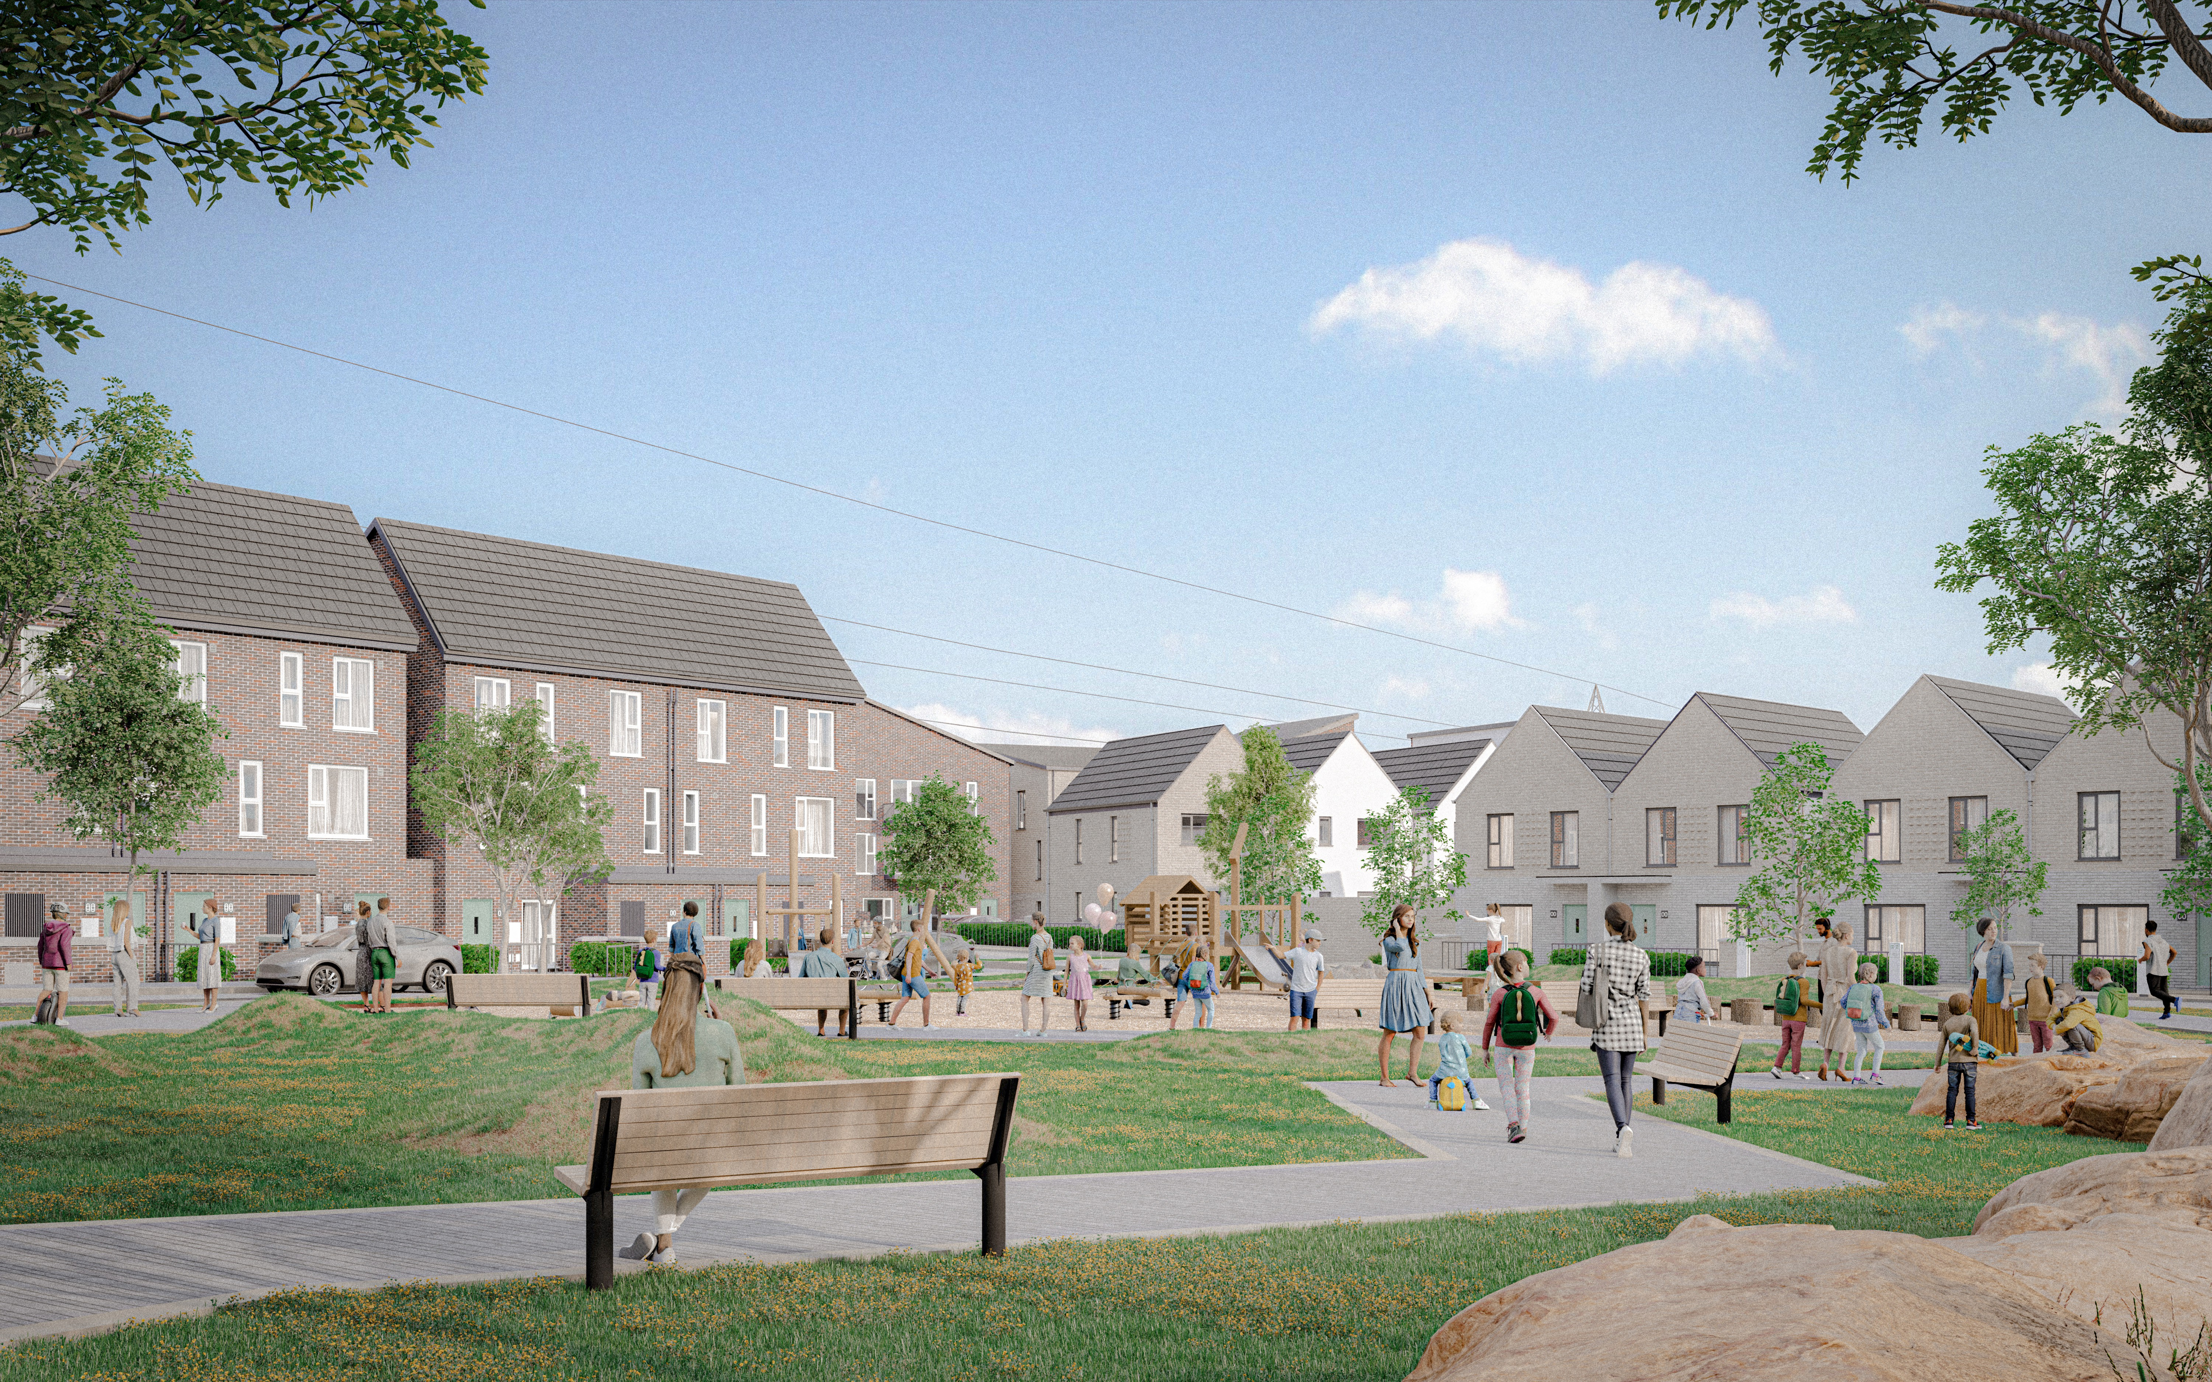
Large Development Sites
Kilcarbery Grange: 1,034 homes with 30% social (310 homes)
Phases 1, 2 and 3 of this project are now complete, with delivery of 263 social homes to date. Construction on phase 4 well advanced and will complete in mid 2025.
Clonburris: Phases 1 & 2 comprising 382 homes (149 social), Phases 3,4,5 with potential for 1,275 homes
Construction at Phase 2 – Canal Extension is advanced and on programme to complete by November 2025. The tender process for construction of 266 social, affordable, and cost rental homes at Phase 1 – Kishogue, closed on the 22nd November 2024. Tender assessment is complete with contract award imminent. Anticipated on-site date in Q1 2025. Following presentation to the Council in November 2024, plans for approximately 1275 social and affordable homes at phases 3, 4 and 5 will shortly be submitted to An Bord Pleanála under a Part 10 planning application.
Rathcoole: Number of homes & tenure mix to be confirmed
Tender assessment underway for Architect led design team to progress the masterplan through to Part 10 planning application to An Bord Pleanála.
Kilcarbery Grange, Clondalkin
Clonburris – Stage 3 - 5

Slide 4
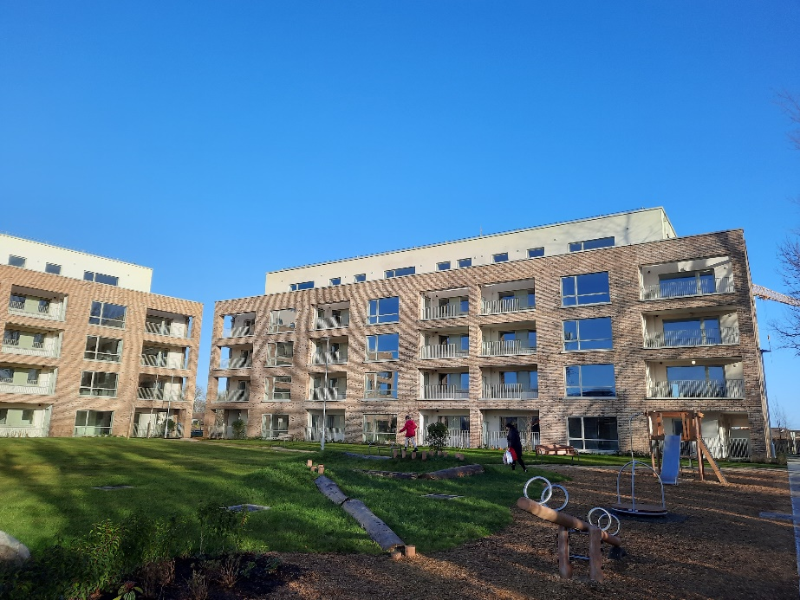
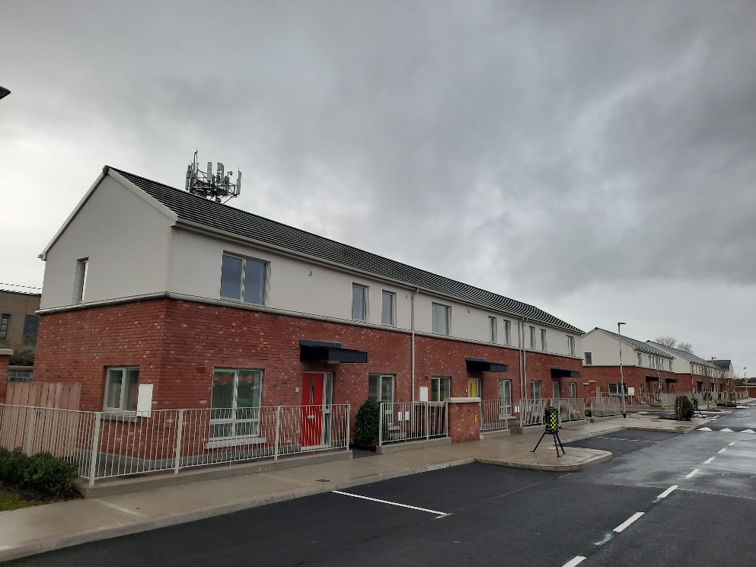
Own Build Developments
LEA | Project | Units | Status
Clondalkin | Old Nangor Road (Eircom) | 93 | Completed December 2024. Tenanting commenced
 | Lindisfarne | 19 | Substantially complete December 2024.
 | Canal Bank Extension | 56 | On-site – phased delivery from November 2025. Mixed Tenure Scheme – 60 Affordable Purchase units
 | Kilcarbery Grange | 47 | On-site – 263 delivered to date. Balance to be delivered by mid 2025
 | St Ronan’s Crescent (Age-Friendly) | 9 | Contractor appointed. Awaiting start date.
 | Alpine Heights (Age-Friendly) | 13 | Enabling works commenced December 2024
 | Deansrath – Melrose | 27 | Enabling works commenced December 2024
 | Kilcarbery School Site | 18 | Construction commenced on site in December 2024, Includes 70 affordable purchase homes.
Old Nangor Road,
Clondalkin
Old Nangor Road,
Clondalkin

Slide 5
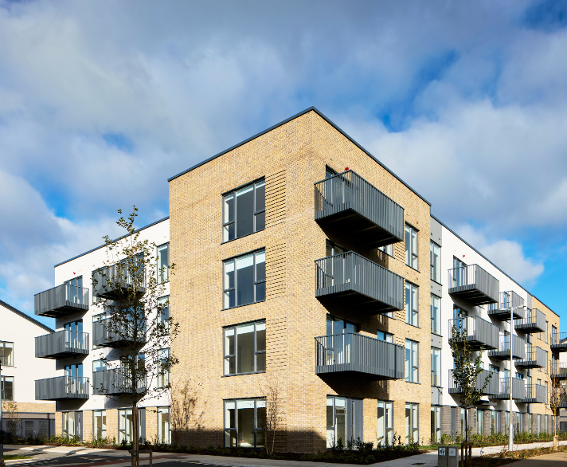
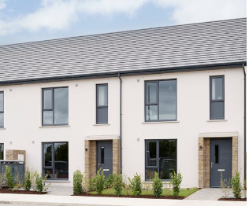
Approved Housing Bodies – Part V Delivery
LEA | Project | Units | Status
Clondalkin | Parklands, Citywest Tuath Housing | 23 | Complete – delivered October 2024
 | Parsons Court, Newcastle. CHI | 8 | On-site – completion Q1.2025
 | Seven Mills, Clondalkin Respond Housing | 172 | Complete – delivered December 2024
 | Graydon, Newcastle Tuath Housing | 24 | Complete – delivered December 2024
 | Gordon Park Part V | 1 | On-site – Completion Q3.2025. Part V agreed.
 | Keepers Lock Part V | 26 | On-site. Completion Q4.2025/Q1.2026. Additional 25 PV Affordable Purchase units. Part V negotiations ongoing
 | Main Street, Saggart Part V | 3 | On-site. Completion Q4.2025. Part V negotiations ongoing.
 | St John’s Road, Clondalkin Part V | 5 | On-site. Completion Q3.2025. Part V negotiations ongoing.
Seven Mills, Clondalkin
Seven Mills, Clondalkin

Slide 6
EXPRESSIONS OF INTEREST 2022- 2025

Slide 7
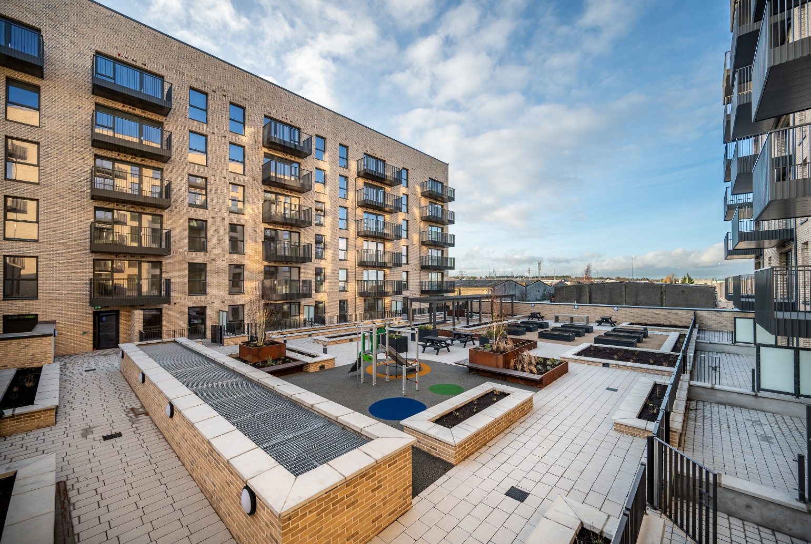
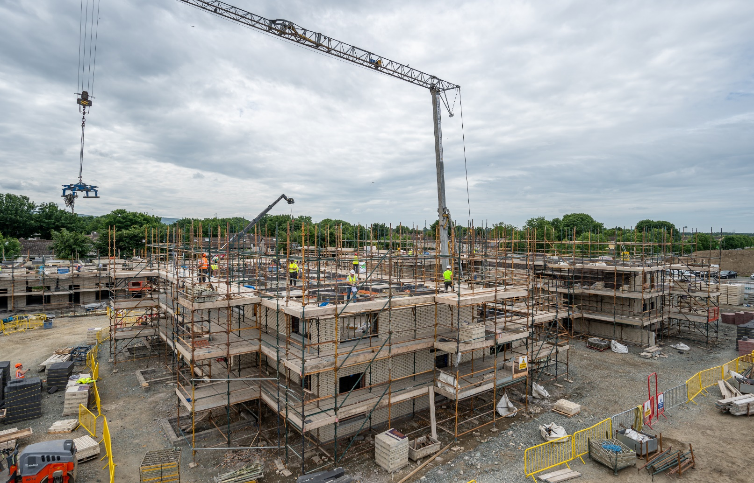
HOUSING DELIVERY 2025 – TARGETS
Programme |  | Target Units
Housing Delivery Action Plan | Social Housing Delivery Target 2025 | 772
 | Affordable & Cost Rental Delivery Target 2025 | 278
Annual Service Delivery Plan 2025 | South Dublin Own Build Homes 2025 | 138
 | Acquisitions Programme 2025 | 80

