Slide 1
South Dublin County Council
Evening-Time Economy EvenEvening Time Economy
February 2025

Slide 2
Context
Tallaght Town Centre Local Area Plan (11,000 homes/15,000 jobs)
Significant Investment in Public Infrastructure
Vacancy Rates
Multi-Cultural Society
Opportunities
Vibrancy & Vitality of Town Centre
Greater Collaboration Between Relevant Agencies
Local Economy & Job Creation
Parthalán Place

Slide 3
Study Area

Slide 4
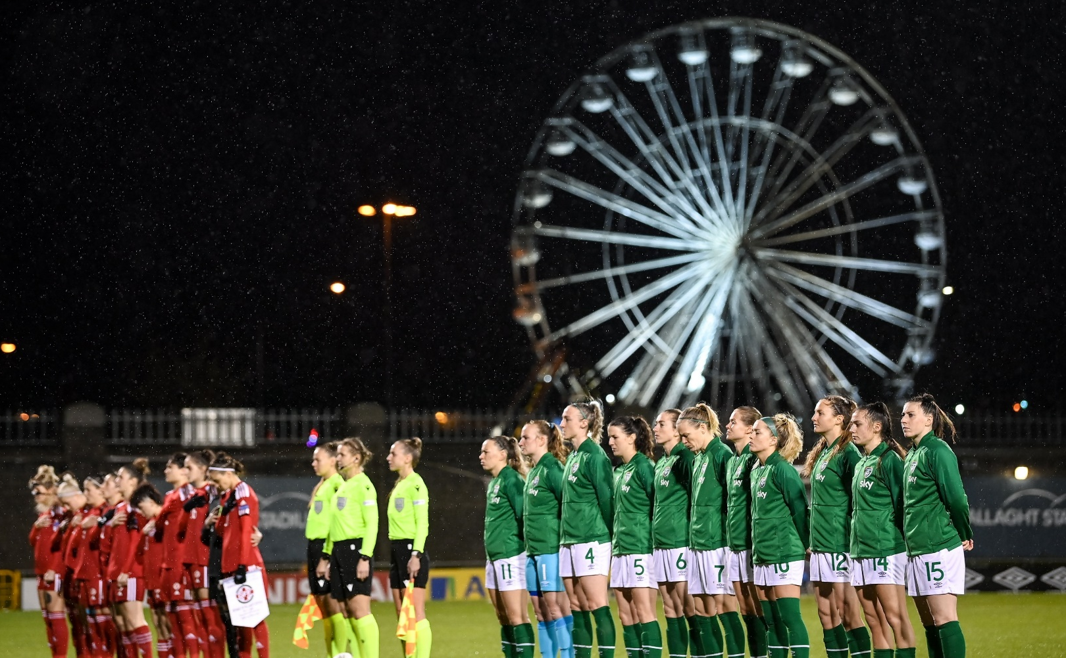
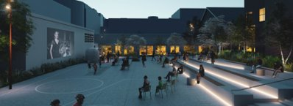
Project Scope & Initial Steps
Research & Analysis
Stakeholder Engagement: Local Businesses & Community Groups
Community Survey
Tallaght’s Current Offering
Case Studies: Benchmark for Success
Analysis of Tallaght
Recommendations & Implementation Roadmap

Slide 5
Consultation & Engagement
Qualitative Engagement: Local Businesses, South Dublin Chamber, Rua Red, Civic Theatre, Shamrock Rovers, South Dublin Volunteer Centre, An Garda Síochána, Citywise, SDCC Depts & Others
Community survey with 845 responses:
82.4% of those surveyed were residents of Tallaght
Perception of Safety: Over 50% of respondents do not feel safe in Tallaght Town Centre in the evening
Atmosphere: Over 60% believe Tallaght Town Centre does not have a vibrant atmosphere
Attractions & Activities: Almost 70% feel Tallaght lacks exciting attractions and activities
Key Takeaways: Perception of Safety
Atmosphere & Vibrancy
Targeted Improvements to Enhance Town Centre’s Appeal & Visitor Experience

Slide 6
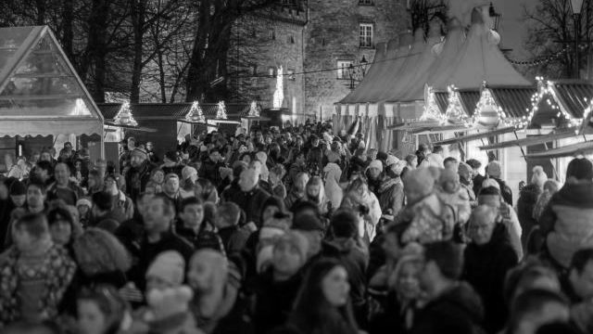
Best Practice Case Studies
Key Insights
Target Audiences: Tailored Offerings
Transport Connectivity: Leverage Transport Links
Night-Time Economy: Dedicated Development Officer
Promotion & Marketing
Cultural & Public Realm Investment
Landmark Festivals
Reducing Vacancy: Revitalise Underused Spaces
Supporting Local Creativity & SMEs: Encouraging Evening Economy Activity
Coordinated Approach: Key Stakeholder Collaboration
Kilkenny
Blackburn
Drogheda
Parramatta

Slide 7
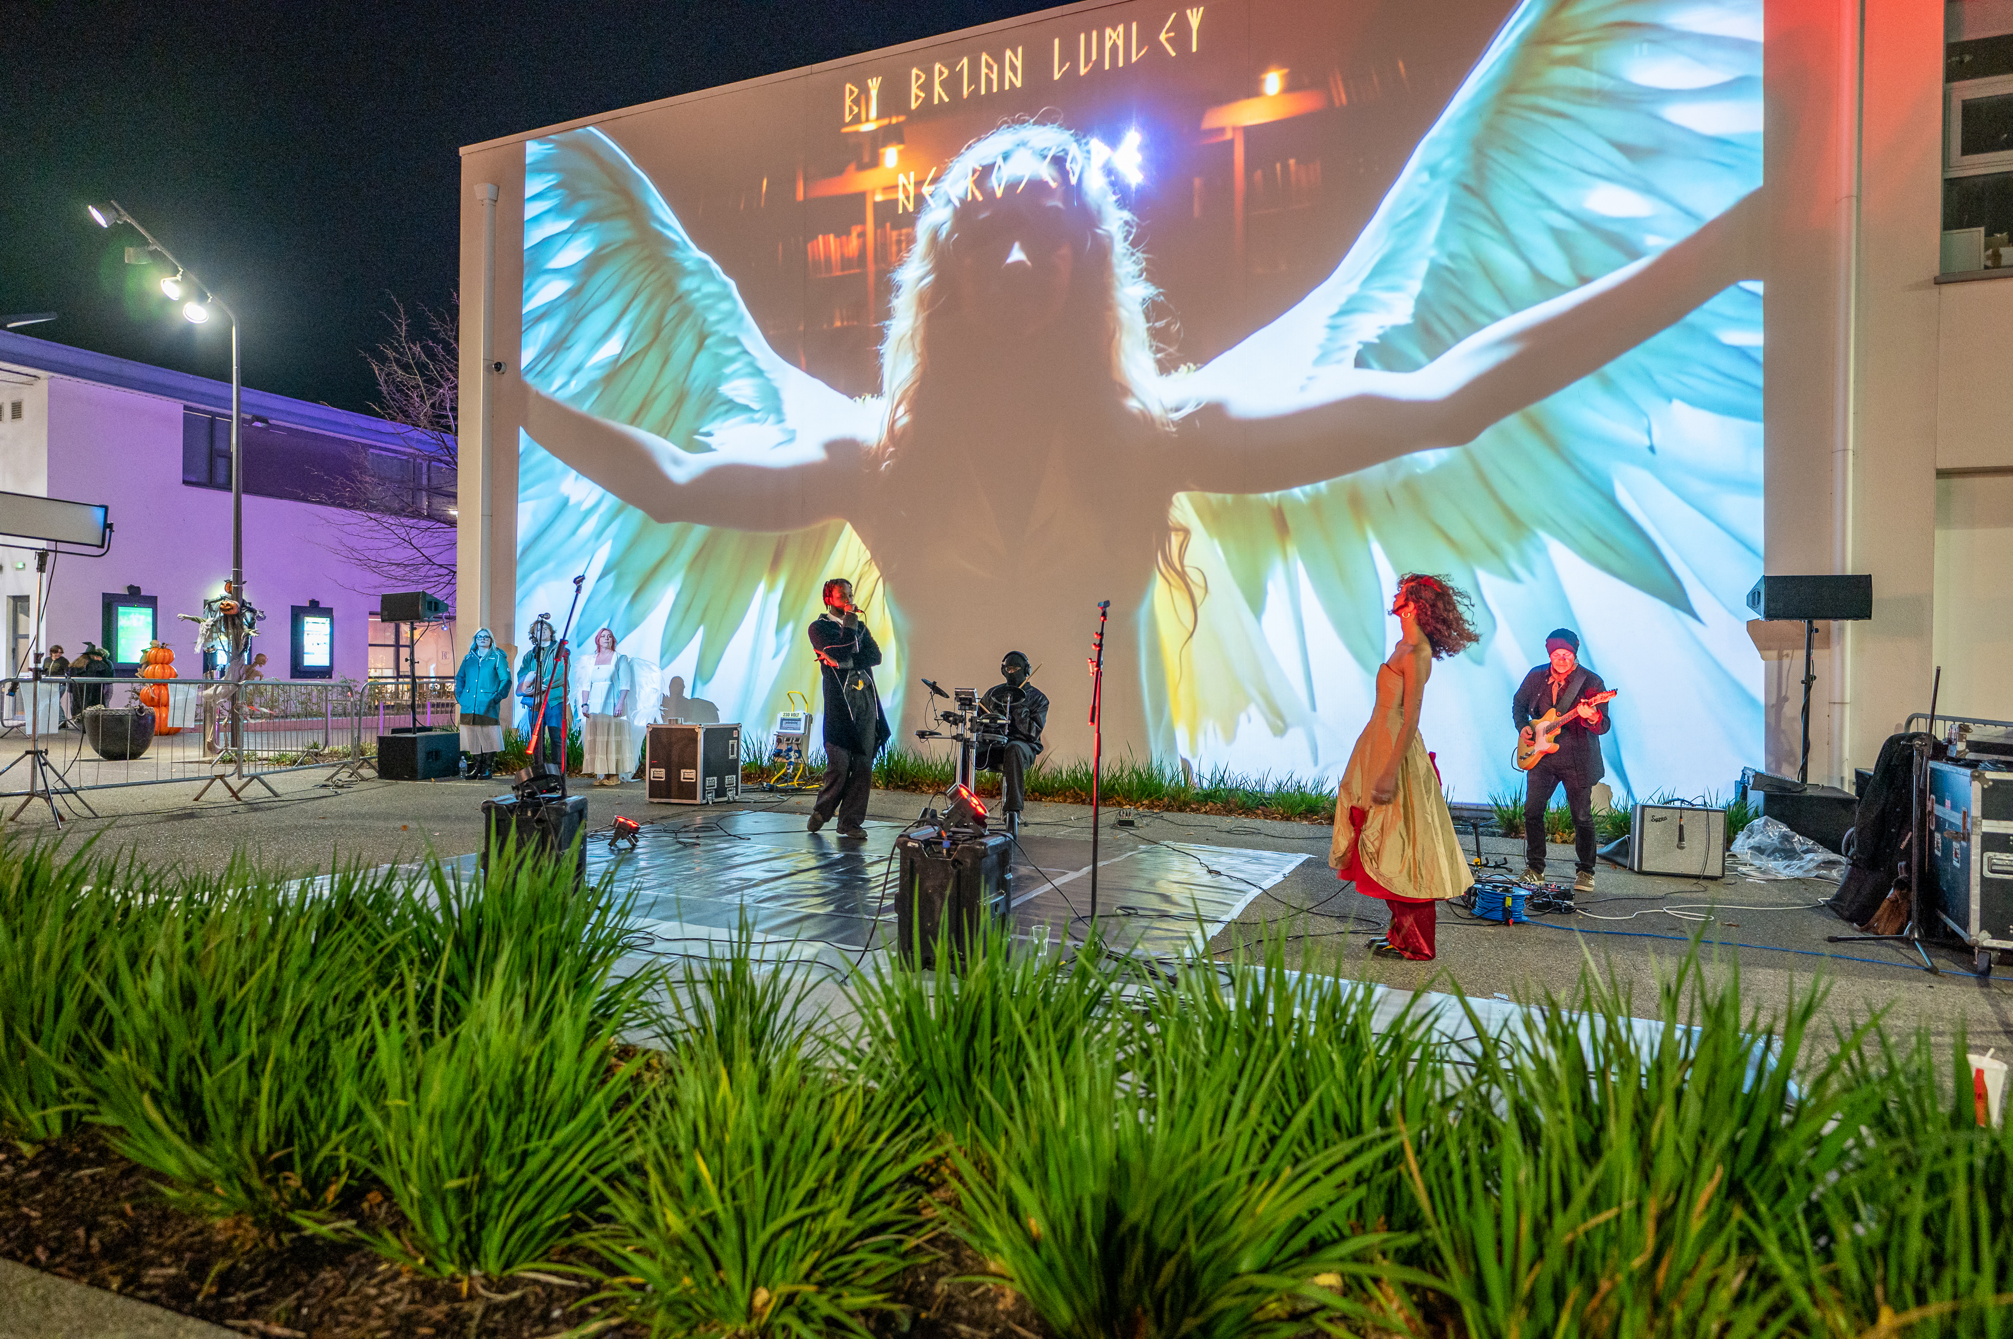
Flagship Initiatives
Enhanced Public Realm
Explore Extended Public Realm at Parthalán Place to Enhance Family-friendly Activities
2. Mixed-Use Cultural Hub
Explore the Potential For Vibrant Cultural Hub combining Arts, Events & Hospitality Uses
3. Evening Time Economy Grant Scheme
Funding Support for Businesses, Venues & Cultural Groups
4. Revitalise Tallaght Village
Support Local Businesses, Public Realm Enhancement & Hosting of Events
5. Landmark Festival (i.e. “Tallaween”)
Establish Annual Signature Event

Slide 8
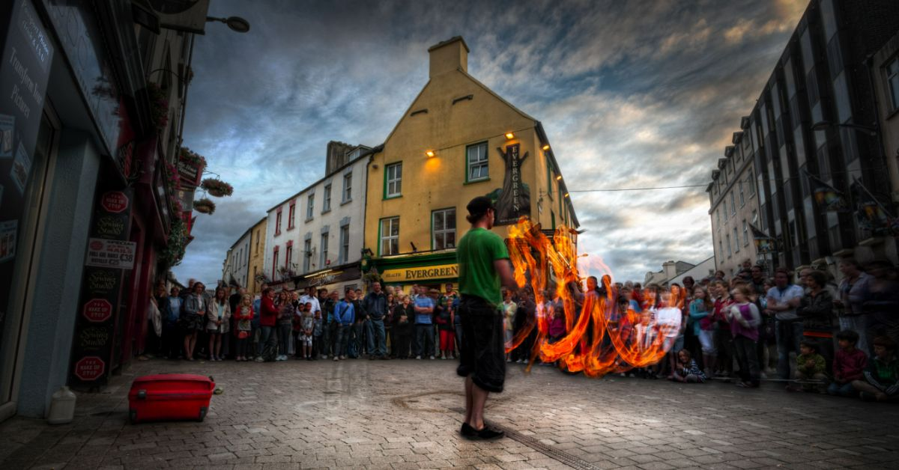
Other Actions
Rates Grant Scheme
Evening Time Economy Officer
High Quality Casual Trading
Communications & Marketing Strategy
Annual Programme of Events
Proactive Approach to Addressing Commercial Vacancy
Artist Studios Development
Enhanced Connections to Parthalán Place

Slide 9
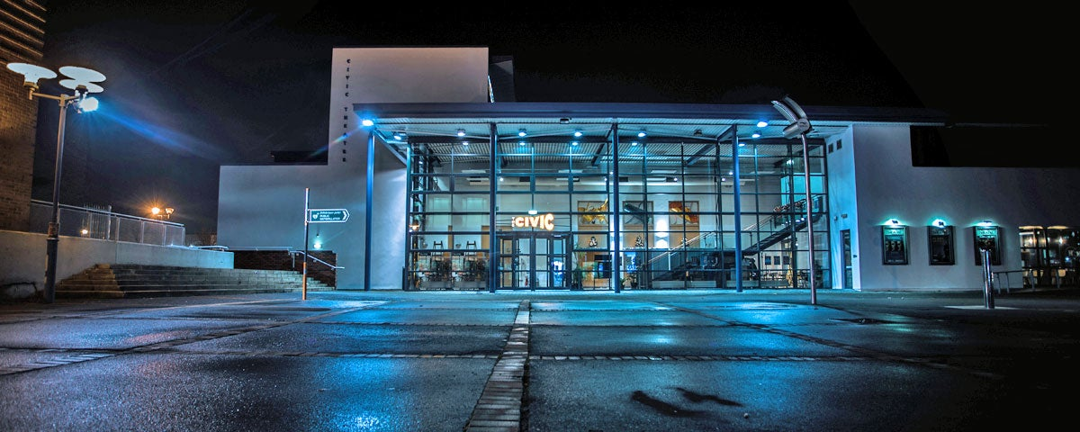
Next Steps
Feedback & Finalise Plan
Targeted Work Programme
- Expand Business Support Fund
- Rates Grant Scheme
- Collaborative Cultural Programming
- Mixed Use Cultural Hub
- Marketing & Communication

Slide 10
Thank You

