Slide 1

South Dublin County Council
Outdoor Advertising Strategy
February 2025

Slide 2

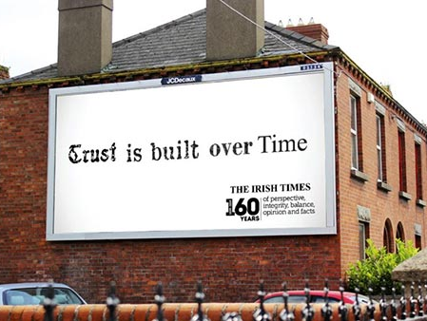
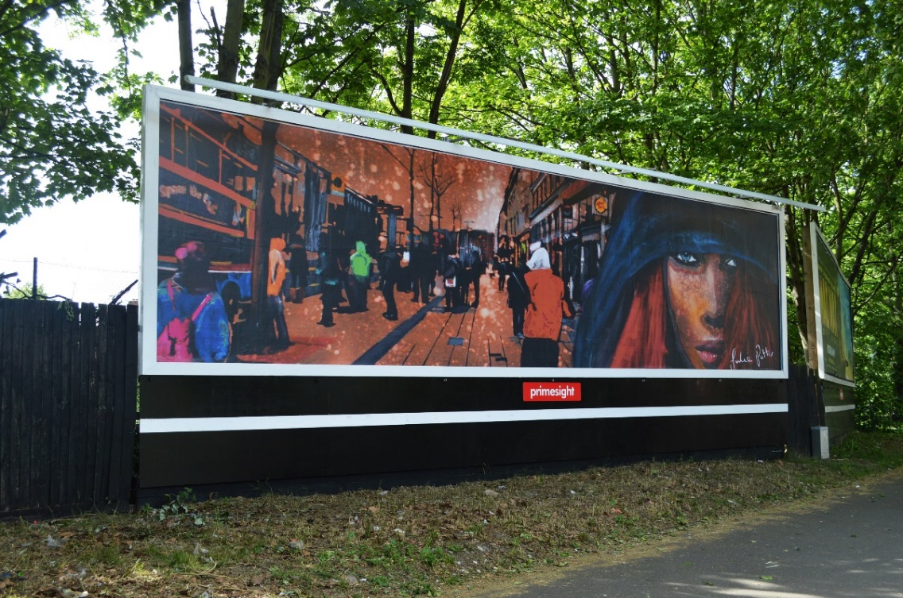
Outdoor Advertising: Background & Context

Slide 3
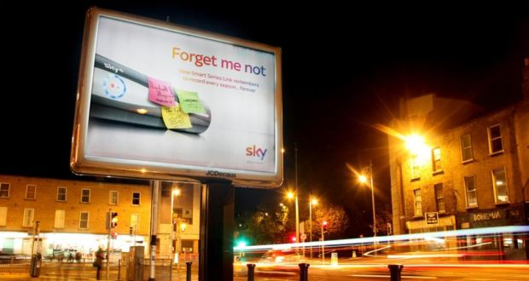
Outdoor Advertising Public Amenity Contracts:
Local Authority Example
Dublin City Council
Proactive Approach to Public Realm Enhancement
Coordinated Management of Advertising Structures
2005 Tender:
170 Panels: €101.68m
120 Panels: €83.55m

Slide 4
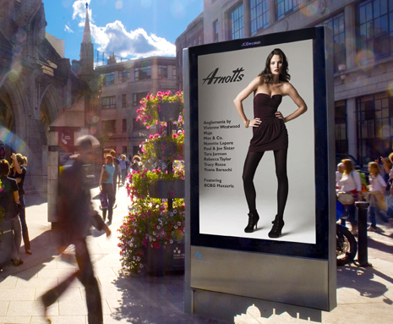
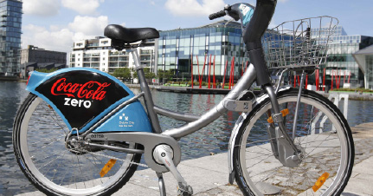
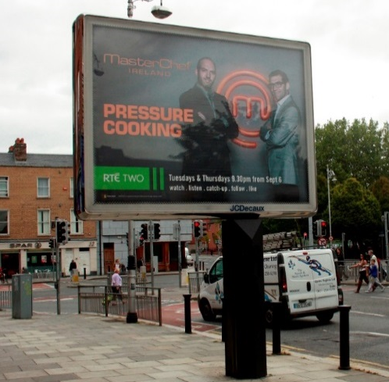
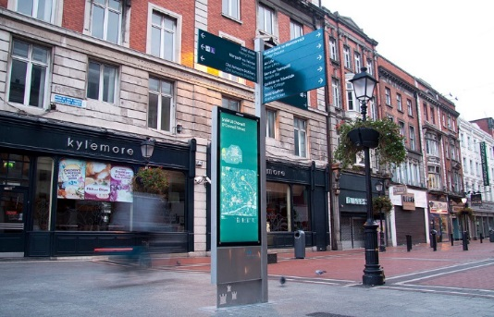
Dublin City Council Public Amenities Contract
Dublin City Council – Pubic Amenities Contract (15 years duration)
Planning permission for 72 Advertisement Panels at a value of €54.36m

Slide 5
Outdoor Advertising: Current Formats
Digital Structures

Slide 6
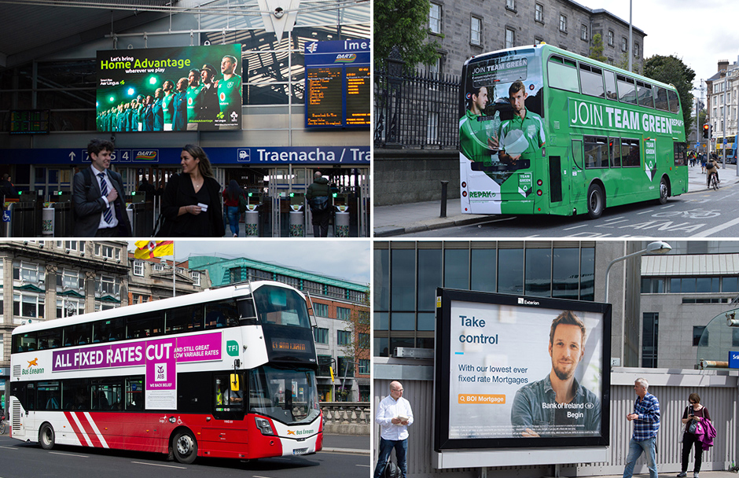
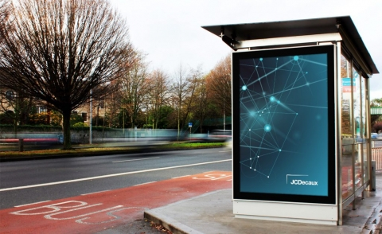
Outdoor Advertising: Other Contract Types
CIE Outdoor Advertising Contract
Awarded to Global Media & Entertainment
5 Year Contract
NTA Bus Shelter Advertising Contract
Awarded to Clear Channel
5 Year Contract

Slide 7
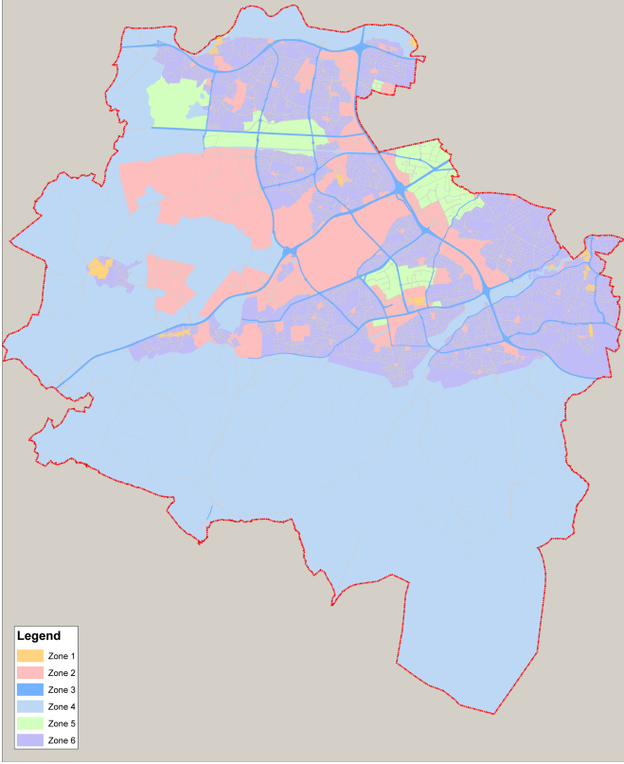
South Dublin County Council
Variation No.5 CDP 2016 - 2022
Updated Modern Policy Position
Set Design Standards For Advertising
Declutter Public Realm
Bartering System
Zones of Advertising Controls
Communication Platform For SDCC
Zones of Control

Slide 8
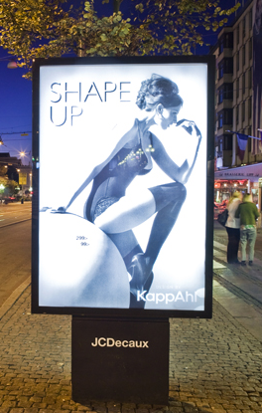
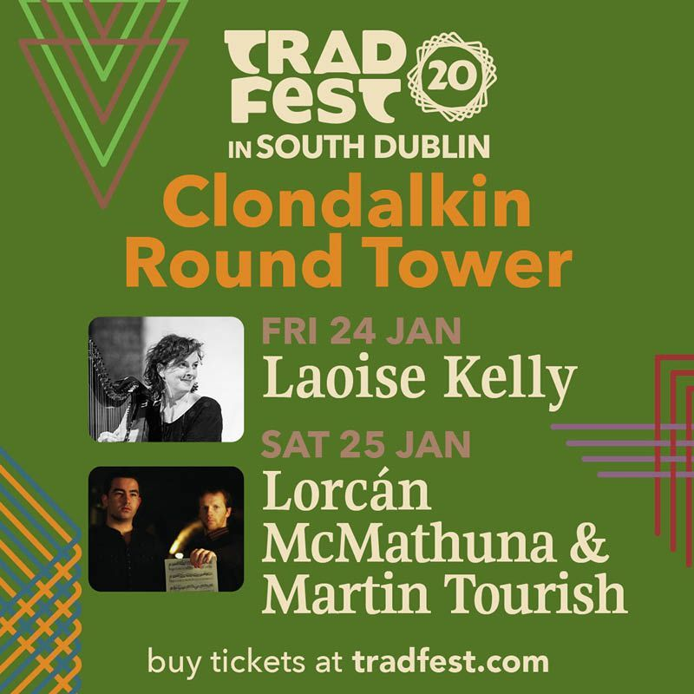
South Dublin County Council
Opportunities & Benefits
Establish SDCC Communication Network
Community Engagement
Enhanced Service Delivery
Revenue Stream & Efficient Asset Management
Real Time Information
Enhanced Reputation
Brand Development

Slide 9
Next Steps
Indicative Timeline
Publish Tender
Secure Partner
Scheme Design
& Part 8
Construction & Operation
March 2025
June 2025
Q4 2025
Q1 2026

