Slide 1
SAFE SCHOOL ZONES
Clondalkin ACM FEBRuary 2025

Slide 2
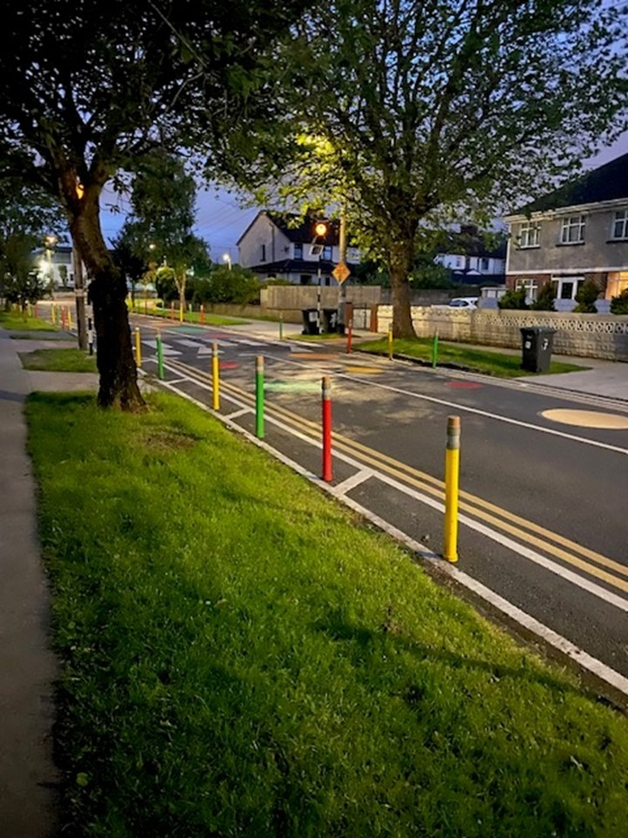
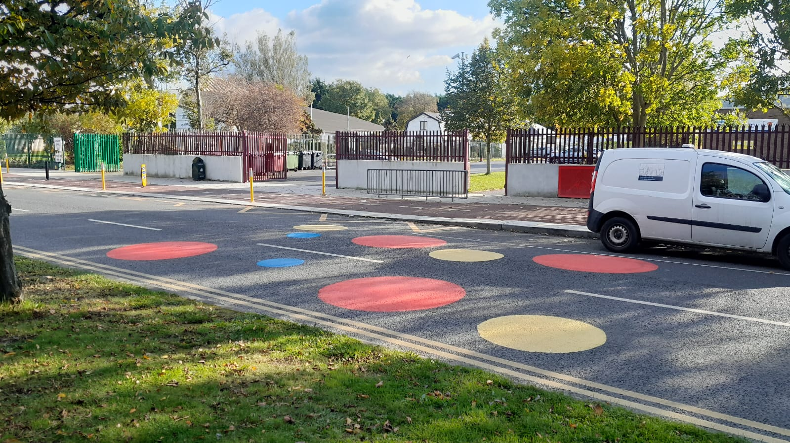
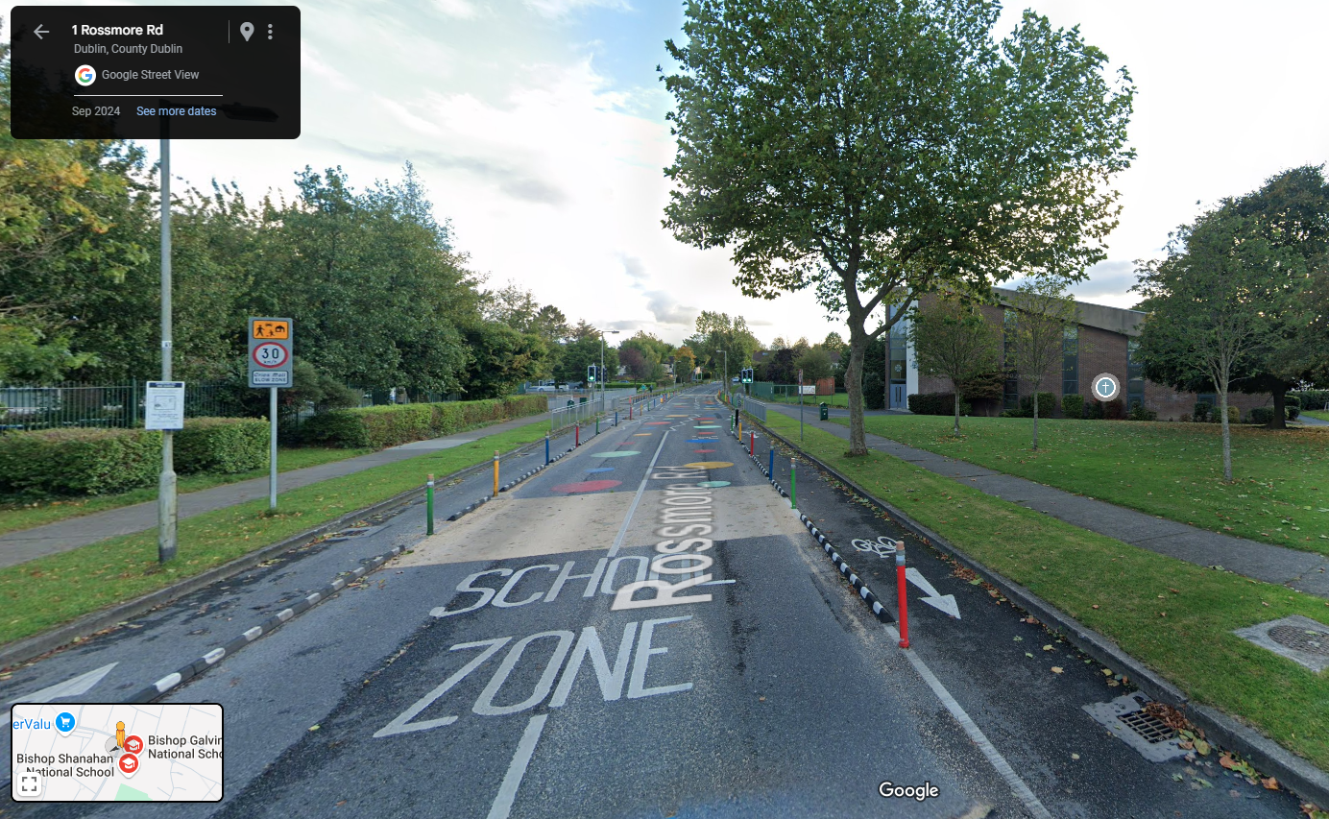
Safe Routes to Schools
The Safe Routes to School (SRTS) Programme was developed by the NTA and Green-Schools, An Taisce, in 2020, as a response to the need to support schools to increase walking and cycling to school.
SDCC have completed works to 12 schools since then, over two rounds of funding, with designs for 3 at a detailed stage and 5 more to commence in 2025.
The works included in the SRTS programme can include large scale intervention such as junction tightening and new footpaths as well as bollards, road markings, pedestrian crossings and signage.
Clockwise from Top Left: Bishop Galvin, Templeogue; Sacred Heart Killinarden, Road Markings and coloured roundels

Slide 3
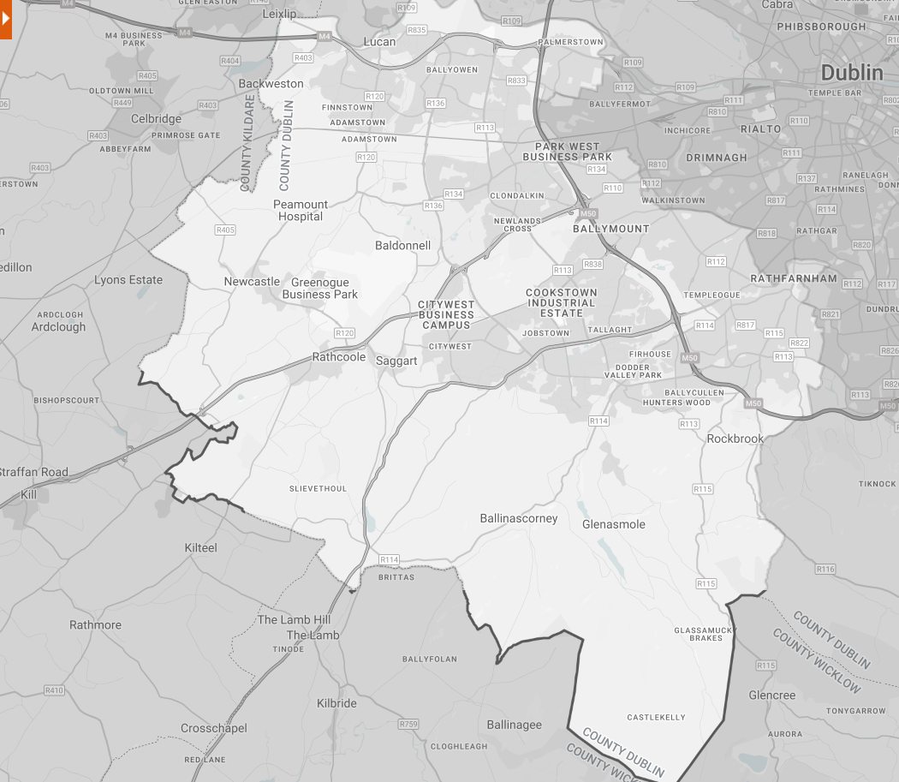
1
Safe Routes to Schools
2
Round 3 of the SRTS programme:
St. Thomas’ JNS Lucan – Esker, Lucan
Scoil Áine Naofa – Esker, Lucan
Sacred Heart SNS – 13 Whitestown Dr, Tallaght Business Park, Dublin 24
Scoil Naomh Aine – New Rd, Brideswell Commons, Dublin 22
St. Colmcille’s SNS – Idrone Avenue, Knocklyon, Dublin 16
Glenasmole National School – Bohernabreena
4
3
5
GRIFFEEN PARK
6
Round 1 Schools
Round 2 Schools
Round 3 Schools

Slide 4
School Schemes in SDCC
STAGE | PROGRAMME | FUNDING | SDCC SCHOOLS | CLONDALKIN-RATHCOOLE SCHOOLS
Completed | SRTS / AT | NTA | 22 | 2
Current | SRTS | NTA | 8 | 1
Future | SRTS | NTA | 17 | 1
Future | Active Travel | NTA | 11 | 0
Future | Safe School Zone | SDCC | 10 | 1
* All current and future schemes are subject to continued funding.

Slide 5
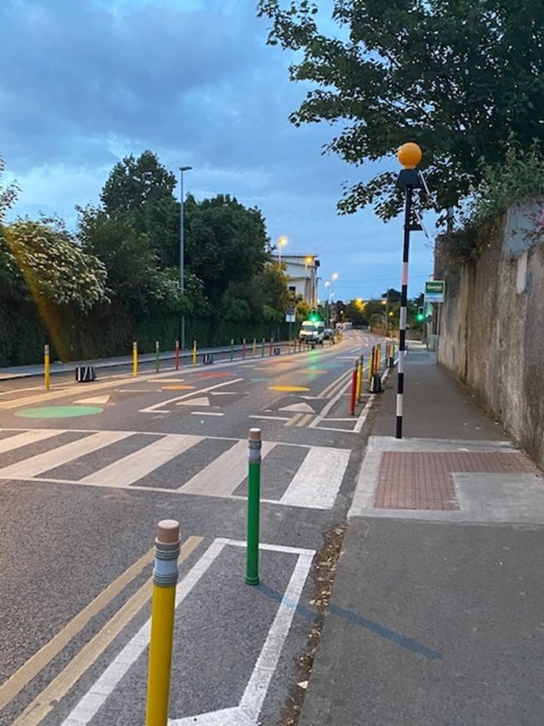
Safe School Zones
Many other schools in South Dublin have requested similar works to increase the safety of the drop off zones around entrances but cannot be accommodated on the SRTS programme.
Active Travel has compiled a list of such schools and a menu of options for smaller scale / lower cost interventions and will allocate funding to these schools when available. Where feasible these will be incorporated in adjacent Active Travel Schemes.
A set of suitability criteria for these works is being prepared and a budget and framework for these is in progress.

Slide 6
Safe School Zones
1
Suitability assessments will be carried out on the following schools;
1. St. Ronan’s NS

