Slide 1
SD24A/0187W Primary Care Centre Planning Application Material Contravention (reserved function)

Slide 2
For Consideration by South Dublin County Council (RESERVED FUNCTION)
To consider deciding to grant planning permission for a 4-storey Primary Care Centre building which will provide HSE Services such as general primary care, mental health, disability and older person services; The building will accommodate GP rooms, day care centre with associated kitchen facilities and external deck amenity space, pharmacy, treatment/consultation rooms, primary care administrative offices, as well as ancillary accommodation including staff facilities, offices, meeting rooms, reception/waiting areas, ESB substation and plant at lands at City West Campus, Garters Lane, Saggart.
Outcome
(a) 30 no. elected members of SDCC vote in favour of material contravention and planning permission is granted
OR
(b) Planning application is refused permission for the material contravention of the County Development Plan
Appeal to An Bord Pleanala - The developer or any third-party objectors may appeal the decision in the usual way to An Bord Pleanala

Slide 3
To Date
Pre-Planning Consultation – April 2024. Planning Application – July 2024 – 4 no. third-party submissions
Additional Information Request - September 2024 – Planning Report published. Response received November 24
Email Notice to Elected Members – December 2024. Newspaper Notice – Submissions invited until Monday 20th Planning Report published recommending permission be granted.
CE Report for Elected Members – available from February 4
Elected Members invited to Briefing – on February 6.
For resolution – February Council Meeting

Slide 4
CE Response to Submission
HSE is not the developer or the landholder but will be the principal end-user by leasehold. Only the specific proposals to this application can be considered as part of this process. The subject site comprises a former coach parking area and green infrastructure has been optimised to site. If granted, the site shall remain zoned Open Space but the proposed specific development with primary healthcare use would be permitted to proceed. The access road is to remain in private ownership.
Concern regarding Material Contravention process noted. However, the process is rarely initiated, first instance under the current County Development Plan. Acknowledged that these proposals are not plan-led by reason of zoning, the proposals are considered in accordance with the principles of good planning. Importantly, aside from the matter of zoning, the proposals are otherwise in compliance CDP, as well as relevant policies/objectives of the Government/Minister and the Regional Spatial and Economic Strategy (EMRA 2019). The administration of these proposals is considered transparent with the related planning report being made available during the Material Contravention public consultation process, with a determination to take place at a Council Meeting (public) and in accordance with the process as set out to Planning and Development Act 2000 (as amended).
Summary of 1 no. Third-Party Submission
The wording of the material contravention is misleading and does not reflect actual proposal, as the HSE is to be a leaseholder only and a private company will be free to sell the building/lands with a residential zoning.
Query on whether the access road will remain private. Concern about the precedence of a material contravention for Citywest land.
Developer intends to carry out significant additional development on Citywest lands. Planning permissions for solar farm and graveyard at Citywest lands referenced.
Concern in relation to the reduction in the amount of green space currently available at the Citywest Campus, key stepping stone in the 2022-28 green infrastructure plan.
Consider that in the interest of transparency and good planning, a master-planning exercise of the entire landholding should be discussed and voted on.

Slide 5
Catchment for PCC

Slide 6
The development would contravene materially the following objective of the development plan:
Land Use Zoning Objective Open Space - To preserve and provide for open space and recreational amenities.
Note - primary health care centre use is not permitted on lands zoned Open Space and the development is proposed on lands zoned Open Space.

Slide 7
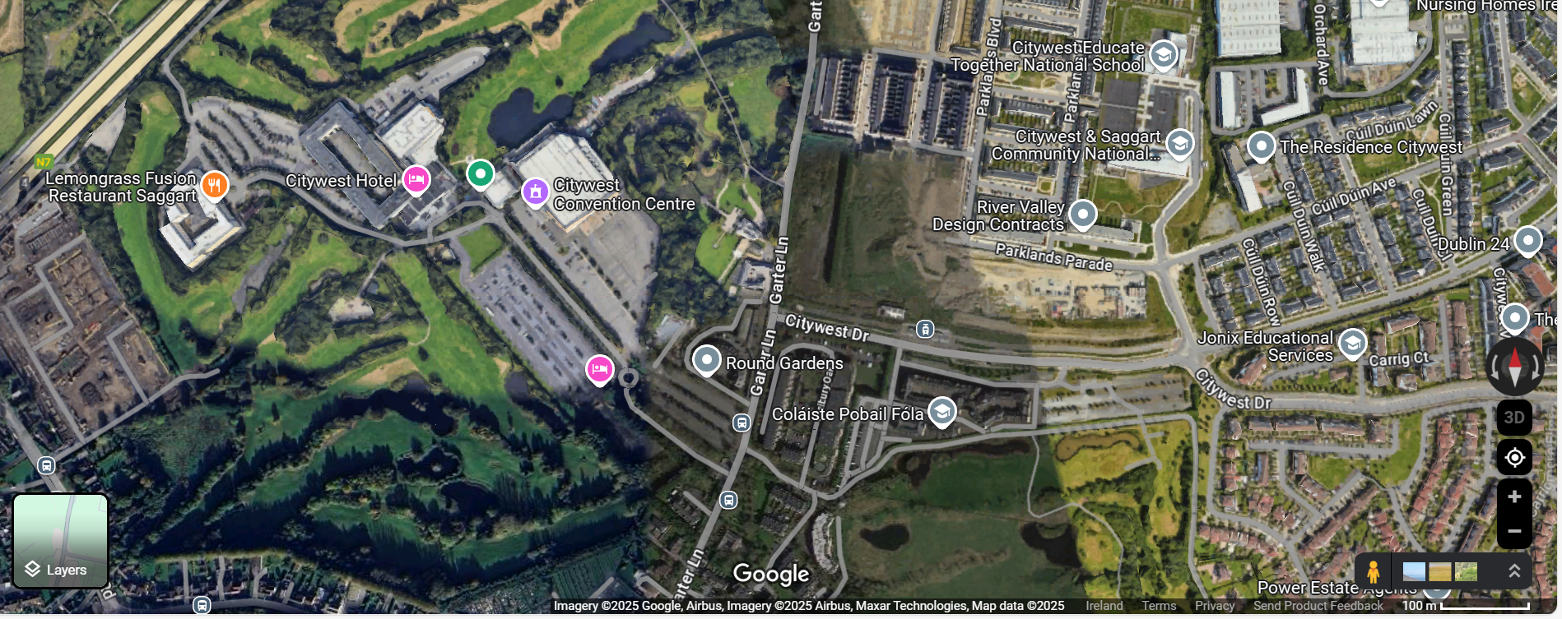

Slide 8
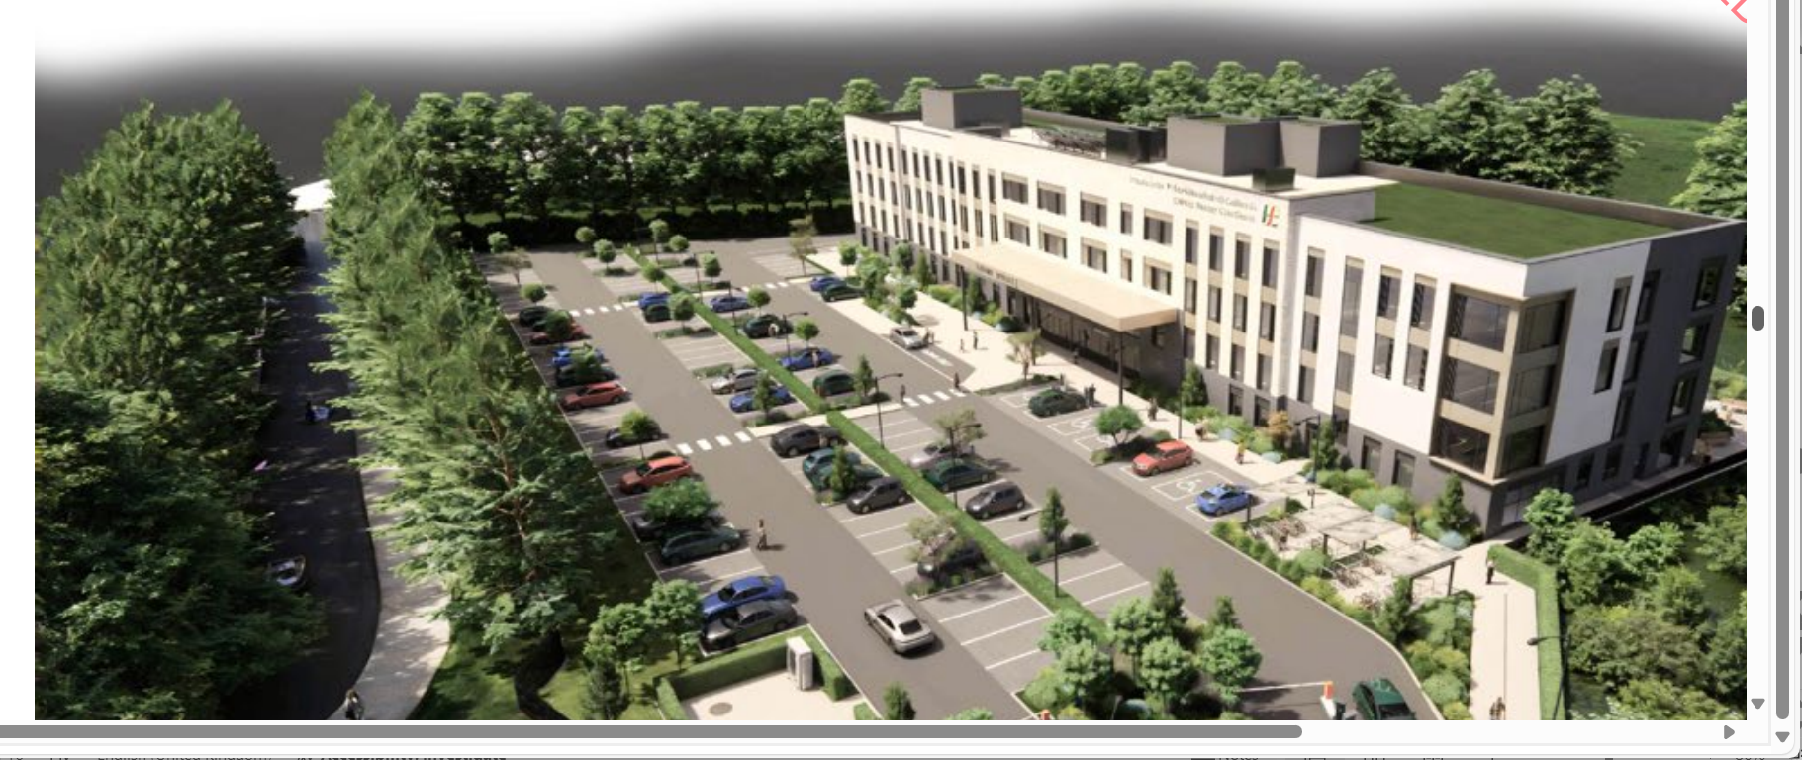

Slide 9
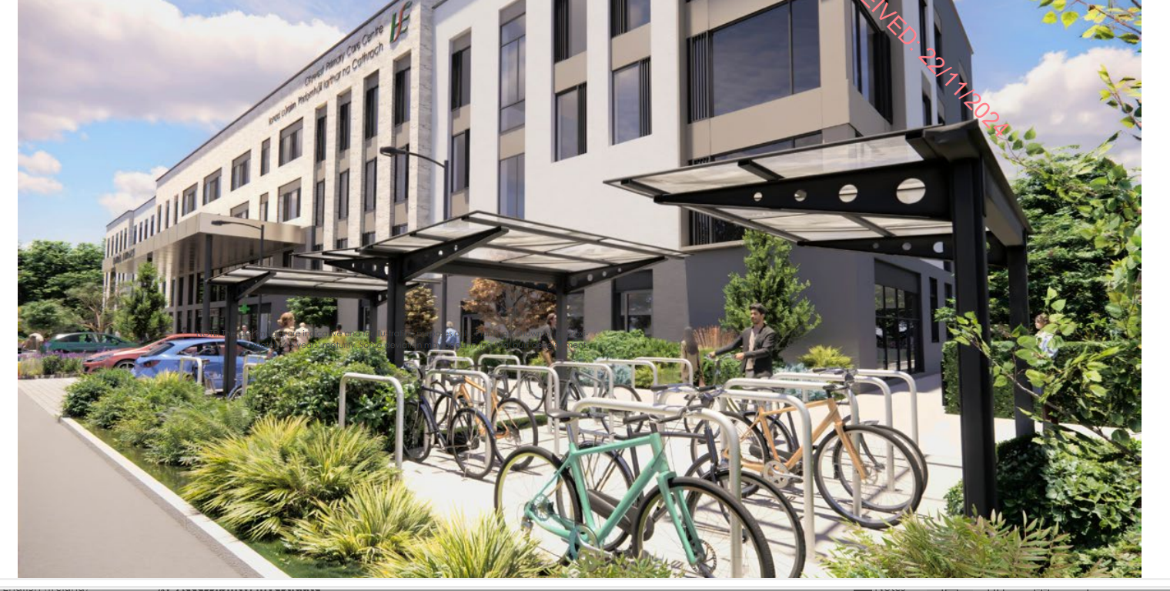

Slide 10
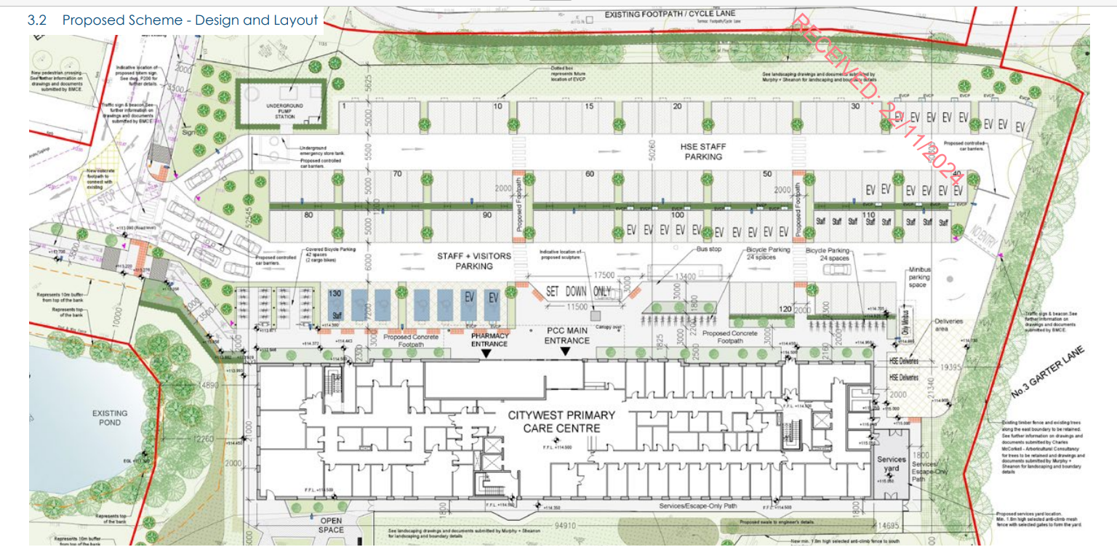

Slide 12
South Dublin County Council (RESERVED FUNCTION)
To consider deciding to grant planning permission for a 4-storey Primary Care Centre building which will provide HSE Services such as general primary care, mental health, disability and older person services; The building will accommodate GP rooms, day care centre with associated kitchen facilities and external deck amenity space, pharmacy, treatment/consultation rooms, primary care administrative offices, as well as ancillary accommodation including staff facilities, offices, meeting rooms, reception/waiting areas, ESB substation and plant at lands at City West Campus, Garters Lane, Saggart.
In Material Contravention of Open Space Zoning Objective - To preserve and provide for open space and recreational amenities.
Outcome
(a) 30 no. elected members of SDCC vote in favour of material contravention and planning permission is granted
OR
(b) Planning application is refused permission for the material contravention of the County Development Plan

