Slide 1
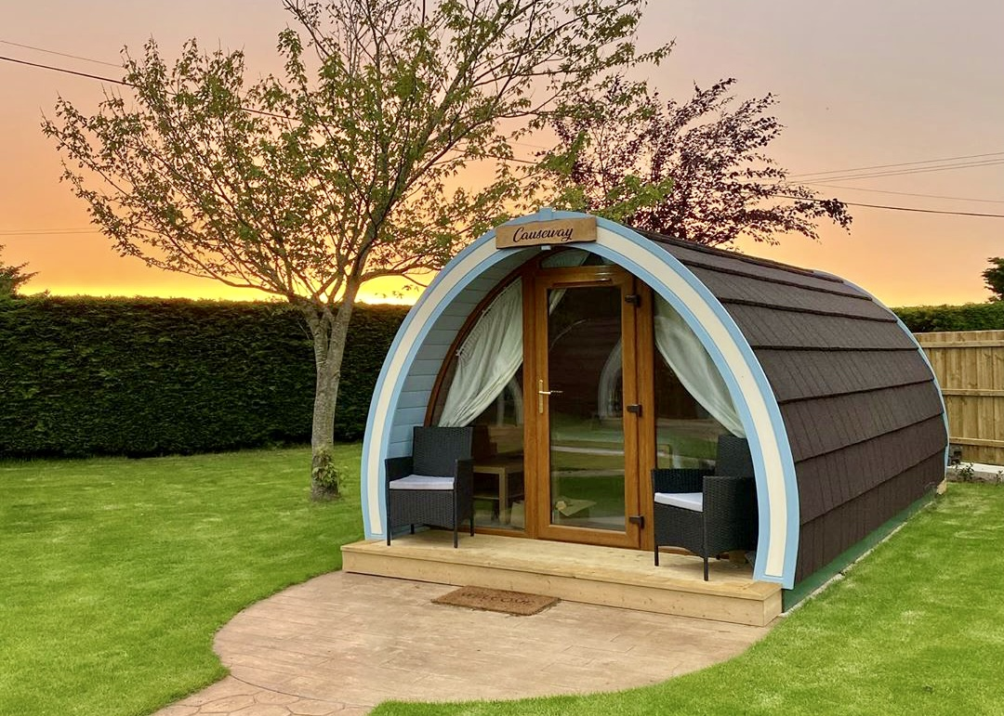
Camac Valley Caravan & Camping Park – Part 8 Process
Presentation to Council Meeting
10th February 2025

Slide 2
Proposed provision of 14 Glamping Pods at Camac Valley Caravan & Camping Park
The works comprise of:
Provision of 14 Glamping Pods.
General site works consisting of Glamping Pod bases and access paths.
All ancillary works

Slide 3
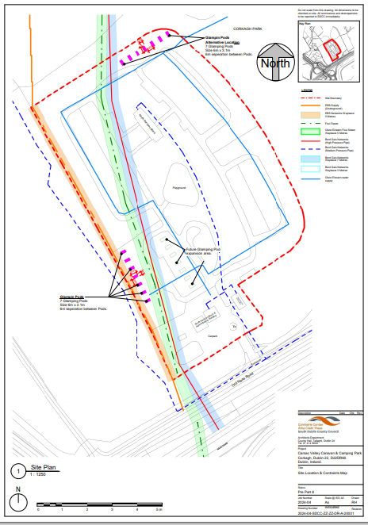
Proposed site layout for glamping pods:

Slide 4
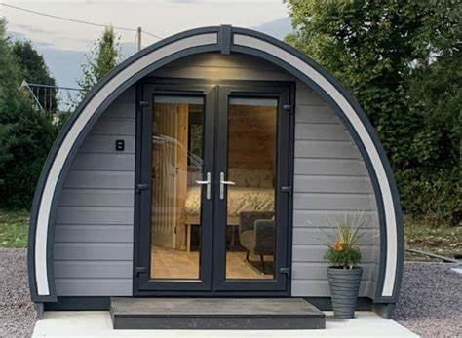
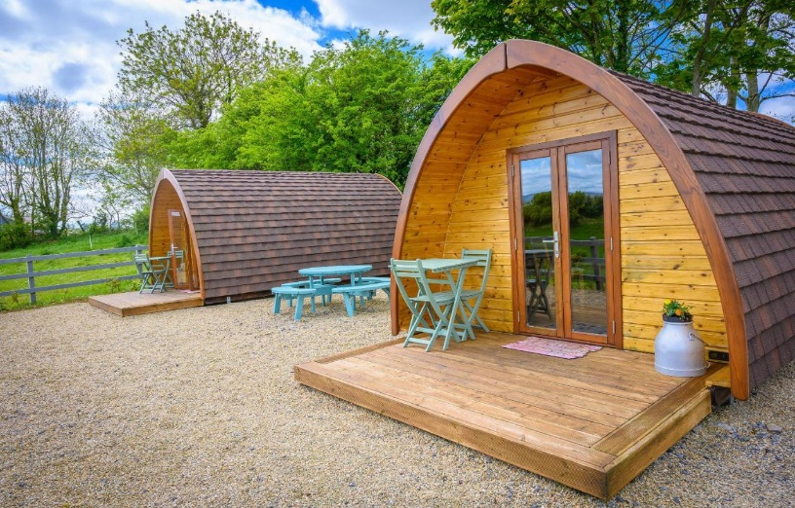
Glamping pods will be of similar shape and size:

Slide 5
Additional Works:
Refurbishment and renewal of existing facilities will be completed separate to Part 8 approval which includes:
Reception block
Shower and toilet block
Laundry room
Kitchen area
Residential block
Playground

Slide 6
Part 8 Time Line
The plans and particulars of the proposed development were available for inspection online on the Council’s Public Consultation portal http://consult.sdublincoco.ie during the period from Monday 16th December 2024 to 5.00pm on Monday 3rd February 2025.
Printed plans and particulars were available for inspection or purchase at a fee not exceeding the reasonable cost of making a copy from Monday 16th December 2024 to Monday 20th January 2025 only; at the Planning Department counter in the offices of South Dublin County Council, County Hall, Tallaght, Dublin 24 during the opening hours of the County Hall.
Submissions and observations with respect to the proposed development dealing with the proper planning and sustainable development of the area in which the proposed development will be situated, could be made in writing up to 5.00pm on Monday 3rd February 2025 and could have been submitted either via:
Online at: https://consult.sdublincoco.ie or post to: Senior Executive O­fficer, Environment, Water & Climate Change, South Dublin County Council, County Hall, Tallaght, Dublin 24 YNN5.

Slide 7
Part 8 Process:
Submissions:
0 submissions received
Issues:
No issues raised
Recommendation:
Following the period of public consultation, the Chief Executive is of the view that the proposal is in conformity
with proper planning and sustainable development.
It is recommended that, as the proposal is in conformity with proper planning and sustainable development,
that the Council proceed with the Part 8 proposal for the glamping pods at Camac Valley Caravan & Camping Park,
Corkagh, Dublin 22.

Slide 8
Next Steps:
Complete:
April - June 2024: Meetings held with stakeholders during the development of the proposals
November 2024: Part 8 proposal to Clondalkin, Newcastle, Rathcoole, Saggart and Brittas Area Committee meeting
November 2024: Environmental screenings
December - January 2025: Public consultation
Next Steps:
February – April: Tender package preparation
Mid April – Tender to framework for a contractor.

