Slide 1
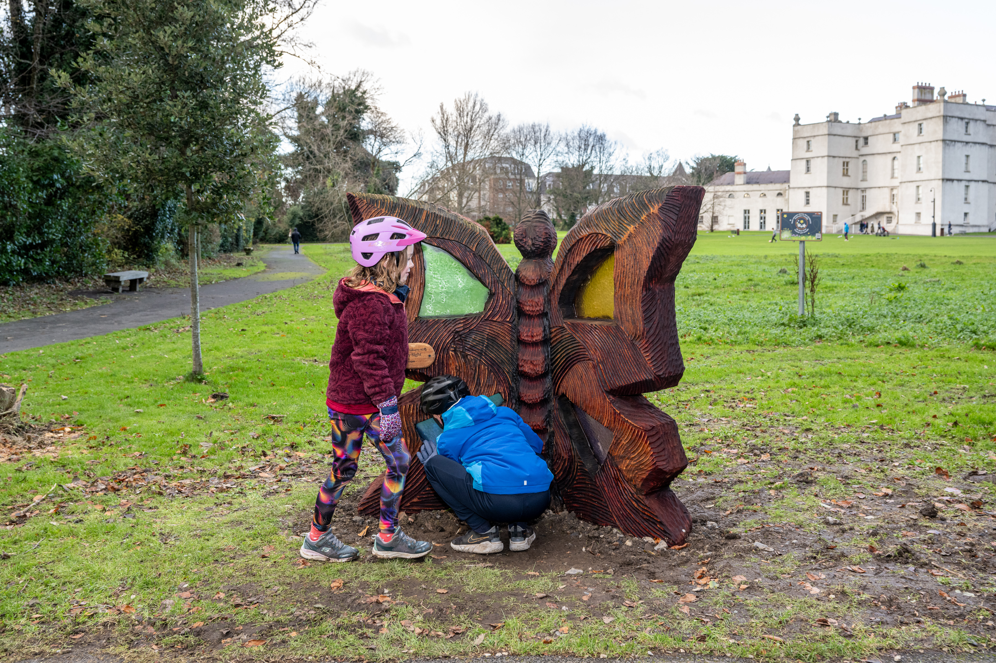
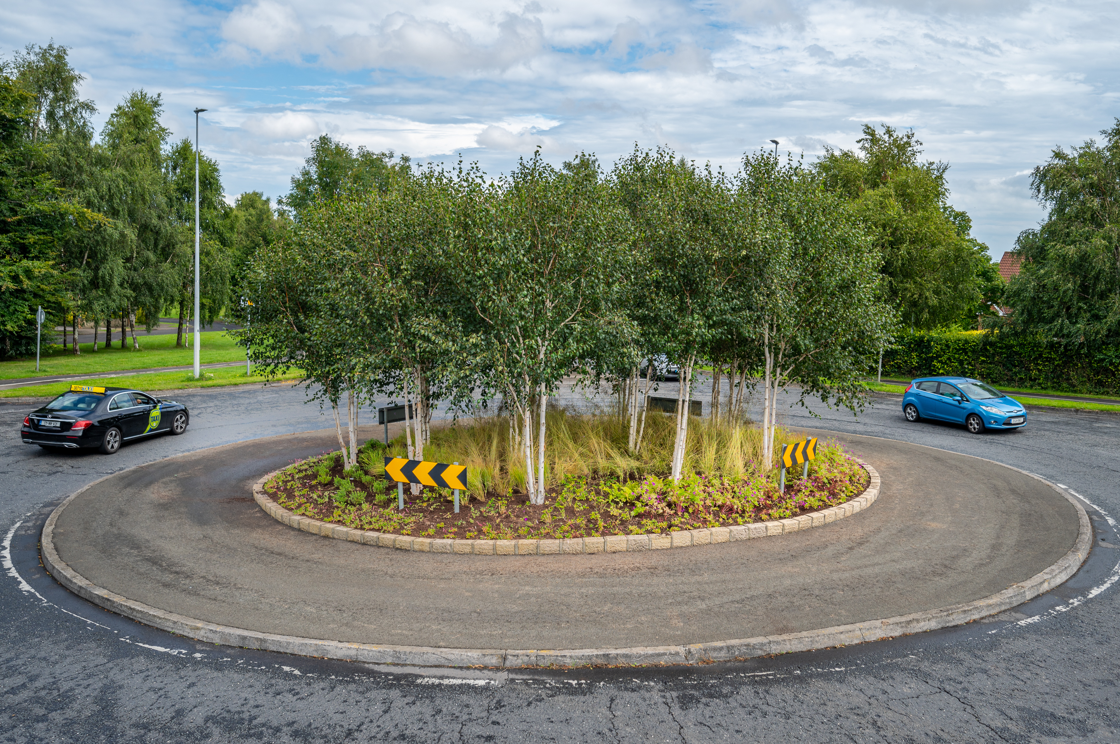
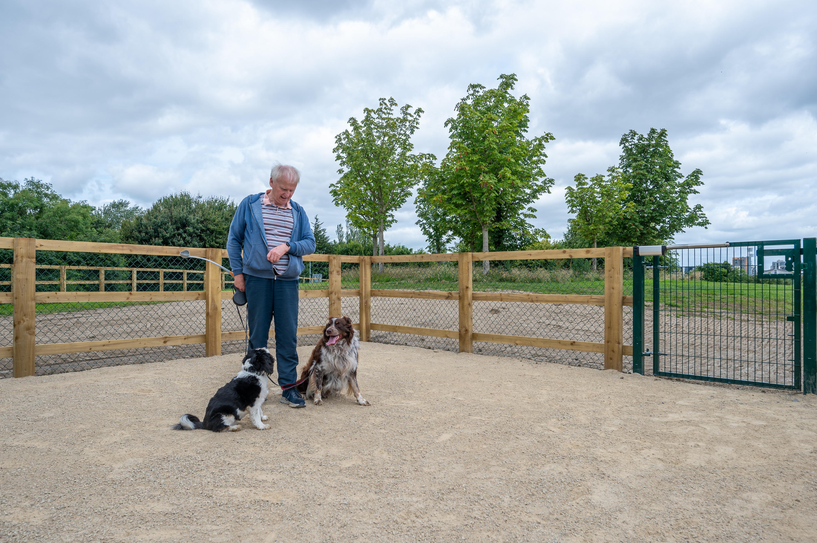
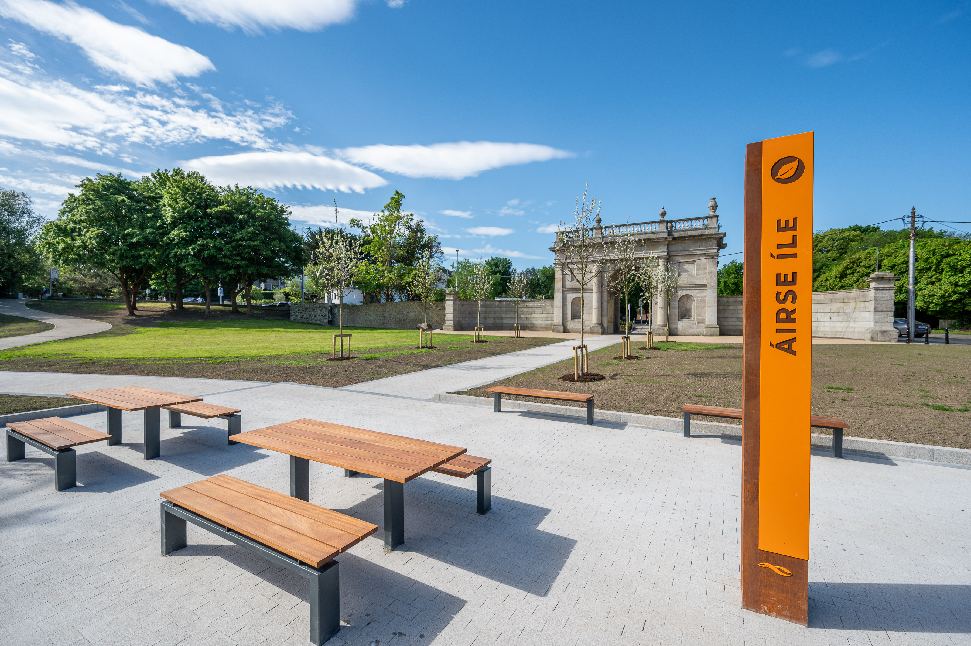
2025 Public Realm & Surface Water Improvement Works Programme
10/02/2025
February Council

Slide 2
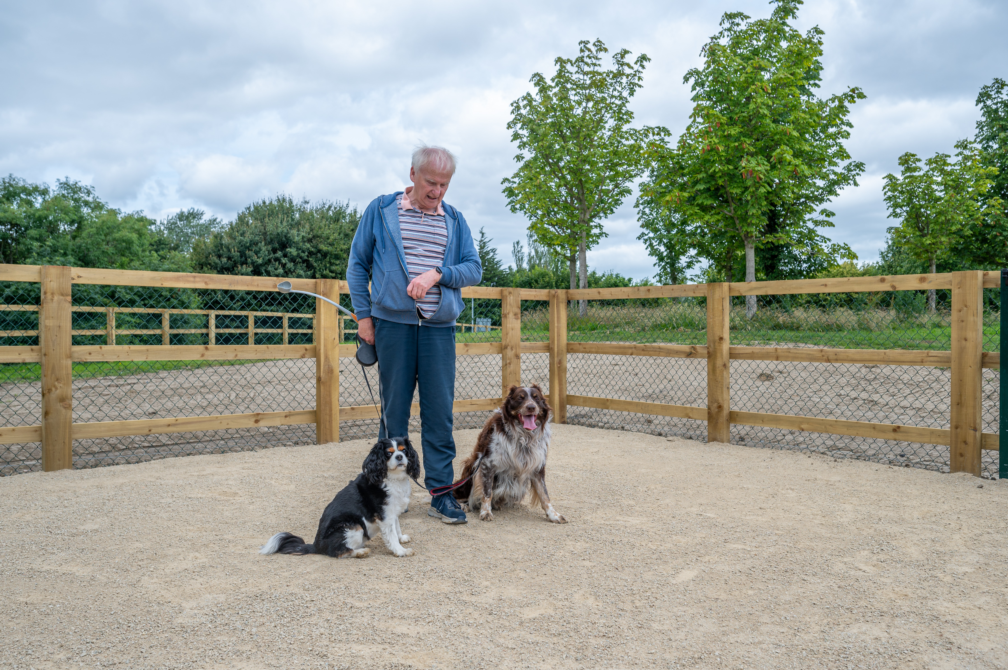
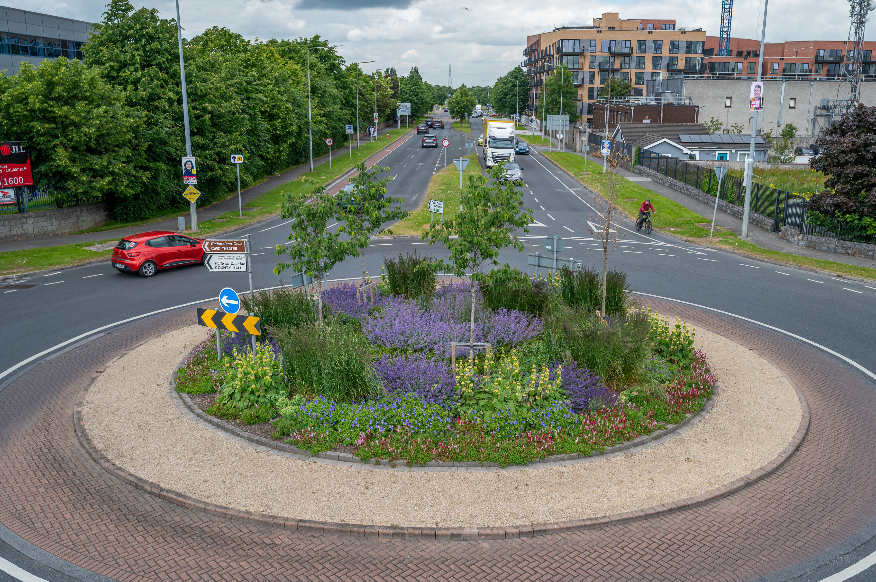
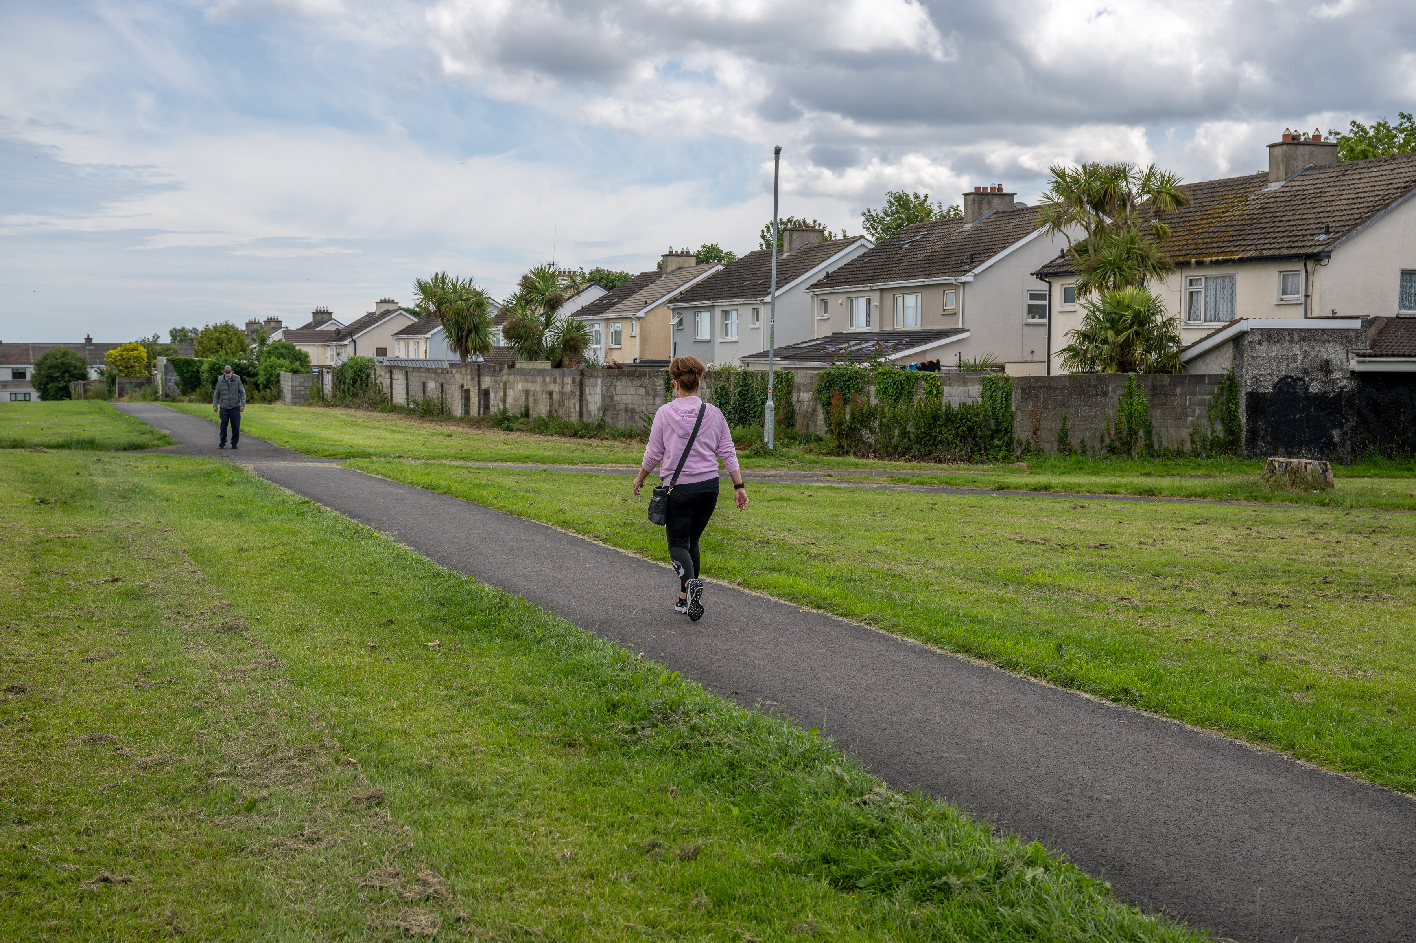
Tallaght ACM
Number | Location | Description of proposed works | Cost estimate
1 | Killinarden Park / Knockmore Park | Improve the boundary in Killinarden Park / Knockmore Park | €30,000
2 | Sheehy Skeffington | Install timber goal posts for informal kick around area | €7,500
3 | Bancroft Park | Replace narrow gate with controlled access gate | €10,000
4 | Aylesbury open space | Install public lighting along Pineview Park Rd & Dalepark Rd | €30,000
5 | Avonbeg field | Overlay existing footpaths in various locations | €15,000
6 | Avonbeg field | Install railings around open space | €45,000
7 | Tymon Park | Upgrade fairy trail in Tymon Park woodland | €50,000
8 | Castle Park | Surfacing of footpath besdie house 143 Castle Park | €10,000
9 | Aylesbury | Install pollinator-friendly bulb planting along Firhouse Rd | €15,000
10 | Belgard road | Resurface existing footpaths between Old Belgard Rd and Belgard Rd R113 | €10,000
11 | Tymon North | Install an exercise footpath with path games | €40,000
12 | Tymon park | Overlay existing footpaths in various locations | €35,000
13 | Jobstown Park | Overlay existing footpaths in various locations | €50,000
14 | Mac Ullium | Upgrade MUGA - sports capital match funding | €50,000
15 | Jobstown Park | Upgrade MUGA - sports capital match funding | €50,000
16 | Tallaght Village | Install focal lighting at the Dancer’s Garden | €25,000
17 | Sean Walsh park | Overlay existing footpaths in near the new dog run | €25,000
18 | Kilnamanagh | Bulb planting & creation of meadows | €10,000
19 | Glenview Lawns | Install footpath adjacent to 362 Glenview Lawns | €10,000
20 | Ballymount Park | Upgrade surface at Kingswood Castle entrance & provide park seating | €15,000
21 | Ballymount Park | Install Dog Run | €60,000
 | Total |  | €592,500
Sean Walsh Park – Dog Run
Belgard Rd/ TUD Roundabout Upgrade
Seskin View Pedestrian Footpath

Slide 3
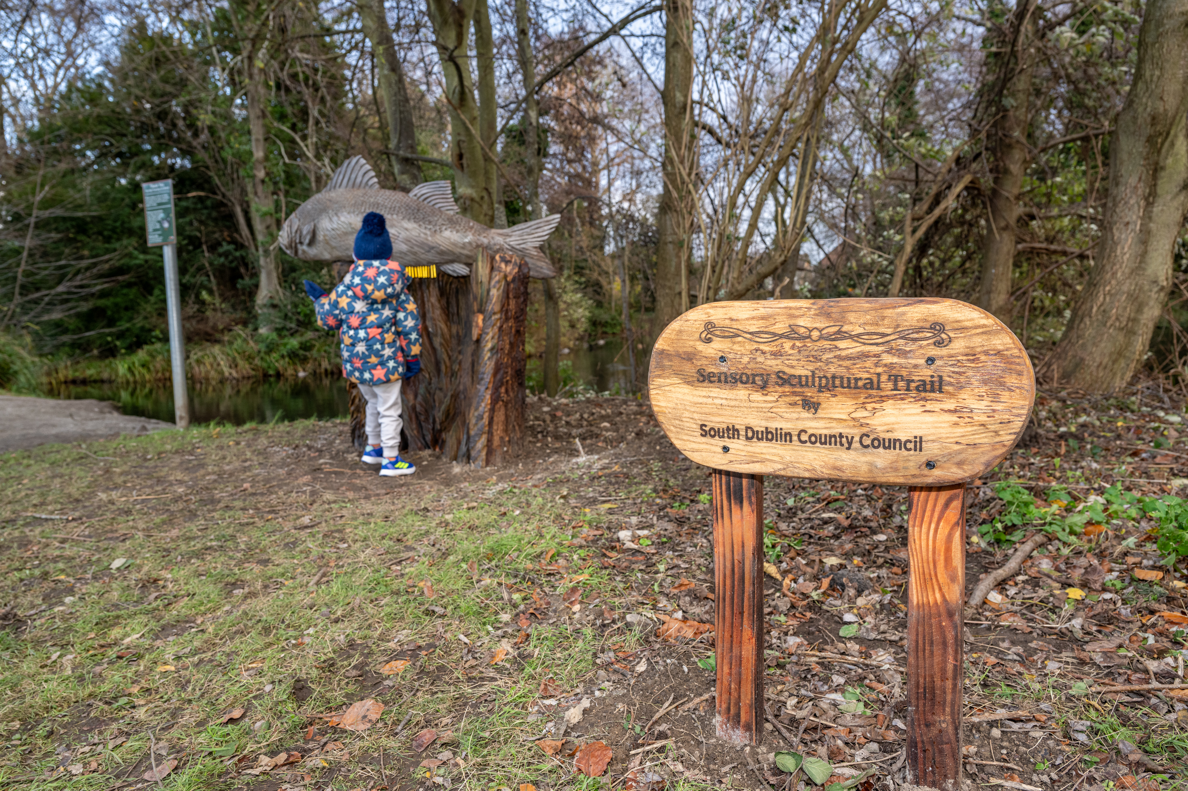
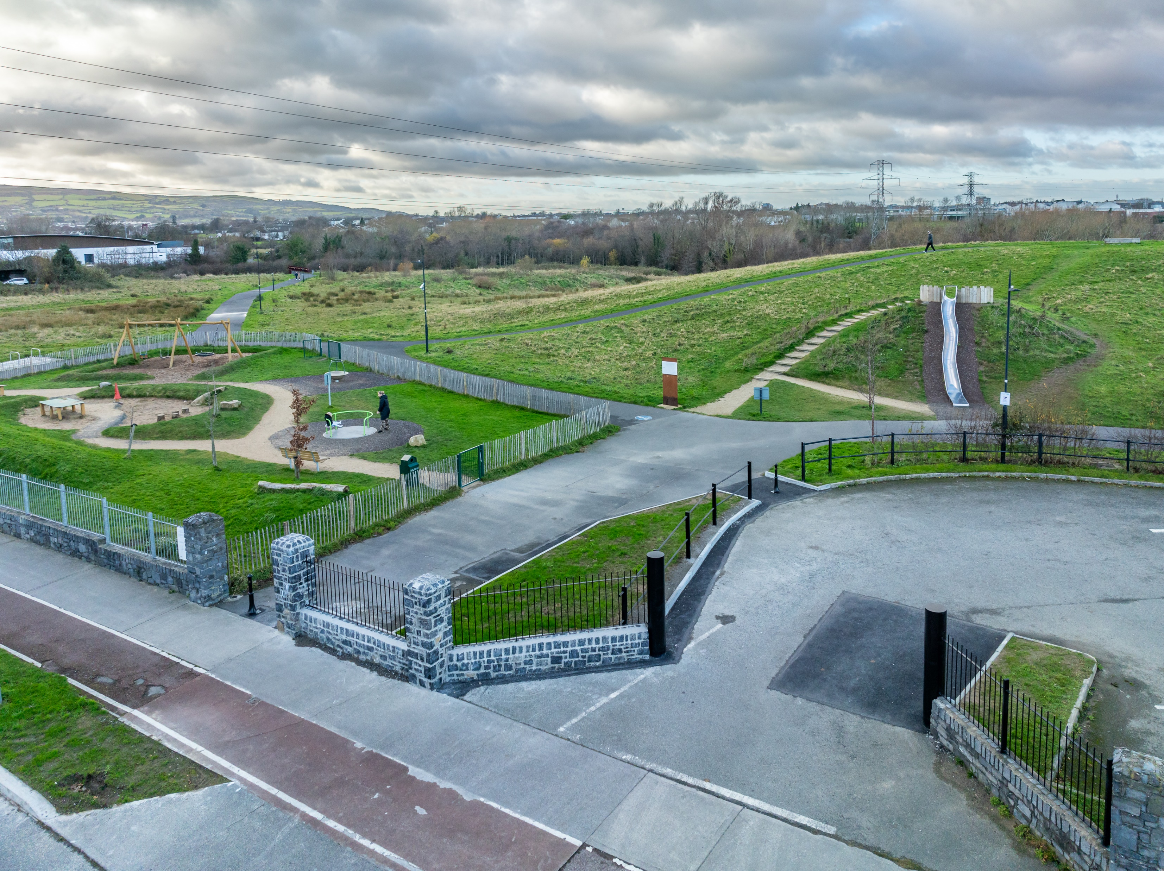
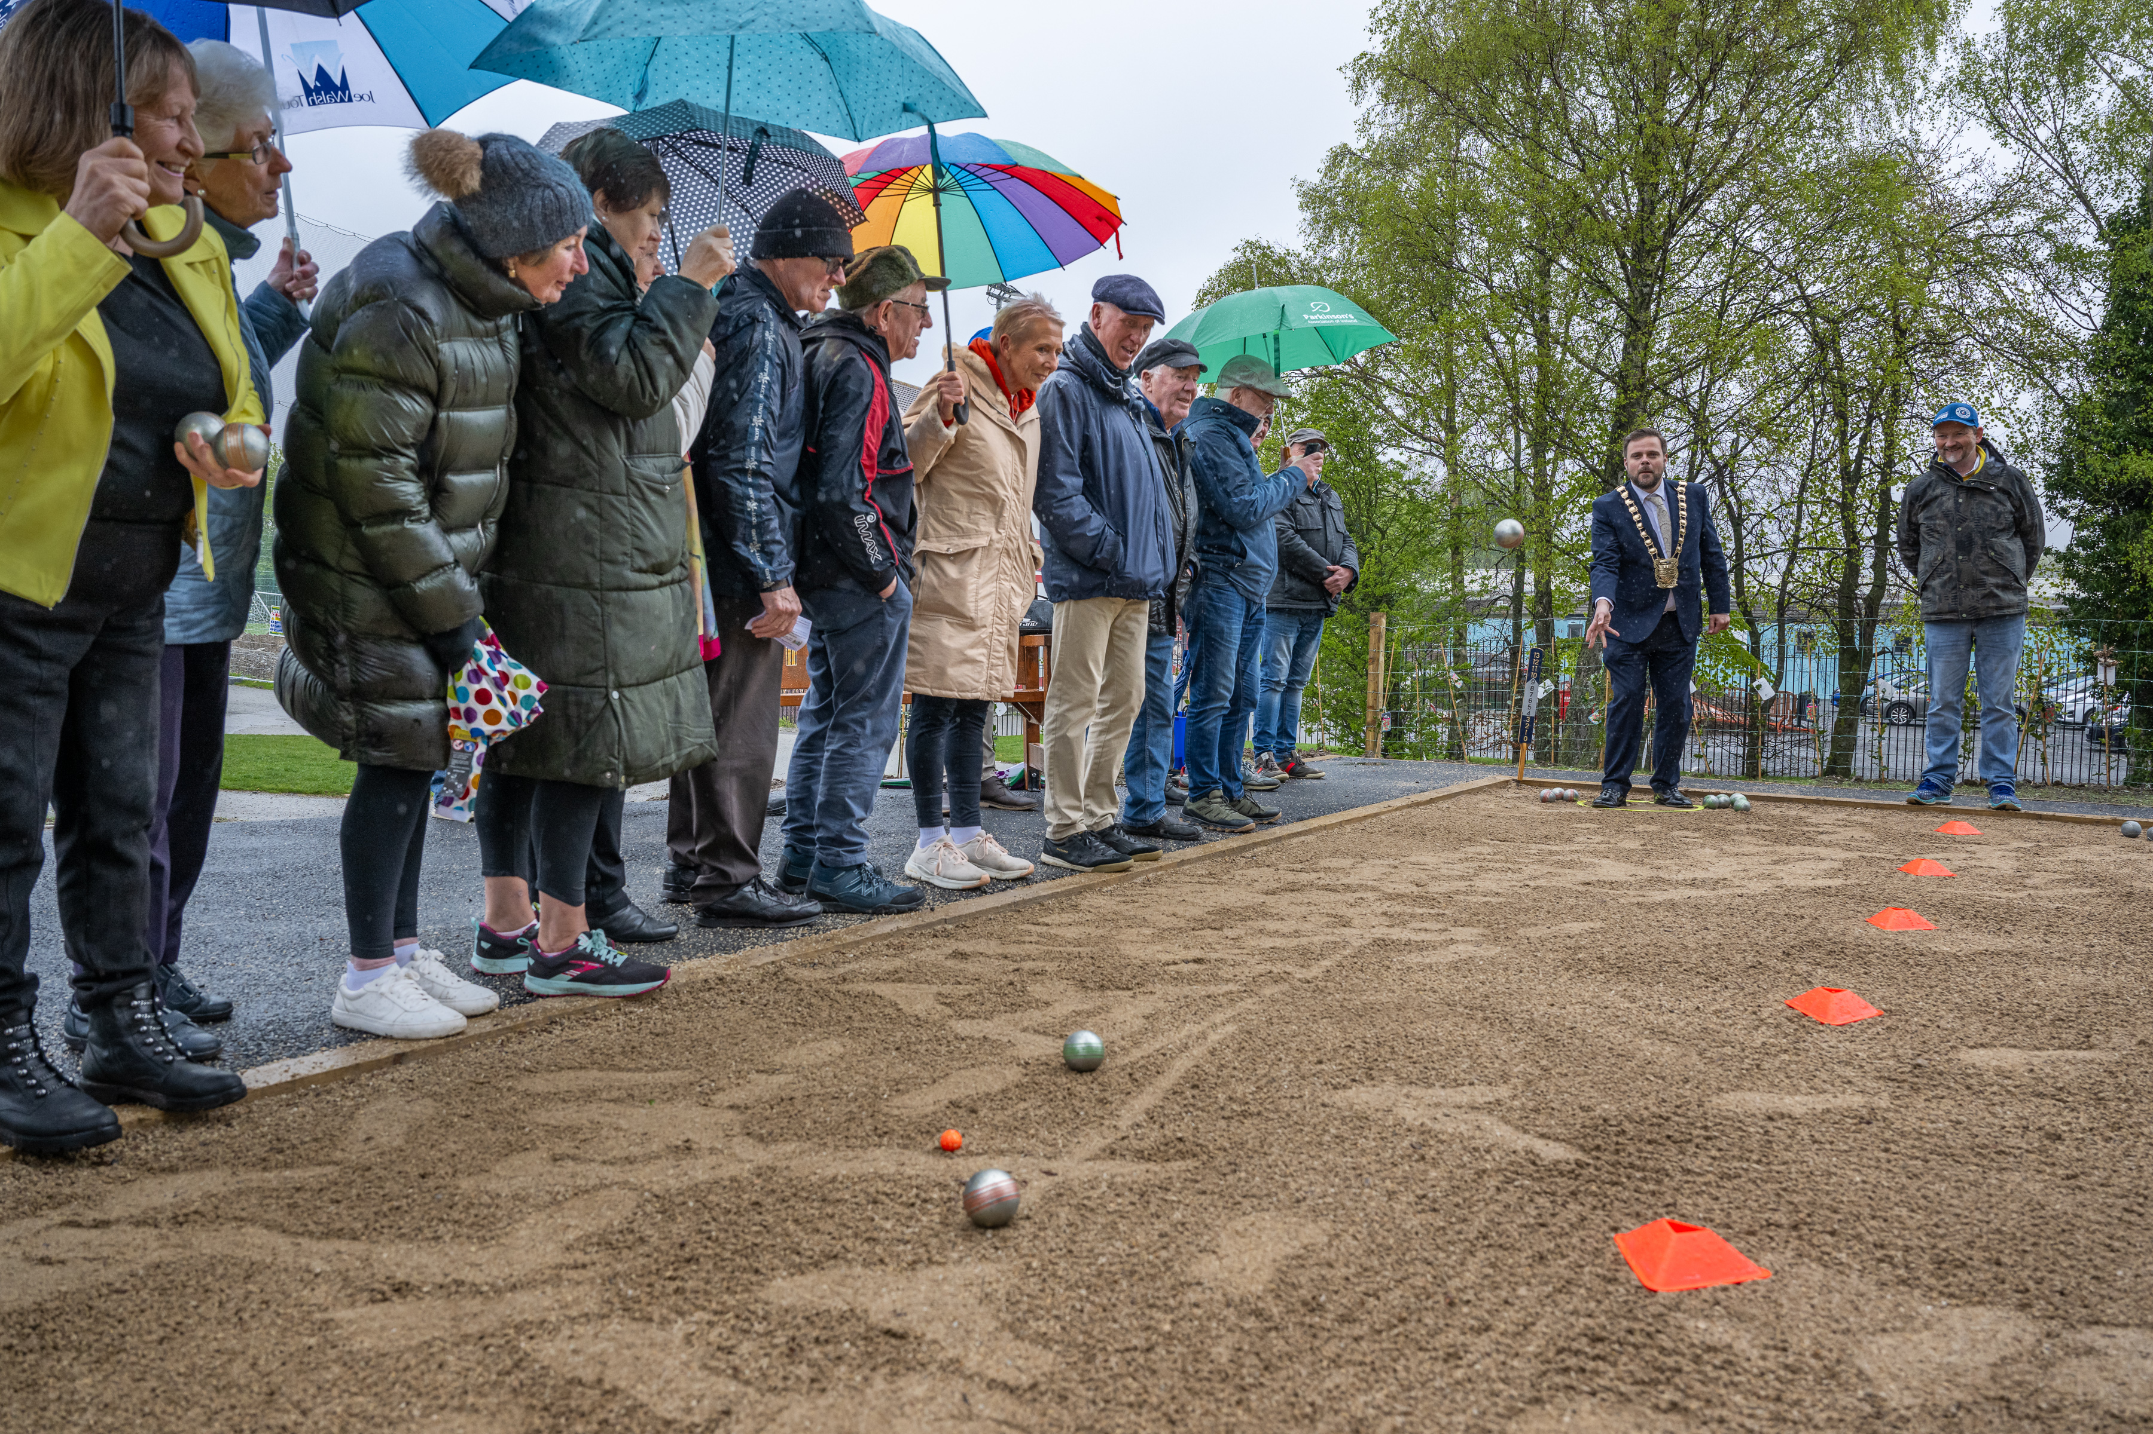
Rathfarnham / Templeogue / Firhouse / Bohernabreena ACM
Number | Location | Description of proposed works | Cost estimate
1 | Woodlawn Park Grove | Overlay footpath between Woodlawn Park Grove & Ballycullen Rd | €30,000
2 | Boden Park | Install footpath and pedestrian entrance to connect Boden Park & Ballyboden Way | €35,000
3 | Glenvara | Provide exercise loop footpath and improve the entrance into green space at Glenvara Park | €60,000
4 | Cypress Downs | Overlay footpath between Cypress Downs Green/Park and Cypress Drive | €30,000
5 | Dodder Valley park | Outdoor gym equipment in Dodder Valley Park - sports capital match funding | €50,000
6 | Greentrees Park Playground | Upgrade footpath in Greentrees Park Playground | €10,000
7 | Hermitage Residents Association Grange Road,Rathfarnham | Lighting on the path between Grange Manor Cl and Hermitage Park and Hermitage Court & Grange Manor Drive | €30,000
8 | Glendown Grove to Wellington Road | Remove kissing gate and provide accessible entrance | €15,000
9 | Springvale and Brookwood estates | Resurface footpath between Springvale and Brookwood estates with associated landscaping. | €50,000
10 | Delaford Grove | Install an accessible tarmac footpath from the corner of Delaford Grove to the new community area. | €20,000
11 | Junction of Grange Road and Nutgrove Avenue | Landscape improvement planting at the junction of Grange Road and Nutgrove Avenue | €30,000
12 | Greentrees Park | Outdoor exercise and gym equipment | €50,000
13 | Firhouse Village | Pocket Park Upgrade & Landscape Improvments | €40,000
14 | Rathfarnham Castle Park | Provide additional natural play features and upgrade playground. | €50,000
15 | Templeroan | Continue footpath loop | €25,000
 | Total |  | €525,000
Rathfarnham Castle Park – Sensory Sculpture trail
Dodder valley Park entrance upgrade
Tymon Park - Boules Petanque Court

Slide 4
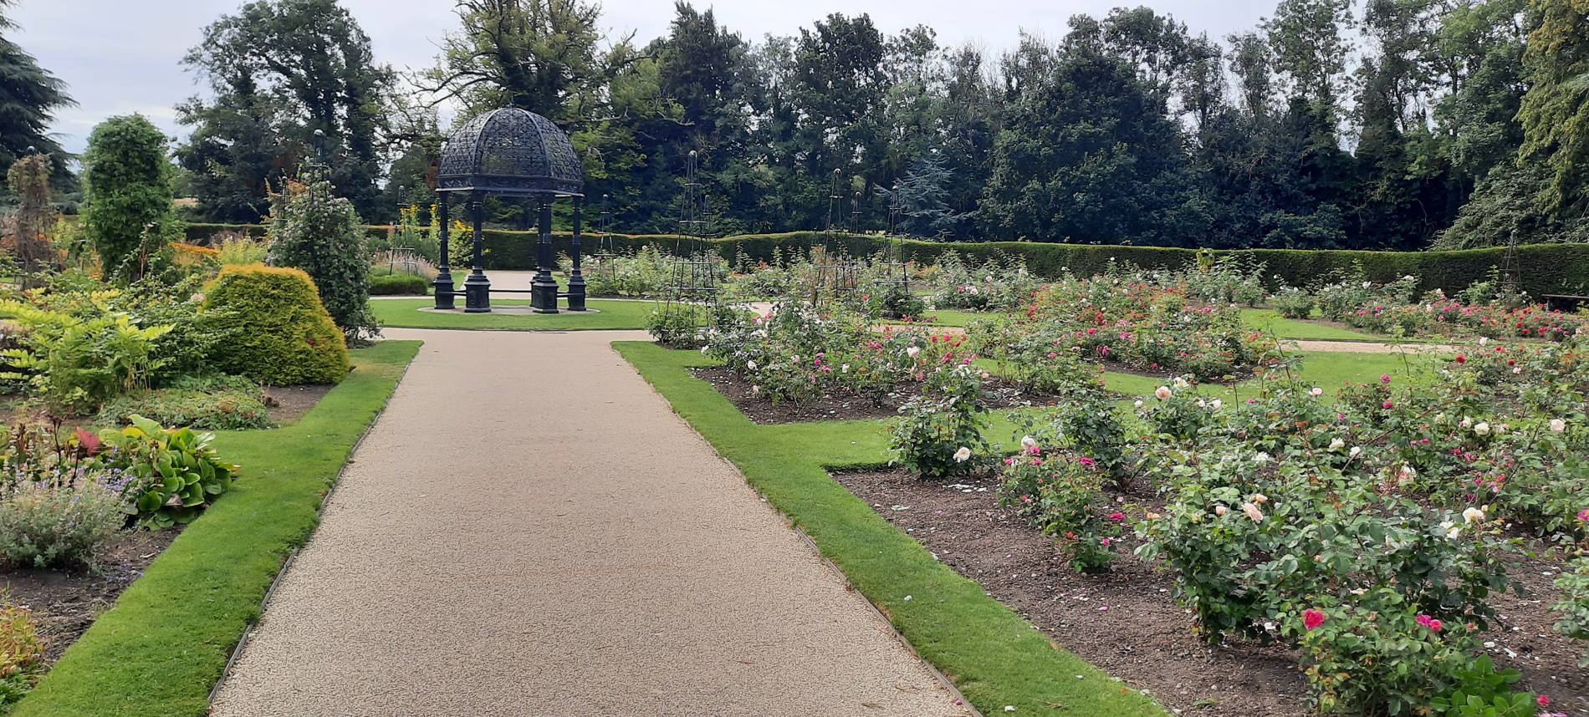
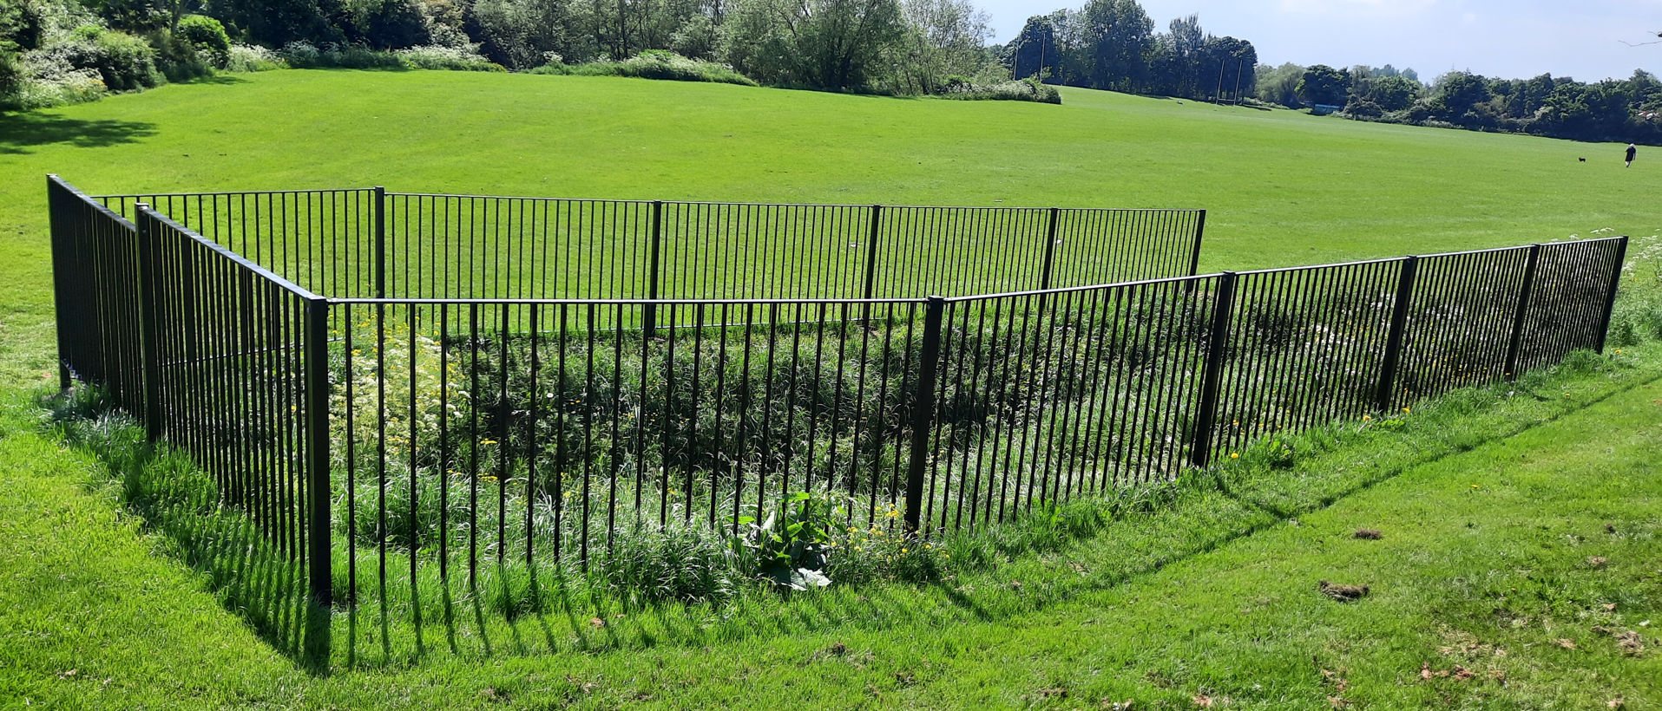
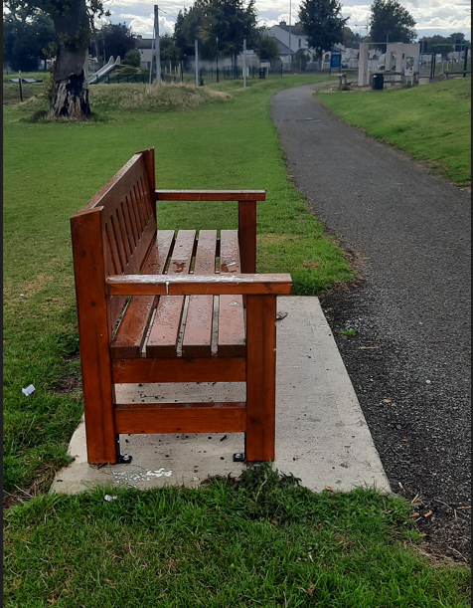
Clondalkin/Newcastle/Rathcoole/Saggart/Brittas ACM
Number | Location | Description of proposed works | Cost estimate
1 | Yellow Meadows | Surface path in park | 40,000
2 | Knockmitten Park | Upgrade Community Centre car park barrier & wall cappings | 60,000
3 | Kilcronan Close | Path across open space from Kilcronan Close to Kilcronan Avenue | 15,000
4 | St Cuthberts Road | Upgrade roundabout at Westbourne/St Cuthberts Road | 10,000
5 | Corkagh Park | Surface area at 'zorb' mound | 10,000
6 | Corkagh Park | Surface section of Back Lane | 50,000
7 | Corkagh Park | Surface path from hub area to lake | 25,000
8 | Corkagh Park | Surface Rose Garden paths Phase 2 | 50,000
9 | Corkagh Park | Surface path at Arboretum (Phase 1) | 50,000
10 | Clondalkin Park | Upgrade vehicle barrier at end of Cherrywood Avenue | 15,000
11 | Clondalkin Park | Landscape area in car park beside Sally Mills apartments | 20,000
12 | Clondalkin Park | Path from car park to Cherrywood Avenue | 30,000
13 | Oakwood Grove | Mini Woodland beside Dunawley Avenue | 10,000
14 | Pinewood to Oak Downs | New path across open space | 15,000
15 | Rathcoole Park | Landscape upgrade at Time Capsule garden | 25,000
 | Total |  | €425,000
Corkagh Park Rose Garden - path upgrade
Clondalkin Park - culvert fence
Collinstown Park – new bench

Slide 5
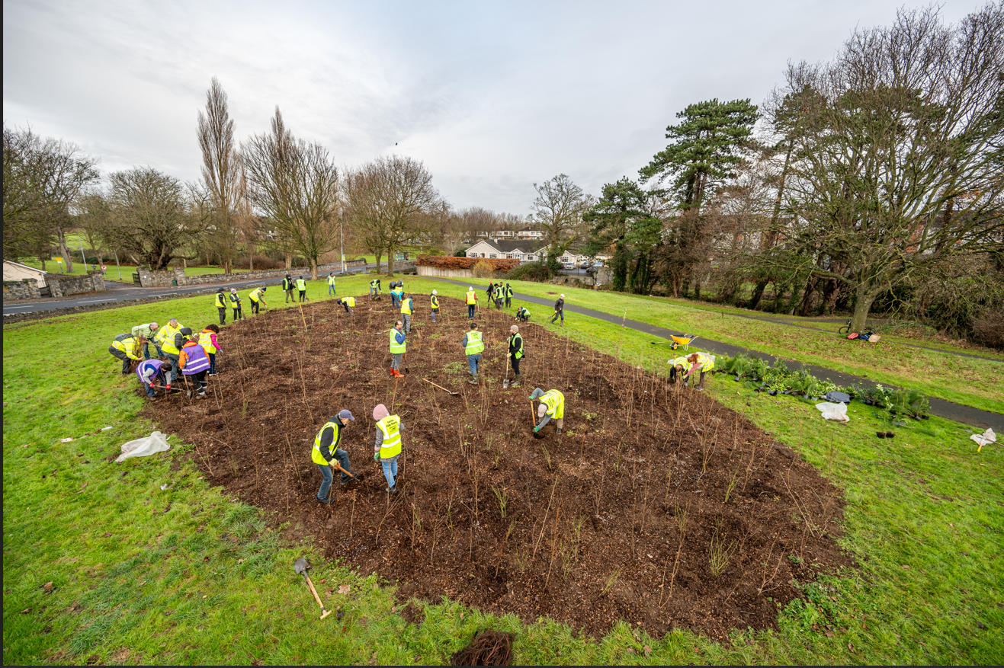
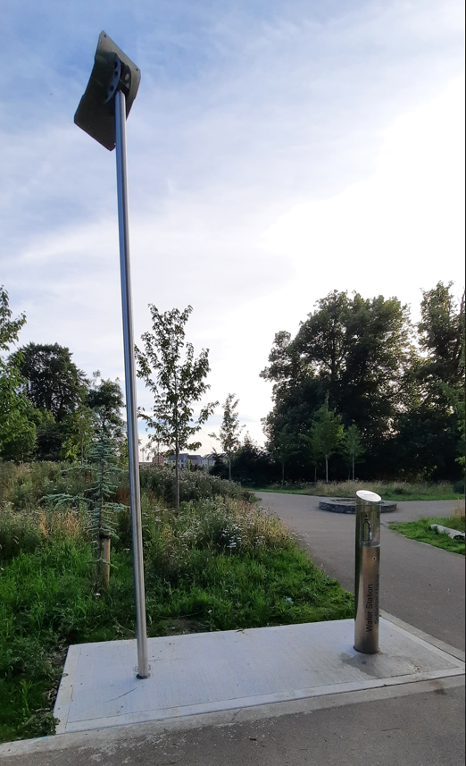
Lucan/Palmerstown/North Clondalkin ACM
Number | Location | Description of proposed works | Cost estimate
1 | Airlie Park | New bollards and minor surfacing at NW vehicle service entrance | 10,000
2 | Esker Cemetery | Surface & line car park (phase 2) | 60,000
3 | Finnnstown Abbey | Surface paths on open space | 40,000
4 | Griffeen Valley Park | Volleyball court area ground works | 30,000
5 | Griffeen Valley Park | Fence at hedge beside boules court | 25,000
6 | Griffeen Valley Park | New path to Tullyhall Mews | 30,000
7 | Hermitage Park | Park Seating + Ballyowen Lane entrance upgrade | 20,000
8 | Neilstown Gardens | Surface path on open space S/O No 38 | 15,000
9 | St Marks Avenue | New path across open space to Fonthill Road | 25,000
10 | Tandy’s Lane | Fence at playground & at interface between 2 sides of park across Tandy’s Lane | 50,000
11 | Waterstown Park | Replace bridge beside Waterstown House | 50,000
12 | Woodview Heights/ Tandy's Lane | New link path across open space | 30,000
13 | Castle Riada Drive | Widen and surface path to Castle Road to alleviate flooding | 25,000
14 | Vesey Park | Install Benches | 15,000
15 | Collinstown Park | Path upgrade | 30,000
 |  |  | €455,000
Griffeen Valley Park – Minin woodland
Tandy’s Lane - Waterstation

Slide 6
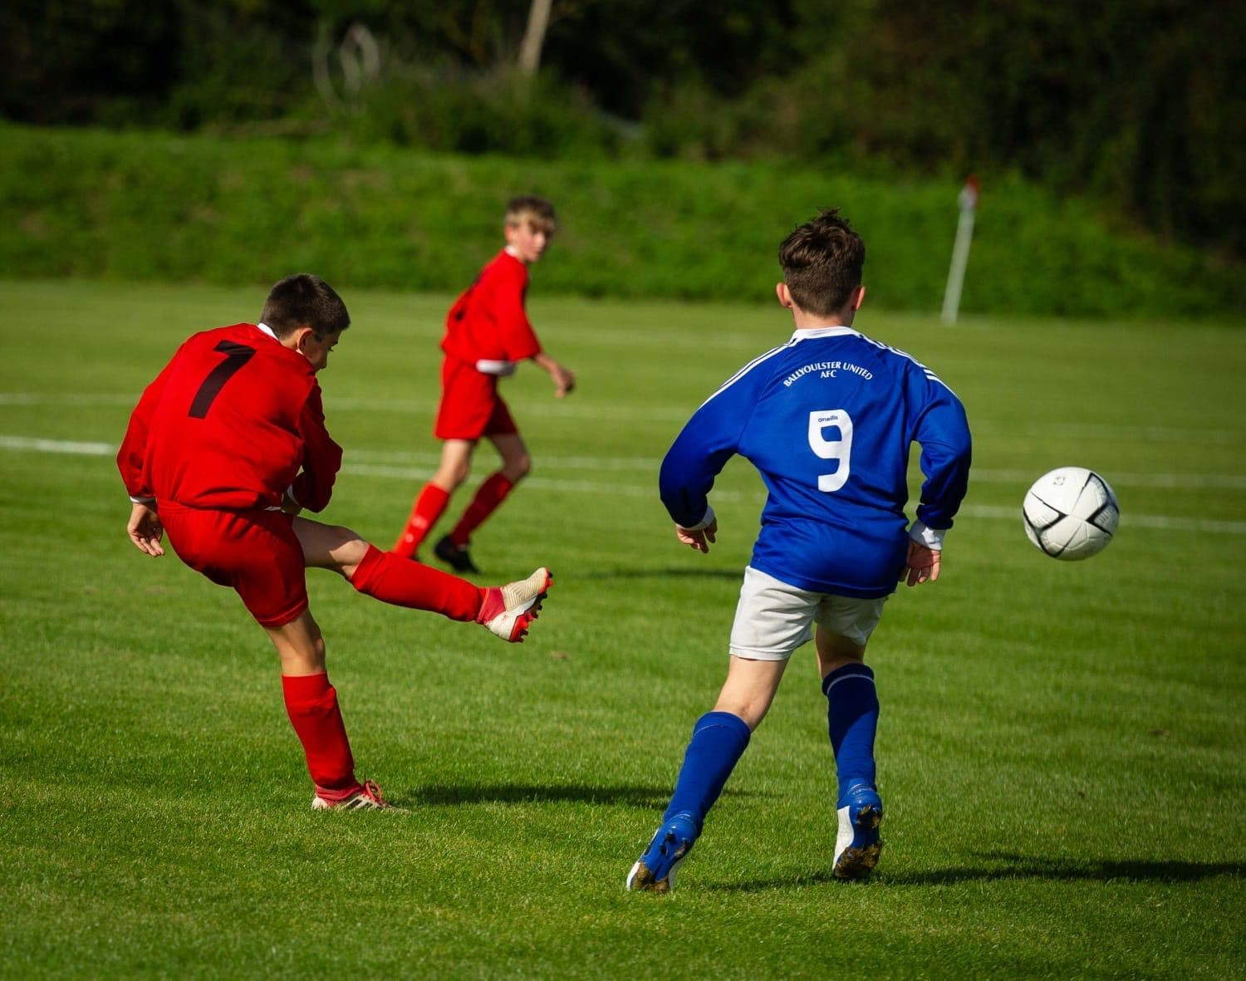
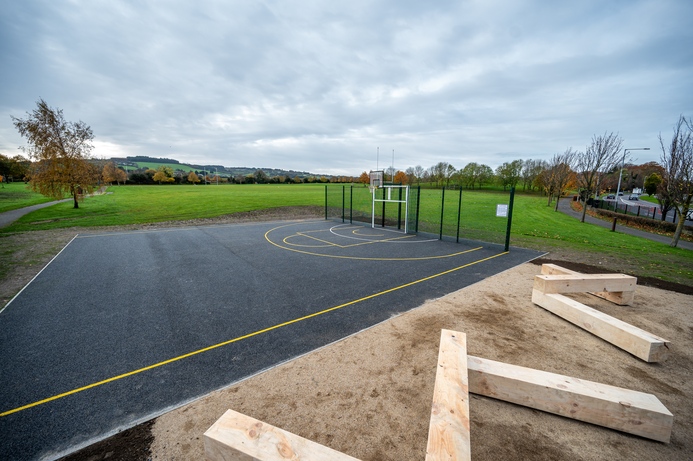
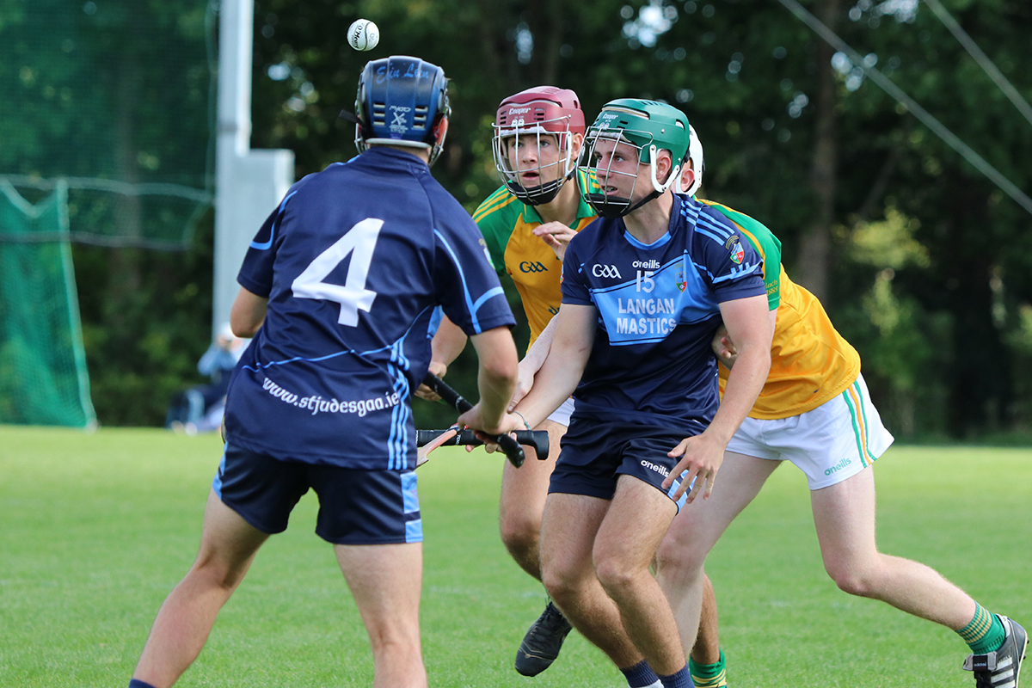
Minor Projects under €500k
No | Location | Description of Works | Cost estimate
1 | Rathfarnham Castle Park Playground | Upgrade the playground surface and provide additional play items | €200,000
2 | Cruagh Cemetery | Landscape improvements to angel's plot | €10,000
3 | Tymon Park, Wellington Playground | Upgrade surface and play items | €100,000
4 | Sean Walsh Park Playground | Upgrade surface of playground | €80,000
Templeogue United FC - pitch upgrade
Sports Capital Projects to be delivered in 2025
No | Location | Description of the works | Cost estimate
1 | Jobstown Park | Upgrade and drain pitch 67 & 68 | €200,000
2 | Jobstown Park | Upgrade MUGA | €90,000
3 | MacUlliam Estate | Upgrade MUGA | €40,000
4 | Dodder Valley Park – Cherryfield | Outdoor gym equipment | €78,000
5 | Balgaddy Open Space | Upgrade MUGA | €90,000
 | Corkagh Park | Upgrade volleyball court to sand court | €86,000
 | Griffeen Valley Park | Provide walking/jogging track around Lucan Athletics track | €45,000
 | Glenaulin Park | Goal Post Storage Compound | €20,000
 | Kingswood Open Space | Goal Post Storage Compound | €20,000
 | Griffeen Valley Park (Haydens Lane) | Goal Post Storage Compound | €20,000
MUGA Rathcoole Park
St Judes GAA – pitch upgrade

Slide 7
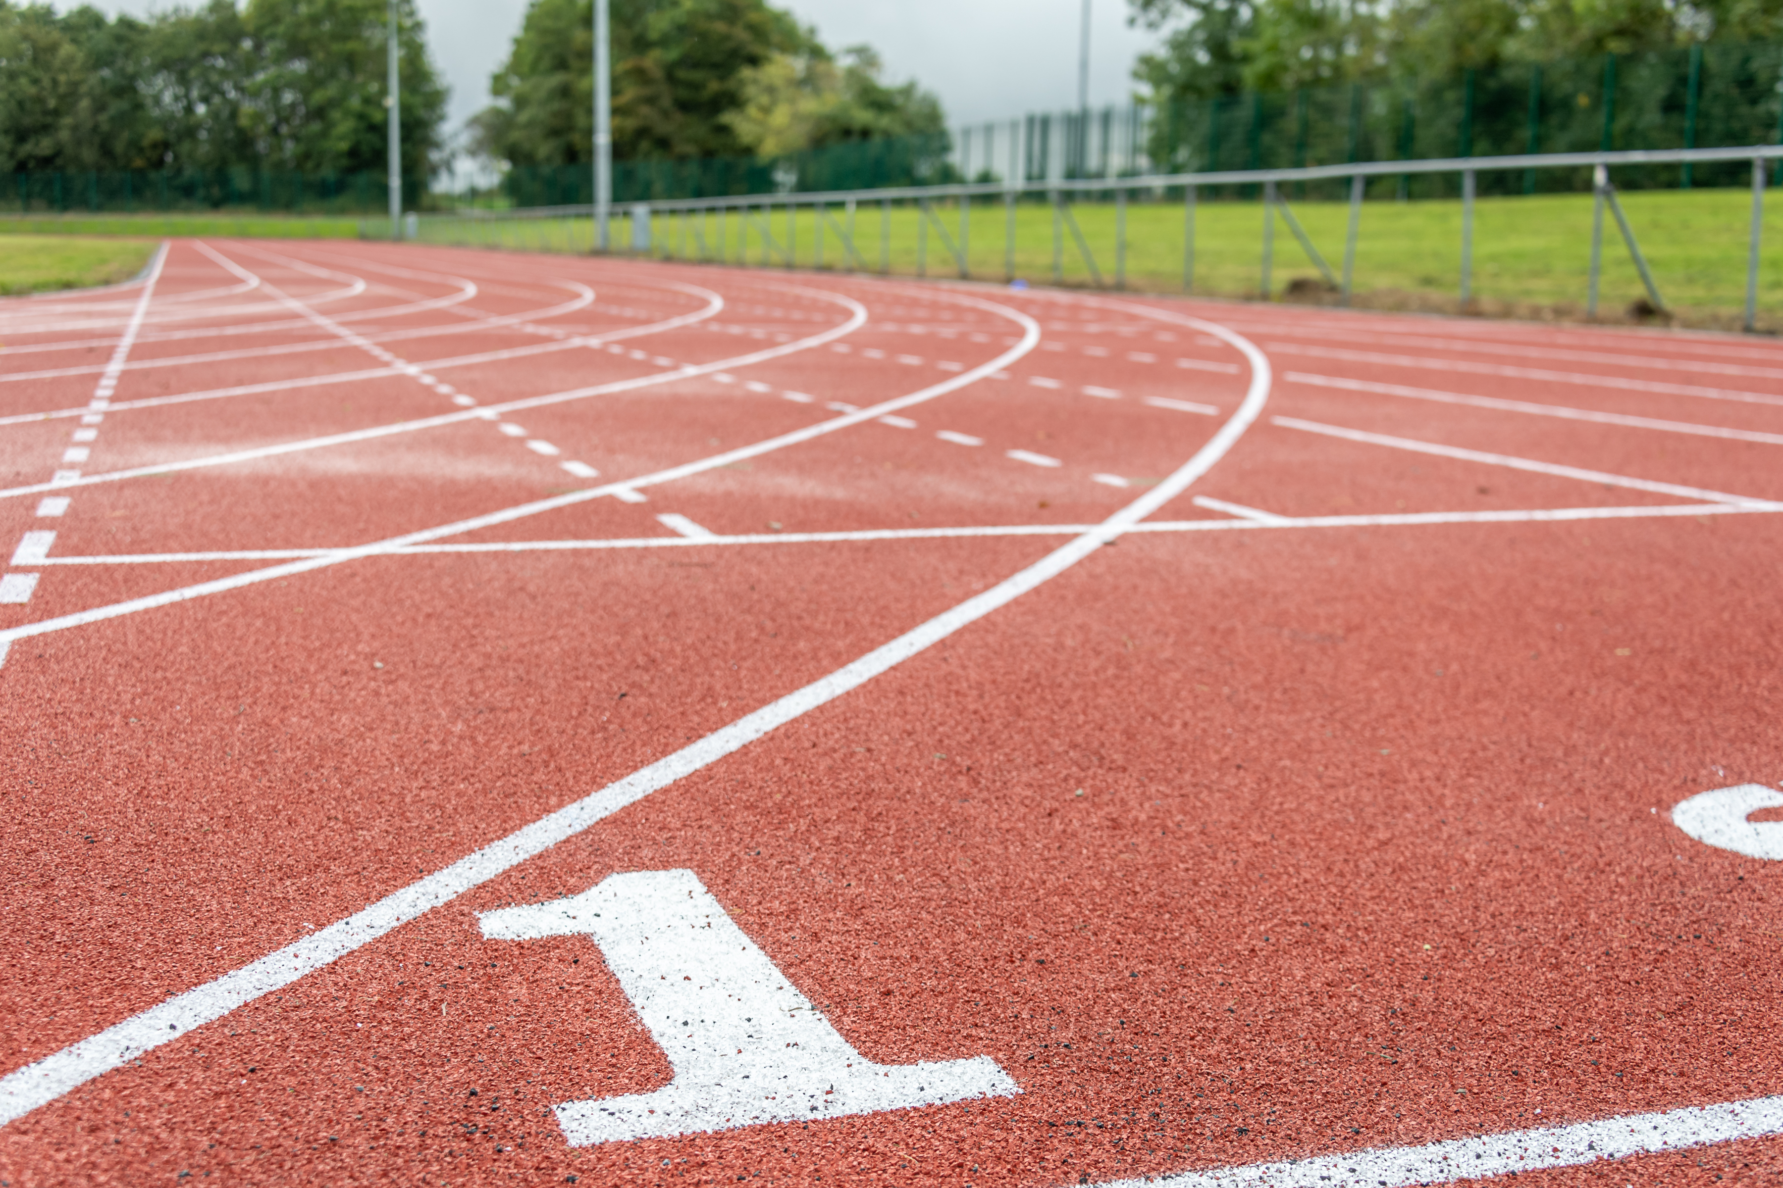
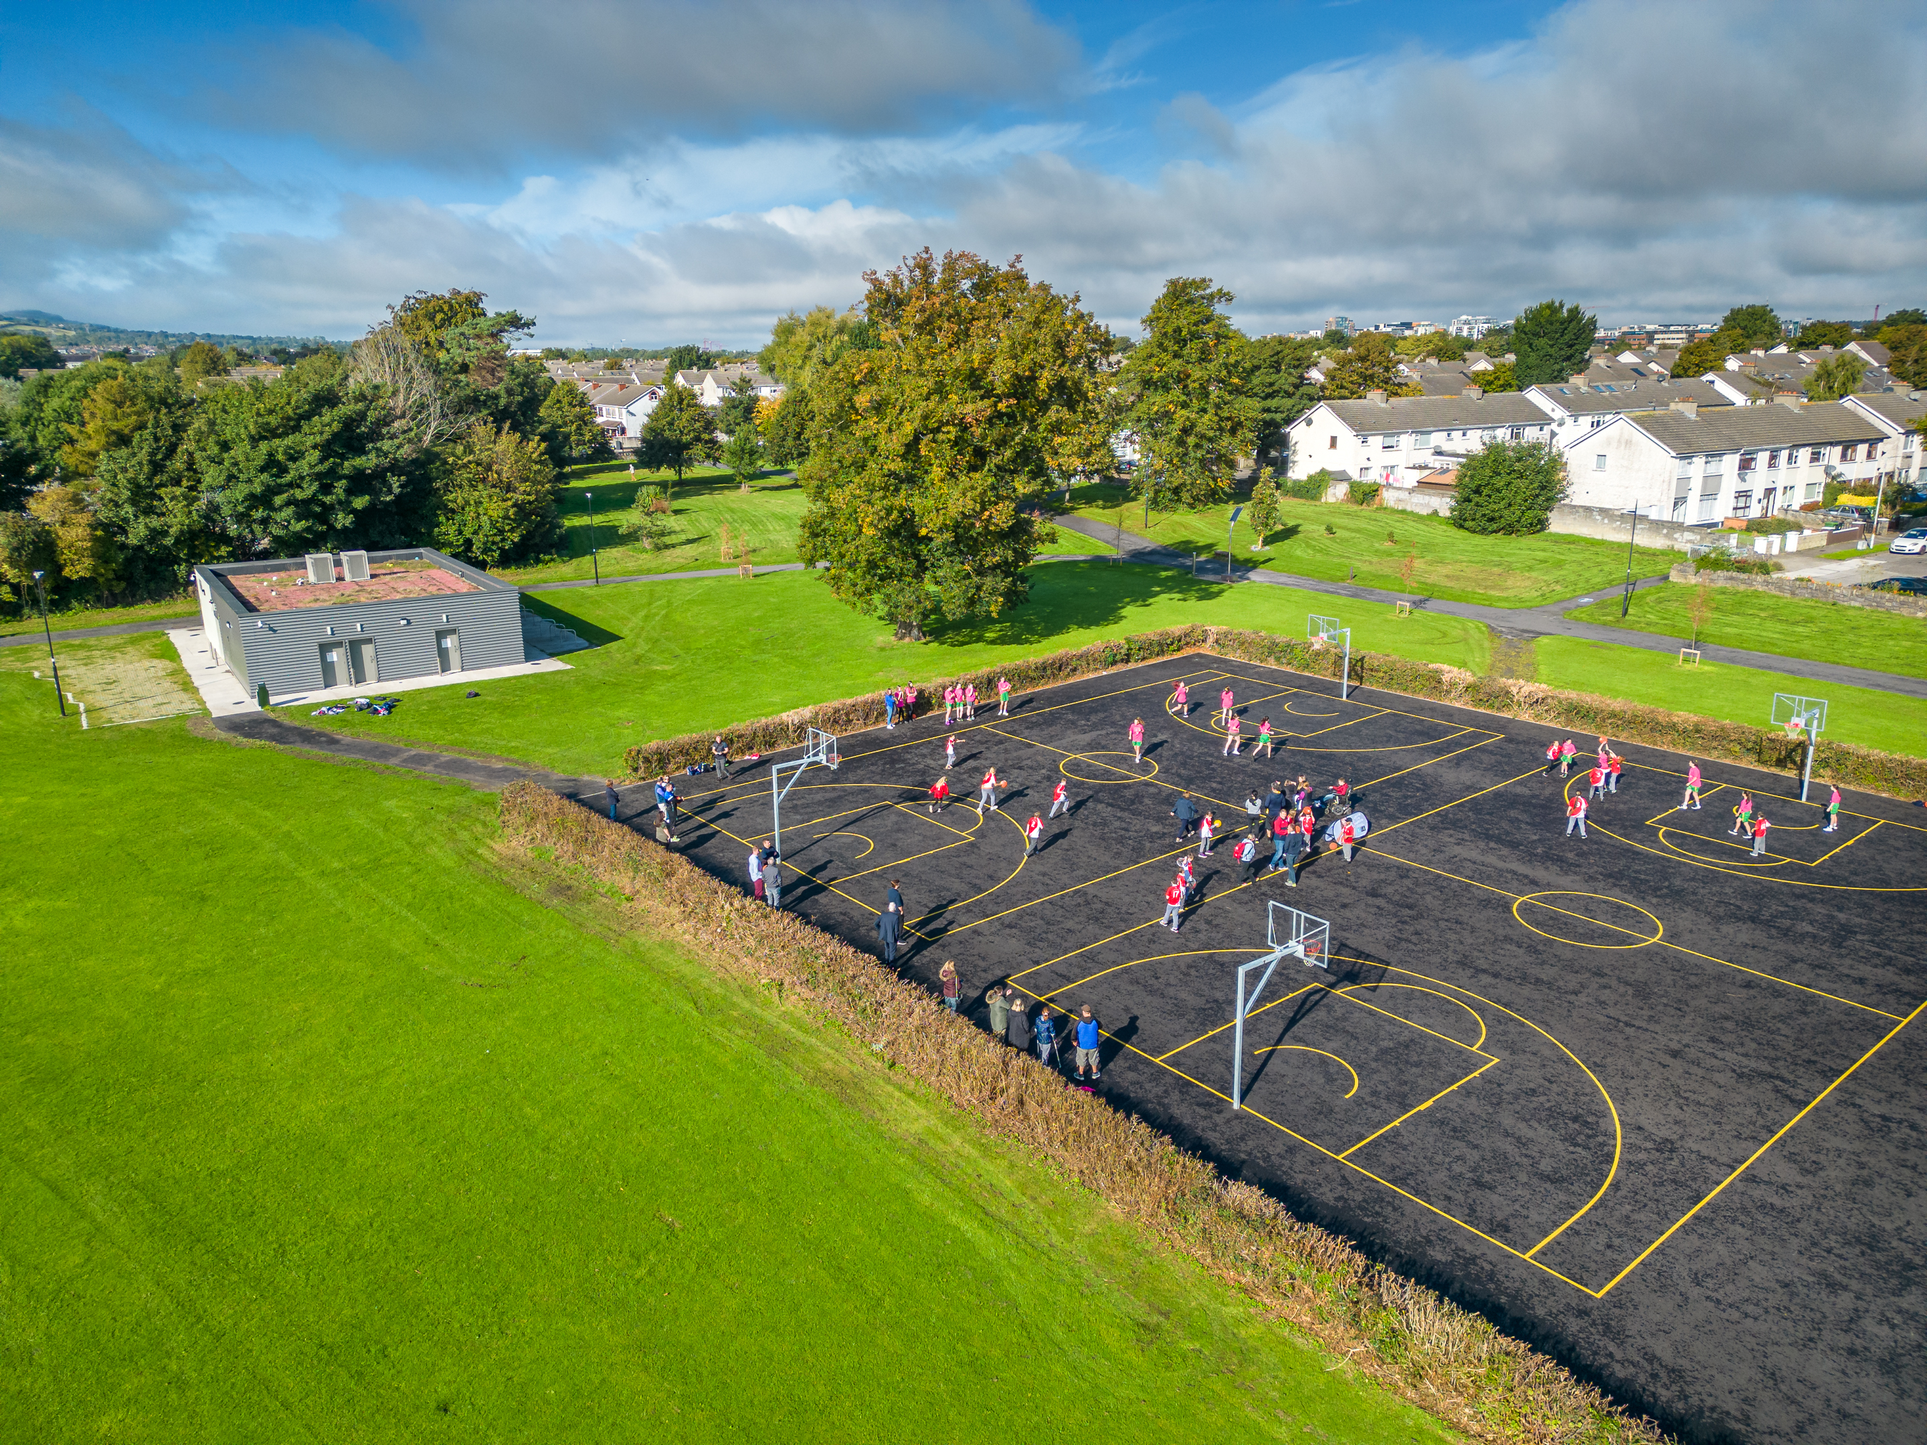
Sports Capital Projects underway in 2025 (part of rolling capital programmme)
 | Location | Description of the works | Grant Amount
1 | Griffeen Valley Pavillion | Sports changing room pavillion | €610,000
2 | Corkagh Park Pavillion | Sports changing room pavillion | €550,000
3 | Glenaulin Park GAA Pitch 24 | Level & small drainage works (underway will be completed in 2025) | €35,000
4 | Griffeen Park GAA Pitch 13 | Level & small drainage works (underway will be completed in 2025) | €78,000
5 | Lucan Athletics Track infield | Design and tender to commence following consultant’s appointment | €200,000
6 | Bancroft Park Athletics Track upgrade | Design and tender to commence following consultant’s appointment | €200,000
Athletic Track at Lucan Harriers
Dodder valley Park - Sports pavillion

Slide 8
Surface Water Minor Works Programme 2025
Location | Project | Projected Exp. For 2025
Newcastle /Rathcoole/Saggart | Clean, Repair and upgrade surface water pipe – follow on works from surface water study | €170,000
Rathfarnham Pond Feed | Serious root incursion in this pipeline, causing issues with Rathfarnham pond feed, contractor to be procured to carry out root cutting and removal, jetting and silt removal and CCTV on completion. | €40,000
Stocking Well | Survey and possible upgrade surface water network | €50,000
Rathcoole Park | Regrade river bank – to alleviate overspill during heavy rainfall | €5,000
Lucan Village | New surface water pipeline required to facilitate and improve road drainage | €100,000
Butterfield Park | New surface water sewer to allow separation of surface water and foul sewage to alleviate foul sewer flooding. | €65,000
Cloverhill Road (Palmerstown Woods) | New surface water pipeline required to provide improved drainage. Project will co-ordinate with a Roads project in same location. | €100,000
Total |  | €530,000
Insert Bullet Point 1 here
Insert Bullet Point 2 here
Insert Bullet Point 3 here
Insert Bullet Point 4 here

