Slide 1
South Dublin County Council Economic Strategy
Economic SPC, 12th February 2025

Slide 2
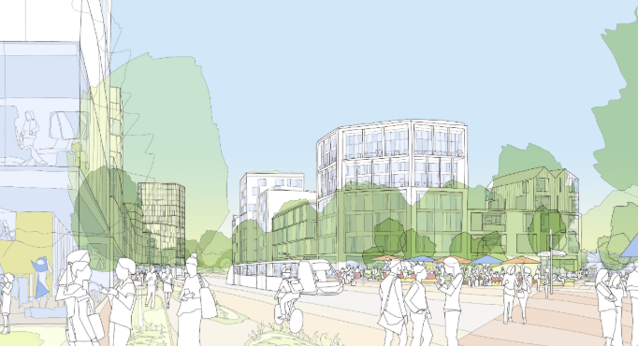
Economic Profile
301,075
People
Profile
- 1,351ha Land Zoned EE
- 554ha Undeveloped EE Land
- Employment Rate: 87%
- 37% Pop. Degrees or Higher
Industry Breakdown
- Commerce & Trade: 27.9%
- Professional Services: 32.1%
- Transport & Comms: 10.6%
- Manufacturing: 8.8%
- Public Administration: 5.8%
- Building/Construction: 5.1%
- Other: 18.7%
Business Parks
- Grange Castle
- Other: 30+
137,100
Employees
South
Dublin
85,000
Jobs
7000 Businesses
€153 m
Rates
3,652
Active LEO
Clients

Slide 3
Project Objective
The preparation of an evidence based, coherent and differentiated Economic Strategy for SDCC which will ensure a resilient economic environment for employment and businesses of all sizes to thrive, building on the core strengths' of the County.

Slide 4
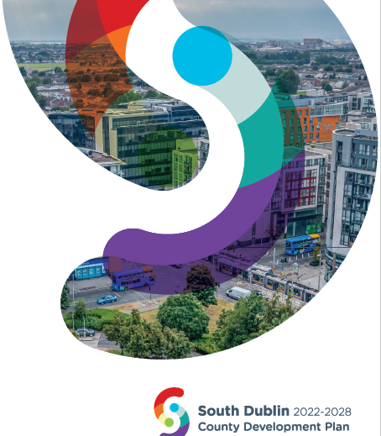
Policy Context
Project Ireland 2040 (National Planning Framework (revision is in draft form)
Regional Spatial and Economic Strategy (RSES) for EMRA
South Dublin County Council County Development Plan (CDP) 2022 - 2028
South Dublin County Council Tourism Strategy 2024 - 2029
South Dublin County Council Local Economic & Community Plan (LECP) 2024 - 2030
Dublin Regional Enterprise Plan to 2024
White Paper on Enterprise 2022-2030
Future IDA Plan – due to be launched early 2025
National Recovery and Resilience Plan
Enterprise 2025 Renewed - Building resilience in the face of global challenges
Report of the SME Taskforce: National SME and Entrepreneurship Growth Plan.
People, Place and Policy - Growing Tourism to 2025

Slide 5
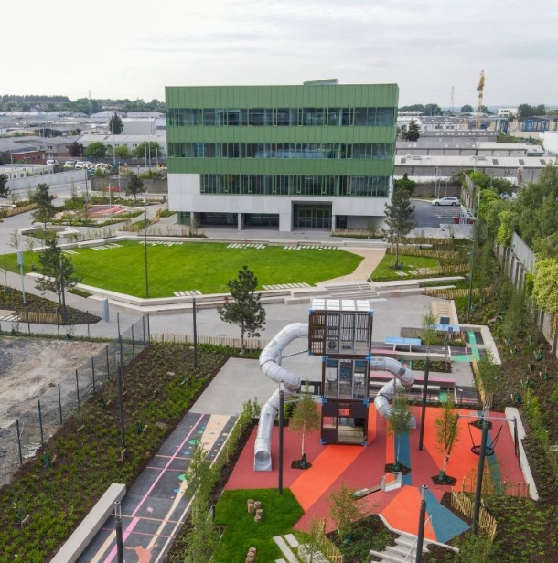
Project Brief
Evaluate the current economic landscape and challenges in the County.
Assess the future opportunity sectors, identifying specific growth sectors to maximise the County's economic potential and competitiveness.
Analyse current and likely future employment trends and associated skills requirements.
Identify existing and proposed sectoral clusters.
Examine employment projections for the County.
Estimate the quantum of space/land to accommodate additional employment capacity.
Evaluate the key components of place making and identification of areas where improvements would be beneficial to future employment potential.

Slide 6
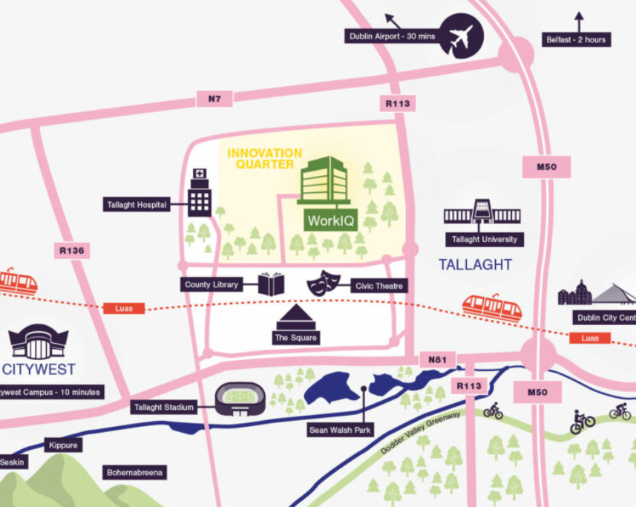
Deliverables and Priorities
Skills development, including synergies between educational institutions, existing enterprise and organisations.
Key priority sectors and economic activities that offer the highest potential for employment levels, competitive advantage / growth and optimal economic mix.
Key international and domestic markets to focus investment and trade promotion efforts.
A clear understanding of the monetary value of the existing economy and the future economy of South Dublin based on the implementation of the strategy.
The role of the evening time economy in supporting South Dublin’s economic development.
Clear and measurable targets and Key Performance Indicators (KPIs) to track progress and assess impact.

Slide 7
Strategy Development - Consultation
Steering committee of key stakeholders will be set up.
Stakeholder engagement at key milestones.
Engagement through workshops, presentations, surveys, interviews.
SPC fully engaged throughout the strategy development.

Slide 8
Timeline
07 December 2024
Tender and Project Brief uploaded to eTenders
29 January 2025
Tender deadline
10 February 2025
Bid Assessments / Award
October 2025
Strategy completion within 6 months from agreed start date.

Slide 9
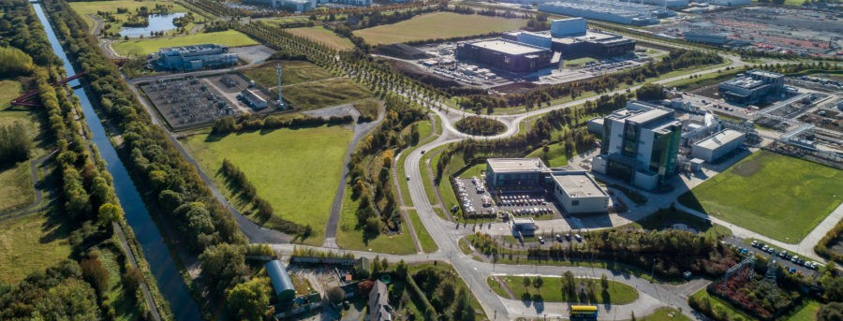
Outcome
To provide a suite of evidence based, implementable priorities and recommendations to focus the County on achieving economic resilience and success for the next 20 years.

Slide 10
Questions?

