Slide 1
Brittas Safety
Improvement Scheme
Options and Feasibility Report
Sept 2024

Slide 2
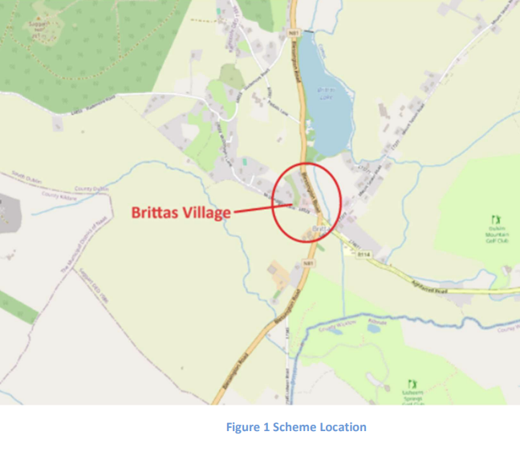
Current Safety Issues
There is very poor distinction between the rural and urban sections of the N81 at Brittas Village.
There are 3 No. sub-standard side road junctions within the village e.g. sightlines are insufficient, turning radii not adequate etc.
There is no provision for pedestrians to safely cross the N81.
Footpaths are too narrow (large sections of footpath <1.8m wide).
Road Signage is cluttered and poorly located.
See through effect travelling N81 in southbound direction onto R114.
The N81 carriageway through the village is too wide encouraging speeding.
Poorly located parking bays outside of the Blue Gardenia adjacent to McDonagh’s Lane

Slide 3
Traffic and Collision Data
Collission Data for the Period 2014 – 2023
Fatal Collision – 1
Serious Injury – 2
Minor Injury – 6
Material Damage – 12
Traffic Volumes
Southbound – 5299
Northbound – 4869
Aghfarrell Road (R114) – 6
McDonagh’s Lane (L6039) – 1694
Speed Survey (85th percentile)
South of Village– 75km/h
North of Village – 73km/h
Village Centre – 65km/h
Pedestrian Movements
19 movements over a 7 day period
This is very low but number would be expected to increase if a safe crossing was provided

Slide 4
Options
Option 1
Do Nothing
Option 2
Do Minimum – Hedge cutting, Road marking renewal
Option 3
Do Something – Traffic Calming and Urban Renewal
Option 4
Do Something – Traffic Calming, Urban renewal, Right turning lane

Slide 5
Preferred Option
Option 3 - Traffic Calming and Urban Renewal
Estimated cost is €890,000 and funding to be provided for from TII

Slide 6
Next Steps
Request TII approval to progress scheme from concept to preliminary design – Q4 2024
Engage with landowners regarding the acquisition of necessary land – Q1 2025
Engage with local community – Q1 2025
Part VIII approval – Q2 2025
Detailed Design – Q3 2025
Procurement – Q4 2025
Construction Q1 2026

Slide 7
Brittas Safety Improvement Scheme
QUESTIONS?

