Slide 1
Local Economic and Community Plan ( LECP) 2024-2030 9th December 2024

Slide 2
Background
LECP is an integrated plan that will guide the County’s economic and community development over the next 6 years
Prepared by the Council in conjunction with the Economic Development, Enterprise and Tourism SPC and the Local Community Development Committee (LCDC)
Extensive consultation with communities across South Dublin, the private sector, education and training providers, government agencies, departments and other key stakeholders.
Use text box for image caption if required

Slide 3
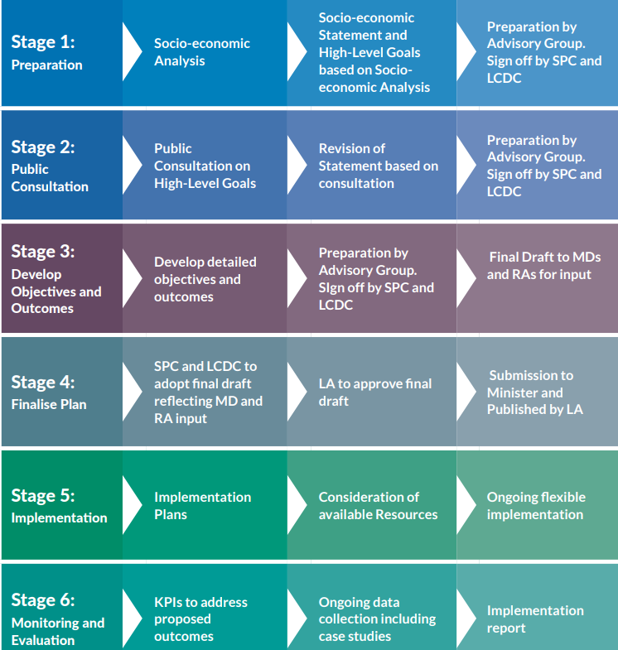
Six Stage Process
Use text box for image caption if required

Slide 4
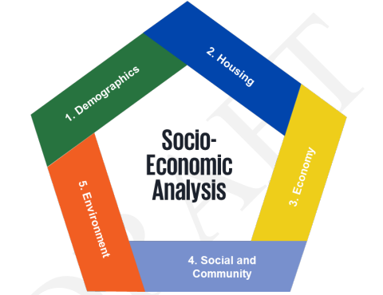
Social Economic Analysis/SCOT
Use text box for image caption if required

Slide 5
6 High Level Goals and 120 Actions
For the County of South Dublin to become a better place in which to live and work.
To improve the physical and mental health of those living and working in South Dublin.
Increase access to education, upskilling and lifelong learning to further meet the social and economic needs of residents and employers now, and into the future.
Fairness, collaboration and innovation to be at the core of South Dublin’s transition to becoming a low carbon county.
Empower communities through SMART initiatives and skills development to help make their areas better places in which to live, work and visit.
For society within South Dublin County to be more inclusive, equitable and welcoming of diversity
Use text box for image caption if required

Slide 6
Final Stage & Next Steps
AA & SEA Screening complete
LECP has been aligned with National, Regional and Local Plans, including the South Dublin County Development Plan
LCDC approved the draft LECP on the 16th October 2024
Economic, Enterprise and Tourism SPC approved the draft LECP on the 19th November 2024
Presented to South Dublin County Council on the 9th December 2024 for adoption & presented to Minister
Implementation – 2 -year plan (x3)
Monitoring and Evaluation
Use text box for image caption if required

