Slide 1
Housing SPC
5th December 2024
Headed Item H
EERP & Planned Maintenance

Slide 2
-
Planned Maintenance Programmes
Energy Efficiency Retrofit Programme
Windows and Doors Programme
Painting Programme
Balgaddy Advanced Maintenance Works
Stock Conditional Survey
Safety Works
5

Slide 3
-
Energy Efficiency Retrofit Programme
The objective of the programme is to upgrade properties with low energy ratings to a building energy rating (BER) of B2 or cost optimal equivalent. Funding of €2,822,000 was approved by the Department of Housing, Local Government and Heritage for 85 properties for 2024.
EERP Works include:
Replacement of Windows and Doors
Upgrade to wall and roof insulation
Installation of Air to Water Heat Pump
Up Grade to heating system and controls
Ventilation and Air Tightness measures
Below is an update on works to date –
85 homes issued to contractors for completion of works in 2024
62 homes completed to date with the remaining 23 due for completion by the end of the year.
97 homes surveyed and subject to tender preparation for 2025
5

Slide 4
-
Windows and Doors
A county-wide survey identified approximately 600 properties with single glazed timber or aluminium window frames requiring replacement.
Progress to date:
Works issued to contractors for 366 homes in 2024.
221 have been completed and 145 are with contractors.
Works are due to commence on a further 109 homes in 2025.
Breakdown of works by Local Electoral Area:
Local Electoral Area | Pre-Tender Stage | Tender Stage | Contractor Stage | Complete | Total
Tallaght South | 2 | 44 | 95 | 158 | 299
Tallaght Central | 0 | 7 | 18 | 23 | 48
Firhouse Bohernabreena | 0 | 0 | 8 | 7 | 15
Rathfarnham Templeogue | 0 | 0 | 18 | 17 | 35
Clondalkin | 1 | 26 | 1 | 7 | 35
Palmerstown Fonthill | 0 | 27 | 1 | 7 | 35
Lucan | 0 | 5 | 4 | 2 | 11
Total | 3 | 109 | 145 | 221 | 475
5

Slide 5
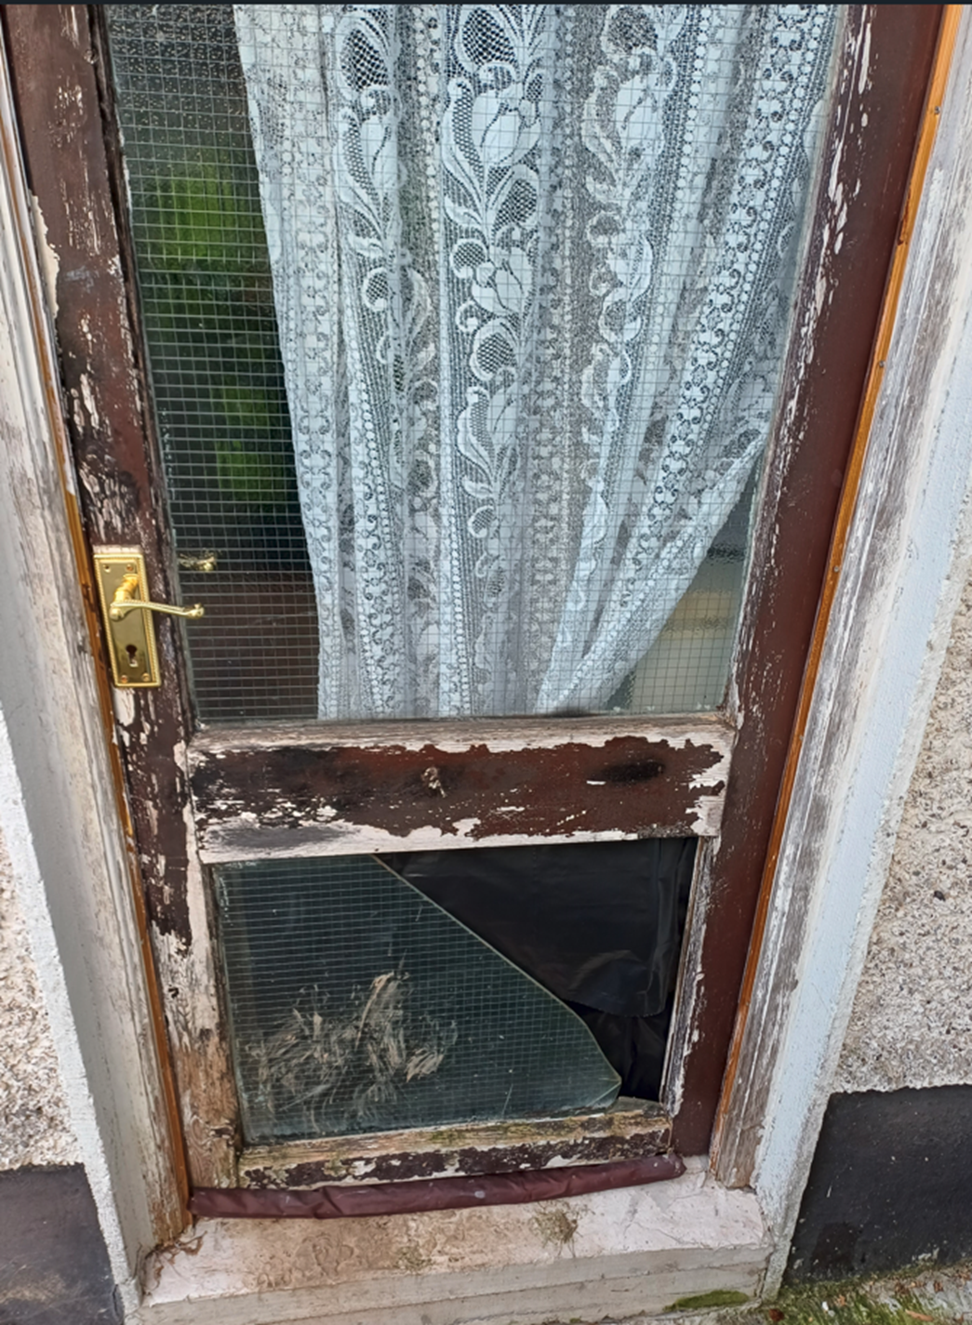
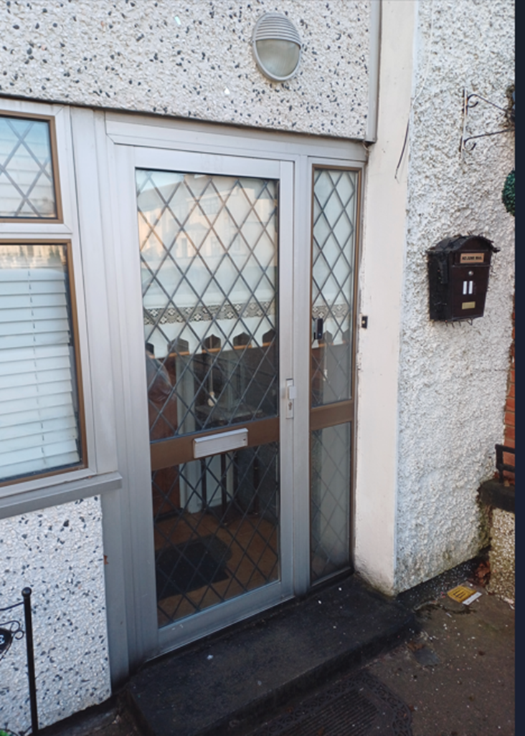
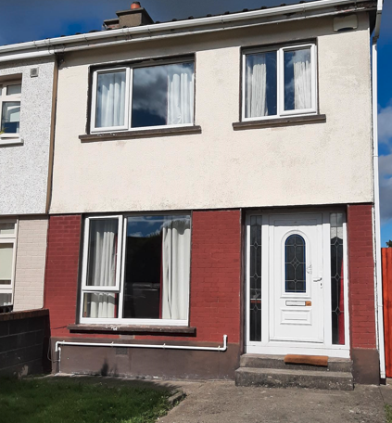
Windows and Doors

Slide 6
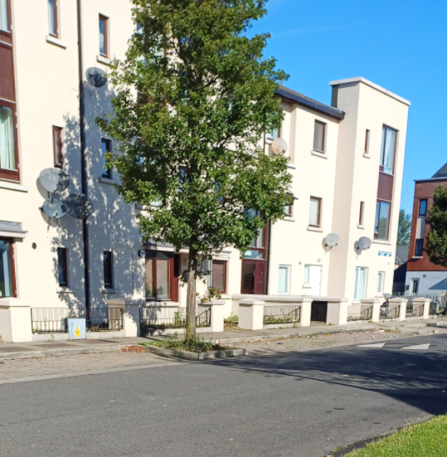
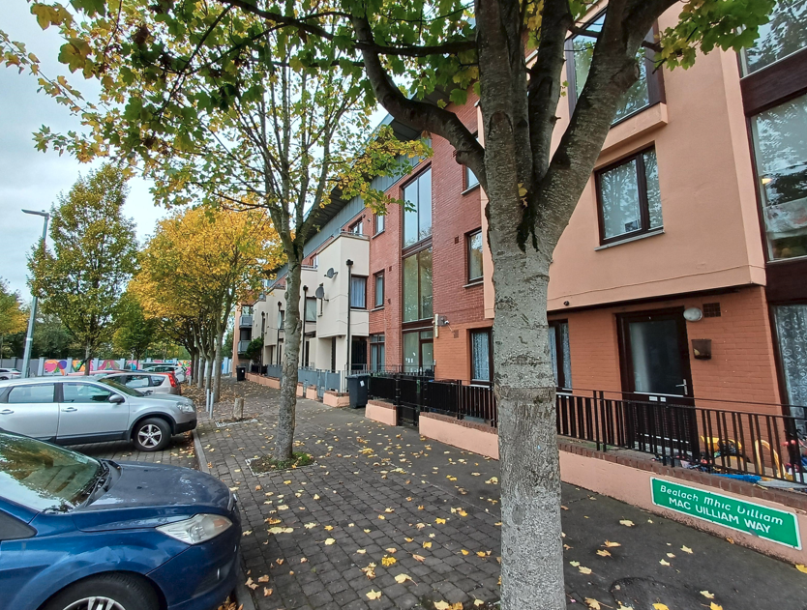
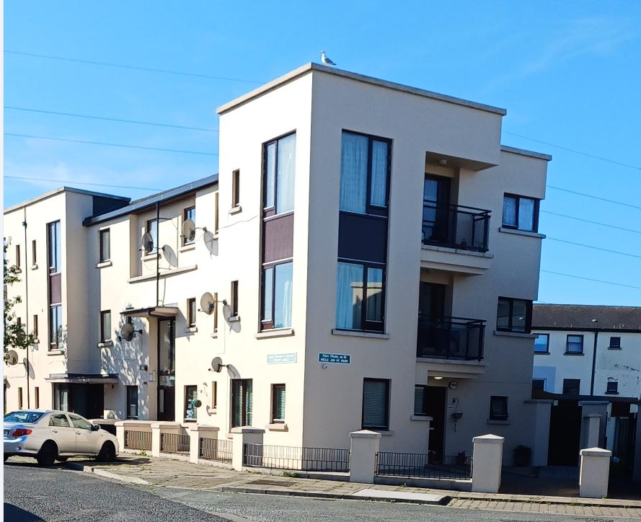
Painting Programme
-
External painting works were completed on 188 homes in the following locations:
Meile An Ri
Foxdene Avenue
Mac Uilliam
Greenfort Park
Liscarne Close
Tor An Ri Walk
Neilstown Village
5

Slide 7
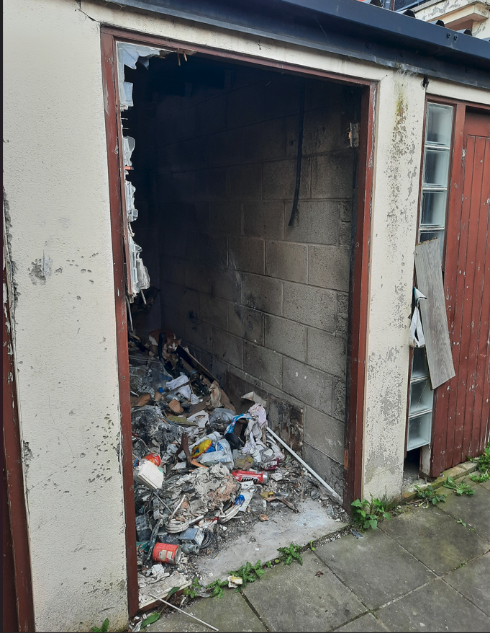
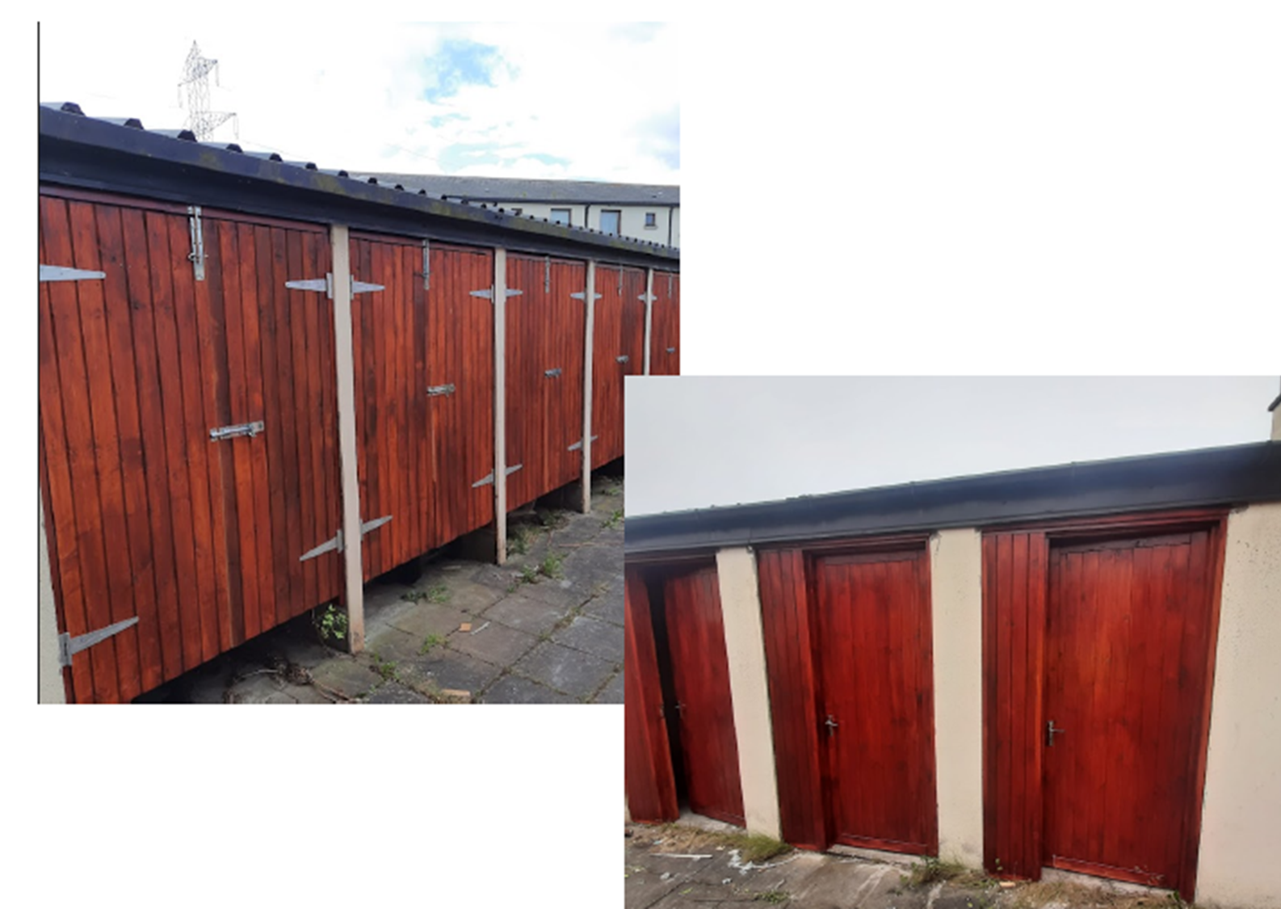
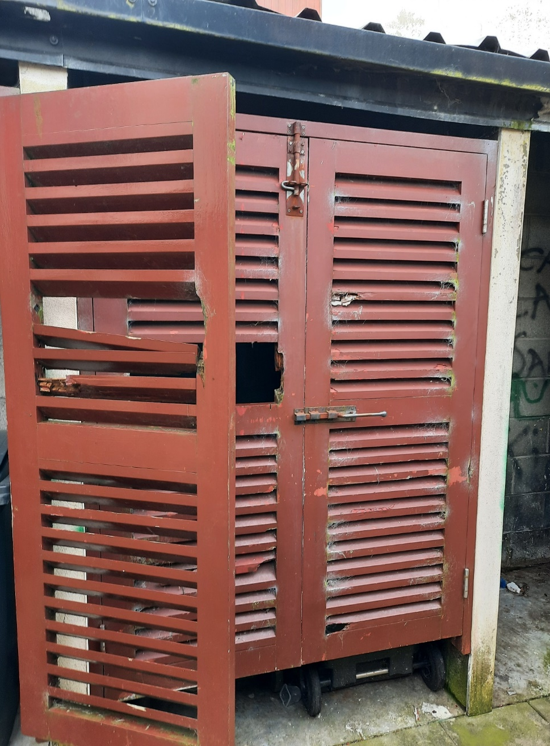
-
Balgaddy Advanced Maintenance Works
Roof repairs and associated works completed on 4 units in Tor An Ri Lane.
Ongoing repair works to bin storage areas to assist in the reduction of anti social behaviour. Phase 1 of 3 have been completed.
The housing maintenance team continue to carry out targeted communal clean ups in Balgaddy with 4 clean ups completed this year.
2
4

Slide 8
-
Stock Conditional Survey and Planned Works 2024
2024 Planned Maintenance allocation to fund the replacement of windows and doors.
33 properties completed at a recouped cost of €333k.
Stock Conditional Survey and Planned Works 2025
Housing Maintenance will commence periodic property inspection, whereby properties will be inspected on a 5-year cycle. The survey results will be integrated into the multi-annual Stock Investment Programme to minimise the need for reactive maintenance and optimize the cost-effectiveness of service delivery. Funding has been provided by the DHLGH to carry out the stock condition surveys. The tender has been awarded, and Stock Conditional Surveys are due to commence in Q1 2025. LGMA Asset Management Application “+Addjust” will assist with the completion of the surveys and the application is to be rolled out Q4-2024.
5

Slide 9
-
Safety Works
SDCC is undertaking a comprehensive fire safety upgrade programme to properties identified for maintenance and replacement of smoke alarms, carbon monoxide alarms, fire blankets, fire extinguishers and window restrictors. Works will be delivered under two keys areas –
Properties Constructed Pre-1994: Replacement of alarms and other safety measures will be carried out by a combination of in-house teams and external contractors. Works include replacement/maintenance of smoke/carbon monoxide alarms, fire extinguishers, fire blankets and window restrictors.
Properties constructed between 1994 and 2006: Approximately 1,900 homes within our housing stock were constructed between 1994 and 2006. Upgrade works will be carried out where required to allow for the hard wiring of existing fire and smoke detectors to the property electric mains supply. Works will be carried out by contractors on the existing electrical framework.
To date, 100 homes have received fire detection and safety work upgrades, and 400 homes have been referred to our contractor.
Other works:
Mechanical Ventilation: To date ventilation works have been carried out to 84 properties and works for a further 61 properties have been issued to contractors for completion.
Kitchens and Bathroom Replacement Programme
135 kitchens replaced to date in 2024
65 bathrooms replaced to date in 2024
5

