Slide 1
Traveller Accommodation Programme 2025 – 2029 Adopted by elected members of SDCC on 14th October 2024.

Slide 2
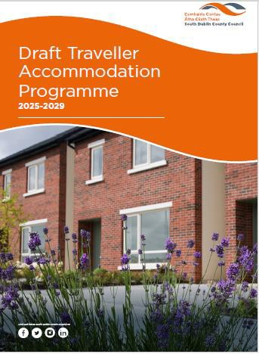
Introduction
Traveller Accommodation Act 1998- Prepare and adapt a 5- year plan to meet the existing and projected need for Traveller Accommodation in the County
Census 2022- There are 2098 Irish Travellers in South Dublin County- (9 Halting sites & 15 Group Housing Developments)
Public Sector Equality and Human Rights Duty
County Development Plan 2022-2028
1st January 2025- 31st December 2029
Latest date for adoption of the TAP is 31st December 2024

Slide 3
Consultative Process
On 9th January 2024, notice of intention to carry out the Assessment of Need and to prepare the draft accommodation programme- 5 submissions received
Independent consultants engaged to facilitate three workshops with Travellers living in the County in April 2024
The draft programme was published on the 1st July 2024
Notice of publication was advertised in the local press and on the
Council’s website, social media platforms and consultation portal
Two -month period given for submissions, with a closing date of 30th August 2024

Slide 4
Submissions & Issues
Submissions
Cena Culturally Appropriate Homes
Issues
Provision of transient site
Provision of culturally appropriate housing
Long term accommodation
Homelessness
Caravan loans
Traveller specific age friendly accommodation
Tenant participation
Wrap around supports for Traveller families
Chairperson of the LTACC
Tallaght Traveller Community Group
Clondalkin Traveller Development Group
Dún Laoghaire Rathdown County Council

Slide 5
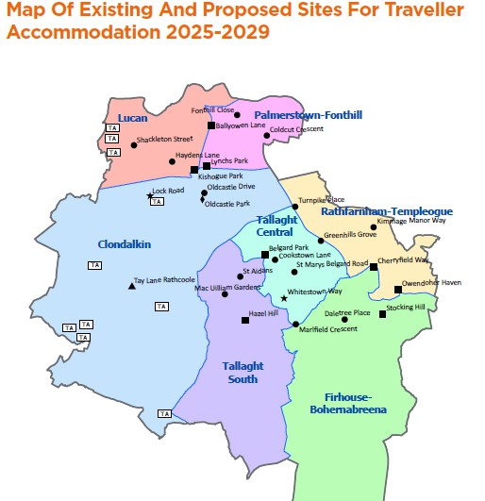
Summary of Assessment and Policy
Number | Accommodation Type
63 | Standard Social Housing Accommodation
6 | Bays
77 | Group Housing
146 | Total
Casual Vacancies in existing Traveller Accommodation sites
Refurbish existing Traveller Accommodation dwellings (ERP)
Redevelop existing hating sites and group housing schemes
Standard social housing
Construction of new Traveller Specific Accommodation

Slide 6
Summary of TAP 2025 – 2029
New construction Adamstown Rathcoole Newcastle
Redevelopment of sites at design/planning stage
Owendoher Haven Old Castle Park Kishogue Park Lock Road*
Other sites under consideration subject to feasibility studies
Belgard Park Hazel Hill Stocking Hill Cherryfield Whitestown Way*

