Slide 1
Clonburris SDZ Phase 6 - Delivery Options Housing Strategic Policy Committee Meeting 5th December 2024

Slide 2
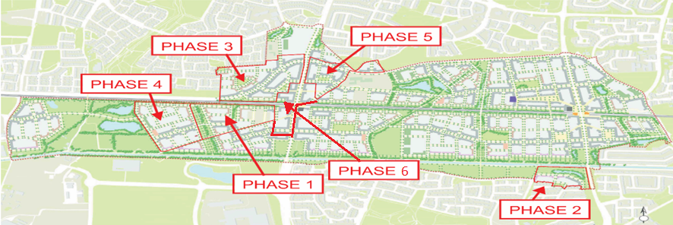
SDCC Housing Delivery
Use text box for image caption if required

Slide 3
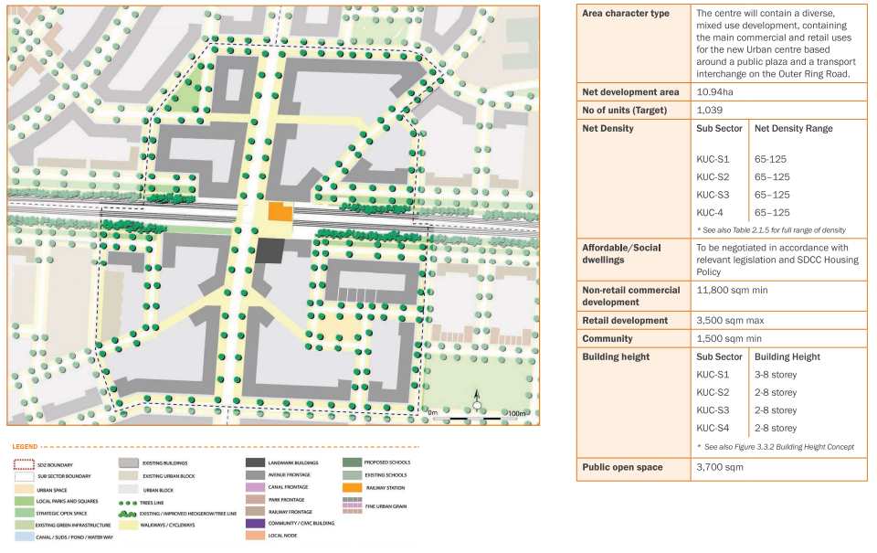
Phase 6: Kishoge Urban Centre
High-density urban centre development (from 2/3 to 8 storeys)
Capacity on Council-owned land for approx. 650 homes with mix of social, affordable purchase & cost rental tenures
7,635m² employment use & ≤ 900m² retail also required
Green infrastructure, gas main, rail corridor and urban core
Complexity & density of site - very challenging for SDCC to manage delivery of this scale & type of development

Slide 4
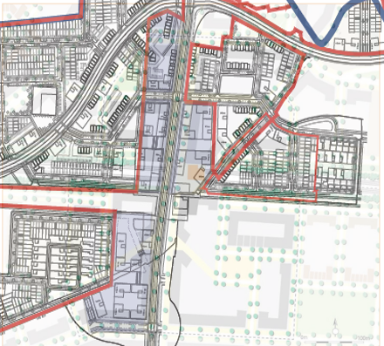
Phase 6: Kishoge Urban Centre
Options:
Procure development partner for detailed design, planning & construction?
Examine possible AHB or LDA partnership?
Wait until phases1-5 are progressed?
Proposed:
Competitive dialogue process to:
Explore cost, tenure mix & delivery timelines
Potential to benefit from market capacity to deliver, expertise & economies of scale which should accelerate delivery
Minimise risk to Council / direct sale process / explore cost rental management options
(s.183 approval required for building licence & land transfer for future sale of affordable housing on Council’s behalf)
Overlay of SDCC owned lands (coloured purple) within Kishoge Urban Centre

