Slide 1
Social Housing Delivery
Housing Strategic Policy Committee Meeting 5th December 2024

Slide 2
2024
Notes:
image
No alt text provided
Potential Units
No alt text provided
textbox
No alt text provided
No. of Potential Units Per LEA
No alt text provided
Housing for All Delivery Pipeline 2024
No alt text provided

Slide 3
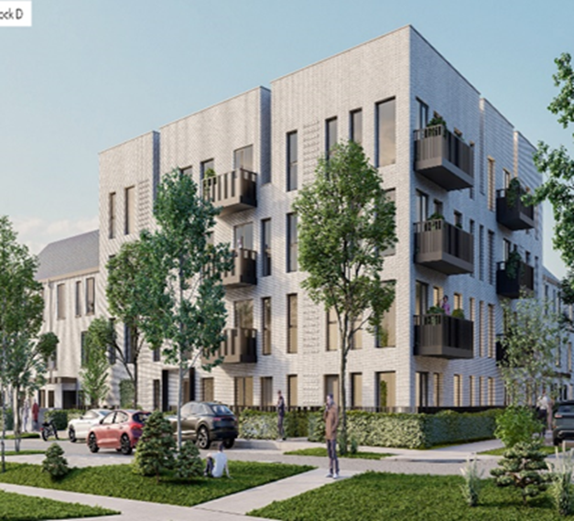
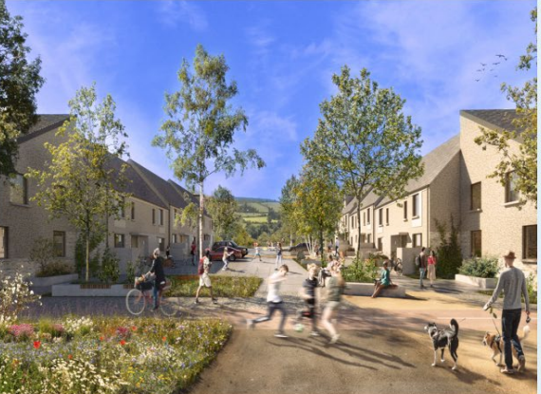
Large Development Sites
Kilcarbery Grange: 1,034 homes with 30% social (310 homes)
Phase 1 & 2 of this project is now complete, with delivery of 227 social homes to date. Construction on phase 3 will complete in December 2024, with completion of phase 4 anticipated by mid 2025.
Killinarden Foothills: 620 homes (including 125 social , 123 Private & 372 affordable purchase)
Commencement of works on-site to start mid December 2024. Phased delivery of first homes expected mid 2026.
Clonburris: Phases 1 & 2 comprising 382 homes (149 social), Phases 3,4,5 with potential for 1,275 homes
The tender process for construction of 266 social, affordable, and cost rental homes in the closed on the 22nd November 2024. This will now proceed to assessment and contract award. Anticipated on-site date in Q1 2025. The Part 8 report for 118 social homes on the PPP site adjacent to Lynch’s Lane went to full Council on Monday 11th November and was approved to proceed. Draft plans for approximately 1275 social and affordable homes were also presented to the Council and were noted ahead of the Part 10 application which will shortly be submitted to An Bord Pleanála.
Belgard Square North: 133 cost rental apartments
Contractor commenced on site April 2023. Delivery anticipated January 2025.
Rathcoole: Number of homes & tenure mix to be confirmed
Tender assessment underway for Architect led design team to progress the masterplan through to Part 10 planning application to An Bord Pleanála.
Clonburris Phase 3 - 5
Killinarden Foothills

Slide 4
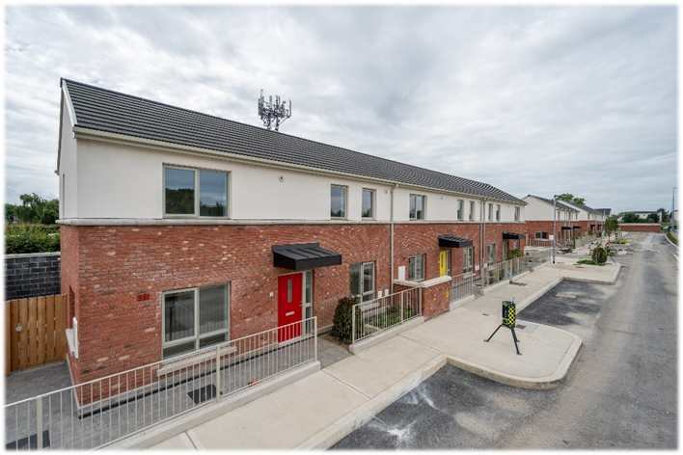
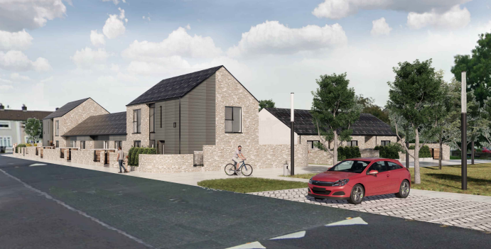
Own Build Developments
LEA | Project | Units | Status
Clondalkin | Old Nangor Road (Eircom) | 93 | Handover December 2024
 | Lindisfarne | 19 | Handover December 2024
 | Canal Bank Extension | 56 | On-site – phased delivery from late 2025. Mixed Tenure Scheme – 60 Affordable Purchase units
 | Kilcarbery Grange | 132 | On-site – 227 delivered to date. Balance to be delivered in 2024 & 2025
 | St Ronan’s Crescent (Age-Friendly) | 9 | Contractor appointed. Awaiting start date.
 | Alpine Heights (Age-Friendly) | 13 | Tender under evaluation
 | Deansrath – Melrose | 27 | Tender currently advertised.
 | Kilcarbery School Site | 18 | Construction will commence on site by December 2024, Includes 70 affordable purchase homes.
Firhouse – Bohernabreena | Homeville | 16 | On-site – completion Q1.2025
Tallaght South | Rossfield | 16 | Tender under evaluation.
Tallaght Central | St Aonghus Green (Age-Friendly) | 12 | Construction commenced August 2024 – 50 week programme
Old Nangor Road,
Clondalkin
St Aongus Green

Slide 5
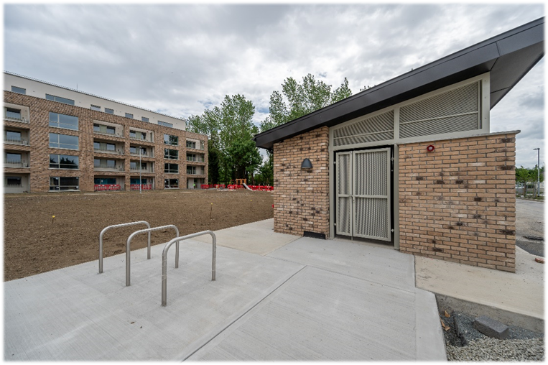
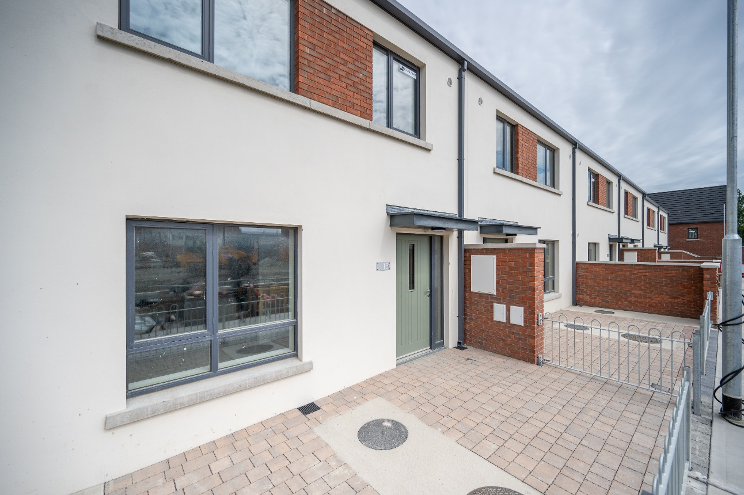
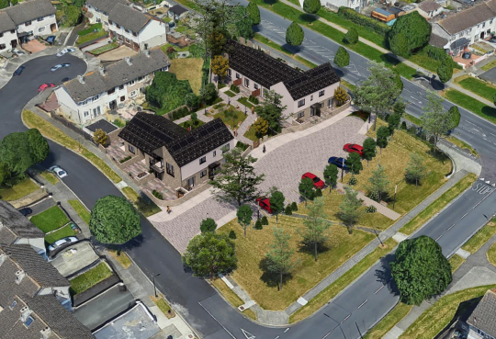
Own Build Developments
LEA | Project | Units | Status
Palmerstown - Fonthill | Balgaddy | 69 | Handover December 2024
Lucan | Sarsfield Park (Age-Friendly) | 5 | Tender under evaluation
Rathfarnham – Templeogue | Pearse Brothers Park | 10 | Contractor appointed.
New Nangor Road
Balgaddy
St Ronan's Crescent

Slide 6
Planning Derogation Sites – Section 179A
Rossfield Avenue, Tallaght
16 Social Homes
Advertised 14/12/2023. Enabling works commenced Sept 2024
Deansrath & Melrose, Clondalkin
27 Age-Friendly Social Homes
Advertised 14/12/2023. Tender advertised November 2024
Kilcarbery Grange, Clondalkin
88 Social and Affordable Homes
Advertised 21/12/2023. Commencement on site December 2024
Alpine Heights, Clondalkin
13 Age-Friendly Social Homes
Advertised 04/04/2024. Tender under assessment
Sarsfield Park, Lucan
5 Age-Friendly Social Homes
Advertised 11/04/2024. Tender awarded. Commencement on site December 2024
Castlefield, Old Knocklyon Road
33 Social and Affordable Homes
Subject to Judicial Review
Kishogue Park, Clonburris
15 Traveller Accommodation Units
Advertised 30/05/2024.

Slide 7
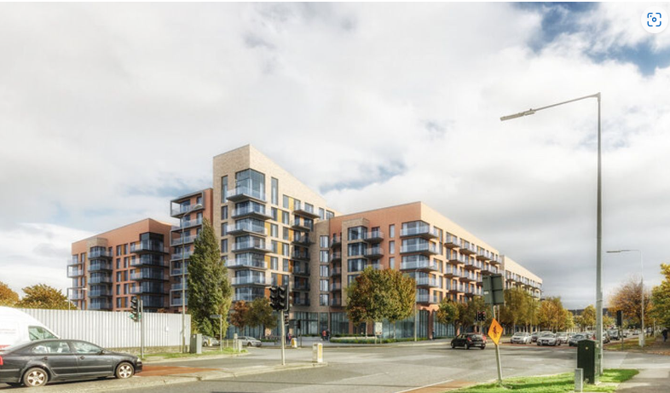
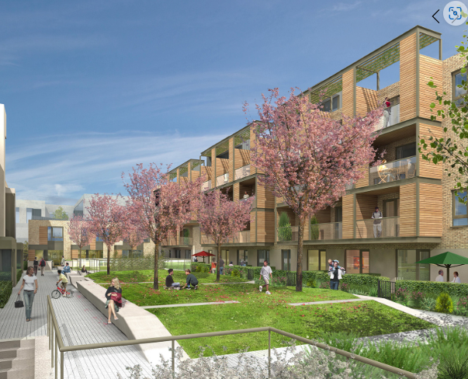
Approved Housing Bodies – Social Housing Investment Programme
LEA | Project | Units | Status
Clondalkin | Parklands, Citywest – Tuath Housing | 23 | Complete – delivered October 2024
 | Parsons Court, Newcastle. Co-operative Housing Ireland | 8 | On-site – completion Q1.2025
 | Seven Mills, Clondalkin Respond Housing | 172 | 24 delivered to date.
 | Graydon, Newcastle Tuath Housing | 24 | On-site – Completion Q4.2024
 | Gordon Park, FOLD Housing | 11 | On-site – Completion Q3.2025
Tallaght South | Cuil Duin, Citywest Tuath Housing | 36 | All units delivered June 2024
 | Foxwood Barn, Citywest Tuath Housing | 69 | On site. Phase 1 delivered.
 | Carrigmore Woods, Citywest. Tuath Housing | 137 | On-site – phased delivery from Q3.2025
Tallaght Central | Airton Plaza, Belgard Road Cluid Housing | 98 | Complete – delivered December 2024
 | Airton Rise, Greenhills Road. Respond Housing | 213 | On-site – phased delivery from Q3.2025
Airton Plaza, Belgard
Road
District Centre, Adamstown

Slide 8
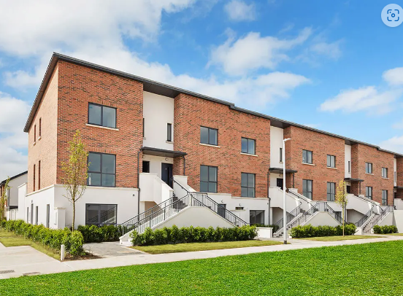
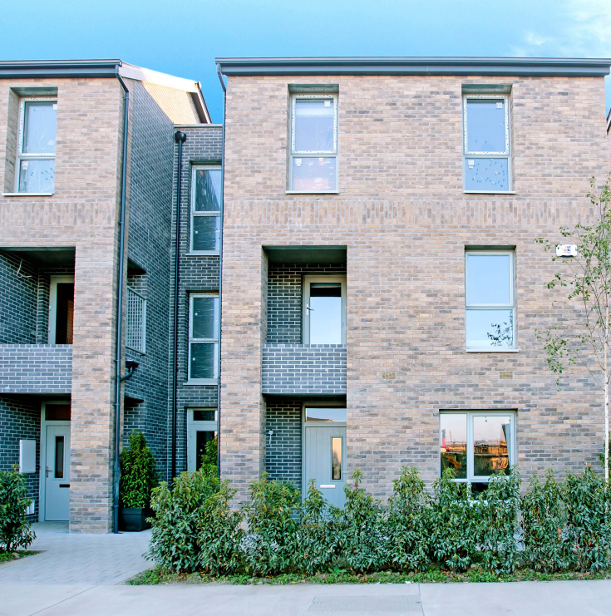
Approved Housing Bodies – Social Housing Investment Programme
LEA | Project | Units | Status
Lucan | The Crossings, Adamstown Oaklee Housing | 30 | Complete – delivered August 2024
 | Adamstown District Centre Tuath Housing | 44 | On-site – completion Q1.2026
 | Hallwell, Lucan Oaklee Housing | 64 | On-site – completion Q1.2025
 | St Helen’s Plaza, Adamstown Tuath Housing | 80 | On-site – phased delivery from Q1.2026
 | Somerton, Adamstown Cluid Housing | 68 | Due for delivery in 2026. Age Friendly Development
 | Tandy’s Lane, Adamstown North & East Housing Association | 15 | On site. Phased delivery from Q2.2025
 | Aderrig, Adamstown Cluid Housing | 23 | Complete – delivered October 2024
Tandy’s Lane, Adamstown
Hallwell, Lucan

Slide 9
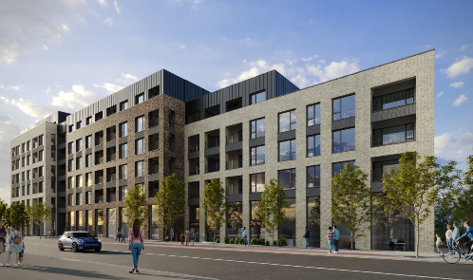
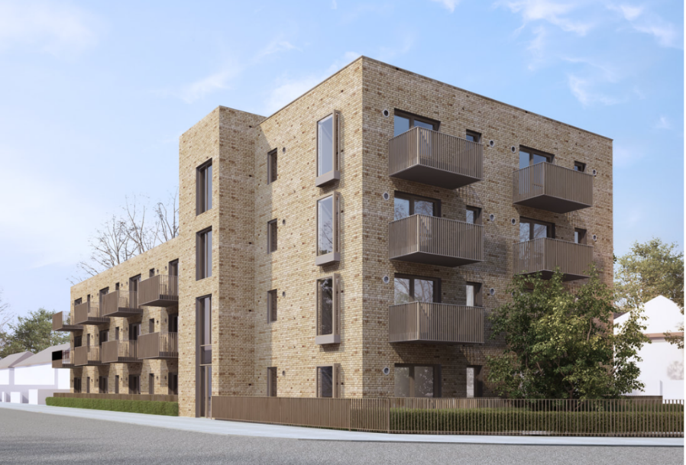
Approved Housing Bodies – Social Housing Investment Programme
LEA | Project | Units | Status
Rathfarnham – Templeogue | Whitehall Road West Focus Ireland | 13 | On-site – delivery from Q2.2026. Age Friendly Development
 | Walkinstown House Cluid Housing | 65 | On site. Due for delivery Q2 2025.
 | Cromwellsfort Road, Walkinstown (Age Friendly) Circle Housing | 20 | On-site – completion Q4.2024
Walkinstown House,
Dublin 12
Cromwellsfort Road
Age-Friendly

Slide 10
Overview
Notes:
textbox
No alt text provided
image
No alt text provided
Number of EOIs By Status
No alt text provided
Number of EOIs by LEA
No alt text provided
Total Number of EOIs
No alt text provided

Slide 11
SDCC Leasing 2024
Target 2024 (HFA) - 120

