Slide 1
Tymon Park South Pavilion Part 8 Process
Presentation to Council Meeting
9th December 2024

Slide 2
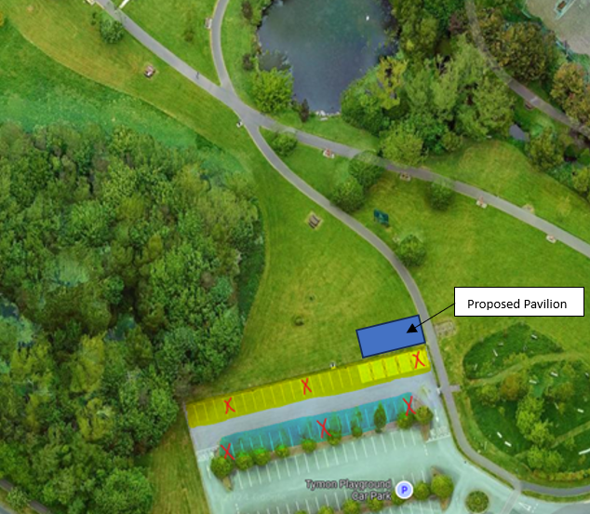
Tymon Park South Pavilion Location

Slide 3
Tymon Park South
Sports Changing Rooms Pavilion at Tymon Park South
One single storey pavilion building consisting of:
Two individual team changing rooms each with one WC area
Two storage areas and plant room
Ancillary landscaping works adjacent to the pavilion building
All associated ancillary works in adjacent areas including but not limited to foul & surface water drainage and utility supplies
CCTV
Appropriate Assessment Screening under the Habitats Directive (92/43/EEC)
Screening for Environmental Impact Assessment (EIA) under the EIA Directive 2014/52/EU.

Slide 4
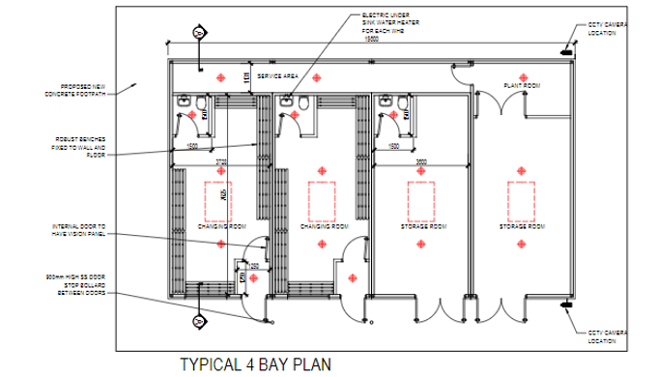
Proposed changing rooms
External Cladding:
Profiled powder coated single skin metal sheeting, mechanically fixed to building perimeter
Structure:
Light gauge steel or similar structure with 100mm Rockwool Insulation with 1 No. layer plasterboard with skim coat.

Slide 5
Part 8 Time Line
The plans and particulars of the proposed development were available for inspection online on the Council’s Public Consultation Portal website (http://consult.sdublincoco.ie)
Printed plans and particulars were available for inspection or purchase at a fee not exceeding the reasonable cost of making a copy at County Hall, Tallaght, Dublin 24 during office hours from 18th October 2024 to 15th November 2024.
Submissions or observations were made in writing up to 5pm on the 29th November 2024
Online Submissions: http://consult.sdublincoco.ie
Post to:
Senior Executive Officer Environment Water and Climate Change, South Dublin County Council, County Hall, Tallaght, Dublin 24 YNN5.

Slide 6
Process
Submissions:
5 submissions received.
Main Issues Raised and Reponses:
Concerns regarding proposed location
Concerns that location within car park would block views of the wider park
Concerns regarding environmental impact
The location at Tymon Park South; has been screened for environmental impact and represents the optimal position for the proposal. SDCC have a pitch upgrade programme underway, which includes proposals to improve the existing pitches at Tymon Park, which will increase their playability and usage.
The proposed location has been assessed for potential impact to views and while proposal impacts on views from eastern car park spaces it does not block views from western car parks spaces, which has best view of the ponds at that location (additional wheelchair spaces will be provided within the car park)
It is recommended that, as the proposal is in conformity with proper planning and sustainable development, that the Council proceed with the Part 8 proposal for the Sports Changing Rooms Pavilion at Tymon Park South, Tallaght, Dublin 24.

Slide 7
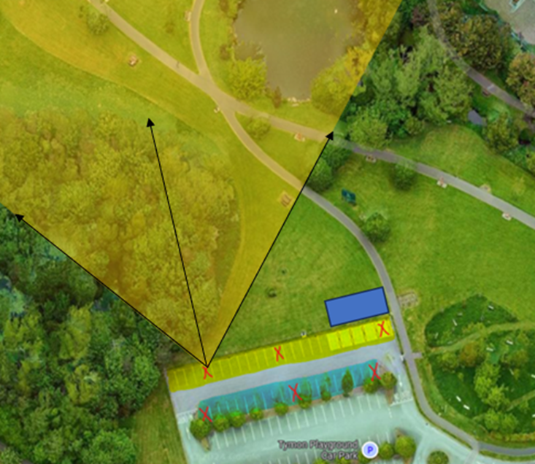
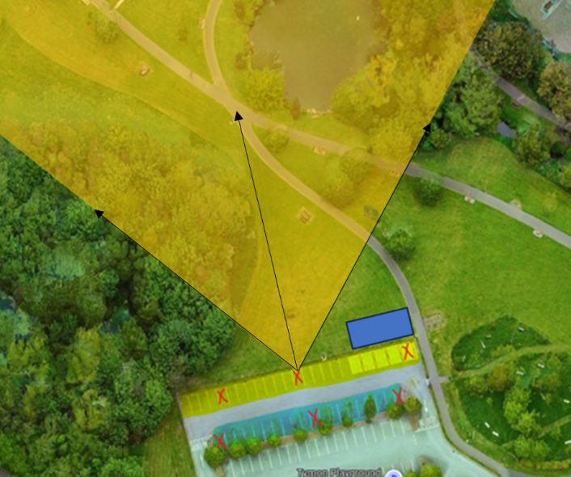
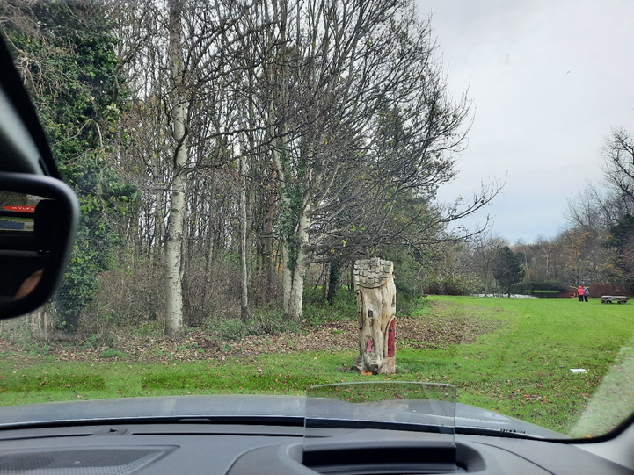
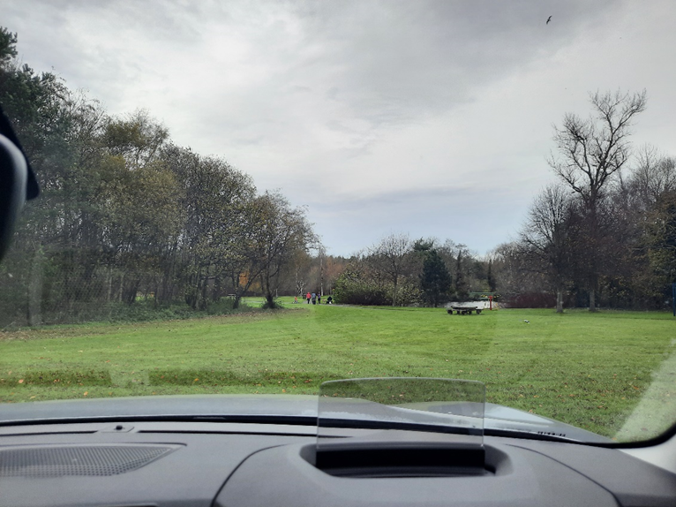
View analysis
2 views shown below; see CE Report for full analysis:

Slide 8
Pavillions Next Steps
Complete:
April 2024: Programme review presented to Council
April-Sept 2024: Environmental frameworks in place and concurrent preliminary design and detail design for modular buildings
November 2024: Civil Works framework in place
November 2024: Decision on Part 8s for Collinstown, Kilnamanagh, Sean Walsh Park, Arthur Griffith Park, Kiltipper & Willsbrook
Next Steps:
December 2024: Decision on Part 8 for Tymon Park South
Issue framework tenders for modular buildings using Corkagh & Griffeen Pavillions
Jan / mid Feb 2025: Tender assessment and award with 8-week lead in and mobilization post same.
Mar 2025: Contractor mobilization for civil works at Corkagh & Griffeen and concurrent modular building manufacture with mini competitions for remaining locations to commence post establishment of framework.
Mid April 2025: Modular installation at Griffeen & Corkagh
Further approved locations progressed after initial projects with estimated 28-week delivery timeframe, dates to be advised by contractor.
*Dates subject to change depending on planning, procurement, manufacture, construction etc.

Slide 9
Pavillions Part 8s
Thank you

