Slide 1
One Dig Policy
Minimising the Impact of Roadworks
Sept 2024

Slide 2
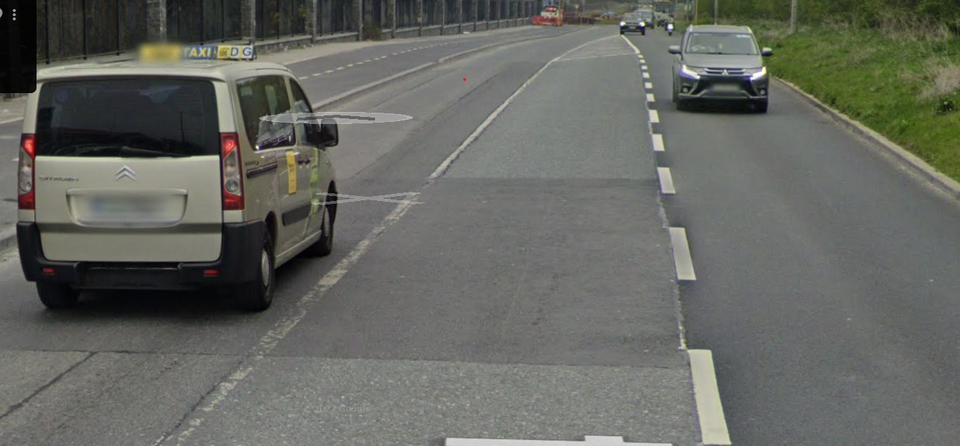
Current Issues
Road Network being dug up on a repeated basis by utility providers resulting in
Increased disruption to the public
Weakness in road structure
Reduced life span of road surface
Increase in minor defects
Poor environmental practice
To resolve the SDCC are now looking to create a “One Dig Policy”

Slide 3
One Dig Policy - Definition
A collaborative approach to infrastructure development where utility providers (e.g., telecoms, water, electricity) and local authorities coordinate their work to install or upgrade infrastructure during a single excavation.

Slide 4
One Dig Policy - Benefits
Cost Savings: Combines multiple projects into one excavation, reducing labor and restoration expenses.
Minimised Disruption: Cuts down roadworks, traffic delays, and public inconvenience.
Faster Deployment: Speeds up infrastructure projects like broadband and utilities.
Environmental Benefits: Lowers carbon emissions and construction waste through fewer digs.
Better Coordination: Encourages collaboration among utilities and local authorities for efficient planning.
Community Relations: Reduces disruption, building trust with residents and businesses.
Future-Proofing: Prepares for growth by installing ducts for future tech upgrades.
Supports Digital Goals: Aligns with GIA and initiatives for broadband and 5G.
Improved Safety: Reduces risks from prolonged roadworks.

Slide 5
One Dig Policy - Challenges
Complex Coordination: Aligning schedules and requirements across multiple stakeholders is difficult.
Upfront Costs: High initial investment may strain smaller providers.
Regulatory Barriers: Legal and regional differences can cause delays.
Technical Challenges: Designing shared systems to meet diverse needs is complex.
Stakeholder Resistance: Conflicting interests can hinder cooperation.
Initial Disruption: Implementation may cause temporary public inconvenience.
Maintenance Disputes: Ownership and upkeep of shared infrastructure can be contentious.
Limited Awareness: Lack of understanding or political will delays progress.
Tech Evolution: Infrastructure may struggle to keep up with rapid technological changes.
Funding Issues: Securing sufficient public and private funding is challenging.

Slide 6
One Dig Policy – Next Steps
Policy Document SDCC are currently drafting a “One Dig Policy” with the intention of having a finalised policy by Q1 2025
Communication SDCC will need to circulate this strategy to the primary stakeholders (utility providers, major end of line users) and outline the new policy and when it will be implemented from
Implementation SDCC to draw up a list of measures to assist in the roll out of the policy
Application to install great than 200m of services in the road
Minimum advance notice period of 12 months
Map to view future dig locations
Monthly circulation of all applications to keep stakeholders informed

