Slide 1
HGV Policy & Procedures Review Update
HGV weight restrictions is an Executive function.
Gross vehicle weight (GVW) is the total weight of a vehicle and its load.
The permitted Gross Vehicle Weight restrictions are contained in S.I. 332 of 2012.
Typical vehicle types and their gross vehicle weight categories are shown in the following illustrations:

Slide 2
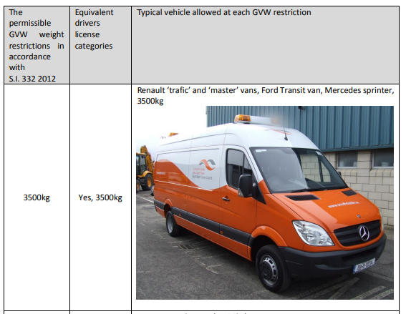
Gross Vehicle Weight Categories

Slide 3
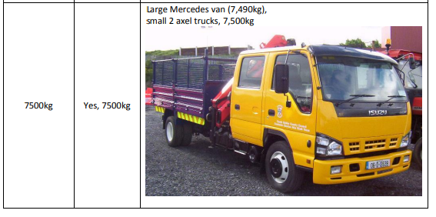

Slide 4
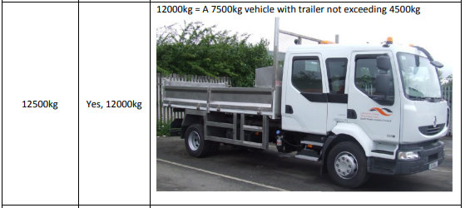

Slide 5
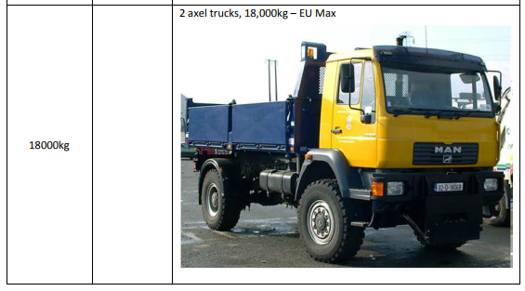

Slide 6
Key Principles in setting Weight restrictions
The safety of pedestrians is key in setting weight restrictions.
Typical proportion of vulnerable users on the Road.
Are there alternative and more suitable roads for the HGV’s?
SDCC need to balance the safety needs of pedestrians against economic activity needs of an area.
We need the agreement of an Garda Síóchána.
It is key to set appropriate Weight Restrictions in terms of Weight class and or Time Limit for Weight Restriction.

Slide 7
Proposed Procedure to review HGV weight Restrictions
Request the Elected members to send SDCC Traffic Section(TS) proposed roads be assessed for suitability for weight restriction.
SDCC (TS) to review the list of locations for suitability to have a weight restriction implemented.
SDCC TS will organise a workshop with each of the four Area committees to prioritise a proposed preliminary list.
SDCC TS will forward the preliminary list to an Garda Síochána for agreement.
Produce a Weight Restriction Masterplan for the agreed weight locations.
Implement weight restrictions on those roads agreed by an Garda Síochána.

