Slide 1
South Dublin County Development Plan 2022-2028 2 Year Progress Report
County Council Meeting 9th December 2024

Slide 2
2 Year Progress Report – Legislative Requirement
Duty of a Planning Authority to take such steps within its powers as may be necessary for securing the objectives of the Development Plan
A requirement that a report on the progress achieved in securing objectives is provided to Members within the first two years of the Plan being made
There is also a requirement to monitor the SEA objectives

Slide 3
Format of the Report and SEA Monitoring
A main highlights section which outlines progress on key policy areas within the Plan chapter by chapter
An overview of the status of the objectives within each chapter in chart format
Appendix 1 which lists each one of the 878 objectives contained in the Plan and gives individual commentary and status
Appendix 2 which gives more detail on objectives in the green infrastructure strategy
Appendix 3 which gives detail of the study on employment lands
An SEA Monitoring Report

Slide 4
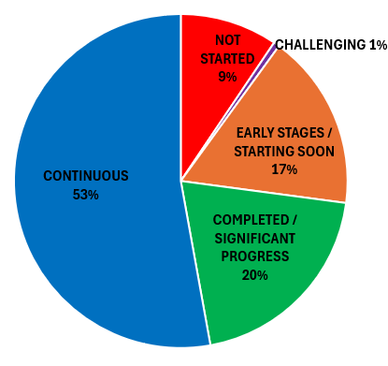
Key Findings on Progress
20% of objectives have been achieved or significantly advanced with a further 17% started or due to start soon
Most objectives are of a type that they are applied on an on-going basis
Just 9% not started
A small amount, 1% are challenging to monitor and their wording or intent will need to be reviewed in the preparation of the next CDP

Slide 5
Innovation - Housing Supply Monitor
In meeting monitoring objectives of the Plan a new Housing Supply Monitor has been developed in-house and will be made public after this meeting Housing Supply Monitor
Notes:
The monitor provides data, updated quarterly, on residential completions since the Development Plan came into effect – this allows for monitoring of the targets set out in the core strategy. The monitor provides for information to be filtered by area, by residential type, by construction status and also indicates the number of bedrooms supplied. It allows for analysis of the ratio of greenfield to brownfield development which is important for understanding delivery of compact development. There is also data on the length of time planning permissions take to be constructed and how long it takes to get planning permission.

