Slide 1
SPC December 2024
Housing Adaptation Grants for Older People and People with a Disability

Slide 2
Overview
To support to individuals with disabilities by ensuring necessary
adaptations, repairs, or improvements are made to their
homes to better suit their needs.
To provide assistance to older people (66 and over) living in poor housing conditions with essential repairs or upgrades.

Slide 3
2024 Budget : €4.5m
Housing Adaptation Grant (HAG)
€3,533,900
Housing Aid for Older People Grant (HOP)
€725,000
Mobility Aids Grant (MAG)
€271,800

Slide 4
Grant Scheme Provisions
From 1st December 2024, S.I. No. 612/2024 - Housing (Adaptation Grants for Older People and Disabled People) Regulations 2024 came into effect.
Main changes include:
Housing Adaptation Grant – max grant increased from €30,000 to €40,000
Housing Aid for Older People – max grant increase from €8,000 to €10,700
Mobility Aids Grant – max grant increase from €6,000 to €8,000
Income will be assessed based on homeowner and spouse in owner occupied housing and tenant and spouse in private rent accommodation, previously assessed on full housing income.
Deductions for children and full-time carers increased from €5,000 to €6,250
New deductions include:
Housing mortgage/rent expenses – up to €6,250
Residential Care fees – up to €12,500

Slide 5
Grant Scheme Provisions
Housing Adaptation Grant (HAG)
Purpose: Assists individuals with disabilities in making necessary adaptations to their homes.
Maximum Grant: €40,000
Eligibility: Means-tested and requires a recommendation from an Occupational Therapist.
Housing Aid for Older People Grant (HOP)
Purpose: Provides funding for essential repairs and improvements for older adults aged 66 and above.
Maximum Grant: €10,700
Eligibility: Means-tested.
Mobility Aids Grant (MAG)
Purpose: Supports mobility-related works for older persons
Maximum Grant: €8,000
Eligibility: Means-tested for households with an income below €37,500 and requires a recommendation from an occupational therapist.

Slide 6
Average Timeline
Initial Inspection & Validation:
2 weeks
Costing:
2 weeks
Senior Management Review:
1 week
Approval letters issued to applicants:
1 week
Assessment of the application and evaluation of the property.
Preparation of an estimated cost for the proposed works and approval.
Final review and approval by senior management.
Notification of approval sent to applicants.

Slide 7
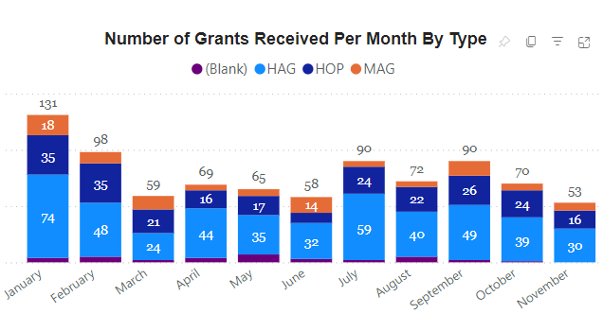
Applications received 2024
Applications Received -855
Applications Approved – 629 average value €7,790
Online Applications -20
53% of applications are deemed invalid, requiring follow up by Grants team

Slide 8
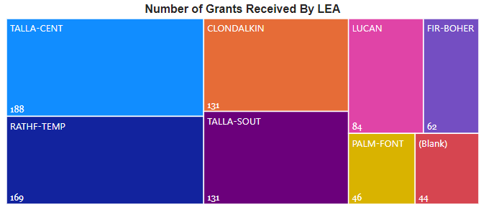
Breakdown by Local Electoral Area
Type of Works
Level Access Facilities
Downstairs WC
Stairlifts
Ramps And Handrails
Steps
Handrails
Grab Rails
Higher Toilets
Hoists
Extensions
Platform Lifts
Level Access Threshold (Doors)
Windows And Doors
Heating Systems
Oil And Gas Boilers
Electrical Upgrades
Roof Repairs

Slide 9
Common Issues
Non-Valid Applications
Significant number (53%) of applications require follow up and may be returned due to incomplete forms and missing documentation
Common missing documents
Income statements
LPT statements
OT receipts
Contractor letters
Access for Inspections
Difficulty in contacting applicants to arrange inspection as a suitable time to carry out necessary inspections.

Slide 10
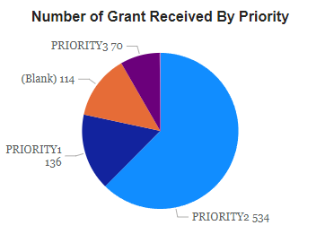
Additional Considerations
Priority Status
Challenging to prioritise one applicant over another.
Priority status is given to an applicant by their doctor to assist with deciding how urgent an application is determined.

Slide 11
Grant Scheme Provisions
Priority 1
Person is terminally ill or fully / mainly dependent on family OR a carer or adaptations would allow them leave hospital/residential care
Priority 2
Person is mobile but need help to access washing, toilet facilities, bedroom or person’s ability to function independently would be harder without the adaptations
Priority 3
Person is independent but needs adaptations to future proof their home so they can live there independently.

Slide 12
Additional Considerations
Quotations for certain works not required. South Dublin County Council Standard Costing document is available on www.sdcc.ie. This outlines standard costs used for various works.
Applications can be downloaded and posted or applicants can apply online, see information and links below:
Housing Grants - SDCC
(81) HOL PHG Short HD – YouTube
Housing Online
.

Slide 13
Housing Grants Team
To apply for a grant or if any questions :
Phone: 01 414 9373
Email hgrants@sdublincoco.ie

