Slide 1
South Dublin SAFE SCHOOL ZONES
Land Use Planning and Transportation Strategic policy Committee. December 2024

Slide 2
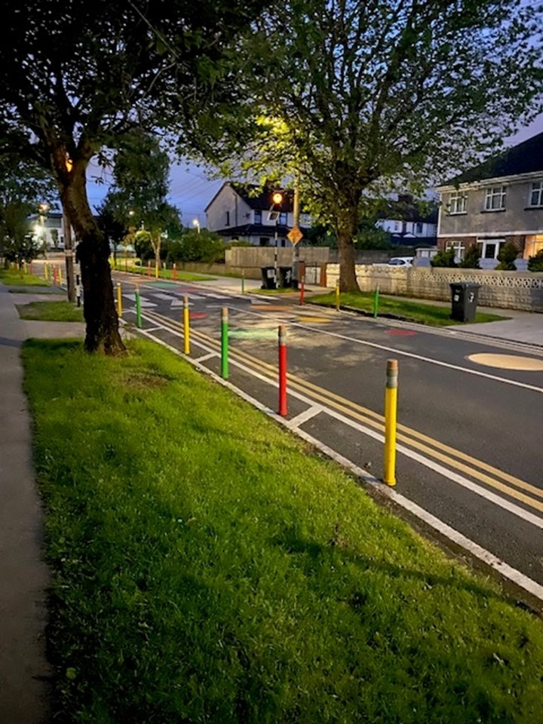
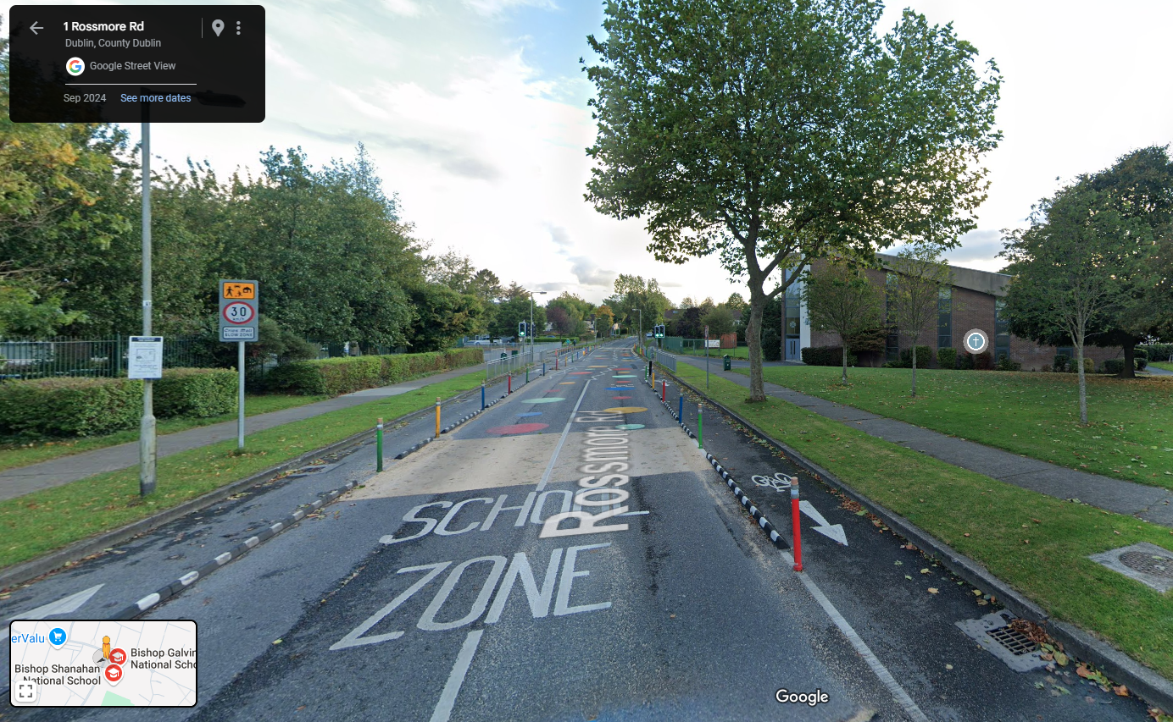
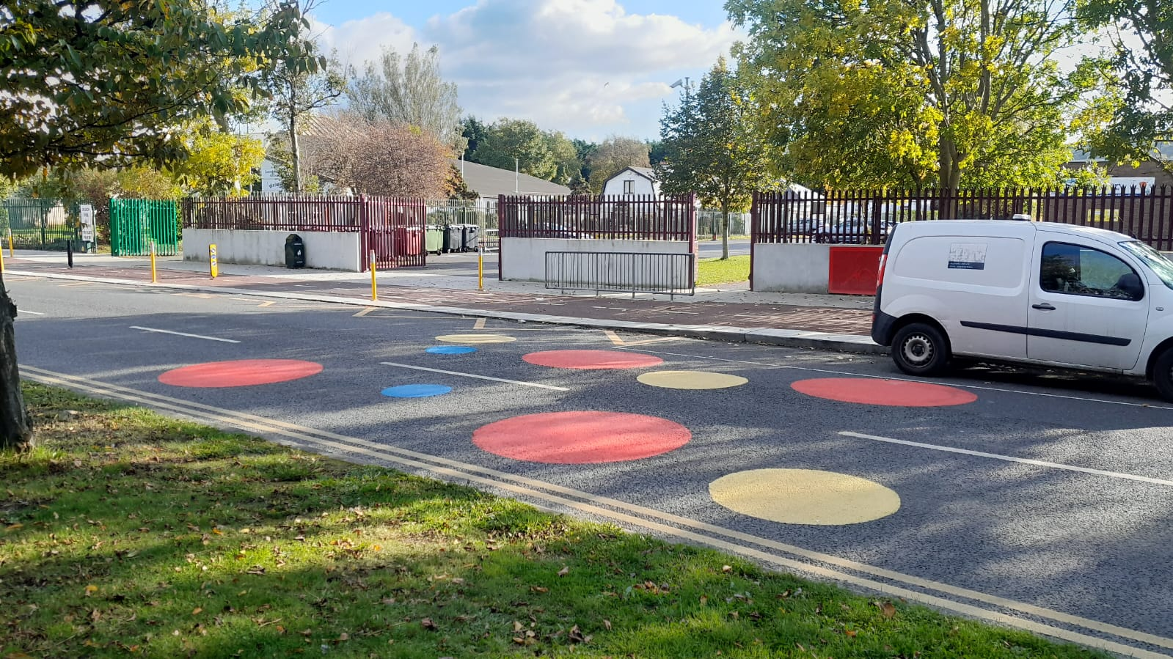
Safe Routes to Schools
The Safe Routes to School (SRTS) Programme was developed by the NTA and Green-Schools, An Taisce, in 2020, as a response to the need to support schools to increase walking and cycling to school.
SDCC have completed works to 6 schools since then, over two rounds of funding, with designs for 2 more at a detailed stage and 5 more to commence in 2025.
The works included in the SRTS programme can include large scale intervention such as junction tightening and new footpaths as well as bollards, road markings, pedestrian crossings and signage.
Clockwise from Top Left: Bishop Galvin, Templeogue; Sacred Heart Killinarden, Road Markings and coloured roundels

Slide 3
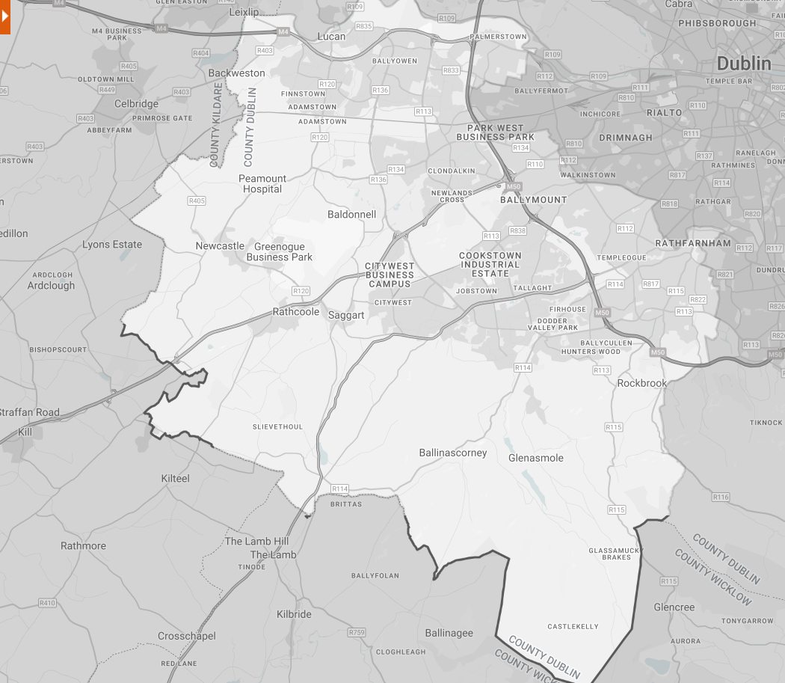
Safe Routes to Schools
5-6 Schools from the SDCC area will be included in Round 3 of the SRTS programme:
St. Thomas’ JNS Lucan – Esker, Lucan
Scoil Áine Naofa – Esker, Lucan
Sacred Heart SNS – 13 Whitestown Dr, Tallaght Business Park, Dublin 24
Scoil Naomh Aine – New Rd, Brideswell Commons, Dublin 22
St. Colmcille’s SNS – Idrone Avenue, Knocklyon, Dublin 16
Glenasmole National School – Bohernabreena
GRIFFEEN PARK
Round 1 Schools
Round 2 Schools
Round 3 Schools

Slide 4
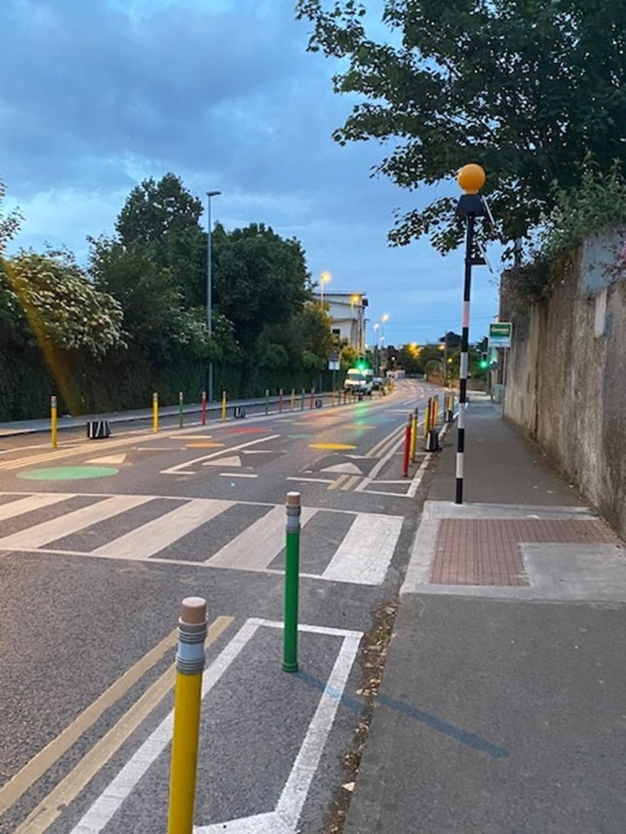
South Dublin Safe School Zones
Many other schools in South Dublin have requested similar works to increase the safety of the drop off zones around entrances but cannot be accommodated on the SRTS programme.
The Active Travel unit has compiled a list of such schools and a is considering a menu of options that can be delivered at a smaller scale and lower cost.
It is proposed to allocate a funding stream to progress interventions at locations where no other means of providing a safe school zone is available.
A set of suitability criteria for these works are being prepared and a budget and framework for these is in progress .

Slide 5
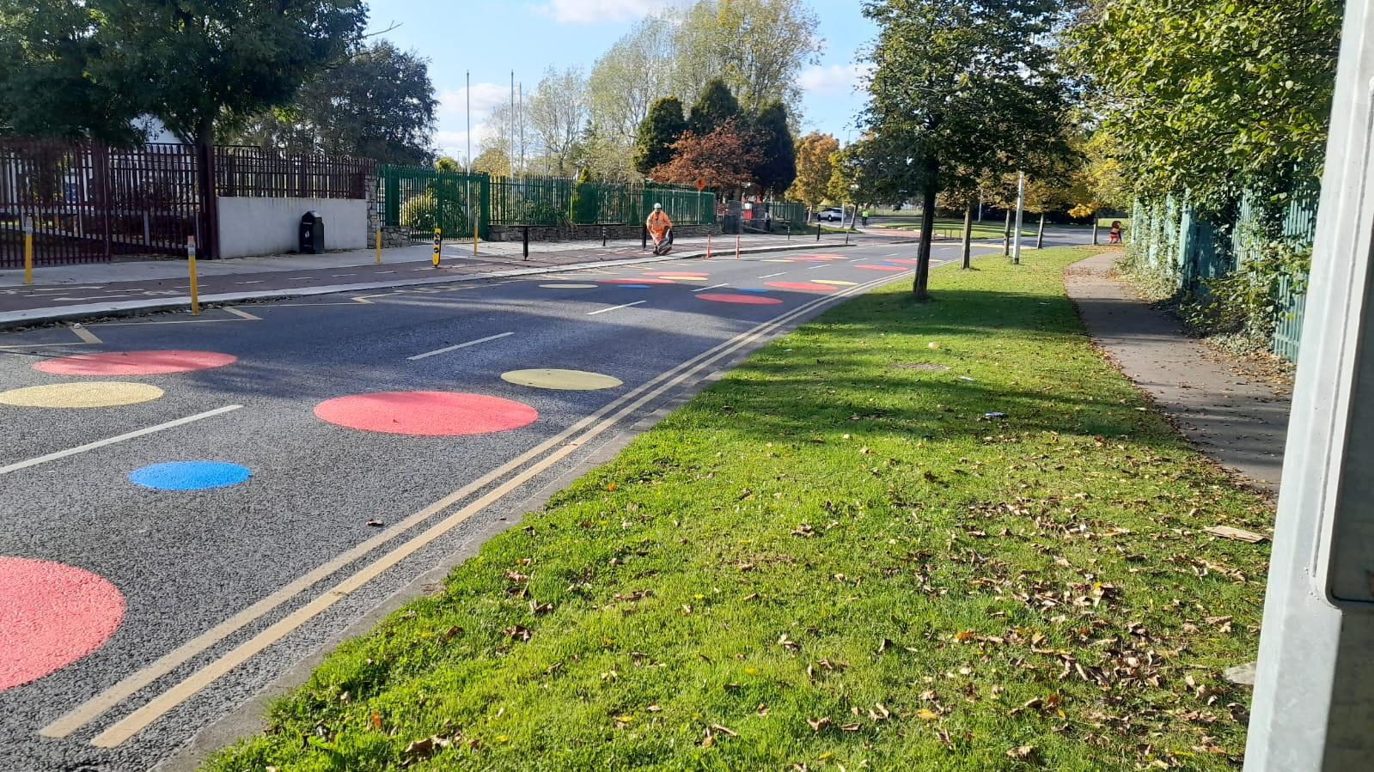
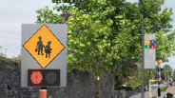
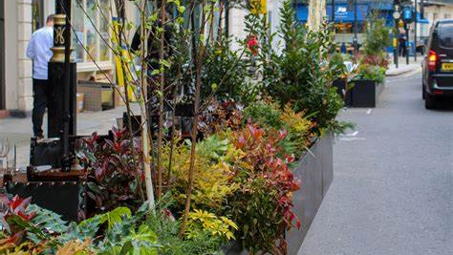
Safe School Zone Interventions Menu
Roundels
Pencil Bollards
Line Marking
School Warning Signs
Pedestrian Crossings
Planters

Slide 6
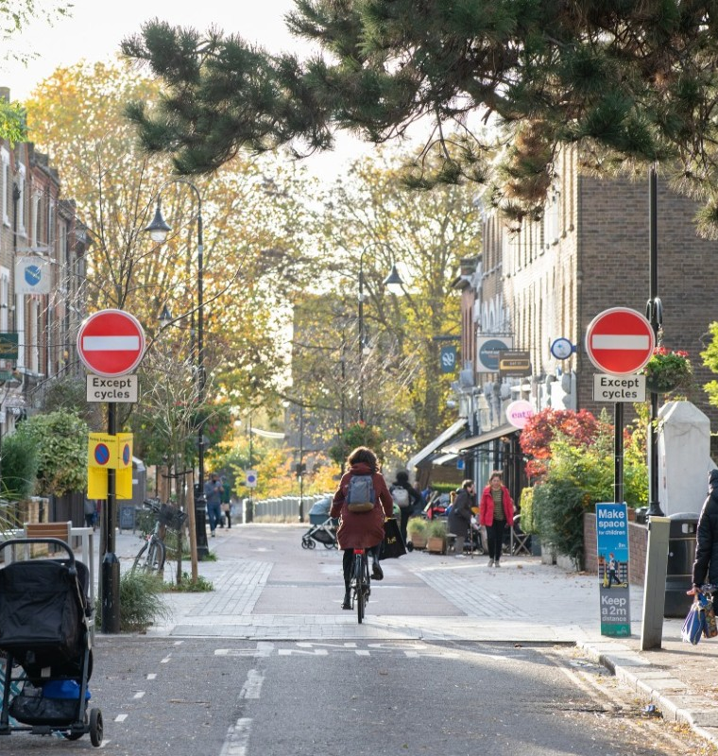
Quiet Streets
The Quiet Streets programme is intended to work with residents to design their streets with a focus on people rather than vehicles. They create spaces where residents can safely walk, cycle and wheel, streets where children can play and residents can come together, where air quality and biodiversity are increased, and noise pollution is reduced. Versions of these have been implemented in DCC and DLR and Low Traffic Neighbourhoods have existed in London since the 1970s.
SDCC would like to seek streets to work with as a pilot for this scheme in the county.
Low Traffic Neighbourhood Street, London (Image: TFL)

Slide 7
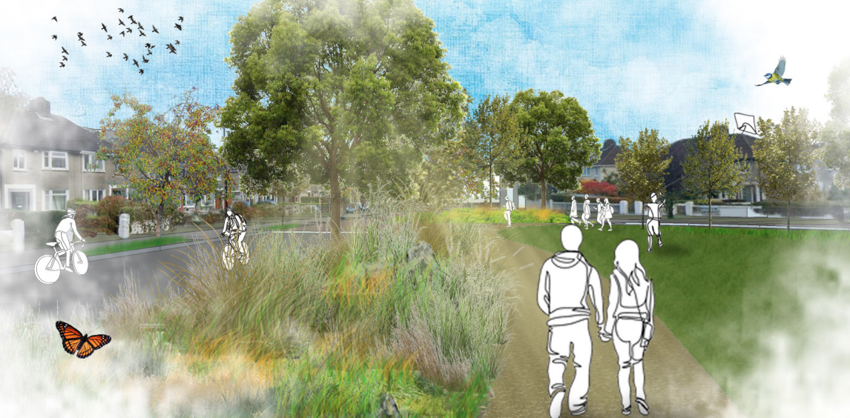
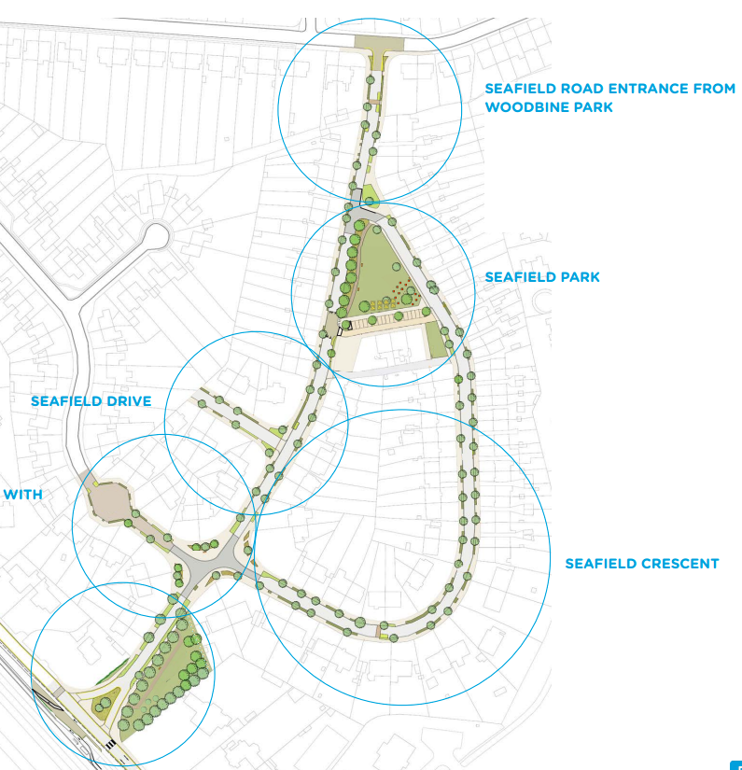
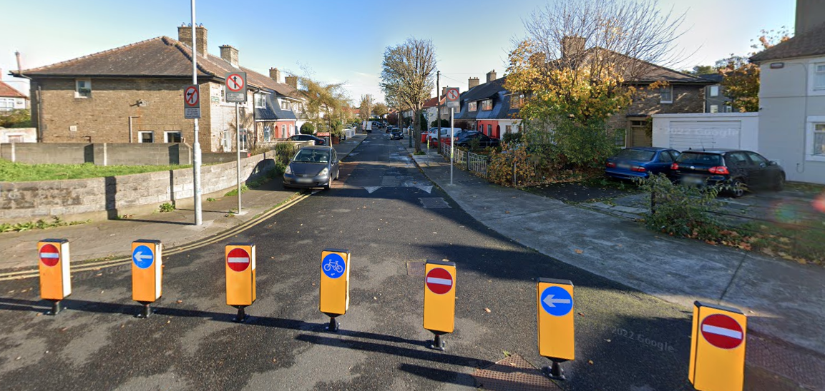
Top and Right; Seafield Estate Quiet Street Project. DLR County Council carried out extensive consultation with local residents and the resulting design is intended to slow traffic, increase planting, natural drainage and biodiversity, and lower noise and pollution in the area. (DLRCOCO) Bottom Left: Haverty Road, Marino (Google Streetview)

