Slide 1


Employment Land Review
SPC 3rd December 2024

Slide 2
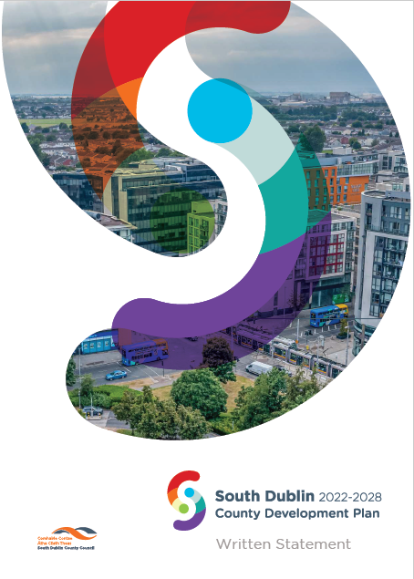
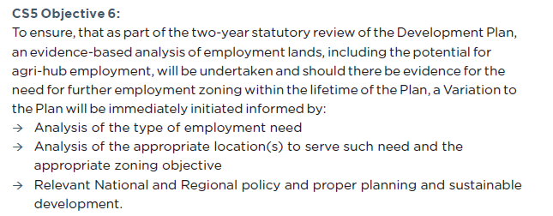
CDP Objective

Slide 3
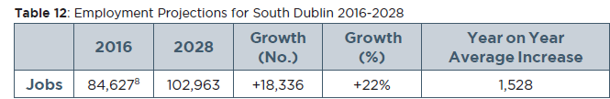
Employment Targets and Background

Slide 4
Zoned Land Capacity
Land quantums with remaining capacity to generate jobs were identified as part of the preparation of the Development Plan
554ha of land zoned for Enterprise and Employment EE);
58.27ha of land in Local, Village, District and Town Centres (zoned LC, VC, DC, and TC);
7.6ha of employment generating lands within Strategic Development Zones;
5.8ha of land zoned Major Retail Centre (MRC); and
1.2ha zoned Retail Warehousing (RW)
Total – 627 ha
Capacity for 34,427 jobs, far exceeding the targeted 9,168 jobs over the 6-year cycle of the County Development Plan (1,528 average per annum)

Slide 5
Analysis Undertaken for 2 Year Review
The analysis has focused on Enterprise and Employment zoned lands and has found:
A total of 72ha of EE zoned lands has been developed in the 2 years since the DP came into effect (August 2022). Not all units are occupied yet
Approximately 439ha of EE zoned land remain undeveloped, the majority of these lands are located in Grange Castle albeit almost all areas have some remaining capacity
Of the 439ha, there is permission on c. 87 ha but no development has commenced
A further 39ha of EE zoned lands in different areas within the county are under construction
There remains a significant quantum of EE zoned lands to deliver on the number of jobs set out in the Core Strategy of the County Development Plan. This is in addition to jobs which can be created on other zoned lands which facilitate signficant employment.
For example, the Innovation Centre - Work IQ - in Tallaght is on Town Centre zoned lands and will facilitate modern and flexible office and coworking space for up to 60 businesses.

Slide 6
Other Learnings from Employment Land Review
The County currently has a broad economic base
There are clusters including around pharma
There is particular demand for ‘big box’ type developments which are often commercially driven through pension funding
Desire to locate close to Dublin and to transport corridors also drives warehousing and ‘big box’
There is increasing automation in logistics and the job to land ratio is likely to fall
From engagement with stakeholders, there is indication that SMEs are finding it difficult to locate space at the right price / right location
On soft infrastructure there is a need to ensure the population has the necessary skill sets for new types of employment including under the ‘Green Deal’ and increasing digitisation

Slide 7
Responding to Learnings
Initial preparation for the commencement of the new 10-year County Development Plan 2028-2038 will start in 2025 and will need to take on board the employment land review including:
  Identification of lands for future employment reflecting the way forward which will be set out in the forthcoming South Dublin Economic Strategy
  Ensuring that lands are located to maximise economic potential while supporting sustainable land use
  Considering the most appropriate land use zoning objectives to accommodate growth in the right place, taking account of the need for both employment lands and housing alongside other infrastructure and transport to facilitate both
  Ensuring that a diverse economic base continues to be facilitated, helping to overcome any shocks to the economy and providing a mix of employment type
  Working with adjoining local authorities to add value to the wider regional and national economy. This will be particularly important as the National Planning Framework is adopted and the Regional Spatial and Economic Strategy is being prepared.
  Examining how the county can best support workers in developing new skill sets

