Slide 1
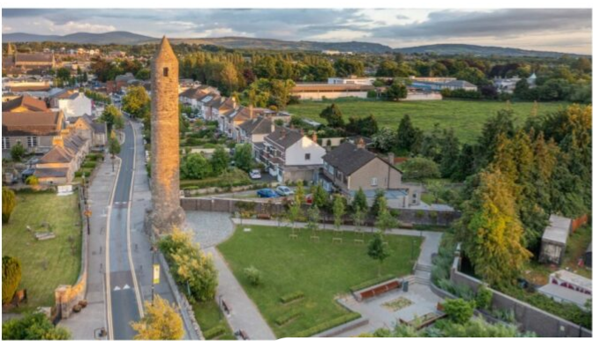


Update - 3rd Round of Public Consultation
SPC Meeting 3rd December 2024

Slide 2
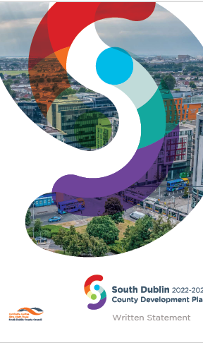
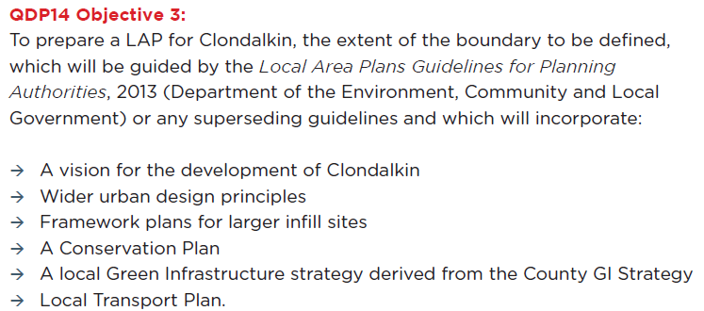
County Development Plan - Objective
Notes:
Almost 13,000 in the study area total.

Slide 3
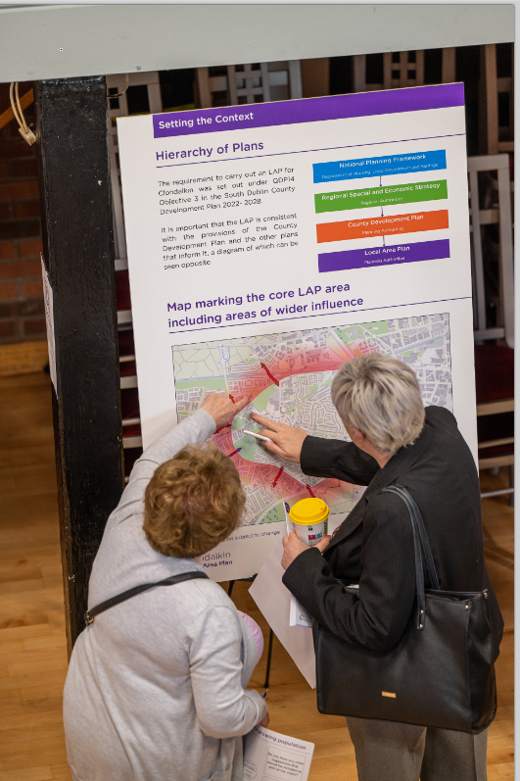
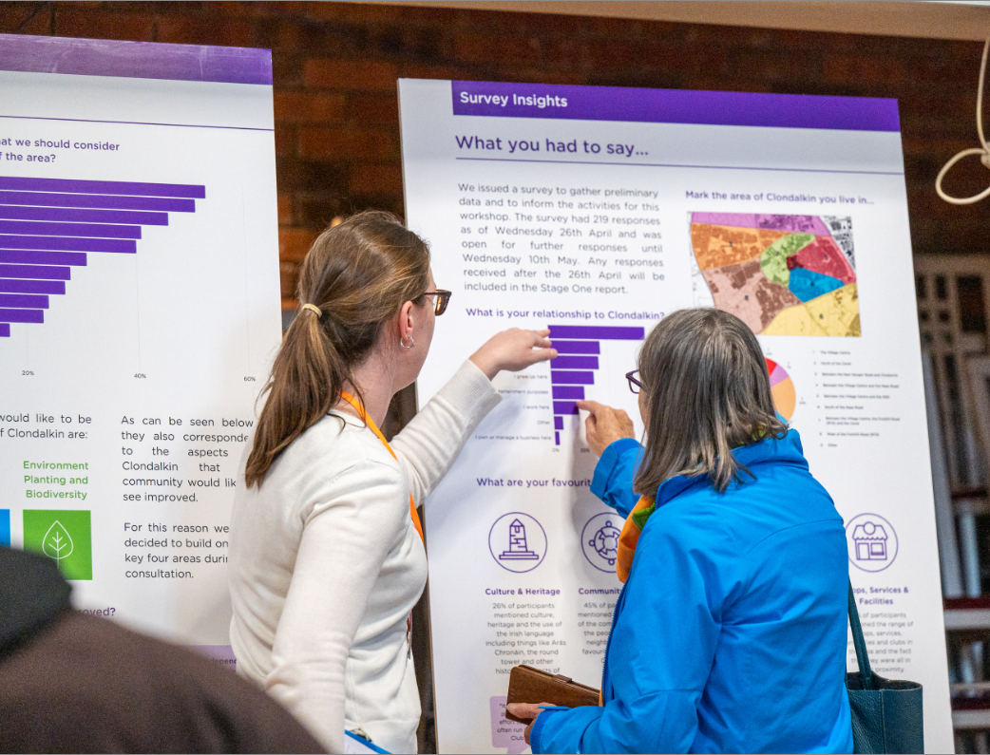
Clondalkin Public Consultation 1st Round March – May 2023
The Key issues raised:
Movement and traffic including accessibility and need for improved public transport and active travel
Desire to protect cultural and built Heritage
Concerns for the environment, biodiversity and planting
Desire for more social and community facilities
Concerns about inappropriate and over development
1. Movement and Transport
2. Social and Community Facilities
3. Culture and Heritage
4. Environment, Biodiversity and Planting
1. Movement and Transport
2. Social and Community Facilities
3. Culture and Heritage
4. Environment, Biodiversity and Planting
Notes:
Almost 13,000 in the study area total.

Slide 4
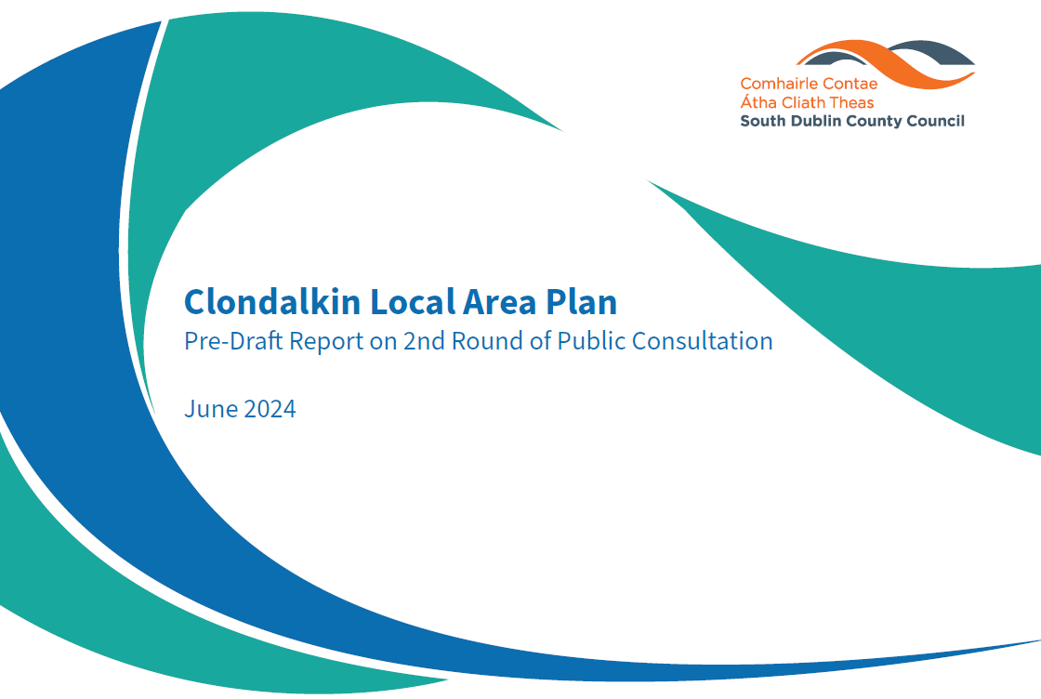
Clondalkin 2nd Round Consultation Feb – April 2024

Slide 5
Clondalkin Public Consultation 2nd Round Feb – April 2024
Approach
Student Council workshop held on 22nd February 2024
Two in person workshops
Online portal workshop form (survey)
Conservation walks
Content Reflected 1st Round Feedback
3 Scenarios
A - Local Vitality 315
B - Healthy Environment 298
C - Built Heritage 259
Village Enhancement schemes
Movement Measures
Conservation Plan
Notes:
Almost 13,000 in the study area total.

Slide 6
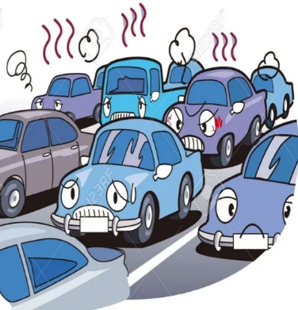
3rd Round of Public Consultation Dec 2024 – Jan 2025
Emphasis on Transport Movement
Need to build greater consensus
Facilitator employed to assist planning department
One-to-one stakeholder meetings underway
Cross –sectoral inclusion: Businesses, community, resident's associations, schools
Feedback will inform Transport Plan and LAP
Briefing with ACM Members following initial meetings
Followed by public meetings in January 2025

Slide 7
Ongoing Plan Preparation
Urban Design Strategy to include:
  Conservation objectives
  Green Infrastructure strategy
  Integration of movement strategy
  Village enhancement schemes
  Principles for development
Conservation architects
  Character appraisals for ACAs
  Conservation Plan including recommendations for inclusion of objectives in LAP
  Identification of important heritage buildings and structures. Two ‘walk abouts’ were held with members of public earlier in 2024.
Environmental Consultants – SEA and AA and SFRA
1. Movement and Transport
2. Social and Community Facilities
3. Culture and Heritage
4. Environment, Biodiversity and Planting
1. Movement and Transport
2. Social and Community Facilities
3. Culture and Heritage
4. Environment, Biodiversity and Planting
Notes:
Almost 13,000 in the study area total.

Slide 8
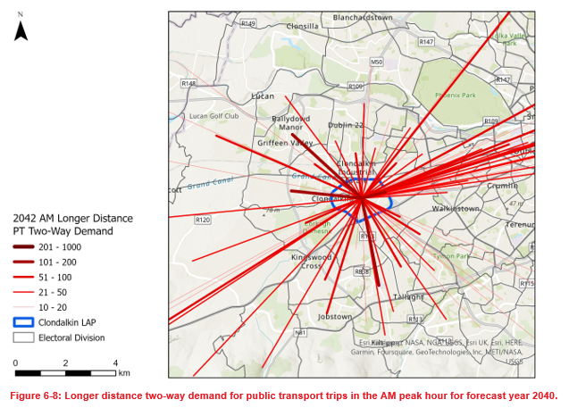
Ongoing Plan Preparation
Local Transport Plan
ARUP were appointed to prepare a Local Transport Plan to inform the Local Area Plan. This is a requirement of the NTA
Demand analysis included traffic surveys conducted in October2023. Baseline analysis will inform approach.
Cycle South Dublin schemes Tallaght to Clondalkin Village and Corkagh Park to Grand Canal through the village are being examined
Options to reduce congestion and through traffic within the village to be informed by further consultation
1. Movement and Transport
2. Social and Community Facilities
3. Culture and Heritage
4. Environment, Biodiversity and Planting
1. Movement and Transport
2. Social and Community Facilities
3. Culture and Heritage
4. Environment, Biodiversity and Planting
Notes:
Almost 13,000 in the study area total.

Slide 9

Next Steps
Complete one-to-one stakeholder consultation – December 2024
Feedback will inform transport options for further consultation
Undertake 3-4 public consultation events – January 2025
Consider further feedback
Integrate into urban design and wider plan objectives
Finalise plan
Review options for statutory process – Variation now likely

