Slide 1
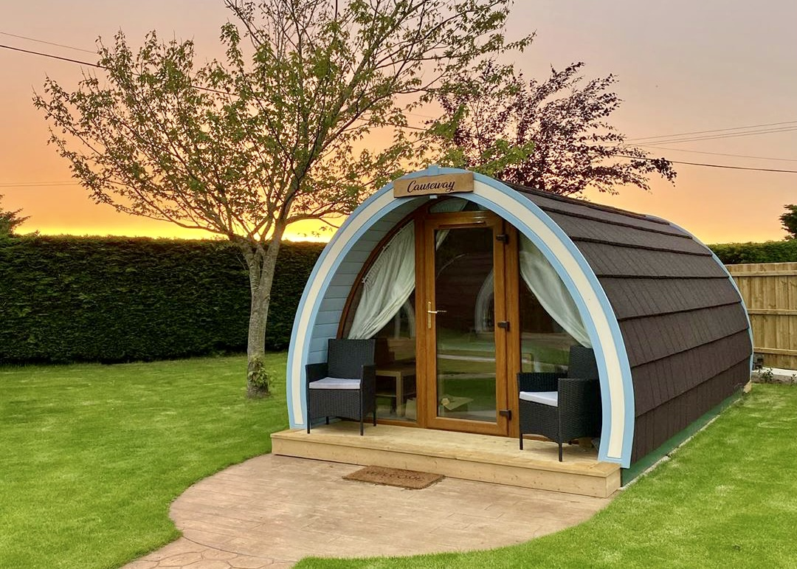
Camac Valley Caravan & Camping Park – Part 8 proposal

Slide 2
Camac Valley Caravan & Camping Park - Part 8 Proposal
Notification of intention to lodge Part 8:
Part 8 proposal to add additional facilities to the Camac Valley Caravan & Camping Park which will comprise of 7-14 glamping pods.
Routine maintenance and renewal of existing facilities will be completed separate to Part 8 approval.
Next Steps:
Environmental screenings due for completion this week.
Public consultation to be done.
Part 8 will come to members early 2025 for approval.
Budget:
Provision in 3-year capital programme: €2.9m

Slide 3
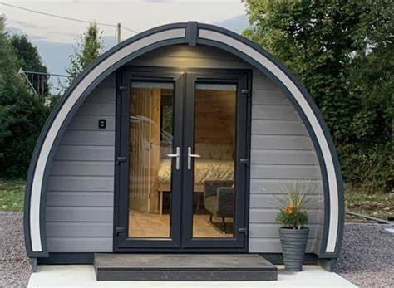
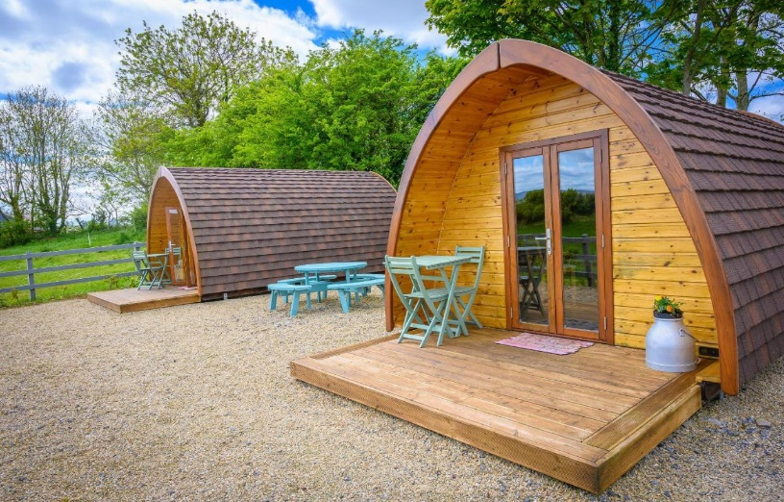
Glamping pods will be of similar shape and size:

Slide 4
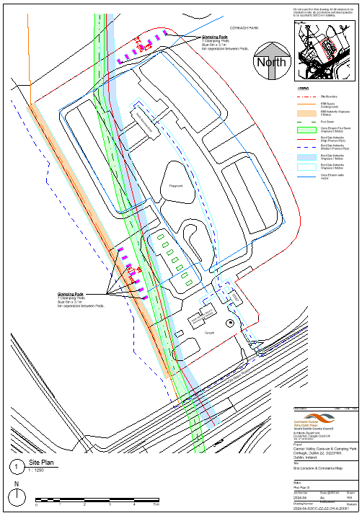
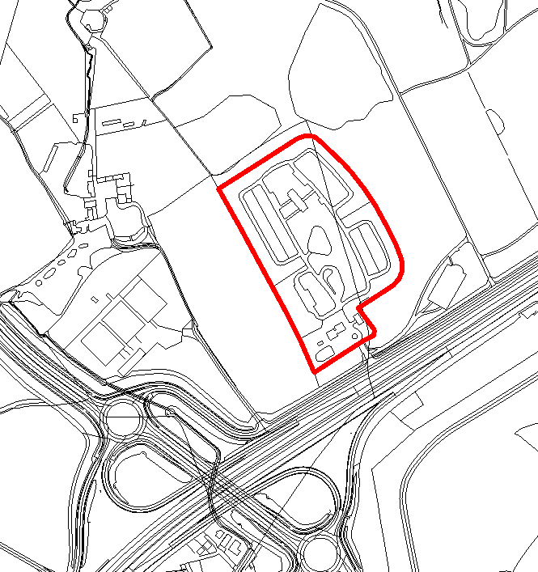
Site Location Map

