Slide 1

Social Housing Delivery
Lucan Palmerstown North Clondalkin Area Committee Meeting
26th November 2024

Slide 2
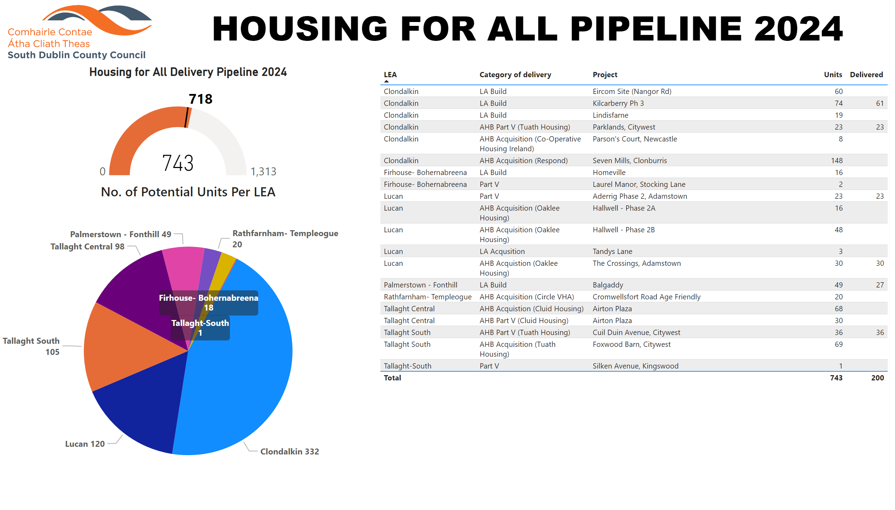
2024
Notes:
textbox
No alt text provided
Housing for All Delivery Pipeline 2024
No alt text provided
No. of Potential Units Per LEA
No alt text provided
Potential Units
No alt text provided
image
No alt text provided

Slide 3

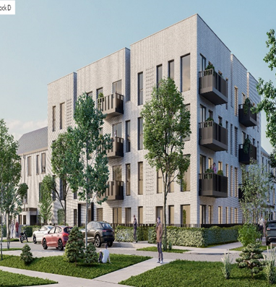
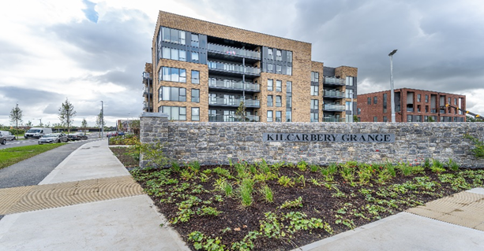
Large Development Sites
Kilcarbery Grange: 1,034 homes with 30% social (310 homes)
Phase 1 & 2 of this project is now complete, with delivery of 227 social homes to date. Construction work is continuing through phases 3 & 4. Full completion of project is anticipated by mid 2025.
Clonburris: Phases 1 & 2 comprising 382 homes (149 social), Phases 3,4,5 with potential for 1,430* homes
The tender process for construction of 266 social, affordable, and cost rental homes in the Kishogue has recommenced with Tenders due to close on 22nd November 2024. Anticipated on-site date in Q1 2025. Part 8 report for 118 social homes on PPP site adjacent to Lynch’s Lane went to full Council on Monday 11th November and was approved to proceed. Draft plans for approximately 1300 social and affordable homes were also presented to the Council and were noted ahead of the Part 10 application which will be submitted to An Bord Pleanála.
Clonburris Phase 1
Kilcarbery Grange

Slide 4
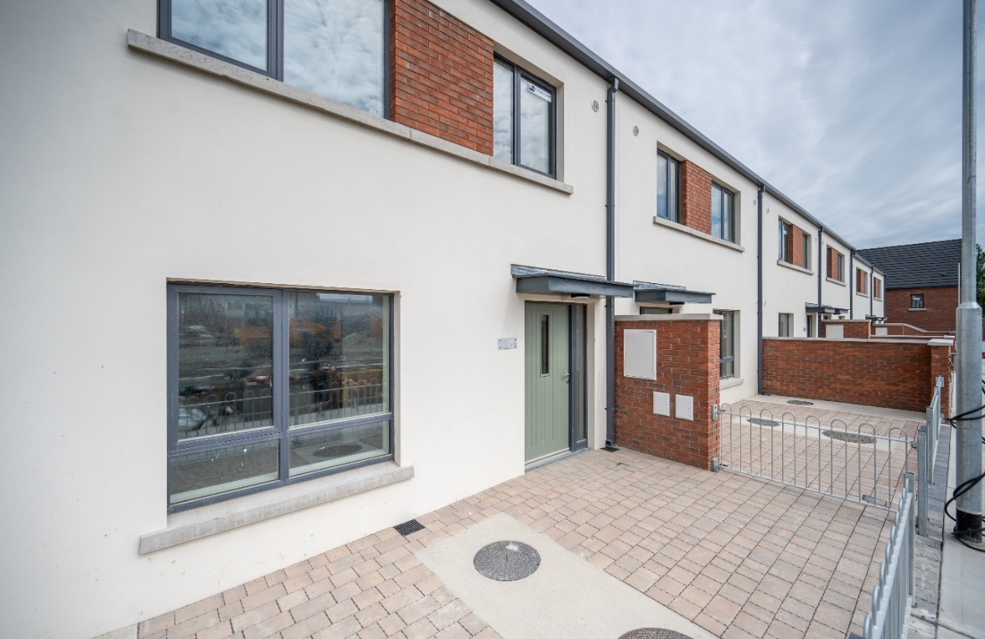
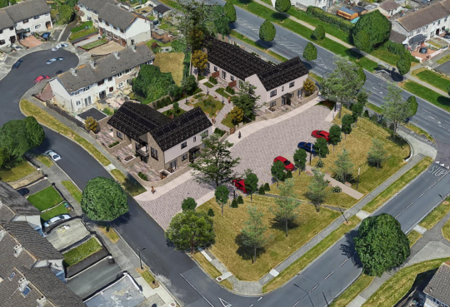
Own Build Developments
LEA | Project | Units | Status
Palmerstown- Fonthill | Omer Walk, Balgaddy | 69 | On-site. 47 homes handed over to date. Full handover November 2024
Palmerstown- Fonthill | St Ronan’s Crescent (Age Friendly) | 9 | Contractor appointed. Awaiting site start date.
Lucan | Sarsfield Park (Age-Friendly) | 5 | Tender closed. Assessment of submissions ongoing
Omer Walk, Balgaddy
St Ronan's Crescent Age Friendly Scheme

Slide 5
Planning Derogation Sites – Section 179A / 161
Rossfield Avenue, Tallaght
16 Social Homes
Advertised 14/12/2023. Tender advertised October 2024
Deansrath & Melrose, Clondalkin
27 Age-Friendly Social Homes
Advertised 14/12/2023. Tender advertised November 2024
Kilcarbery Grange, Clondalkin
88 Social and Affordable Homes
Advertised 21/12/2023. Section 183 approved at Council Meeting October 2024
Alpine Heights, Clondalkin
13 Age-Friendly Social Homes
Advertised 04/04/2024. Tender advertised Sept 2024
Sarsfield Park, Lucan
5 Age-Friendly Social Homes
Advertised 11/04/2024. Tender assessment ongoing.
Castlefield, Old Knocklyon Road
33 Social and Affordable Homes
Subject to Judicial Review
Old Castle, Clondalkin
130 Social, Affordable and Traveller Accommodation Units
Detailed design ongoing – boundary agreement outstanding
Stocking Lane, Rathfarnham
25 Social Homes
Detailed design complete – to be advertised.
Owendoher Haven, Rathfarnham
9 Traveller Accommodation Units
FRA Ongoing
Kishogue Park, Clonburris
15 Traveller Accommodation Units
Advertised 30/05/2024. Tender preparation

Slide 6
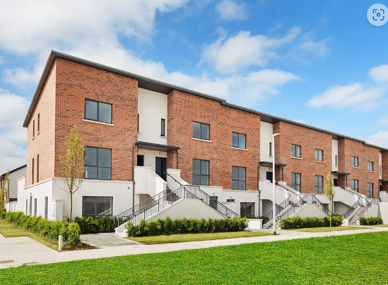
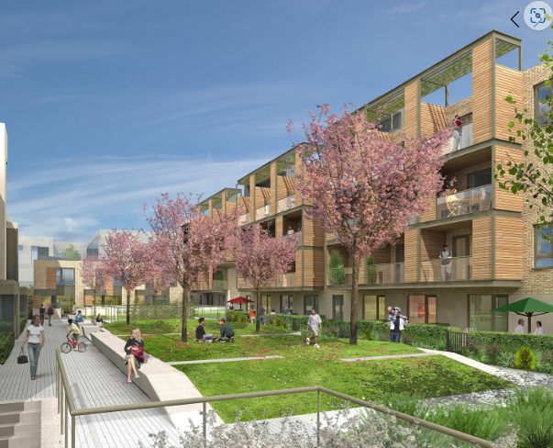
Approved Housing Bodies – Part V Delivery
LEA | Project | Units | Status
Lucan | Tandy’s Lane, Adamstown North & East Housing Association | 15 | On site. Phased delivery from Q2.2025
 | Aderrig, Adamstown Cluid Housing | 23 | Delivered November 2024
 | The Crossings, Adamstown Oaklee Housing | 30 | Delivered August 2024
 | Adamstown District Centre Tuath Housing | 44 | On-site – completion Q1.2026
 | Hallwell, Lucan Oaklee Housing | 64 | On-site – completion Q4.2024
 | St Helen’s Plaza, Adamstown Tuath Housing | 80 | On-site – phased delivery from Q3.2025
 | Somerton, Adamstown Cluid Housing | 68 | Due for delivery 2026. Age Friendly Development
 | Hallwell Avenue Tuath Housing | 17 | On site. Delivery Q2 2025. Age Friendly Units
Tandy’s Lane, Adamstown
Adamstown District Centre

Slide 7
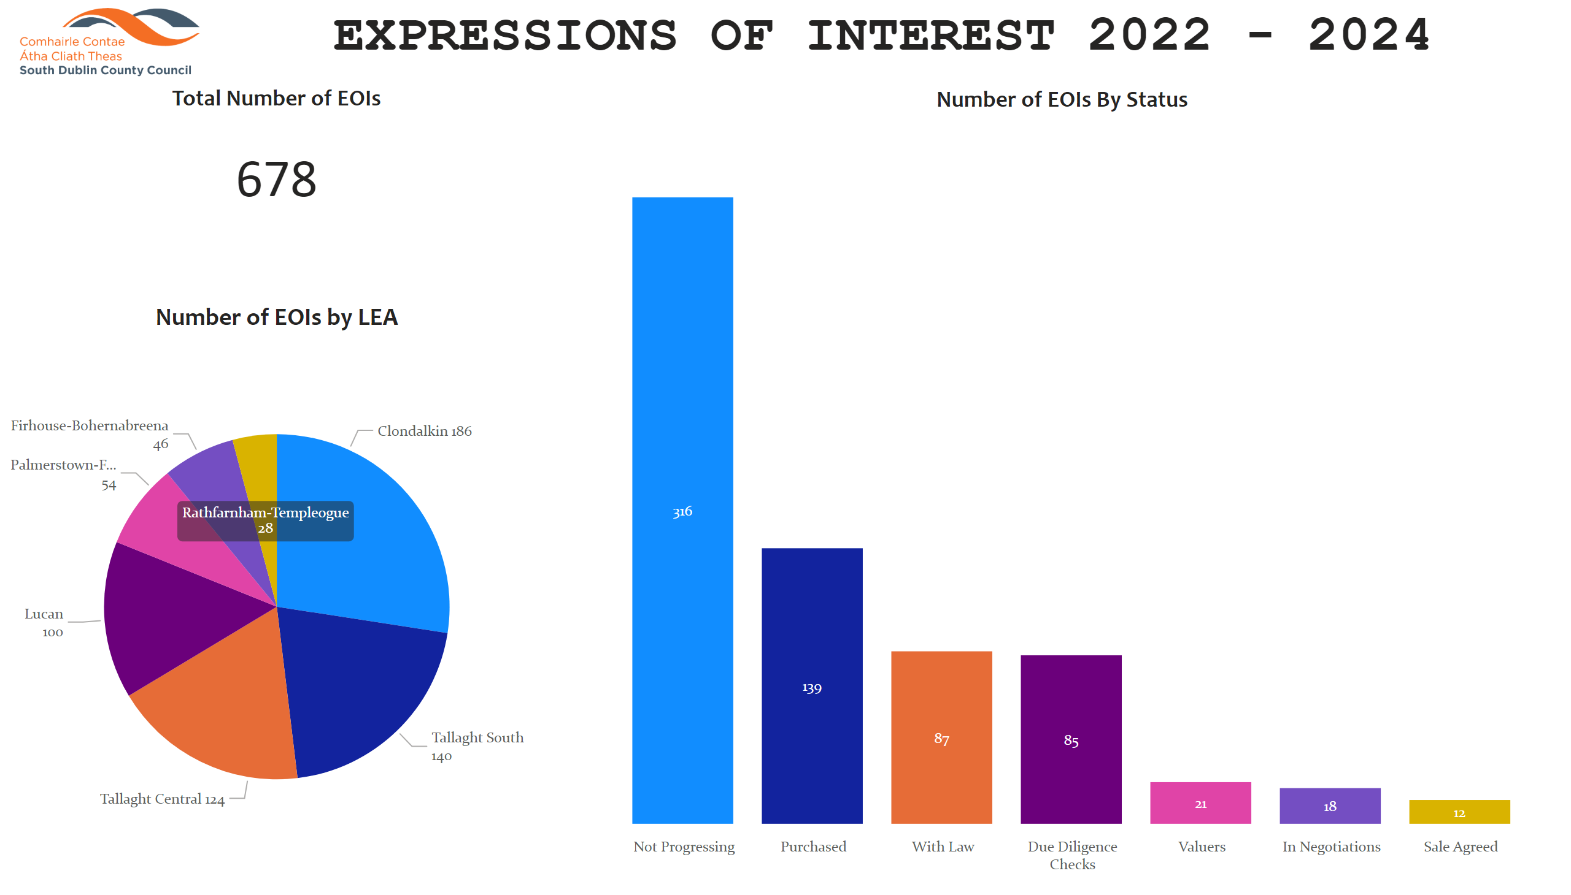
Overview
Notes:
Total Number of EOIs
No alt text provided
Number of EOIs by LEA
No alt text provided
Number of EOIs By Status
No alt text provided
image
No alt text provided
textbox
No alt text provided

