Slide 1

Draft Budget 2025
Annual Budget Meeting of South Dublin County Council
14th November 2024

Slide 2

Budget Strategy
Local Property Tax (LPT) to be reduced by 15% for 2025, as approved at October Council meeting
No proposed increase in Differential Rent Scheme for 2025
No proposed increase in Annual Rate on Valuation (ARV) or Commercial Rates Multiplier
Reduction in Commercial Rates Vacancy Scheme proposed from 25% to 0% refund for properties vacant in 2025, subject to approval by Council
Financial supports for small and medium businesses to be maintained in 2025
Specific additional provisions for the following:
  Significant expansion of AHB & leasing social housing provision in line with Housing Delivery Action Plan
  Further investment in town/village enhancement & public realm maintenance including trees, laneways, graffiti removal etc.
  Community centre developments & community supports
  Economic, tourism and heritage projects
  Park, playground, teenspace and outdoor furniture upgrades
  Safety, inclusivity and accessibility initiatives

Slide 3
Revenue Expenditure 2025 v 2024

Slide 4
Sources of Expenditure

Slide 5
Revenue Income 2025 v 2024

Slide 6
Sources of Income

Slide 7
Director of Housing, Social & Community Development

Slide 8
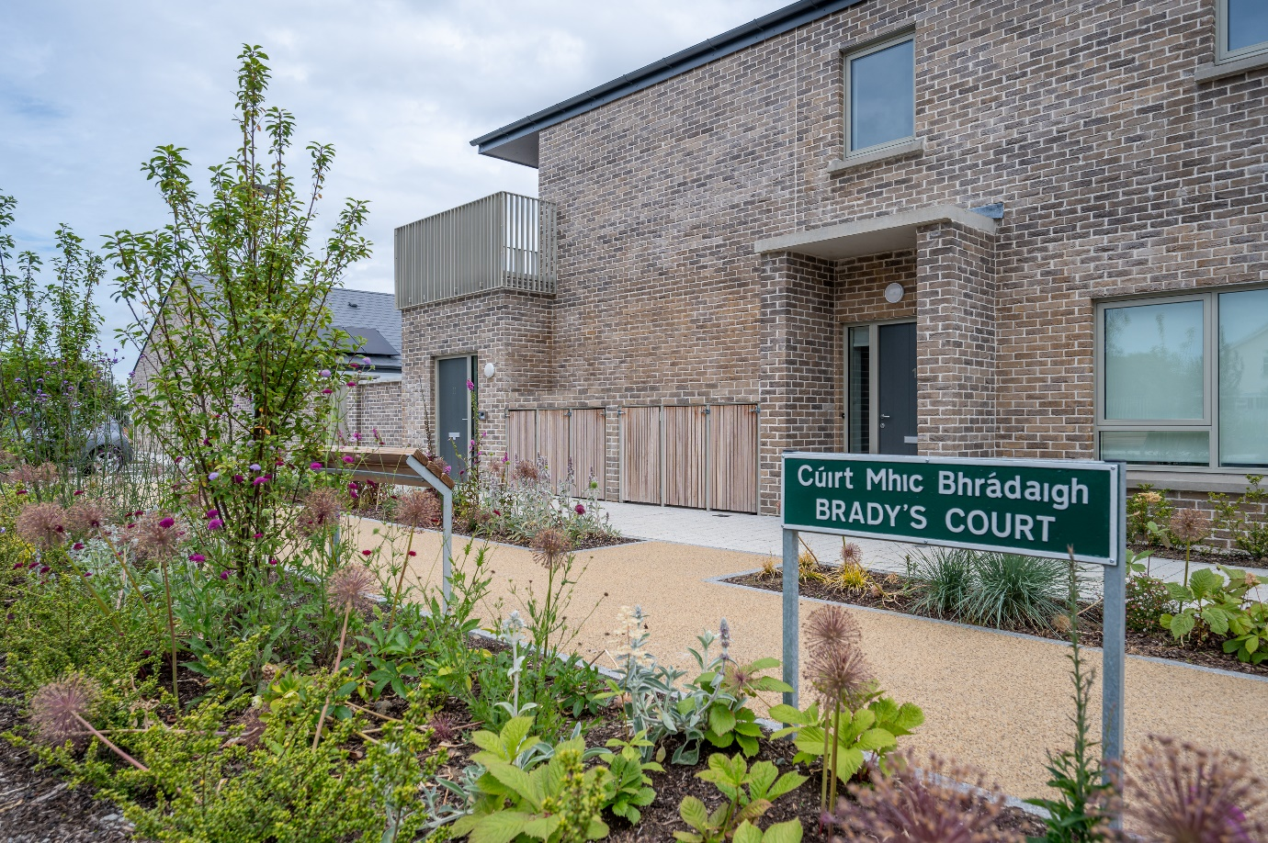
Housing (Division A)
Expenditure of €174,288,000 proposed for 2025 (€41,013,000 increase on 2024)
€104,567,500: for the provision of AHB, RAS and Leased properties
€21,894,100: maintenance of over 10,000 homes including €7,799,000 for re-lets/rightsizing transfers & €2,000,000 transfer to planned maintenance fund
€12,880,600: supporting housing strategy, construction and delivery including Part V
€6,970,900: for homeless services provided directly and with DRHE
€7,296,400: housing grants & supports for disabled/older persons and Travellers
€6,027,900: loans & rents assessment (including debt management)
€5,980,000: estate & tenancy management including housing welfare supports
€2,818,900 for vacant property refurbishment grants
€1,663,000: private rented inspections
Income of €164,429,000 projected for 2025 (€42,162,300 increase on 2024)
DHLGH funding: €103,056,600 for AHB /RAS/ Leasing supply in addition to funding for: Re-lets, Traveller accommodation, housing grants, private inspections etc.
Projected combined rental income of €40,261,400

Slide 9
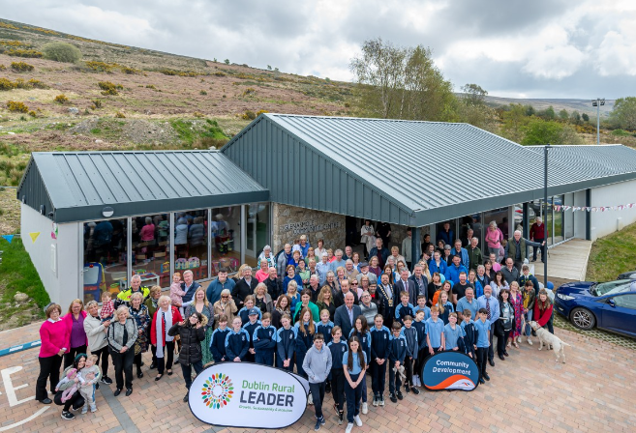
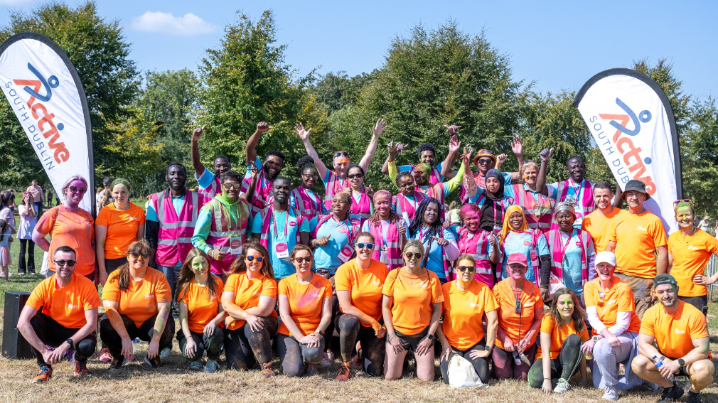
Social & Community Development
(Parts of Division D, F & G)
Social Inclusion & Interagency (Division D)
€3,536,800: Social Inclusion and Community Activation Programme (SICAP)
€1,403,100: Various additional social inclusion, interagency, integration, younger & older person’s initiatives, and €75,000 to support the new Community Safety Partnership
Community Development & Sports (Division F)
€1,856,100: community facilities including solar panel installations & virtual scanning
€720,000: community & sports grants and community infrastructure fund
€329,000: community events & projects including St. Patricks Day Festival in Tallaght
€350,000 for new Whitechurch sports facility & €250,000 for fit-out of new youth facilities
€1,291,400: Active South Dublin and other sports, physical activity & wellbeing programmes, contributions to sporting organisations (including €25,000 to Special Olympics Ireland) & access to sports/leisure facilities
€2,096,000: CE schemes & €461,900 for Community CCTV operational costs
Miscellaneous (Division G)
€128,500: school meals programme (22 schools) & €52,500 education/sports bursaries

Slide 10
Director of Land Use, Planning and Transportation

Slide 11
Road Transport & Safety (Division B)
Expenditure of € 41,879,300 proposed for 2025 (€1,122,800 increase on 2024)
Forward and Delivery Planning: €3,885,200
€4,743,000: road, footpath & winter maintenance on national & regional roads
€20,565,400: local road maintenance including general road & winter maintenance (€9,483,600), footpath maintenance (€2,200,000), cycle track maintenance (€200,000), social housing estate footpath works (€300,000) €400,000 for enhanced accessibility works, €56,000 for footpath dishing & €475,900 for bridge safety works
€750,000 for district centre enhancement programme (incl. feasibility studies for Tallaght & Rathfarnham) & €500,000 for Clondalkin Village design stage
€5,645,900 for maintenance of 32,000 public lights & LED upgrade programme (c.1,500 upgrades in 2025)
€4,598,800 for traffic management centre & operation/maintenance of traffic lights (including €450,000 for new traffic signals upgrade programme starting in 2025)
€2,552,100 for road safety & improvement works with €825,000 to deliver street management & traffic calming guide, €558,200 for on & off-street car-parking
€2,185,700 Road safety promotion & education including school warden service
30+ active travel (pedestrian & cycle) schemes under Cycle South Dublin programme. A SDCC Quiet Streets programme and a School Zone programme will also be commenced.

Slide 12
Development Management (Division D)
Expenditure of €11,253,100 proposed for 2025 (€340,200 increase on 2024)
Forward and Delivery Planning: €3,885,200
Implement adopted County Development Plan & begin preparatory work for next 10-year CDP
Manage delivery of SDZ planning schemes at Adamstown & Clonburris & of adopted LAPs at Newcastle, Tallaght, Ballycullen-Oldcourt & progress Clondalkin LAP & CDP variation for City Edge lands
Active Land Management (RZLT, Vacant Sites Register, Housing Task Force & new Dev. Contribution Scheme) & review employment land & rural housing
€240,500 for heritage, biodiversity and conservation projects
Development Management and Planning Enforcement: €6,262,500
2024 (up to end Sept): 692 planning applications received & 231 planning enforcement cases opened/434 closed
e-Planning operational since May 2024 (€66,400 provided)
Building Control at €750,900
2024 (up to end Sept): 174 Disability Access Certs / 256 Fire Certs / 515 Commencement Notices

Slide 13
Director of Environment, Water and Climate Change

Slide 14
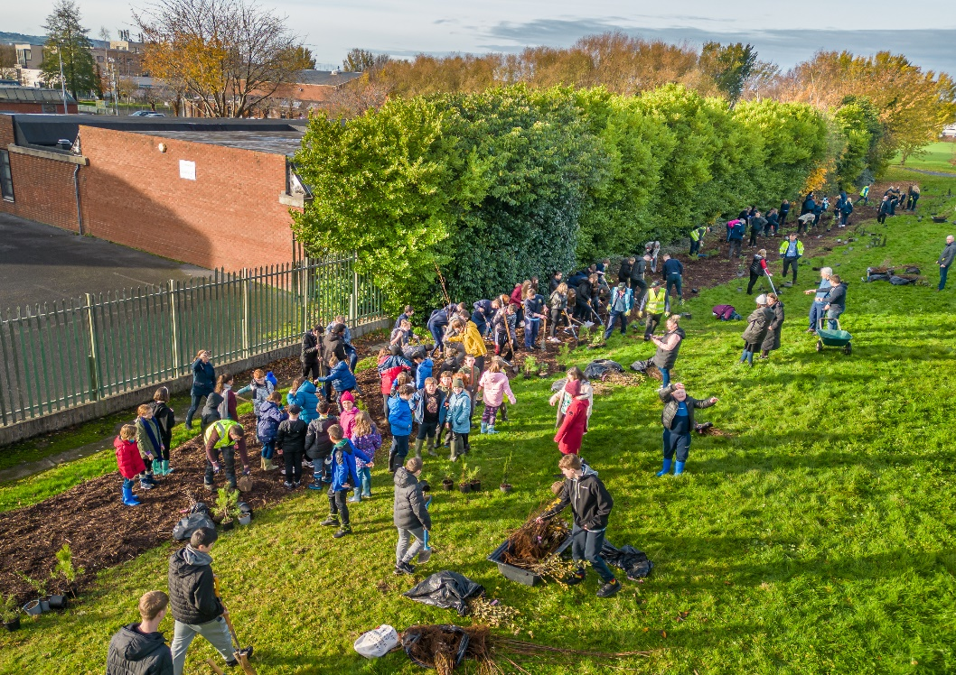
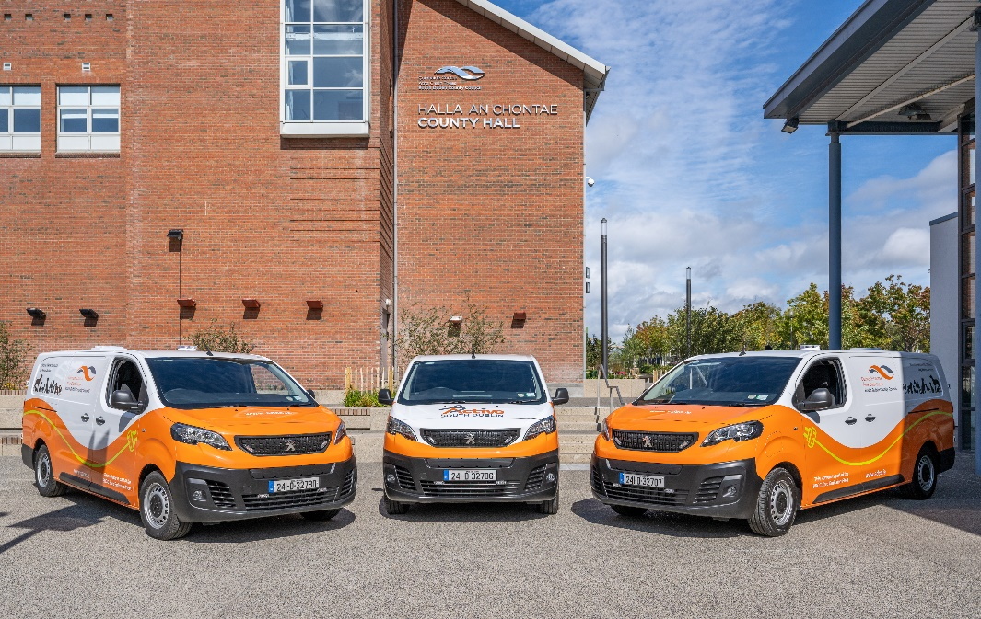
Environment Water & Climate Change
(Division C, E, F, G & H)
Overall Expenditure of €98.37m proposed for 2025
Water Services (Division C)
€16.24m expenditure including €10m for water & wastewater services (recoupable from Uisce Éireann/DHLGH) & €6.68m for surface water & flood management
Environmental Services (Division E) €50.9m expenditure including:
€27m for Fire Service (operated by DCC on our behalf)
€14.62m public realm & cleansing (litter management/litter wardens, village/street cleaning/litter bins, environmental awareness, waste regulation & enforcement)
€4.45m to support Climate Action Plan initiatives
€1.45m for burial grounds including Columbarium wall & car park improvements at Bohernabreena
€1.1m for landfill operations & aftercare at Arthurstown & other historic landfills
€811k for water quality, air & noise pollution control
€396k for derelict sites & dangerous buildings

Slide 15
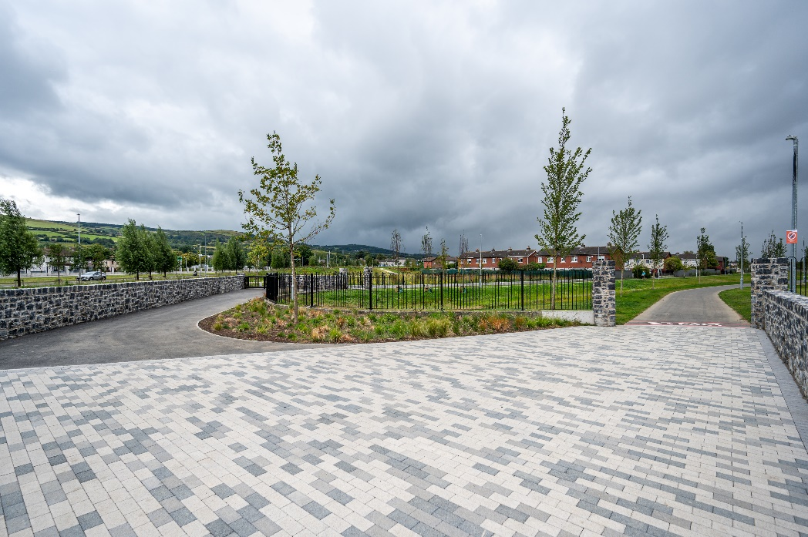
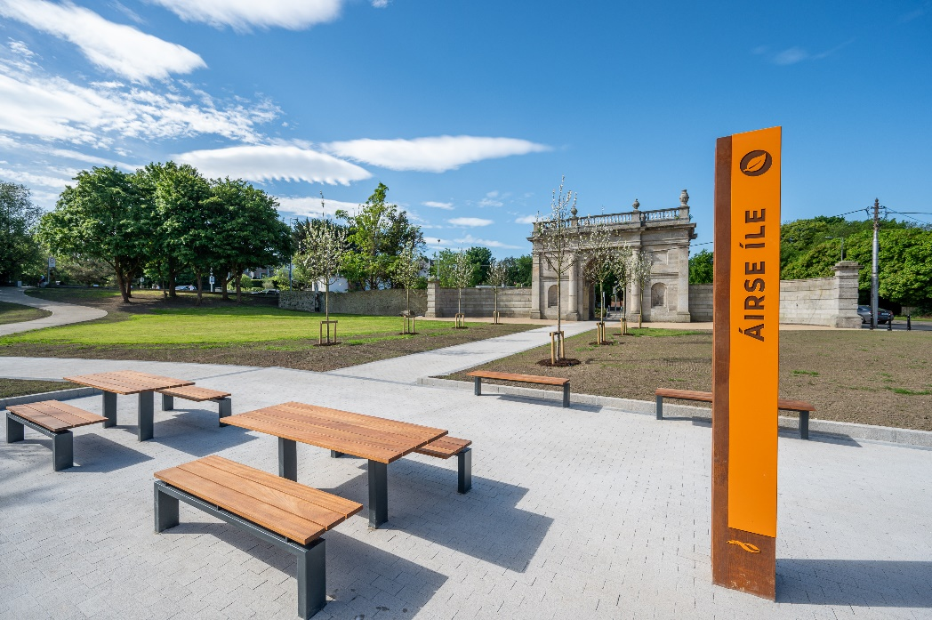
Environment Water & Climate Change
Division F Recreation & Amenity
Expenditure of €30.34m proposed for maintenance & improvement of public realm for 2025 (€2.63m increase on 2024):
  Grass-cutting €5.70m
  Tree/hedge management €4.59m
  Public realm/parks management & operation €3.97m
  Park Ranger services €1.13m
  Pitch maintenance/improvements €1.02m
  Public realm improvement works €2.84m
  Leisure facility & playground maintenance €1.88m
  Delivery of 3G artificial pitches & teenspaces €1.00m
  Upgrades at Killinarden, Jobstown and Quarryvale Parks, maintenance of new parks (Airlie) and upkeep of Lucan House
Miscellaneous (Division G & H)
  €4.21m for machinery yard including €1m for updating/decarbonising our fleet
  €1.57m for veterinary services
  .

Slide 16
Director of Economic Enterprise & Tourism Development

Slide 17
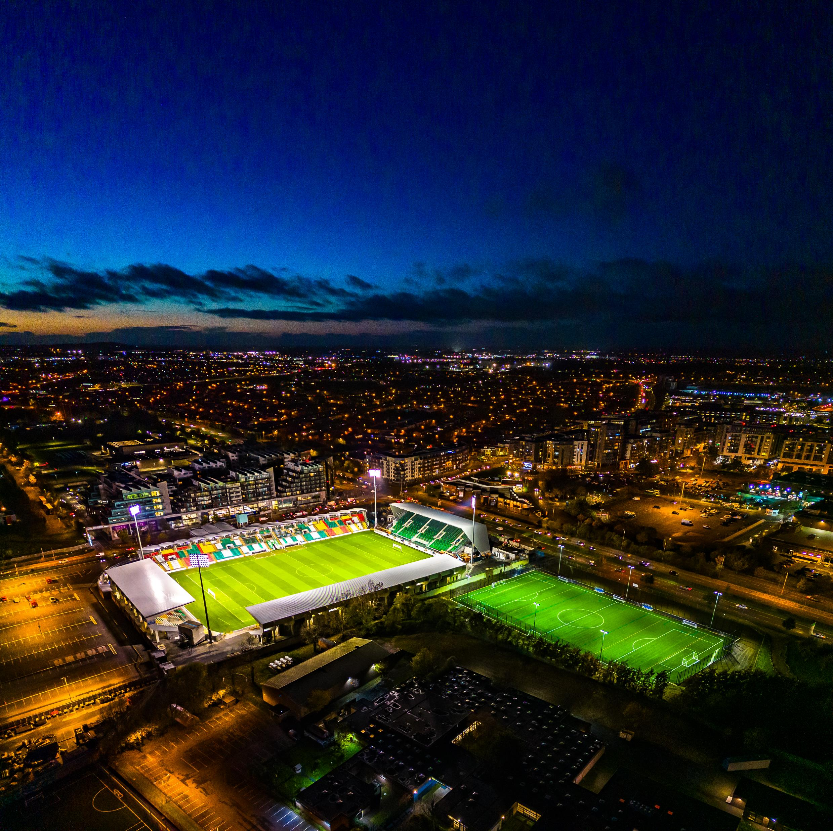
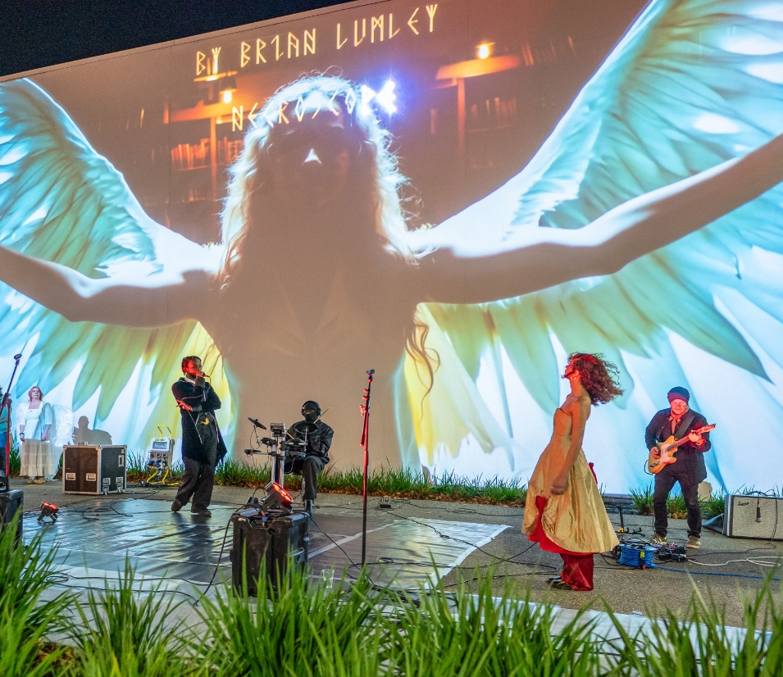
Economic, Tourism & Enterprise Development (Division D & F)
Expenditure of €28,279,500 proposed for 2025 (€1,712,600 increase on 2024)
  Working with Business & Tourism (Division D & F)
  Business Support Fund: €1,000,000
  Grange Castle Business Park & Expansion
  County Economic Strategy 2025
  LEO Grants
  Development of Business Networks: : €1,227,400
  12th Lock Masterplan: €1,500,000
  Tourism: Dublin Mountains, Rathfarnham Castle & Grand Canal Greenway
  Rathfarnham Village Economic Plan: €100,000
  Lucan House Masterplan: €190,000
  Tallaght Stadium

Slide 18

Economic, Tourism & Enterprise Development (Division D & F)
  Division F: Managing & Promoting Culture (Division F)
  Library Services: €9,950,400 / Arts Programme: €2,974,700
Library Development Plan Strategy 2023-2027
Library Branch Running Costs: €1,300,000
Books, periodicals & other materials: €1,104,100 (€3.67 per capita)
Dublin West Library revenue to capital transfer: €555,000
Music Generation Programme: €414,200
Other Arts Programmes: €378,100
Creative Ireland & Cruinniú na nÓg Programmes: €278,800
Live Outdoor Performance Programme: €180,000
Parthalán Place Activation Programme: €100,000
Civic Theatre: €425,400
Rua Red Arts Centre: €460,000

Slide 19
Director of Corporate Performance & Change Management

Slide 20
Corporate Performance & Change Management (Division D & H)
Division D Development Management
  D06 Participatory Budgeting initiative €300,000
  D06 Diversity in Local Government €10,000
  D09 Twinning €20,000
  D09 Eastern and Midland Regional Assembly (EMRA) annual contribution €262,30
  (79% increase in since 2023)
  Division H –Miscellaneous Services
  H04 Franchise Costs Register of Electors and Local Elections €744,700
  H09 Local Representation and Civic Leadership €2,002,300

Slide 21
Director of Finance

Slide 22
Finance Dept. (Division H)
Division H: Miscellaneous Services | 2025 | 2024
Expenditure | €11.7m | €12.3m
Income | €24.1m | €21.2m
 | (€12.4m) | (€8.9m)
Division H03: Administration of Rates Expenditure | 2025 | 2024
Refund due to Vacancy | €0.8m | €1.625m
Provision for Irrecoverable Rates | €3.6m | €4.0m
Division H: Miscellaneous Services - Income | 2025 | 2024
Government Grants: Payroll Recoupment | €16.7m | €12.8m
Goods & Services: Other Income IPB Investment Income | €0.00m €1.83m €4.5m | €4.4m €0.75m €2.4m

Slide 23
Draft Budget 2025 & Adopted 2024
Divisions | Budget Expenditure 2025 | Budget Expenditure 2024 | Budget Income 2025 | Budget Income 2024
Housing & Building | €174,288,000 | €133,274,700 | €164,429,000 | €122,266,700
Road Transport & Safety | €41,879,300 | €40,756,500 | €5,434,600 | €5,784,400
Water Services | €16,249,300 | €15,048,600 | €10,879,800 | €10,142,000
Development Management | €32,960,700 | €30,285,300 | €10,631,400 | €9,451,800
Environmental Services | €50,938,900 | €47,733,700 | €6,184,600 | €7,227,300
Recreation & Amenity | €62,096,800 | €57,239,800 | €4,834,000 | €4,566,600
Agriculture, Education, Health & Welfare | €1,757,100 | €1,630,500 | €605,600 | €689,200
Miscellaneous Services | €11,772,100 | €12,352,000 | €24,068,200 | €21,251,000
Total | €391,942,200 | €338,321,100 | €227,067,200 | €181,379,000
Local Property Tax |  |  | €11,704,800 | €11,509,600
Rates |  |  | €153,170,200 | €145,432,500
Total |  |  | €391,942,200 | €338,321,100

