Slide 1

Draft Budget 2025
Ronan FitzGerald Director of Finance
7th November 2024

Slide 2

Budget Strategy
Local Property Tax (LPT) to be reduced by 15% for 2025, as approved at October Council meeting
No proposed increase in Differential Rent Scheme for 2025
No proposed increase in Annual Rate on Valuation (ARV) or Commercial Rates Multiplier
Reduction in Commercial Rates Vacancy Scheme proposed from 25% to 0% refund for properties vacant in 2025, subject to approval by Council
Financial supports for small and medium businesses to be maintained in 2025
Specific additional provisions for the following:
  Significant expansion of AHB & leasing social housing provision in line with Housing Delivery Action Plan
  Further investment in town/village enhancement & public realm maintenance including trees, laneways, graffiti removal etc.
  Community centre developments & community supports
  Economic, tourism and heritage projects
  Park, playground, Teenspace and outdoor furniture upgrades
  Safety, inclusivity and accessibility initiatives

Slide 3
Revenue Expenditure 2025 v2024

Slide 4
Sources of Expenditure

Slide 5
Revenue Income 2025 v 2024

Slide 6
Sources of Income

Slide 7
Director of Housing, Social & Community Development

Slide 8
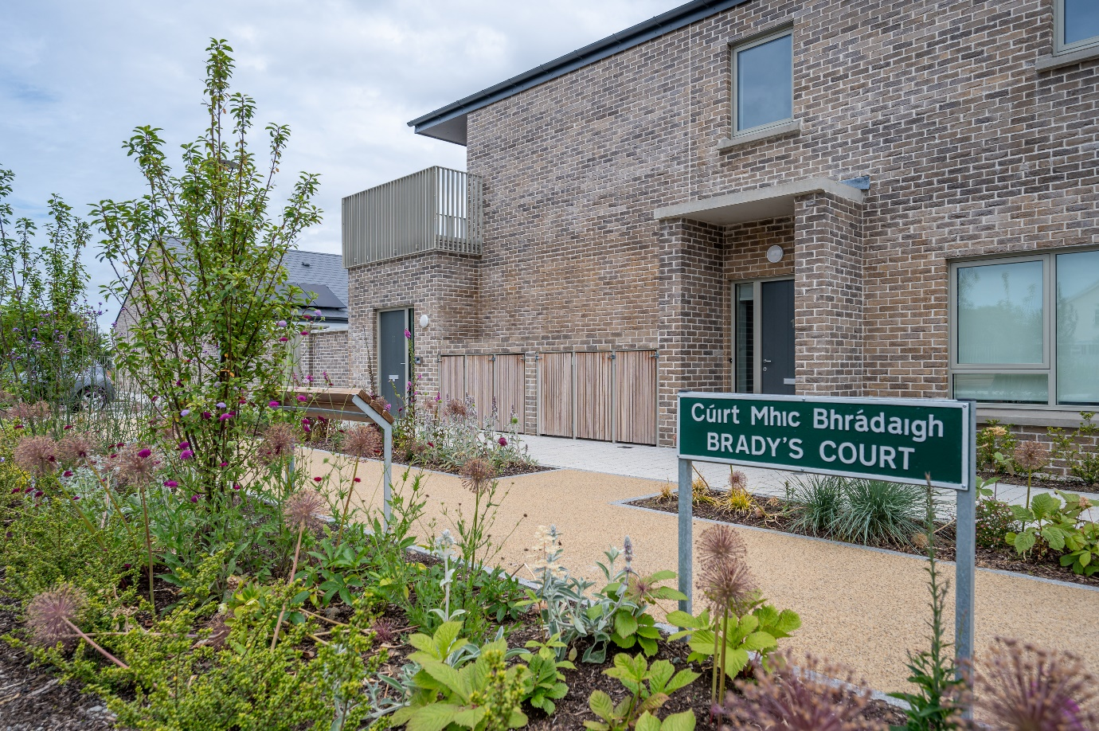
Division A: Housing
Expenditure of €174,288,000 proposed for 2025 (Increase of €41.013,000 on 2024)
€104,567,500: for the provision of AHB, RAS and Leased properties
€21,894,100: maintenance of over 10,000 homes including €7,799,000 for re-lets/rightsizing transfers & €2,000,000 transfer to the planned maintenance programme fund
€12,880,600: supporting housing strategy, construction and delivery including Part V
€6,970,900: for homeless services provided directly and with DRHE
€7,296,400: housing grants & supports for disabled/older persons and Travellers
€6,027,900: loans & rents assessment (including debt management)
€5,980,000: estate & tenancy management including housing welfare supports
€1,663,000: private rented inspections
€2,818,900 for vacant property refurbishment grants
Income of €164,429,000 projected for 2024 (Increase of €42,162,300 on 2024):
DHLGH funding: €103,056,600 for AHB /RAS/ Leasing supply in addition to funding for: Re-lets, Traveller accommodation, housing grants, private inspections etc. Projected combined rental income of €40,261,400

Slide 9
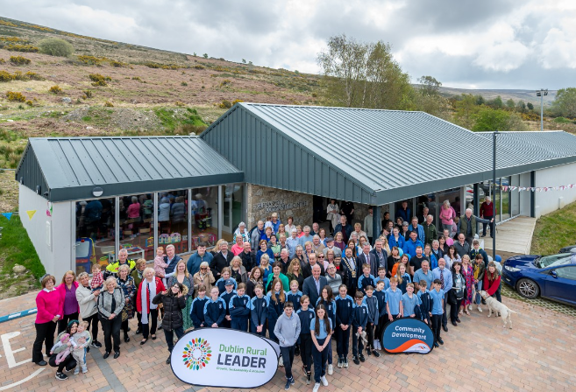
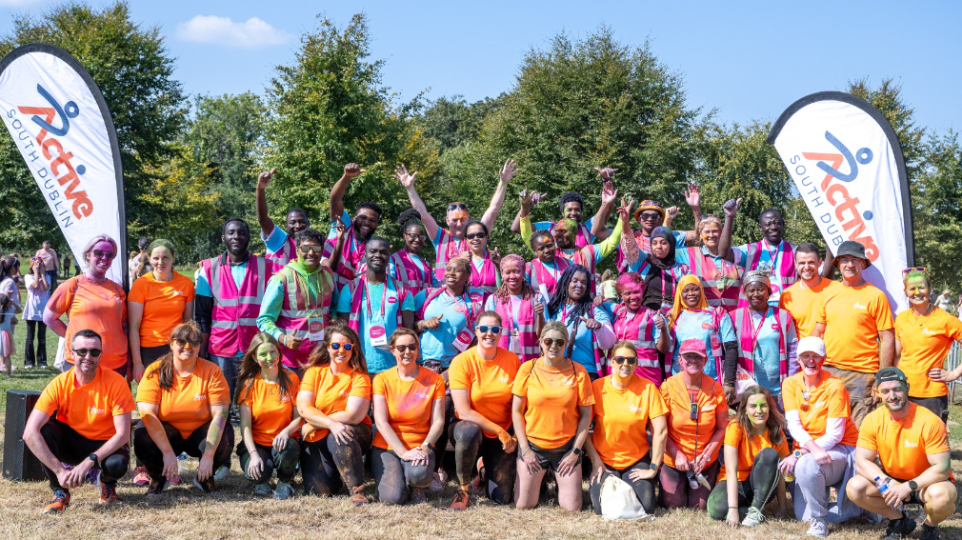
Parts of Division D, F & G Social & Community Development
Division D-Community Development, Sports, Interagency & Social Inclusion Programme
€3,536,800: Social Inclusion and Community Activation Programme (SICAP)
€1,403,100: Social Inclusion, interagency, younger and older person’s initiatives, integration and €75,000 to support establishment of the new Local Community Safety Partnership
Division F
€1,856,100: community facilities including solar panel installations and a new virtual scanning project
€720,000: community and sports development grants including €420,000 community infrastructure fund
€329,000: community events, projects and festivals with €60,000 St. Patricks Day Festival in Tallaght
€350,000: towards the delivery of a new Sports Hub in Whitechurch and €250,000 for the fit out of new youth facilities
€1,291,400: sports, physical activity & wellbeing programmes including Active South Dublin,
contributions to sporting organisations including €25,000 to Special Olympics Ireland and improved
access to sports/leisure facilities
€2,096,000: CE/J.I schemes & €461,900 for Community CCTV operational costs
Division G
€128,500: school meals programme for 22 schools in the County & €52,500 education/sports
bursaries

Slide 10
Director of Land Use, Planning and Transportation

Slide 11
Division B: Road Transport & Safety
Overall expenditure proposed for 2025 is €41,879,300
Increase of €1,122,800 over the 2024
National and regional road works: €4,743,000
Includes general road and footpath maintenance to our national and regional road network as well as winter maintenance (works to national road network only covers N81 as TII maintain the remaining national roads)
Local road maintenance: €20,565,400
Includes: €9,483,600 for general road and winter maintenance, footpath maintenance (€2,200,000), Cycle Track maintenance (€200,000), Social Housing Estate footpath works (€300,000) and footpath dishing (€56,000)
An allocation of €400,000 has been provided for enhanced accessibility works
Bridge safety works (€475,900) including safety works to four bridges in 2024
District centre enhancement programme (€750,000) including funding for feasibility studies for Tallaght and Rathfarnham. Completion of the works in in Lucan Village. Commence design for Clondalkin Village (€500,000)

Slide 12
Division B: Road Transport & Safety
Public lighting at €5,645,900
Provides for the maintenance of 32,000 public lights a year and
The LED upgrade programme with €850,000 to provide c.1,500 LED upgrades in 2025
Traffic management improvement, road safety & promotion and car parking at €9,894,800
Operation, maintenance and refurbishment of our traffic lights and management centre €4,598,800. This includes the commencement of a Traffic Signals Upgrade programme for which €450,000 is provided
Road safety and improvement works €2,552,100 of which €825,000 will be used to deliver the Council’s Street Management and Traffic calming guide
Road safety promotion, school wardens and education work €2,185,700
On street and off street-car parking €558,200
Alongside this, over 30 active travel (pedestrian & cycle) schemes are being progressed through the Cycle South Dublin programme. A SDCC Quiet Streets programme and a School Zone programme will also be commenced.

Slide 13
Division D: Development Management
Overall expenditure proposed for 2025 at €11,253,100
Increase of €340,200 on adopted 2024 budget
Forward and Delivery Planning at €3,885,200
Implement adopted County Development Plan, manage final JRs & implement a new monitoring system
Preparatory work for the next County Development Plan (10-year plan) will commence in 2025.
Manage delivery of SDZ planning schemes at Adamstown & Clonburris
Manage delivery of adopted LAPs at Newcastle, Tallaght, Ballycullen-Oldcourt and progress the Clondalkin LAP
Progress a CDP variation for City Edge lands
Continue review of County’s Employment Land & Rural Housing
Active Land Management: RZLT, Vacant Sites Register, Housing Task Force & new Dev. Contribution Scheme
Heritage & biodiversity projects €119,000 and Conservation projects €221,500

Slide 14
Division D: Development Management
Development Management and Planning Enforcement at €6,262,500.
At the end of September 2024, the Council had received 692 planning applications for assessment
At the end of September 2024, a total of 231 planning enforcement cases were opened and closed 434 cases.
e-Planning became operational in 2024 and will enable submission of applications online €66,400
Building Control at €750,900
At the end of September 2024, the Council had received :
  174 Disability Access Certs
  256 Fire Certs
  515 Commencement Notices

Slide 15
Director of Environment, Water and Climate Change

Slide 16
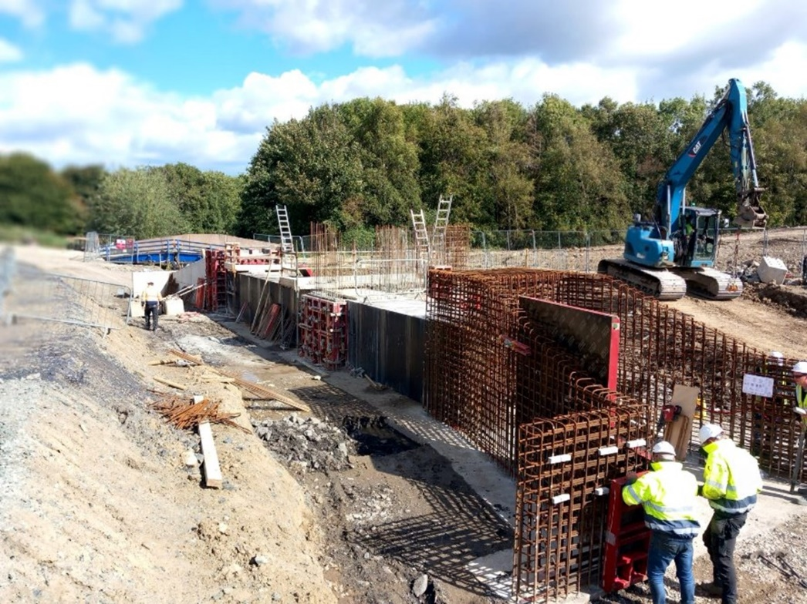
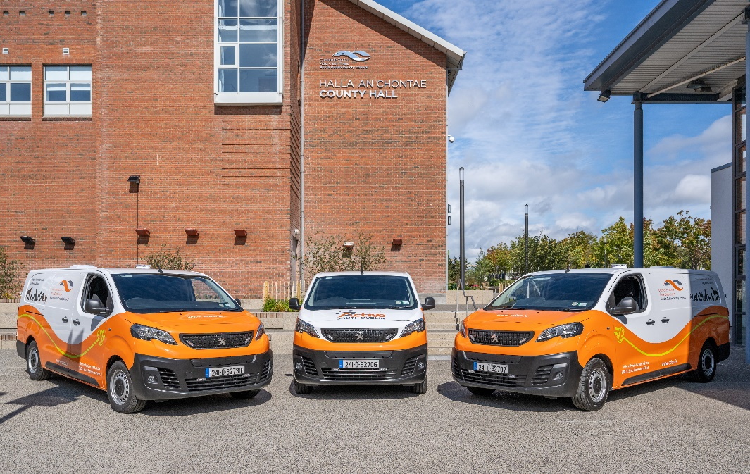
Division C, G & H Water Services etc
The total proposed expenditure of €98.37M for Environment, Water & Climate Change Directorate is across Divisions C,G,H,E &F.
Water Services (Division C)
Total Expenditure of €16.24m of which €10m is for provision of
Water & Wastewater Services (recoupable from Uisce Éireann and from
the Department of Housing, Local Government and Heritage)
Surface Water/Flood Management expenditure for 2025 is €6.68m
Agriculture, Education, Health and Welfare (Division G)
Overall proposed expenditure on Veterinary Services is €1.57
Machinery Yard (Division H) 2025
The total Machinery Yard budget for 2025 is €4.21m including
€1m for updating and decarbonising the Council’s fleet.

Slide 17
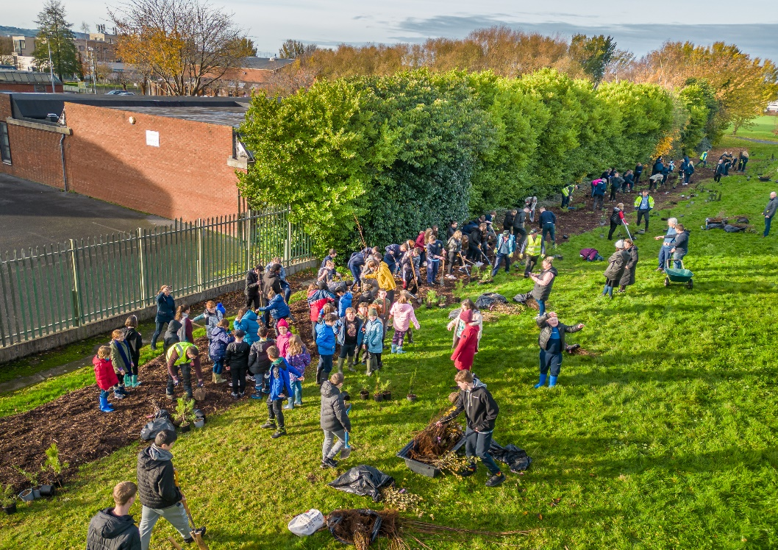
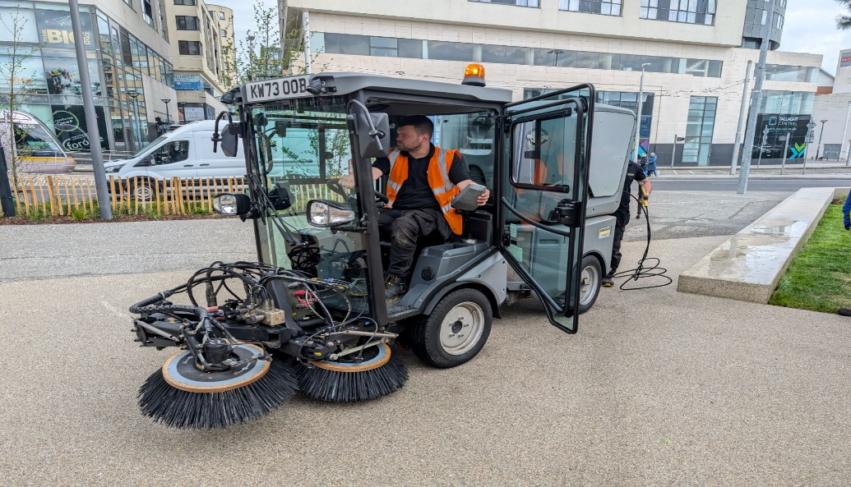
Division E Environmental Services
Proposed overall expenditure in Division E is €50.9m including the following main areas of expenditure:
Fire Service (operated by DCC on our behalf) has a proposed increase of €2m bringing this provision to €27m for 2025
Provision of €14.62m made for Public Realm Cleansing Programme which includes litter management, the litter warden service, village maintenance, environmental awareness programmes, street cleaning, bin provision & collection, estate cleaning, waste regulation & enforcement
€4.45m to support the delivery of the Climate Action initiatives
€1.1m in Landfill Operations for aftercare costs at Arthurstown & other historic landfills
€811k for Water Quality, Air & Noise Pollution Control
€1.45m for Burial Grounds including €325K for Columbarium wall at Bohernabreena and car park improvement works
Derelict Sites & Dangerous Buildings provision of €396k

Slide 18
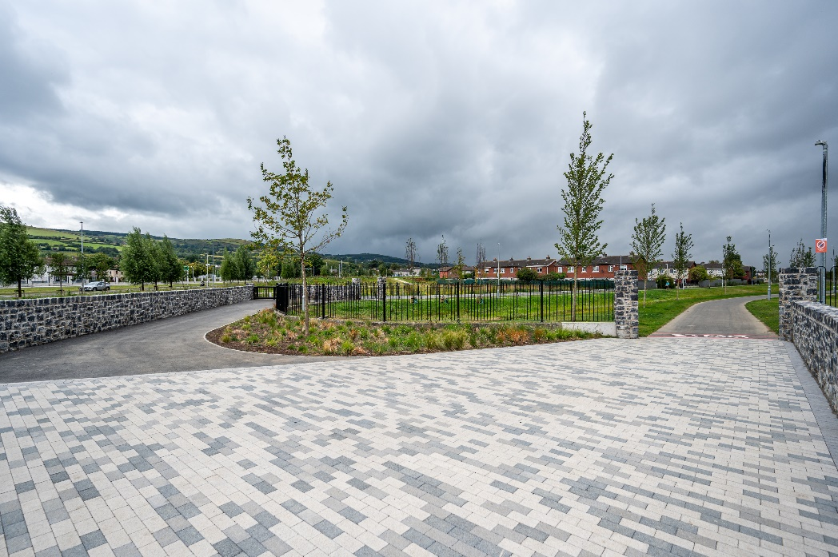
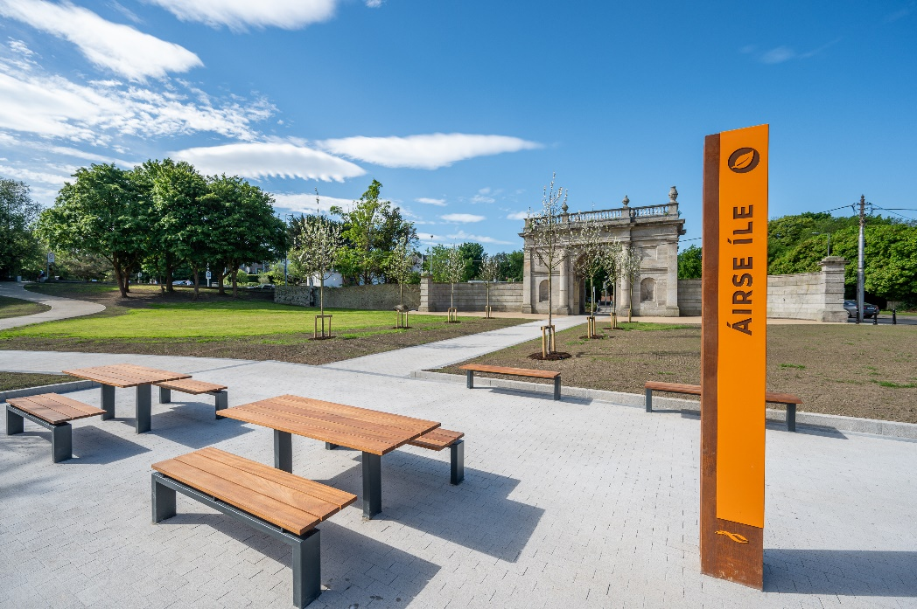
Division F Recreation & Amenity
Proposed total expenditure for Maintenance & Improvement of Public Realm is €30.34m representing a €2.63m increase on 2024.
The main areas of expenditure are:
  Grass Cutting Programme €5.70m
  Tree/Hedge Management Programme €4.59m
  Public Realm/Parks Management & Operation €3.97m
  Park Ranger Services €1.13m
  Pitch Maintenance/Improvements €1.02m
  Public Realm Improvement Works €2.84m
  Leisure Facility & Playground Maintenance €1.88m
  Delivery of Artificial 3G Pitches & Teenspace Programme €1.00m
  Upgrades at Killinarden, Jobstown and Quarryvale Parks, maintenance of
  new parks (Airlie and Kiltipper) and the upkeep of the grounds of Lucan House
  in 2025.

Slide 19
Director of Economic Enterprise & Tourism Development

Slide 20
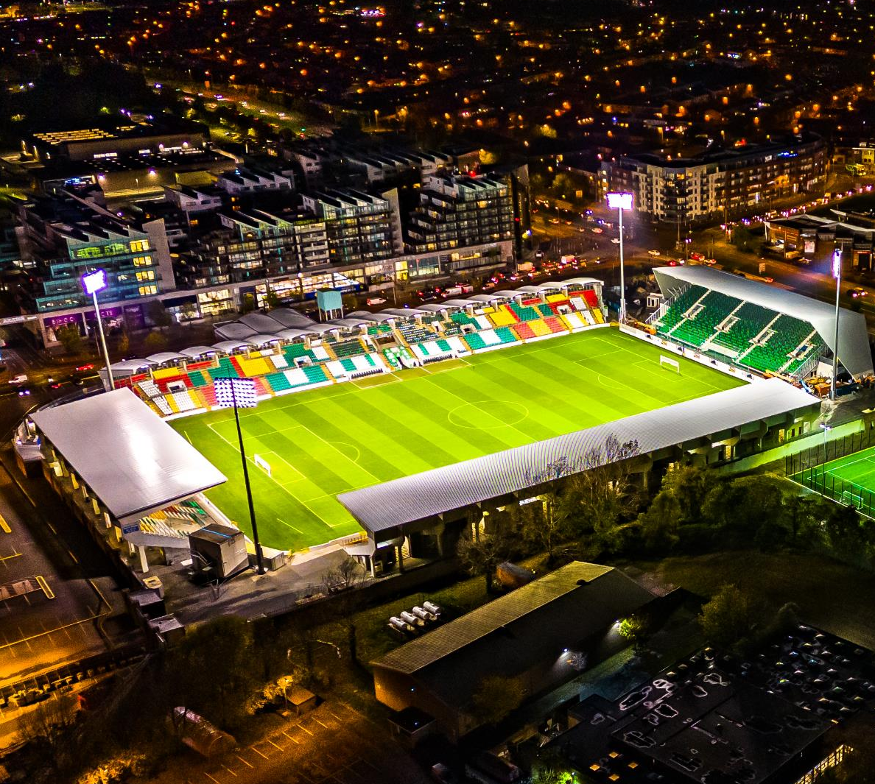
Division D & F: Working with Business & Tourism
€28,279,500 (2025) / € 26,566,900 (2024)
Business Support Fund: €1,000,000
Grange Castle Business Park & Expansion
County Economic Strategy 2025
LEO Feasibility, Priming & Business Expansion Grants: €719,000
Development of Business Networks: €508,400
12th Lock Masterplan: €1,500,000
Dublin Mountains, Rathfarnham Castle & Grand Canal Greenway
Rathfarnham Village Economic Plan: €100,000
Lucan House Masterplan: €190,000
Tallaght Stadium

Slide 21
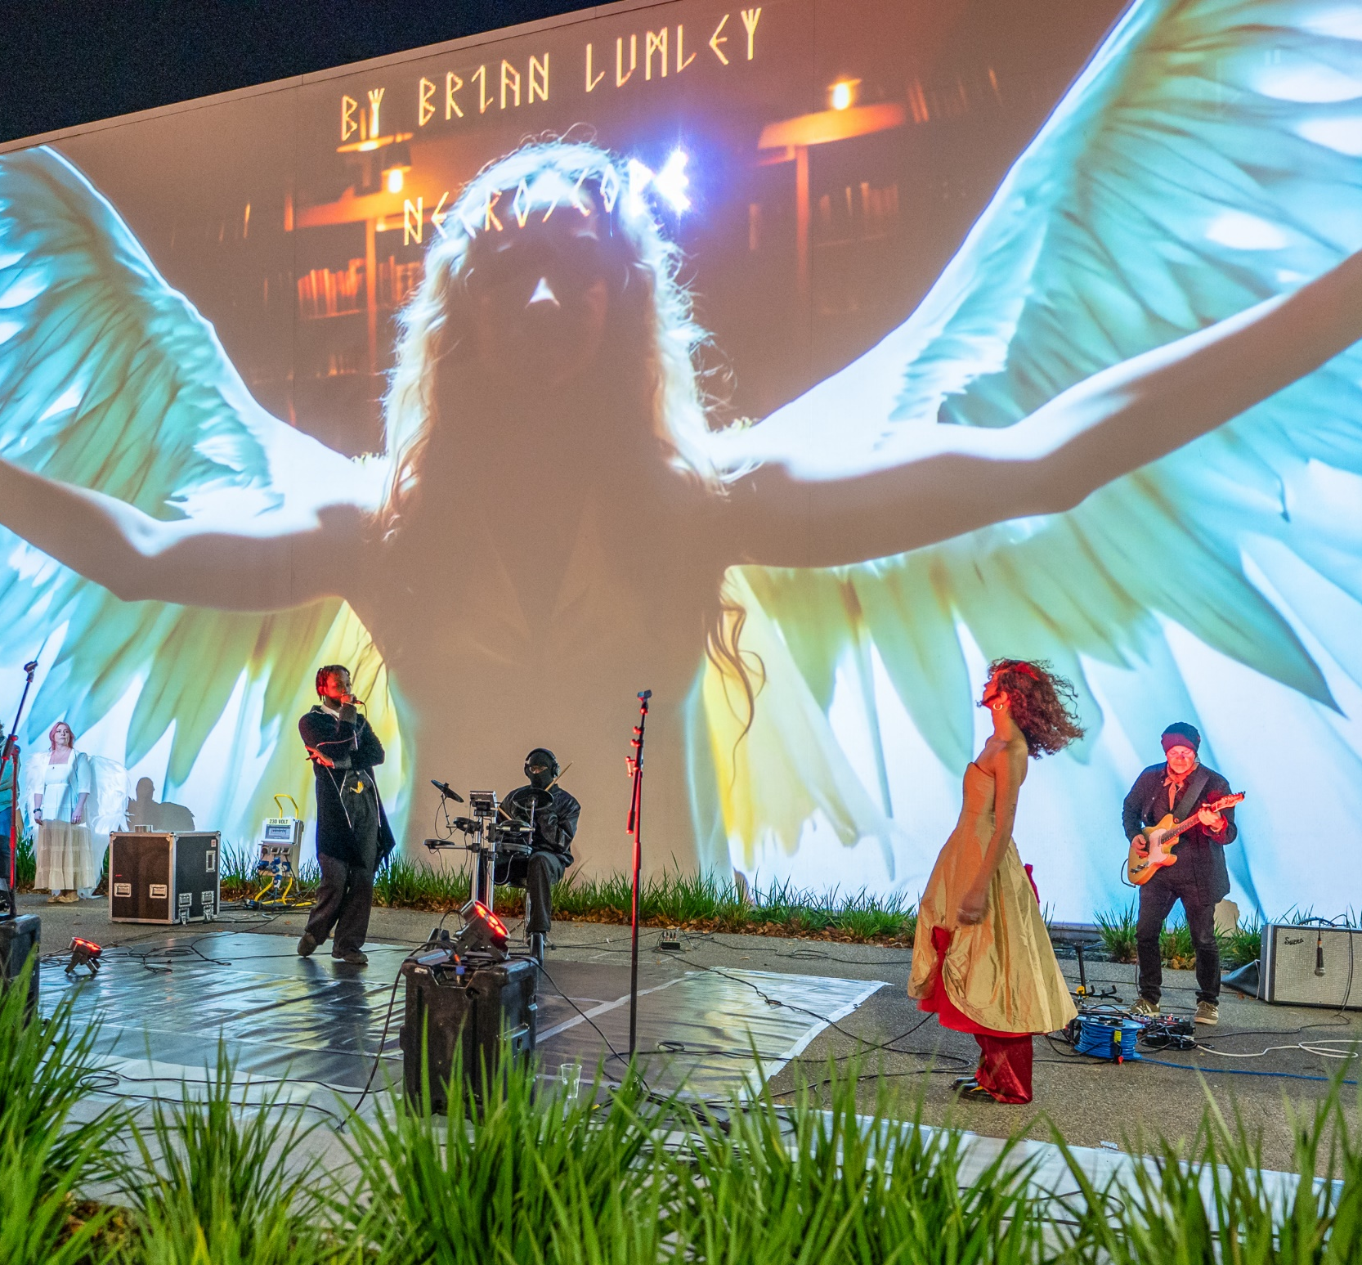
Division F: Managing & Promoting Culture Assets
Library Services: €9,950,400
Arts Programme: €2,974,700
Library Branch Running Costs: €1,300,000
Books, periodicals & other materials: €1,104,100
Dublin West Library Revenue to Capital Transfer: €555,000
Library Development Plan Strategy 2023-2027
Music Generation Programme: €414,200
Other Arts Programmes: €378,100
Creative Ireland & Cruinniú na nÓg Programmes: €278,800
Live Outdoor Performance Programme: €180,000
Parthalán Place Activation Programme: €100,000
Civic Theatre: €425,400
Rua Red Arts Centre: €460,000

Slide 22
Director of Corporate Performance & Change Management

Slide 23
Division D & H: Corporate Performance & Change Management
  Division D Development Management
  D06 Participatory Budgeting initiative €300,000
  D06 Diversity in Local Government €10,000
  D09 Twinning €20,000
  D09 Eastern and Midland Regional Assembly annual contribution €261,400 (79% increase in since 2023)
  Division H –Miscellaneous Services
  H04 Franchise Costs Register of Electors and Local Elections €744,700
  H09 Local Representation and Civic Leadership €2,002,300

Slide 24
Director of Finance

Slide 25
Division H Miscellaneous Services
2025 2024
Expenditure €11.7m €12.3m
Income €24.1m €21.2m
Net Cost (€12.4m) (€8.9m)

Slide 26
Division H03: Administration of Rates Expenditure
2025 2024
Refund due to Vacancy €0.800m €1.625m
Provision for Irrecoverable Rates €3.6m €4.0m

Slide 27
Division H: Miscellaneous Services - Income
2025 2024
Government Grants:
Payroll Recoupment €16.7m €12.8m
Goods & Services:
    Other Income €0.00m €4.4m
    IPB €1.83m €0.75m
    Investment Income €4.5m €2.4m

Slide 28
Draft Budget 2025 & Adopted 2024
Divisions | Budget Expenditure 2025 | Budget Expenditure 2024 | Budget Income 2025 | Budget Income 2024
Housing & Building | €174,288,000 | €133,274,700 | €164,429,000 | €122,266,700
Road Transport & Safety | €41,879,300 | €40,756,500 | €5,434,600 | €5,784,400
Water Services | €16,249,300 | €15,048,600 | €10,879,800 | €10,142,000
Development Management | €32,960,700 | €30,285,300 | €10,631,400 | €9,451,800
Environmental Services | €50,938,900 | €47,733,700 | €6,184,600 | €7,227,300
Recreation & Amenity | €62,096,800 | €57,239,800 | €4,834,000 | €4,566,600
Agriculture, Education, Health & Welfare | €1,757,100 | €1,630,500 | €605,600 | €689,200
Miscellaneous Services | €11,772,100 | €12,352,000 | €24,068,200 | €21,251,000
Total | €391,942,200 | €338,321,100 | €227,067,200 | €181,379,000
Local Property Tax |  |  | €11,704,800 | €11,509,600
Rates |  |  | €153,170,200 | €145,432,500
Total |  |  | €391,942,200 | €338,321,100

