Slide 1

Rathfarnham Stables & Courtyards
ACM Update
November 2024

Slide 2

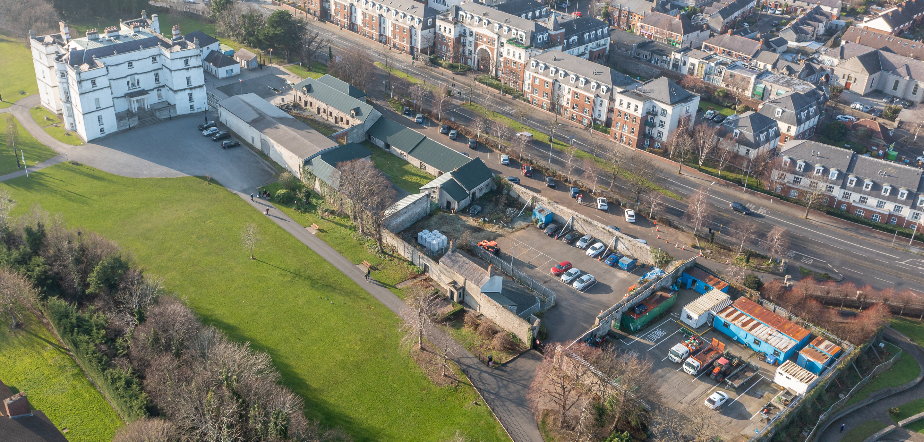


Slide 3
Background
  Objectives from the County Development Plan acted as a guide throughout the master planning process.
  Redevelopment of a brownfield site of significant cultural-heritage importance in Rathfarnham
  Enhancement of a built heritage asset which can support place-making in Rathfarnham
  The delivery of a quality design to underpin effective place-making, allowing Rathfarnham become more attractive for everyone who lives, works and visits the area.
  The creation of a space that offers social, community and recreational benefits and that fosters a healthy, inclusive and sustainable community in Rathfarnham.
Three stage non statutory public engagement process

Slide 4
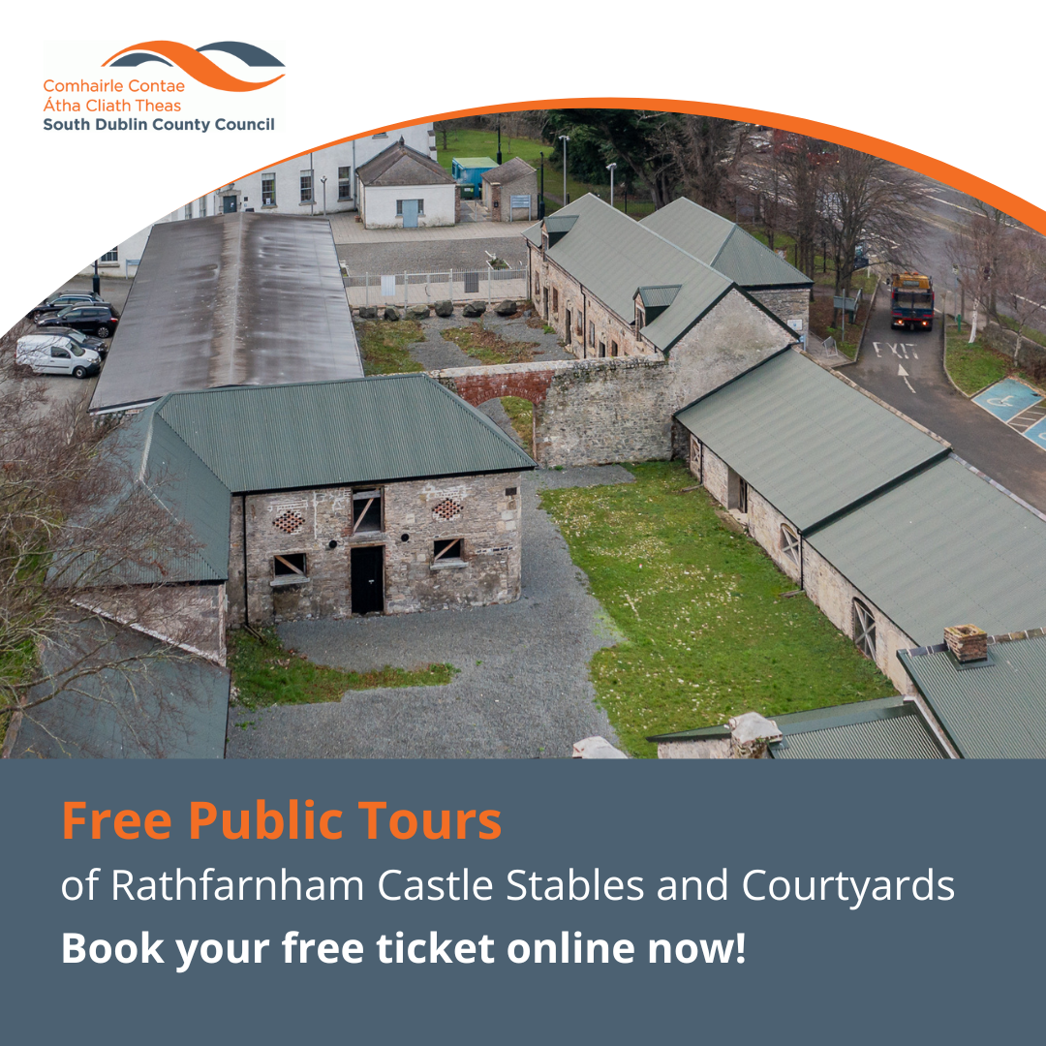
Non statutory public engagement
A three stage non statutory public engagement process was undertaken
Comprising three phases:
Inform; historical tours of the courtyards to give a historical context to the buildings
Consult; an online and paper questionnaire
Interrogate; a series of focus groups, where issues were teased out
120 people availed of historical tours of the courtyards – for many, this was the very first time they had been behind the walls of the space.
Over 1,000 people completed the questionnaire.
Over 60 people were invited to a series of focus groups including a youth session consisting of children between the ages of 8 – 19.
Given the largely positive engagement, the consultant engaged to conduct the process felt that, overall, there was a willingness to see the development in a more productive way.

Slide 5
Public Consultation (Key Themes)
Culture and Heritage
Sustainability (Circular economy, local produce, organic food, garden store, farmer markets etc.)
Economic Development
- Extension to Rathfarnham village
- Revitalise Rathfarnham (its dead, no evening time economy, needs injection of life and culture)
- Connectivity to village
Tourism
Accessible and Inclusive space
A Lively, Living Space: Arts, Crafts, Heritage/Culture and Performances, Health/Fitness
  - Avoca/Kilkenny Design/Malahide Castle: retail/dining/farm shops/arts and crafts
Travel
- foot
- car
Car parking
Sean Keating Garden
Recommendation: Master Plan design response

Slide 6
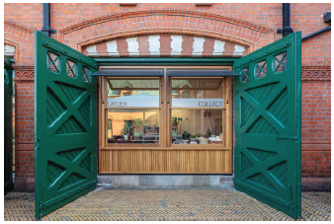
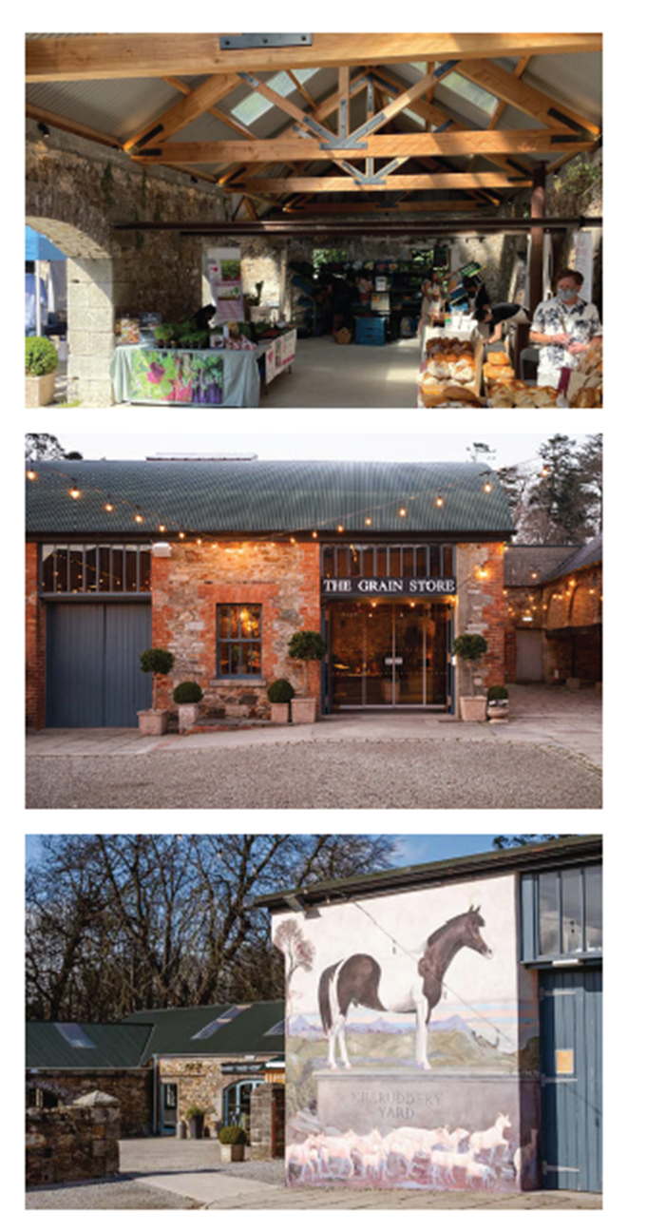
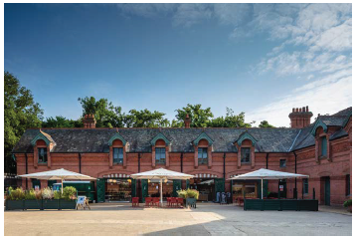
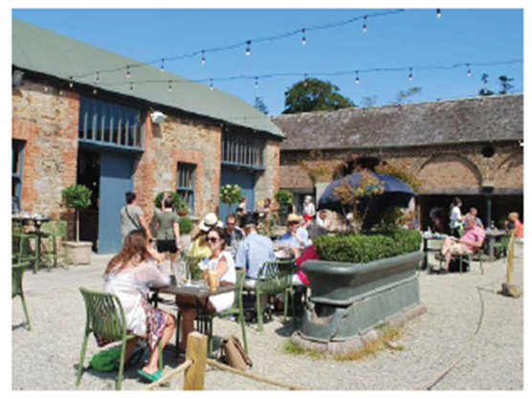

Slide 7
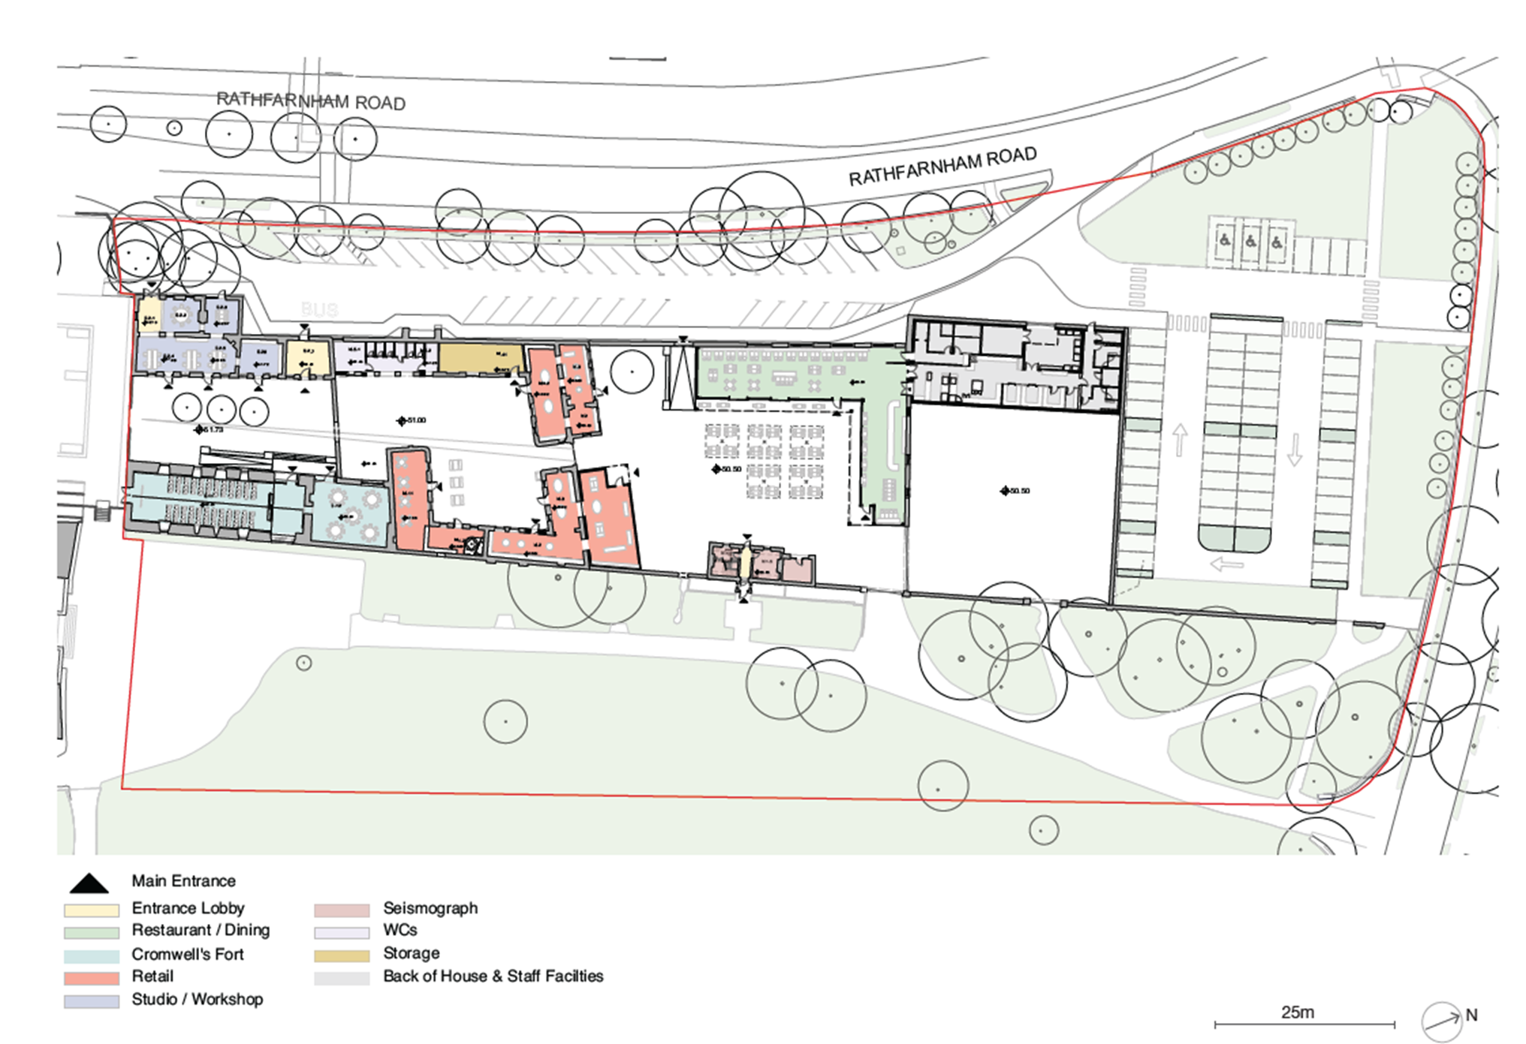
Rathfarnham Stables Concept Design in response to the public engagement

Slide 8
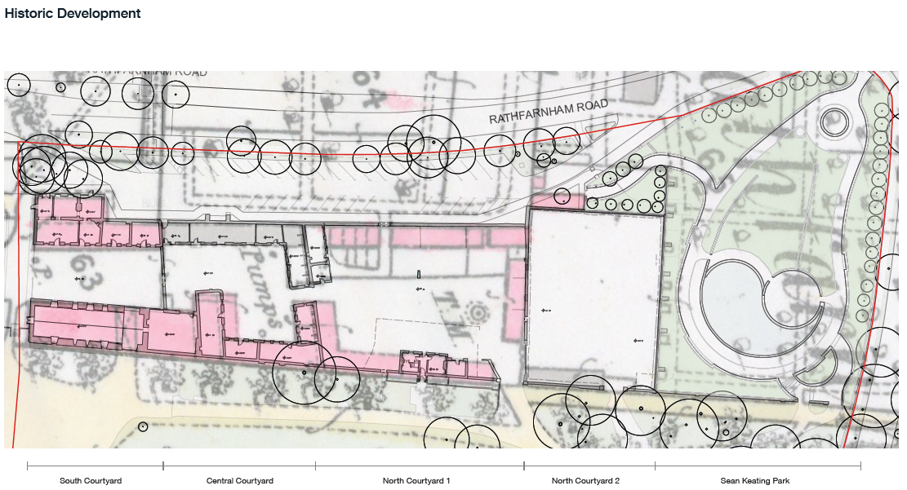
Rathfarnham Stables Concept Design maps the historic development

Slide 9
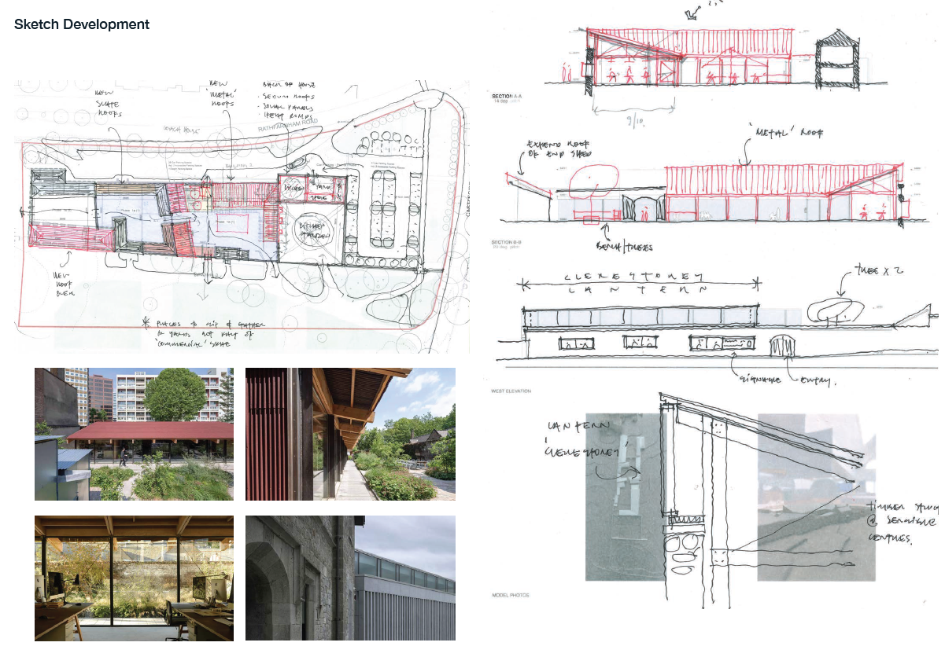

Slide 10
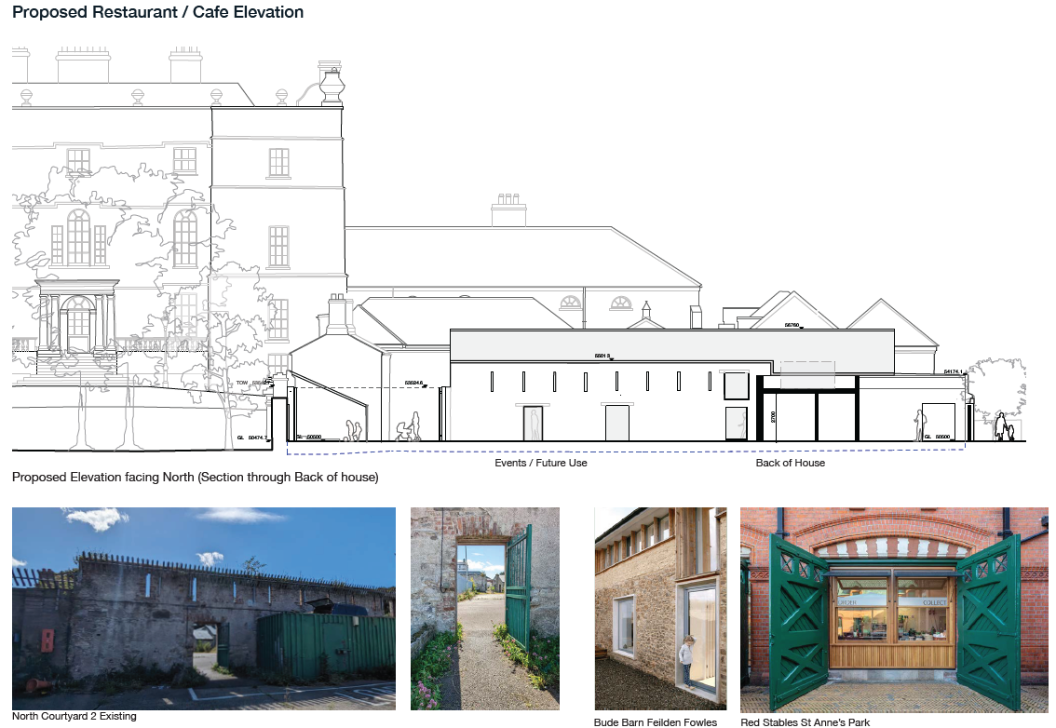

Slide 11
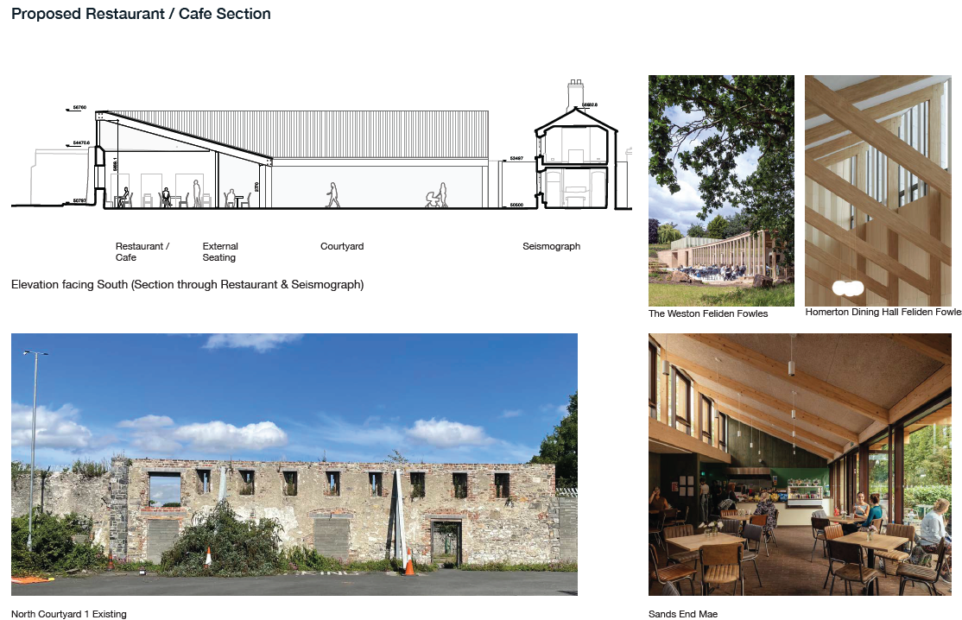

Slide 12
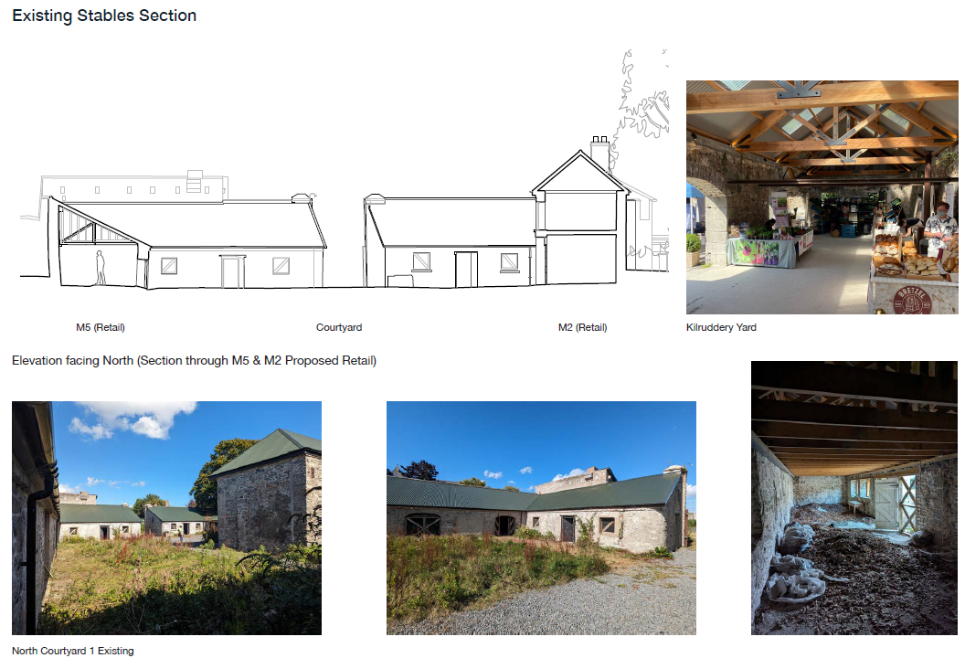

Slide 13
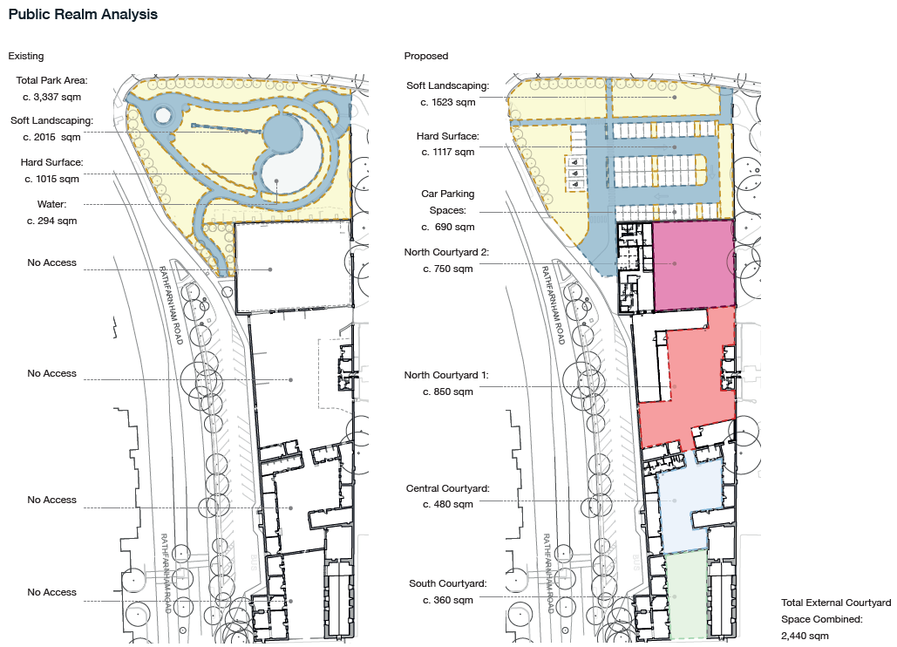
Outstanding Concerns - Car Parking/Sean Keating Garden

Slide 14
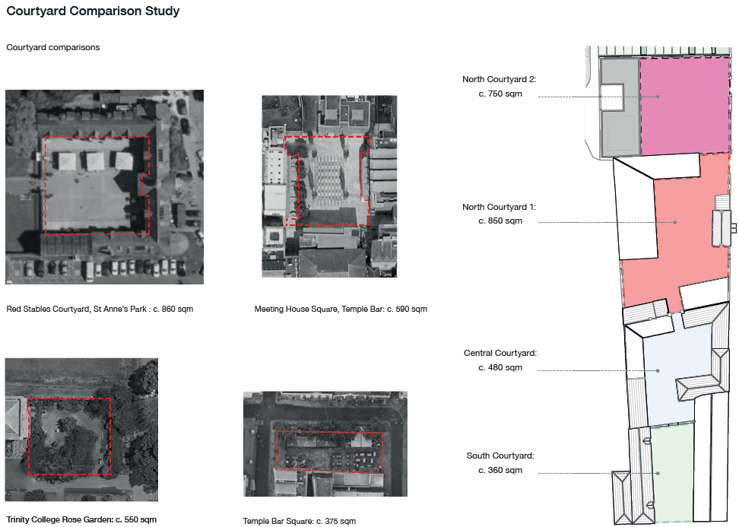
Outstanding Concerns - Car Parking/Sean Keating Garden

Slide 15
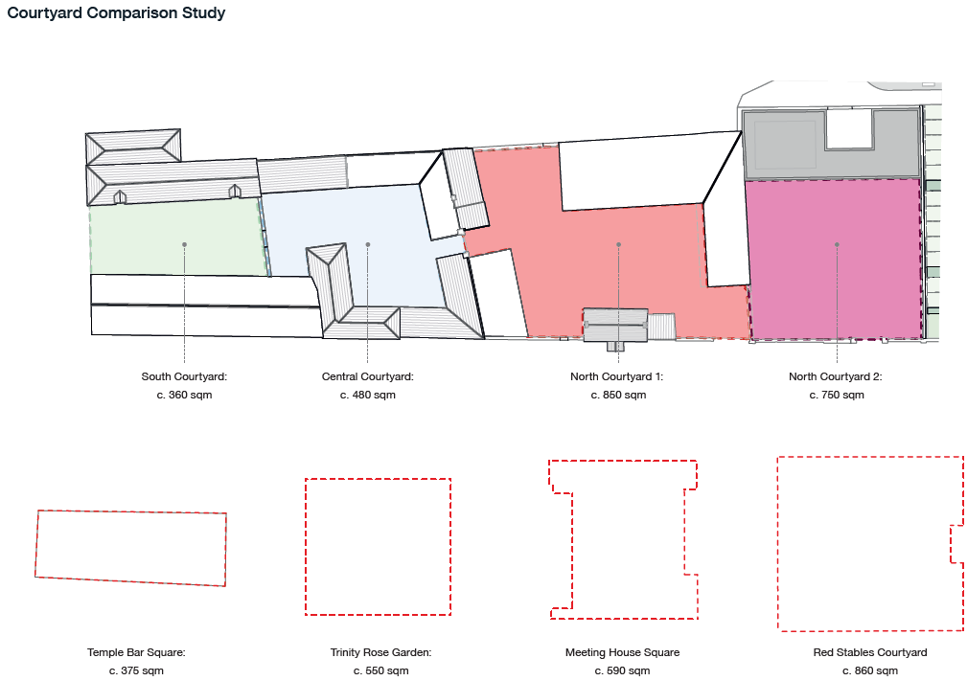
Outstanding Concerns - Additionality

Slide 16
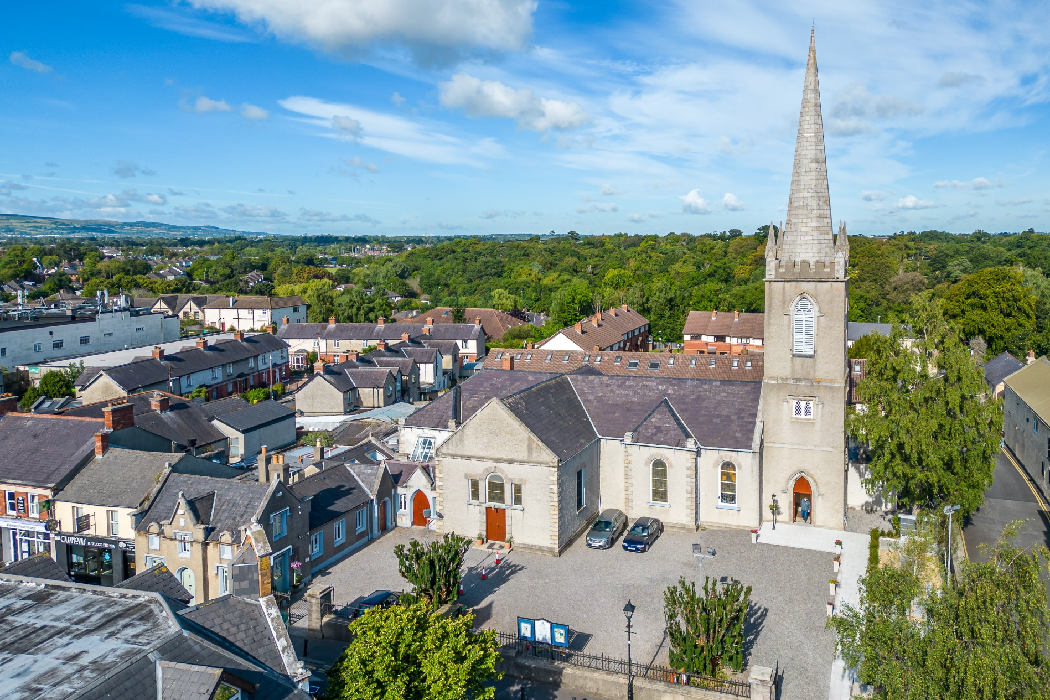
Revitalising Rathfarnham Village
The relationship with the village has been highlighted as a concern
The village is seen as needing an injection of life, culture, and investment with little to draw people there in comparison to other villages nearby.
Respondents felt decline of the village was attributable to the lack of car parking.
Sees the project as an extension of Rathfarnham village.
In response, the Council has included the following in the
draft 2025 budget. These are linked to the delivery of
the courtyards project:
Rathfarnham village economic plan: €100k
Rathfarnham village Physical Enhancement Feasibility: €50k

Slide 17
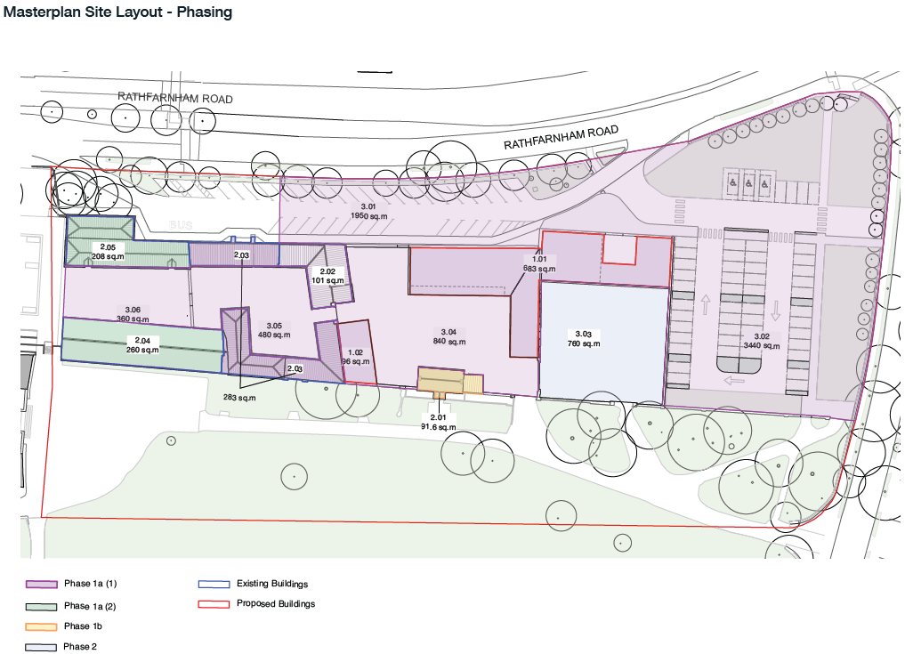
Rathfarnham Stables Concept Phasing

Slide 18
Overall proposals will….
Drive development employment and tourism in Rathfarnham
Assist with placemaking
Provide internal and external performance, and event space
Provide for new commercial, hospitality, creative, and retail space
Provides for interpretation in relation to the original buildings and the Seismograph House
Provide additional parking, including accessible spaces, older persons parking, EV charging
Provide toilet facilities including changing places space for park users
Provides opportunities for social interactions, classes, relaxation spaces

Slide 19
Rathfarnham Stables Project: Next Steps
November ACM
Part 8 Preparation
Project Cost Review
Part 8 Public Consultation
Part 8 Determination
Detailed Design
Project Cost Review
Project Construction
Thrive Funding Application
Rathfarnham Village Urban Design Plan/Village Design Statement

