Slide 1
Social Housing Delivery
Rathfarnham Templeogue Firhouse Bohernabreena ACM
12th November 2024

Slide 2
2024
Notes:
Housing for All Delivery Pipeline 2024
No alt text provided
No. of Potential Units Per LEA
No alt text provided
textbox
No alt text provided
Potential Units
No alt text provided
image
No alt text provided

Slide 3
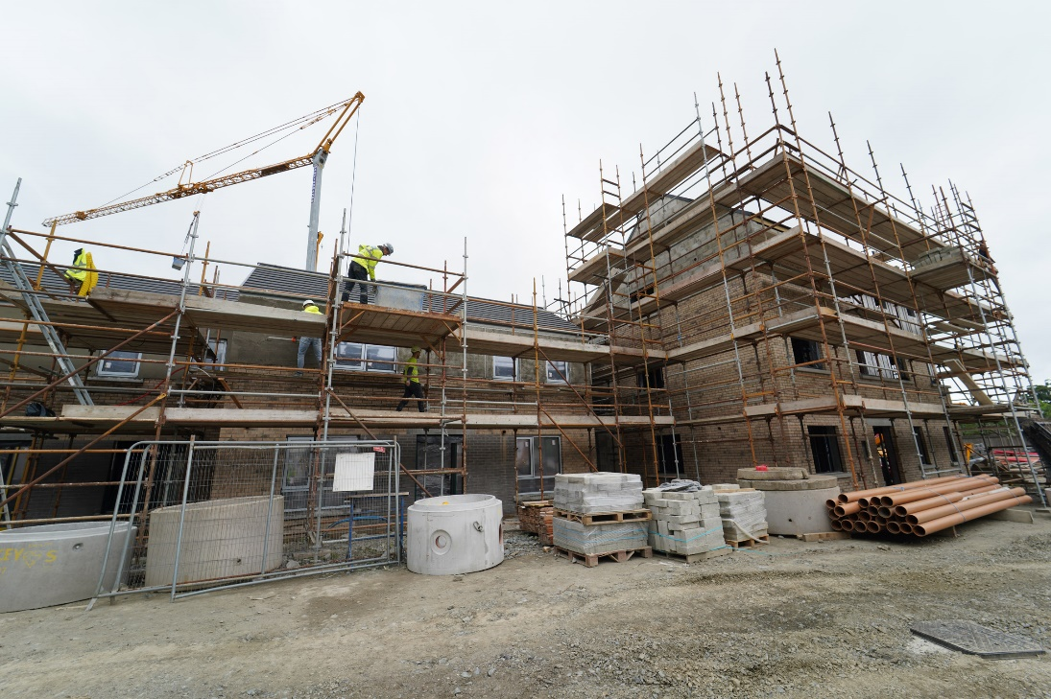
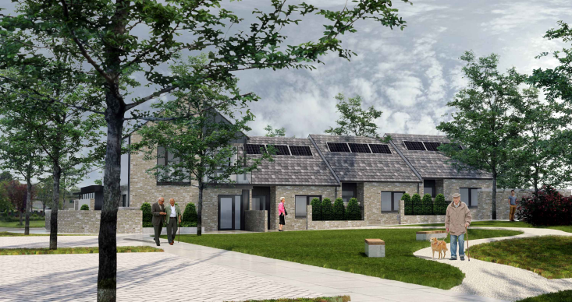
Own Build Developments
LEA | Project | Units | Status
Firhouse – Bohernabreena | Homeville | 16 | On-site – completion Q4.2024
Rathfarnham – Templeogue | Pearse Brothers Park | 10 | Contractor appointed. On site
Homeville, Knocklyon
Pearce Brothers Park

Slide 4
Planning Derogation Sites – Section 179A / 161
Stocking Lane, Rathfarnham
25 Social Homes
Owendoher Haven, Rathfarnham
9 Traveller Accommodation Units
Castlefield, Old Knocklyon Road
33 Social and Affordable Homes
Detailed design finalised
FRA Ongoing
Judicial Review
Progress to advertisement

Slide 5
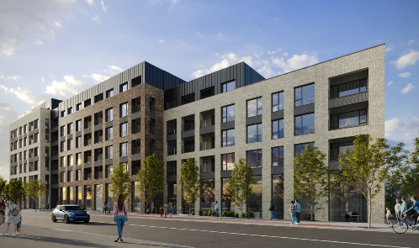
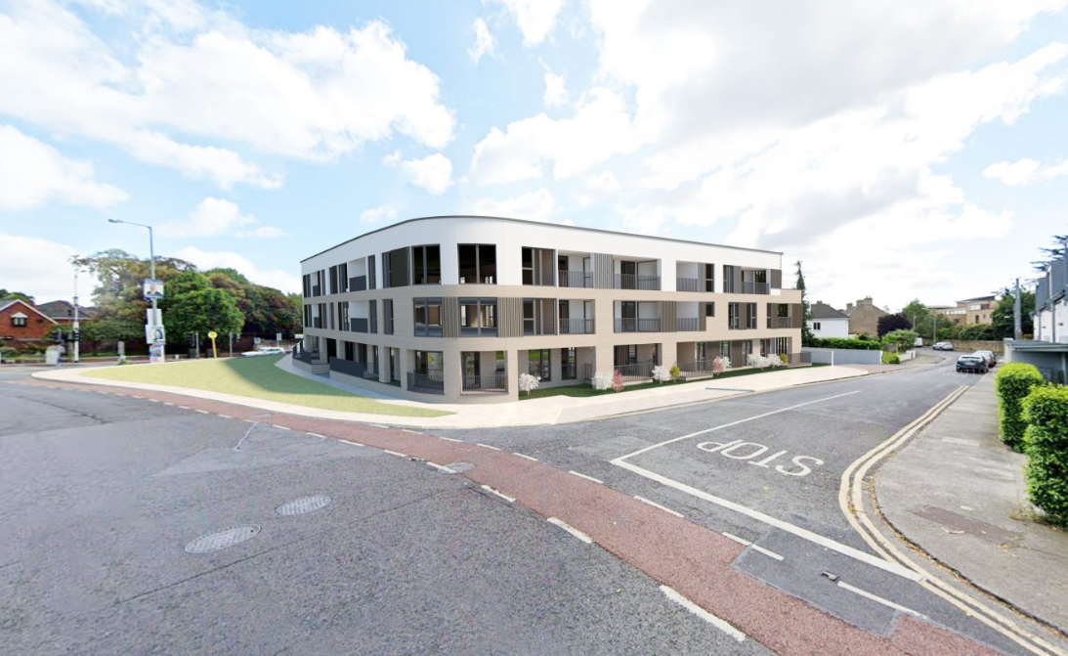
Social Housing Investment Programme
LEA | Project | Units | Status
Firhouse - Bohernabreena | Laurel Manor, Stocking Lane (Part V) | 2 | On-site – completion Q4.2024
 | Dodderbrook, Oldcourt (Part V) | 2 | On-site – completion Q2.2025
Rathfarnham – Templeogue | Cromwellsfort Road (AHB) Circle Housing | 20 | Completion Q4.2024.Age Friendly Development
 | Whitehall Road West (AHB) Focus Ireland | 13 | On-site – delivery from Q2.2026. Age Friendly Development
 | Stoneview, Walkinstown House (Part V / AHB) Cluid Housing | 65 | On site. Due for delivery Q2 2025.
 | Nutgrove Avenue, Rathfarnham (Part V / AHB) Oaklee Housing | 28 | On site. Due for delivery Q4.2025
Stoneview,
Walkinstown House,
Dublin 12
Grange Road, Rathfarnham

Slide 6
Overview
Notes:
Total Number of EOIs
No alt text provided
Number of EOIs by LEA
No alt text provided
Number of EOIs By Status
No alt text provided
image
No alt text provided
textbox
No alt text provided

