Slide 1
Social & Affordable Housing Clonburris SDZ (Phases 3-6) Meeting of South Dublin County Council November 2024

Slide 2
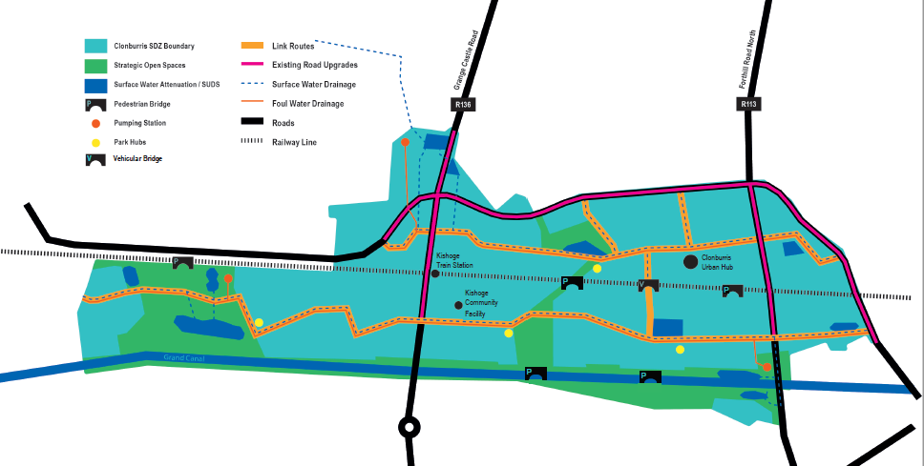
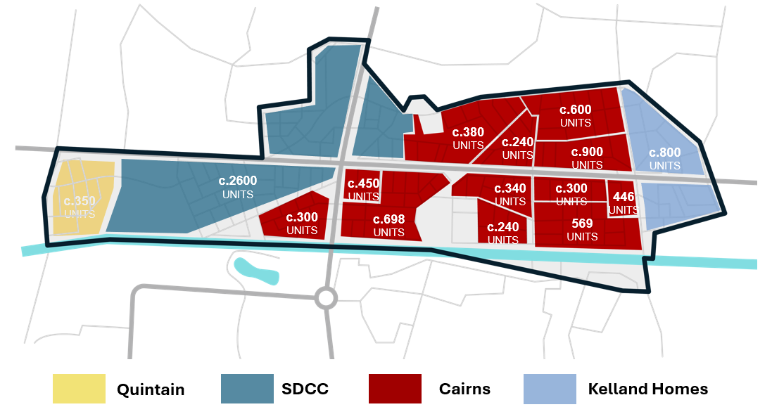
SDZ Progress
Infrastructure
Nine major projects for delivery by 2032
Total cost €322m (incl. €186m URDF, €19m NTA & balance from landowners)
Southern Link Street (phase 2) on site
Planning for additional infrastructure ongoing in conjunction with landowners
Overall Housing delivery
Landowners’ commitment to deliver 8,750+ homes
3,456 homes with planning permission
470 homes completed
1730 homes under construction

Slide 3
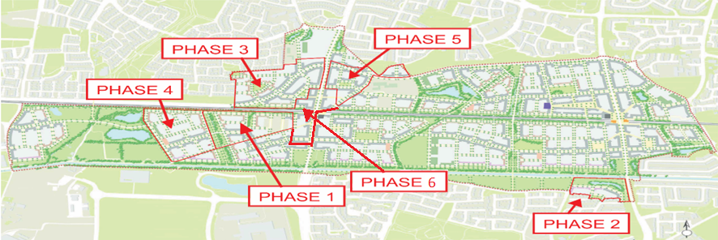
SDCC Housing Delivery
Use text box for image caption if required
Capacity for >2,500 homes on Council-owned lands within SDZ
Delivery across 6 mixed-tenure phases
Overall tenure mix: approx. 35% social and 65% affordable (comprising affordable purchase & cost rental)
Additional Part V/AHB/LDA/turnkey opportunities across all tenures

Slide 4
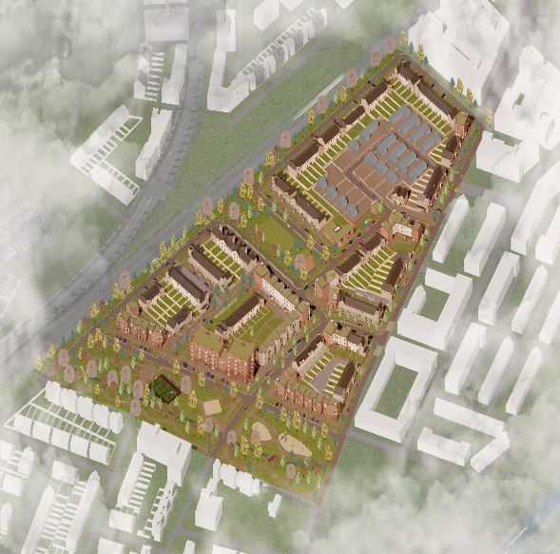
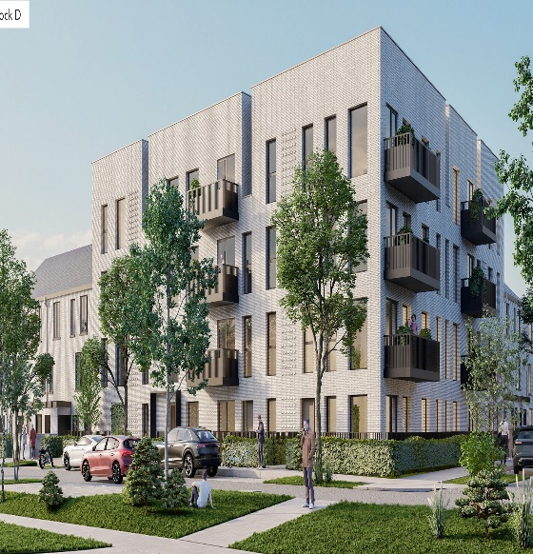
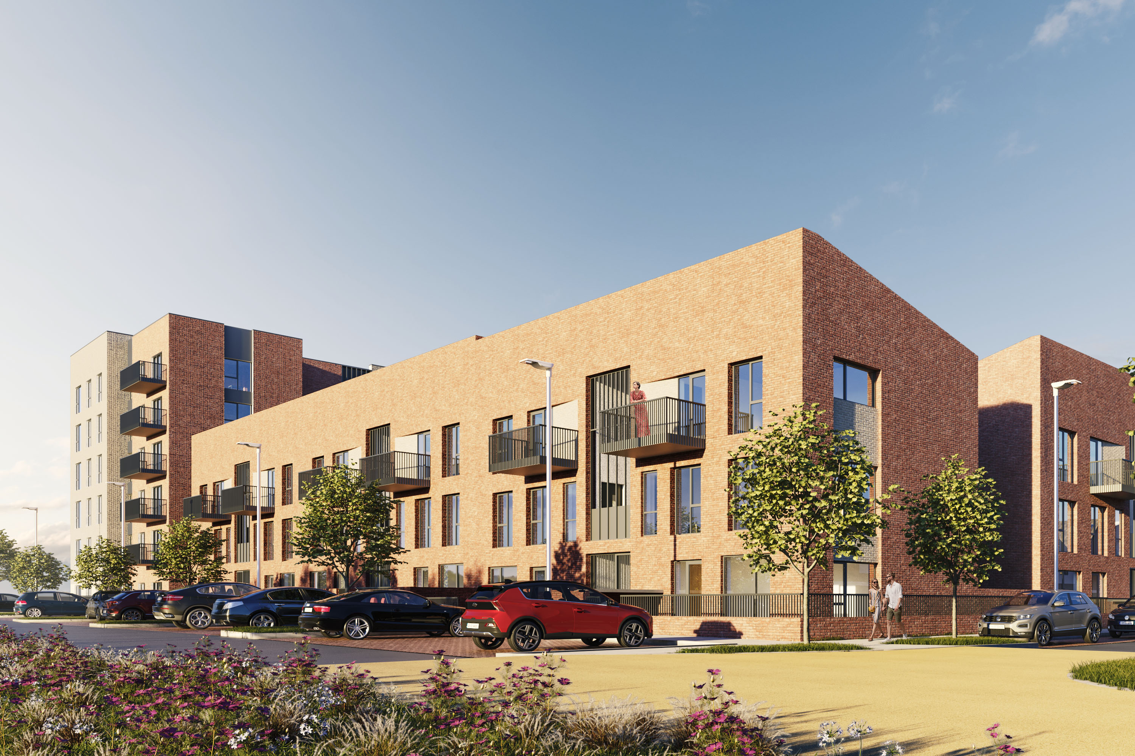
Phases 1 & 2 / PPP Site
Phase 1: 266 homes
(Part 8 approval June ’22)
93 social, 83 cost rental & 90 affordable purchase
Existing residents & impact of adjoining strategic infrastructure
Tender complete- Q4/24
Phase 2: 116 homes
(Part 8 approval July ’22)
56 social & 60 affordable purchase
Commencement Q4/23
Completion by Q4/25
Engagement of selling agent to manage sales
PPP Site
118 Social Homes
Site within SDCC Phase 5
PPP Bundle 6
S.85 agreement with DCC
Part 8 planning process commenced in July 2024
Delivery by 2028

Slide 5
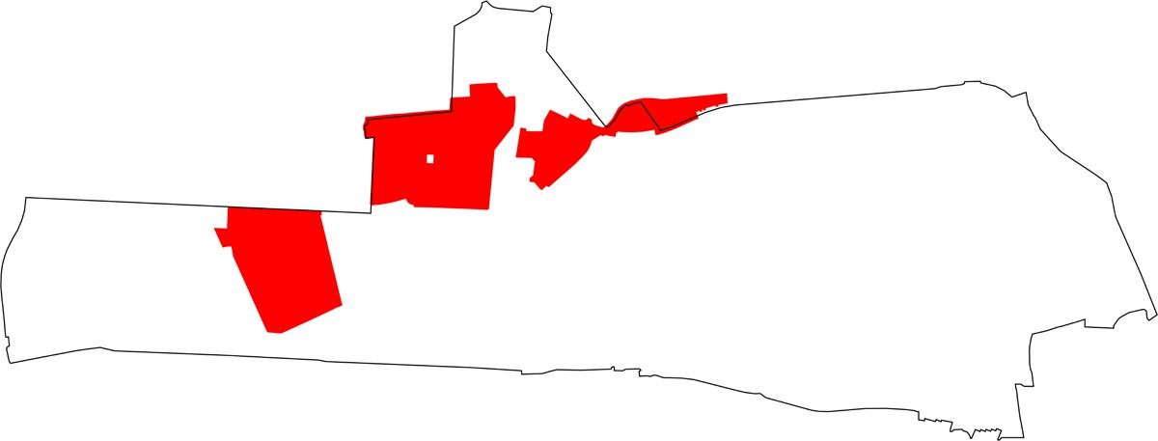
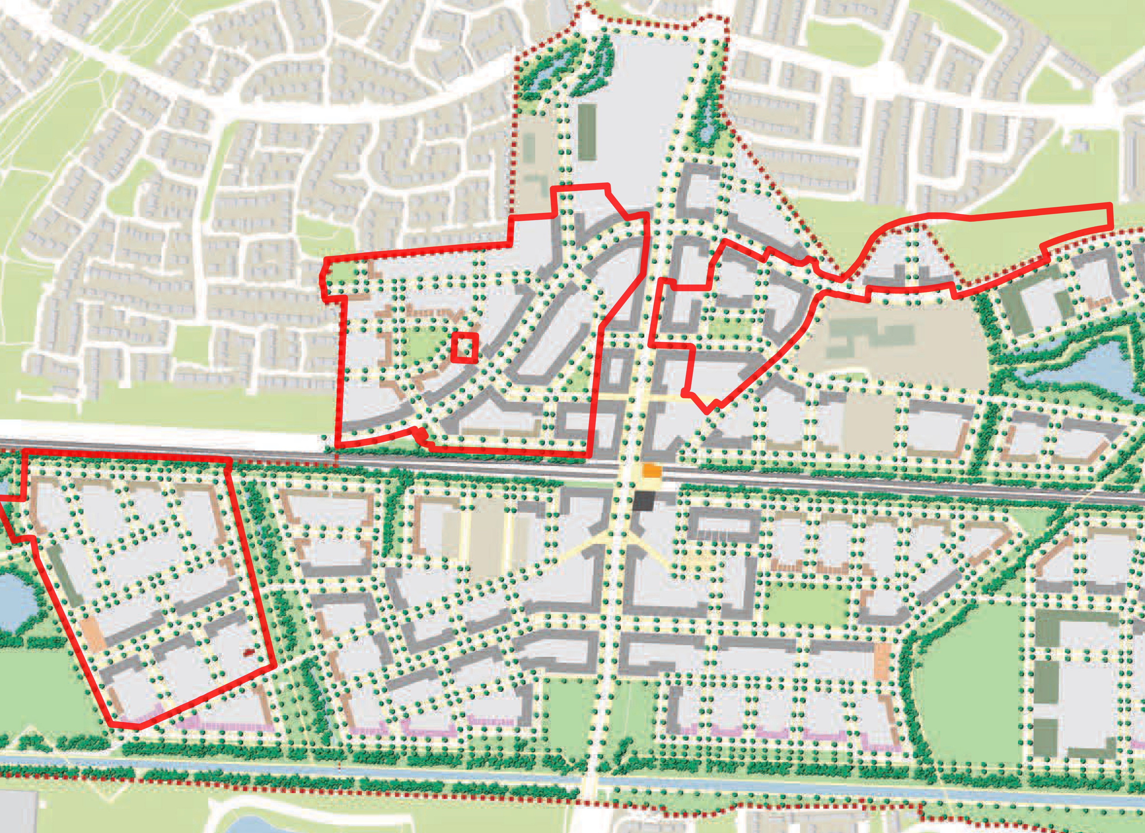
Phases 3, 4 & 5
Lucan Educate Together
Proposed Secondary School
Kishoge Community College
5
3
4
Key Plan of Sites 3, 4 & 5 within Clonburris SDZ
SITE 5
North Link Street,
Pre-planning
SITE 5
SITE 3
Phase 1, tender for 266 homes
KISHOGE
Proposed Community Facilities
STATION
SITE 4
South Link Street, 2025 completion

Slide 6
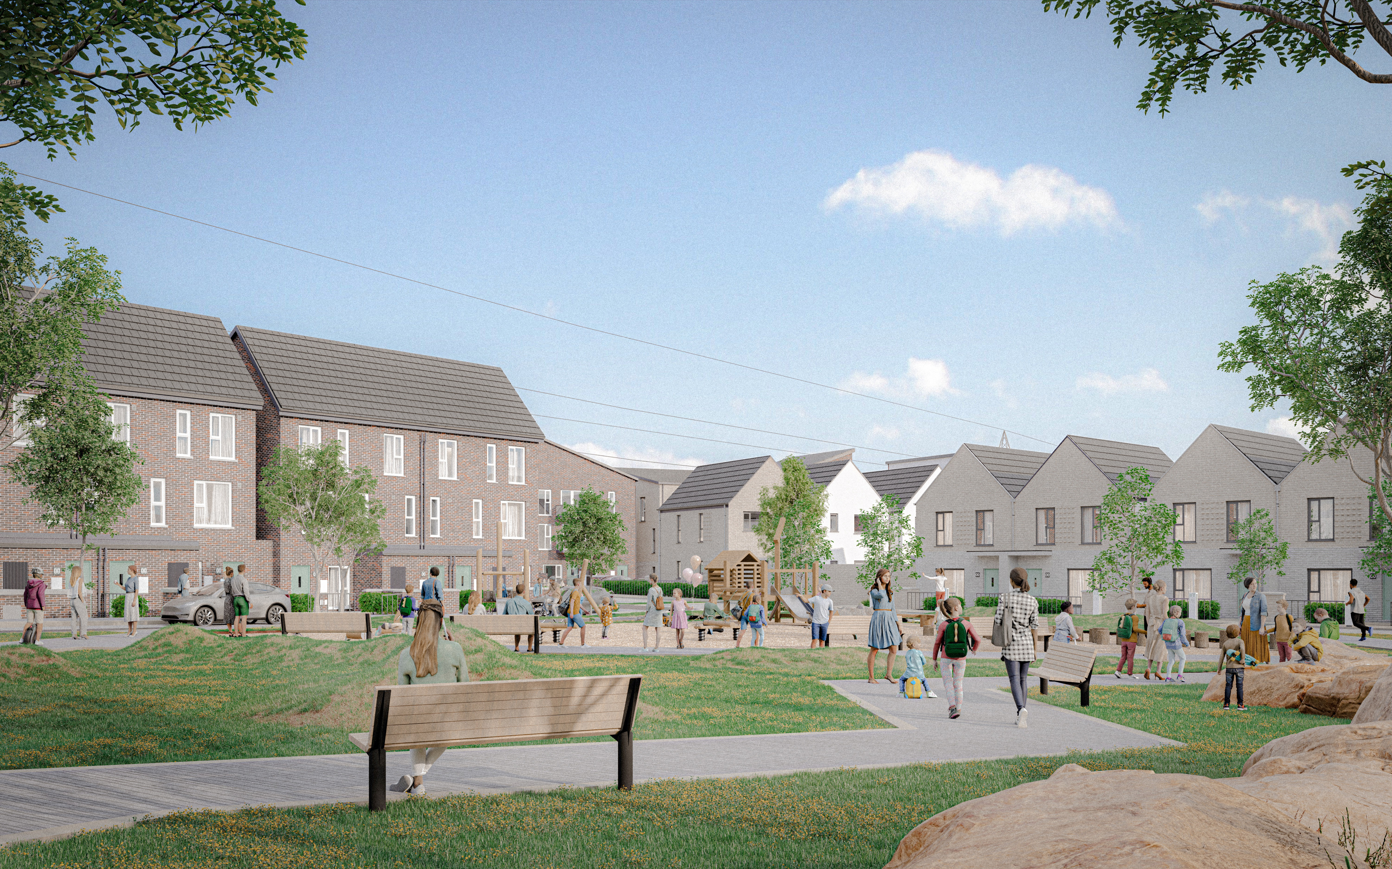
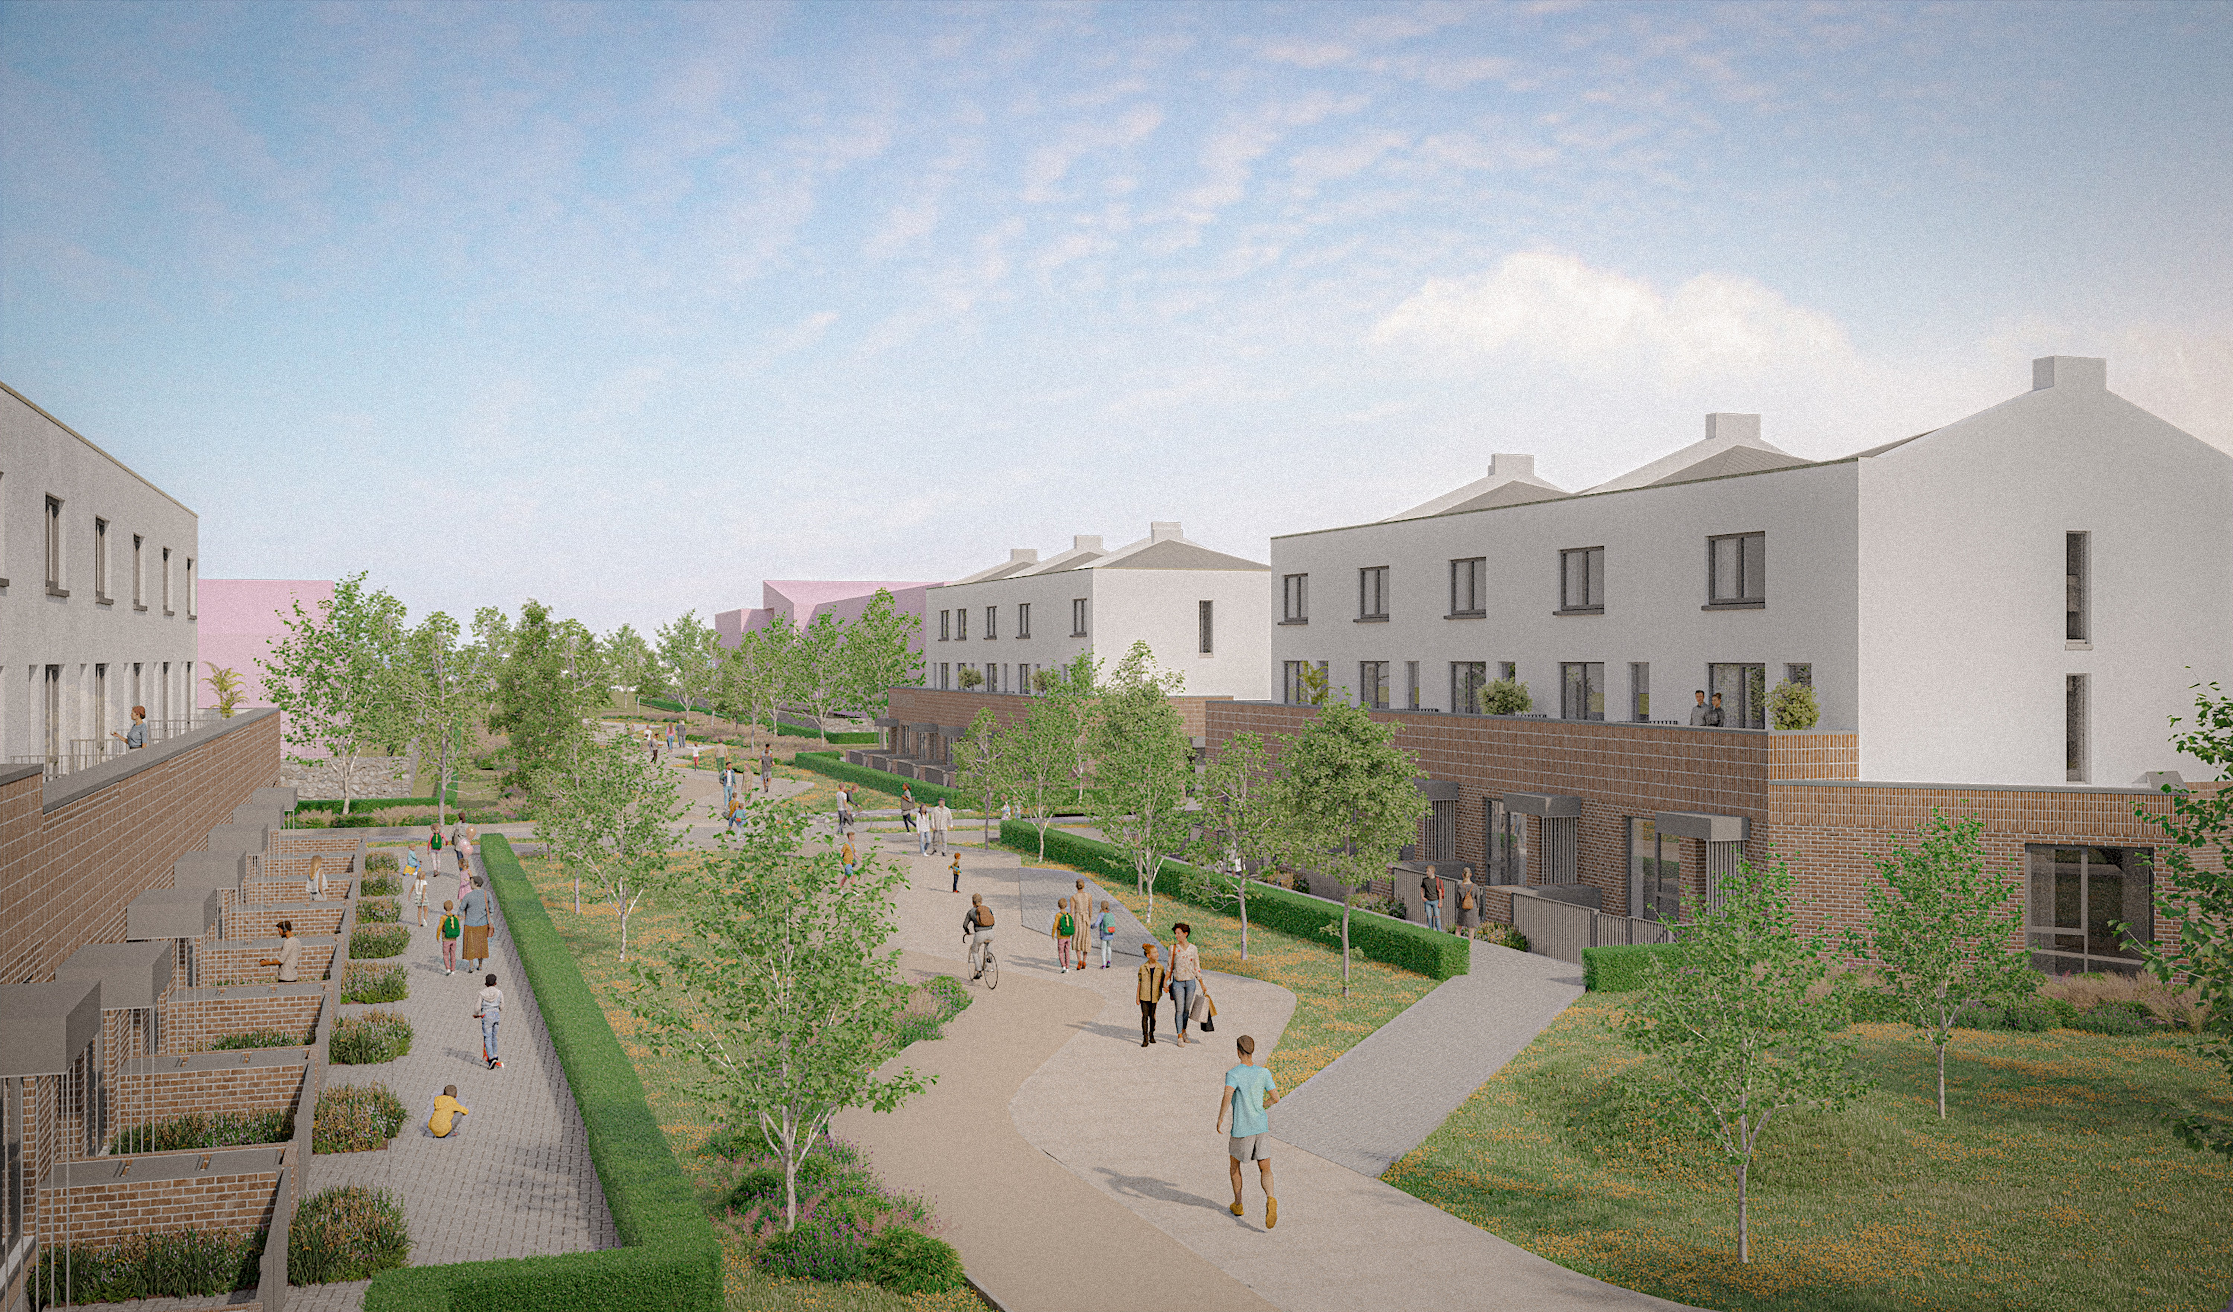
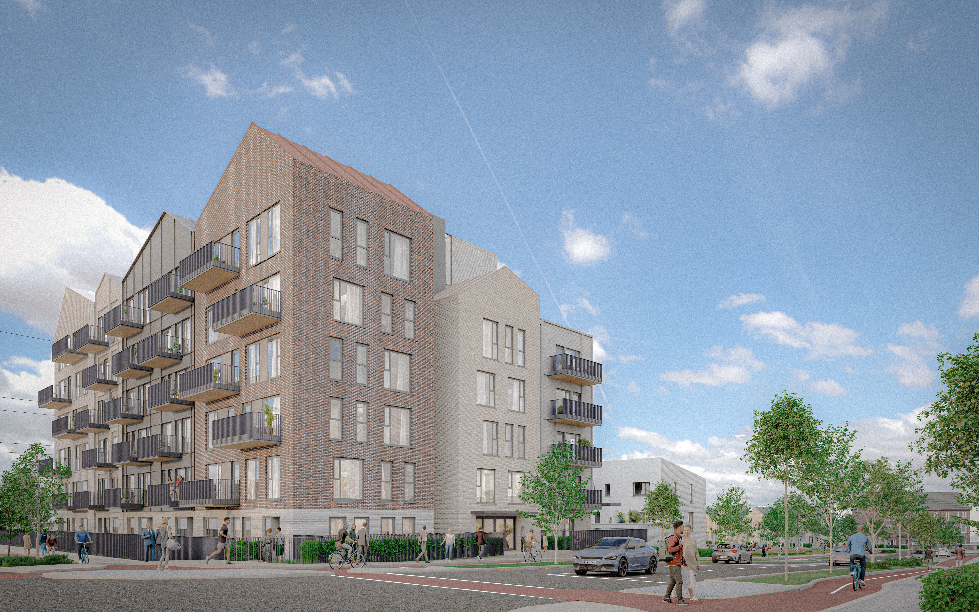
Phase 3, 4 & 5 Design Context
Variation in home types to animate neighbourhoods
Green links to community infrastructure, /schools, retail & public transport
Mix of densities moving from urban centre to adjacent existing residential

Slide 7
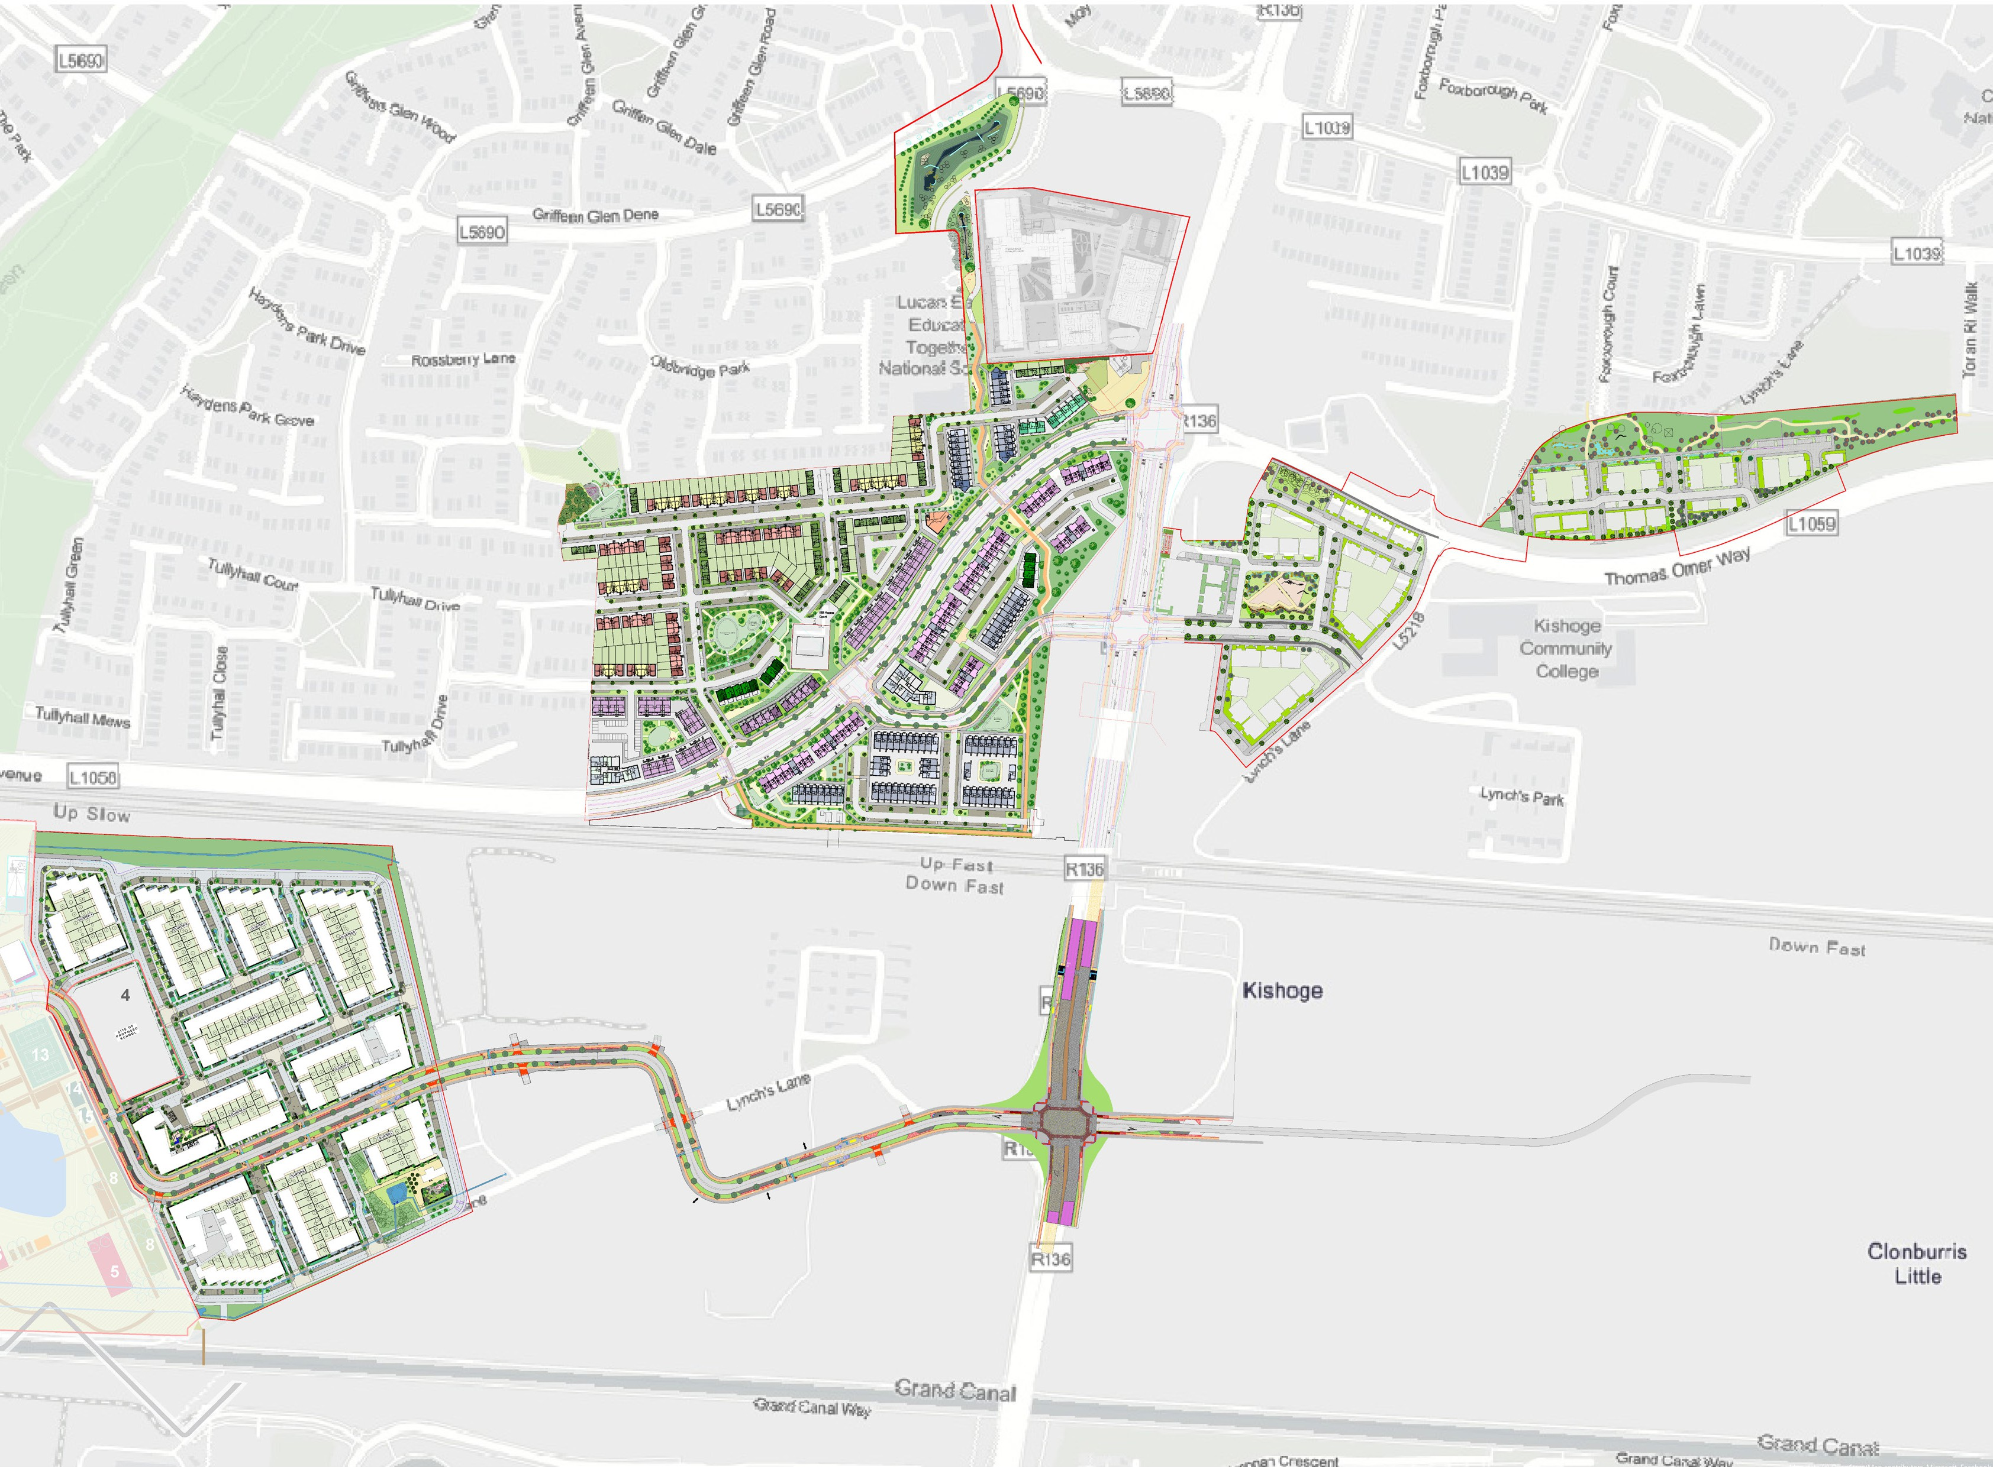
Phases 3, 4 & 5 – Overall Proposal
32-hectare site area
1,269 new homes:
326 houses
673 duplex/triplex
270 apartments
9,030m² public open space
Two creche facilities
Community facilities & phasing of schools/ retail/ commercial space etc. per SDZ requirements
Part X planning application to An Bord Pleanála due to scale of development (>500 homes)

Slide 8
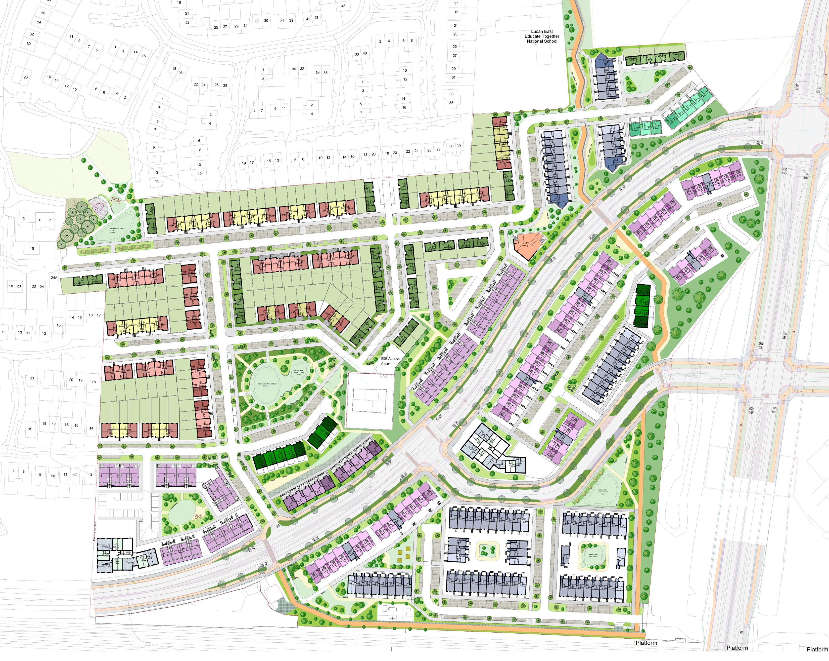
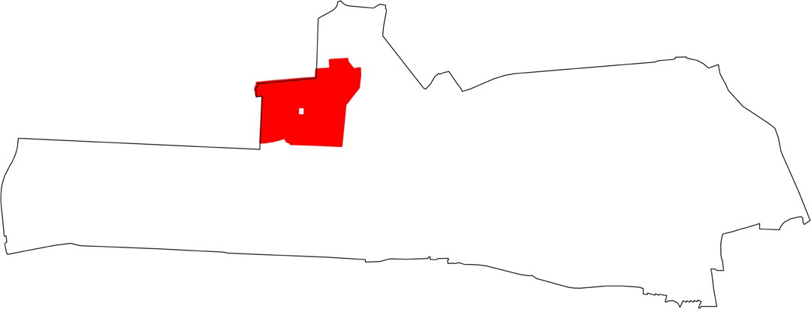
Phase 3 – Analysis & Proposal
597 new homes:
150 houses
367 duplex/triplex
80 apartments
6,030 m² new public open space (including
Green corridor along rail line & green link connecting Kishoge station to Griffeen Centre & schools
Creche for 100 children
Constraints with gas & electricity infrastructure
Public Open Space
Central Open Space
Creche
Green Link
.
C
3
Key Plan of Site 3 within SDZ

Slide 9
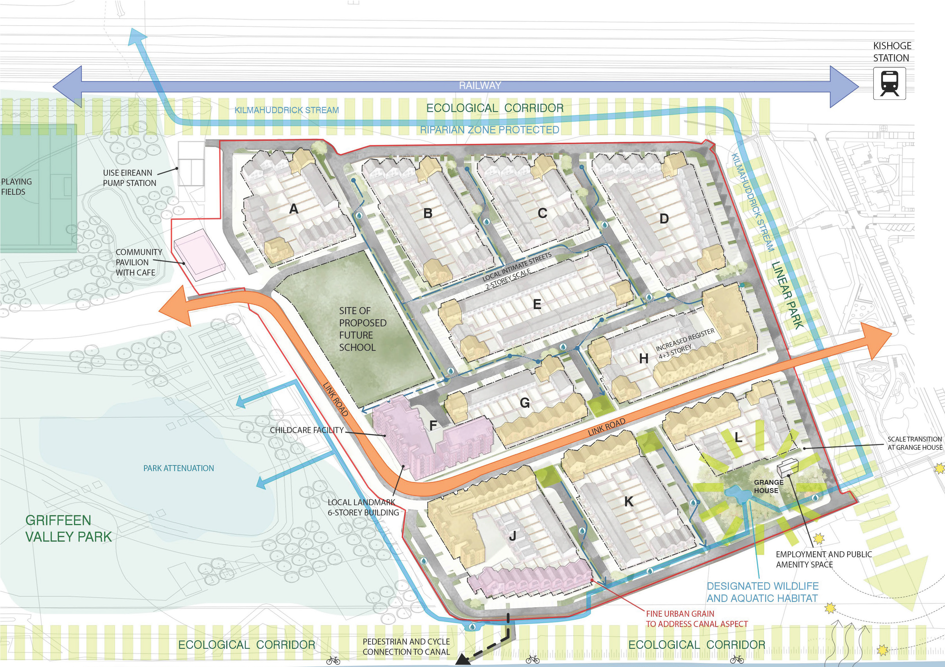
Phase 4 – Analysis & Proposal
436 new homes:
141 houses
163 duplex/triplex
132 apartments
600m2 community facility& ground floor retail (Block D)
Between Griffeen Valley Park Extension & site 1 linear park
South Link Street access & proposed primary school site
Ecology considerations & future use of Grange House
4
Key Plan of Site 4 within SDZ

Slide 10
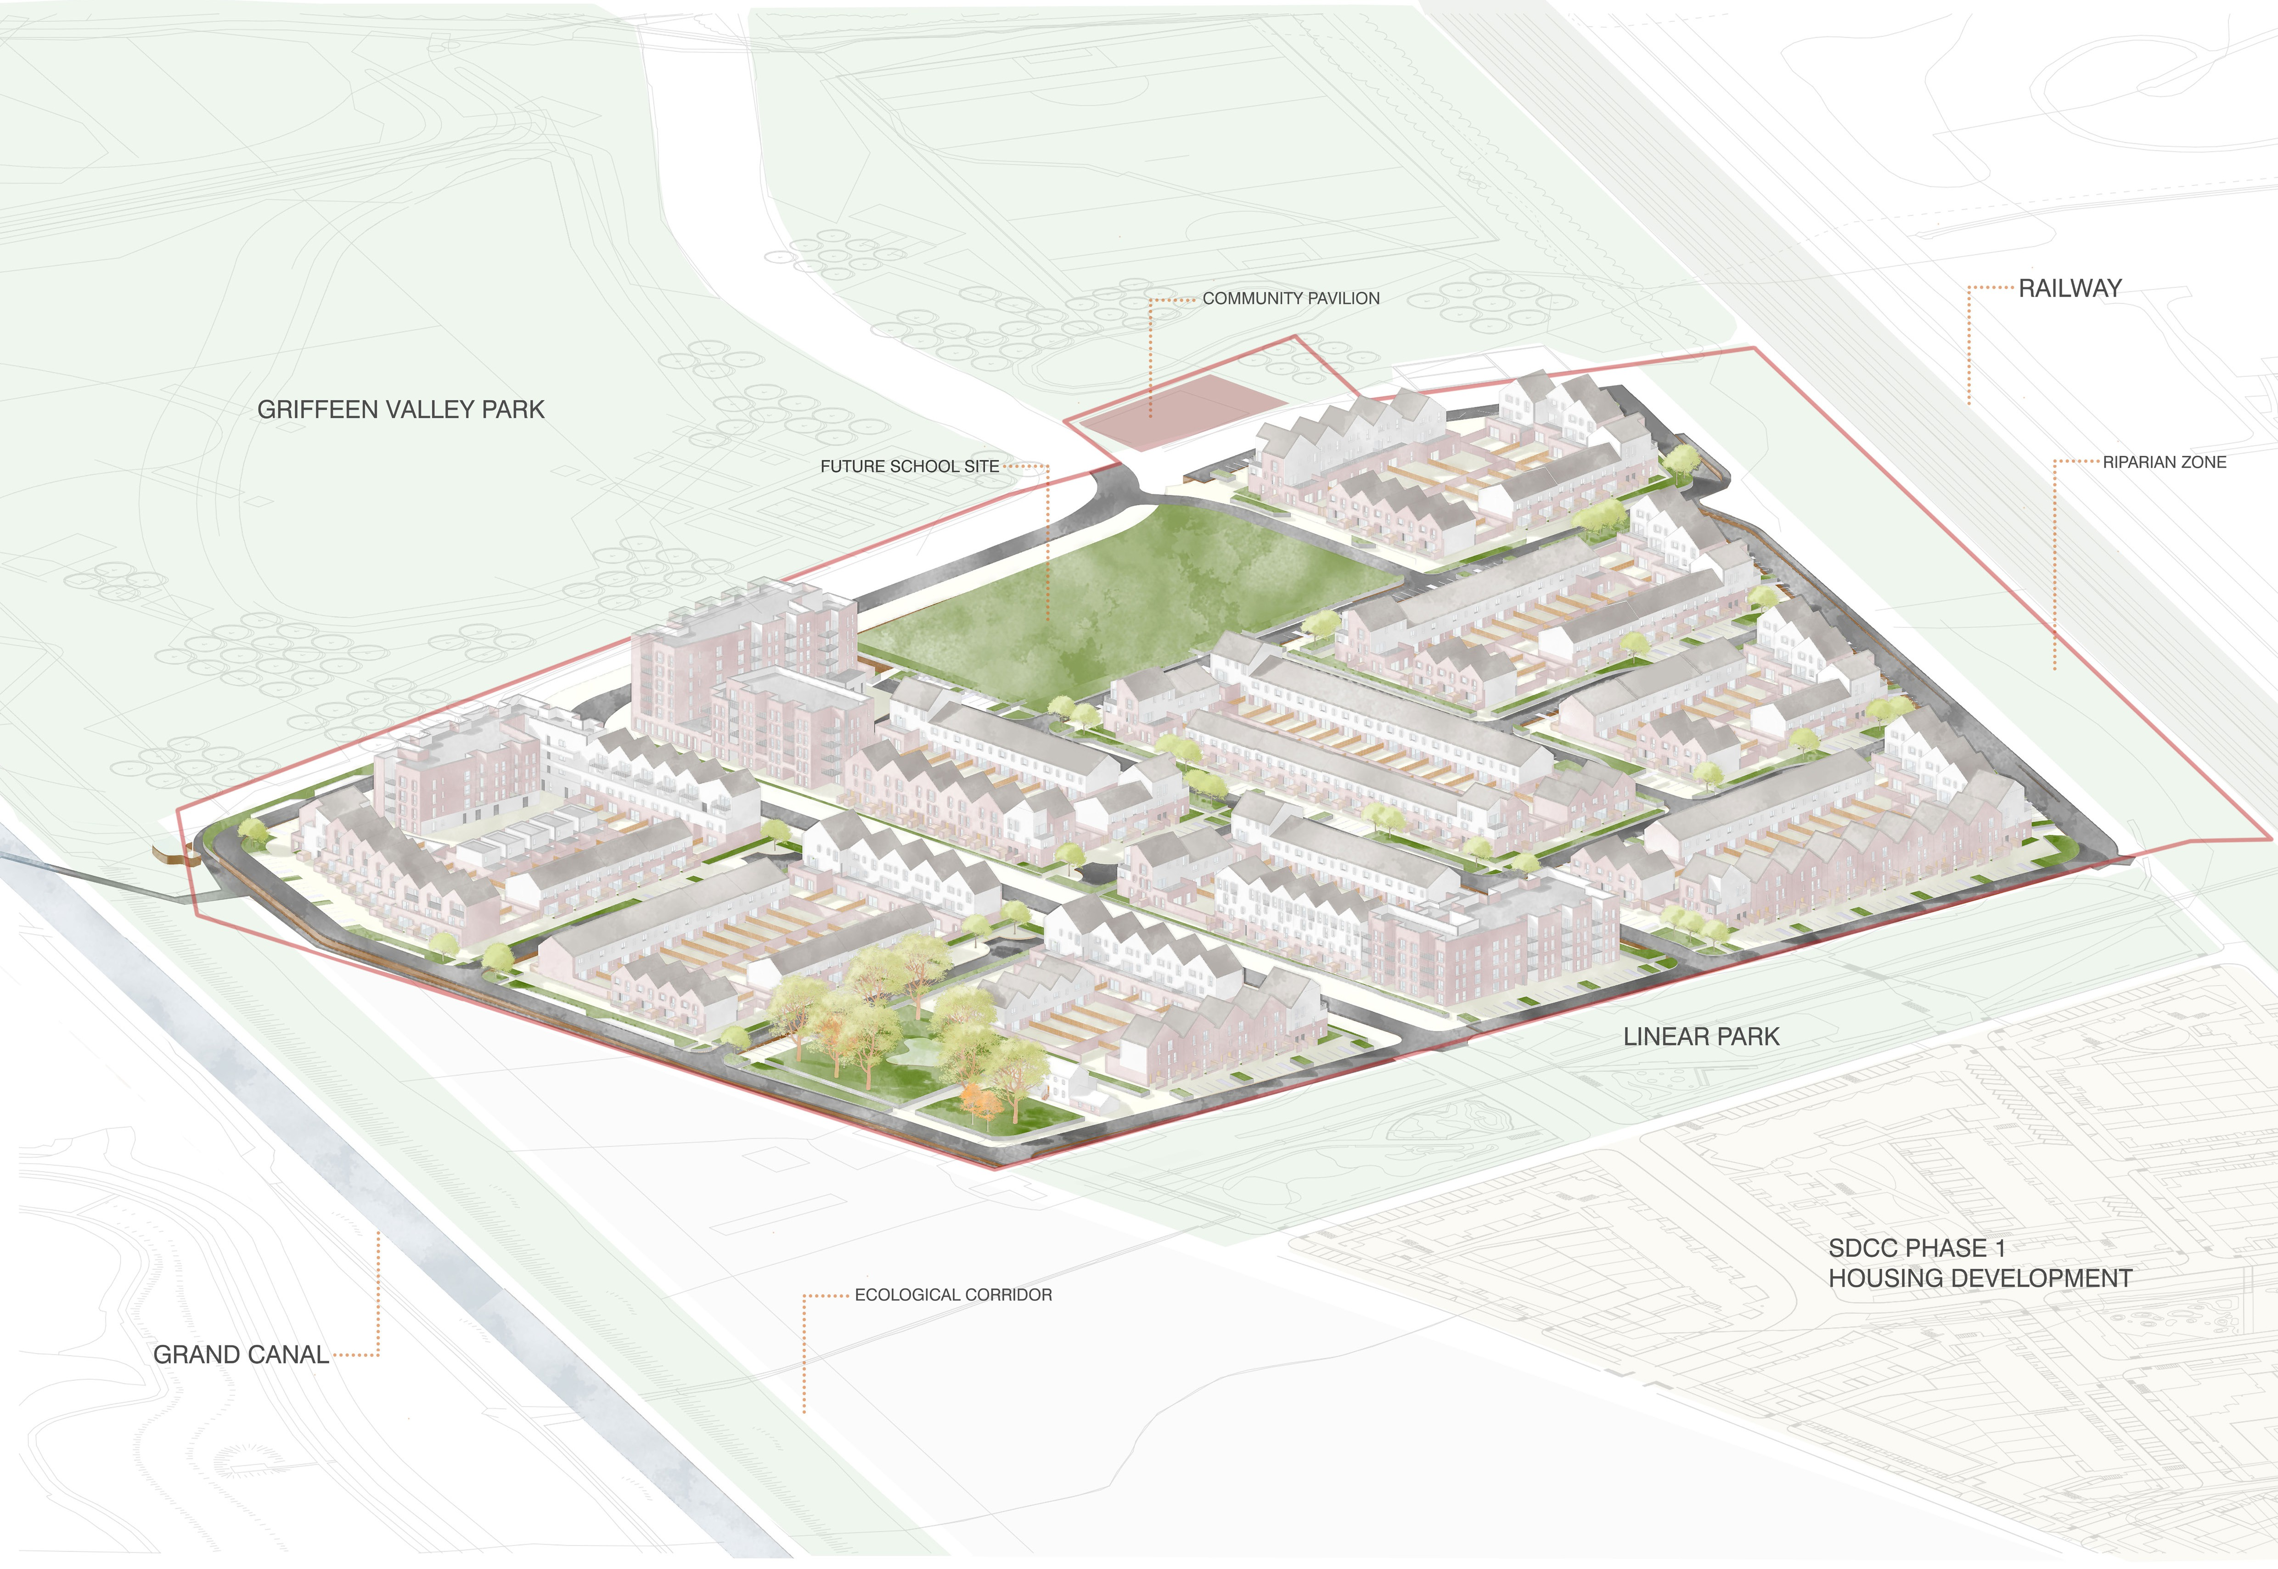
Phase 4 – Proposal

Slide 11
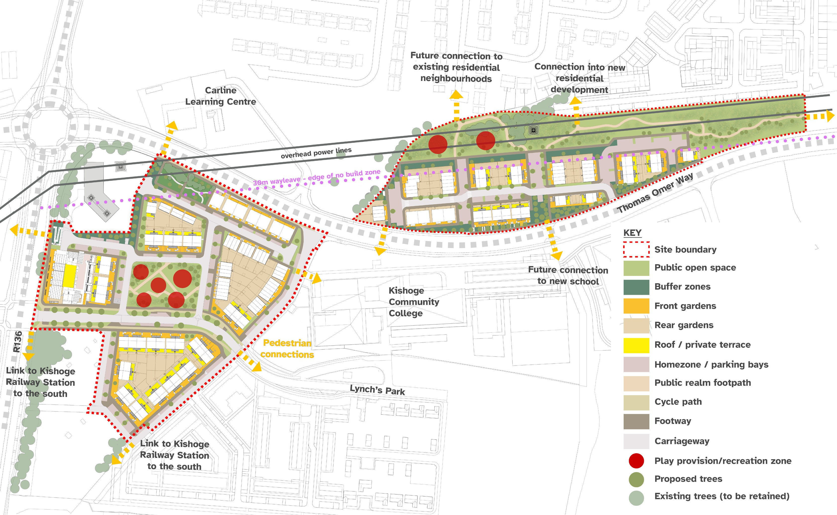
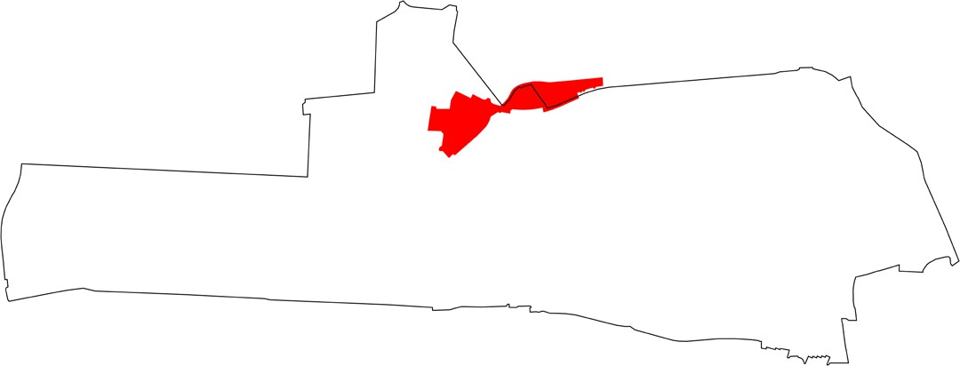
Phase 5 – Analysis & Proposal
236 new homes:
35 houses
143 duplex/triplex
58 apartments
Parks/public open space: 2700m² (Site 5A) & 3400m² (5B)
Density step-down from town centre to adjacent development
Building frontage on Thomas Omer Way and to R138 per SDZ
Offset from overhead cables & retain existing ESB compound
5
Key Plan of Site 5 within SDZ

Slide 12
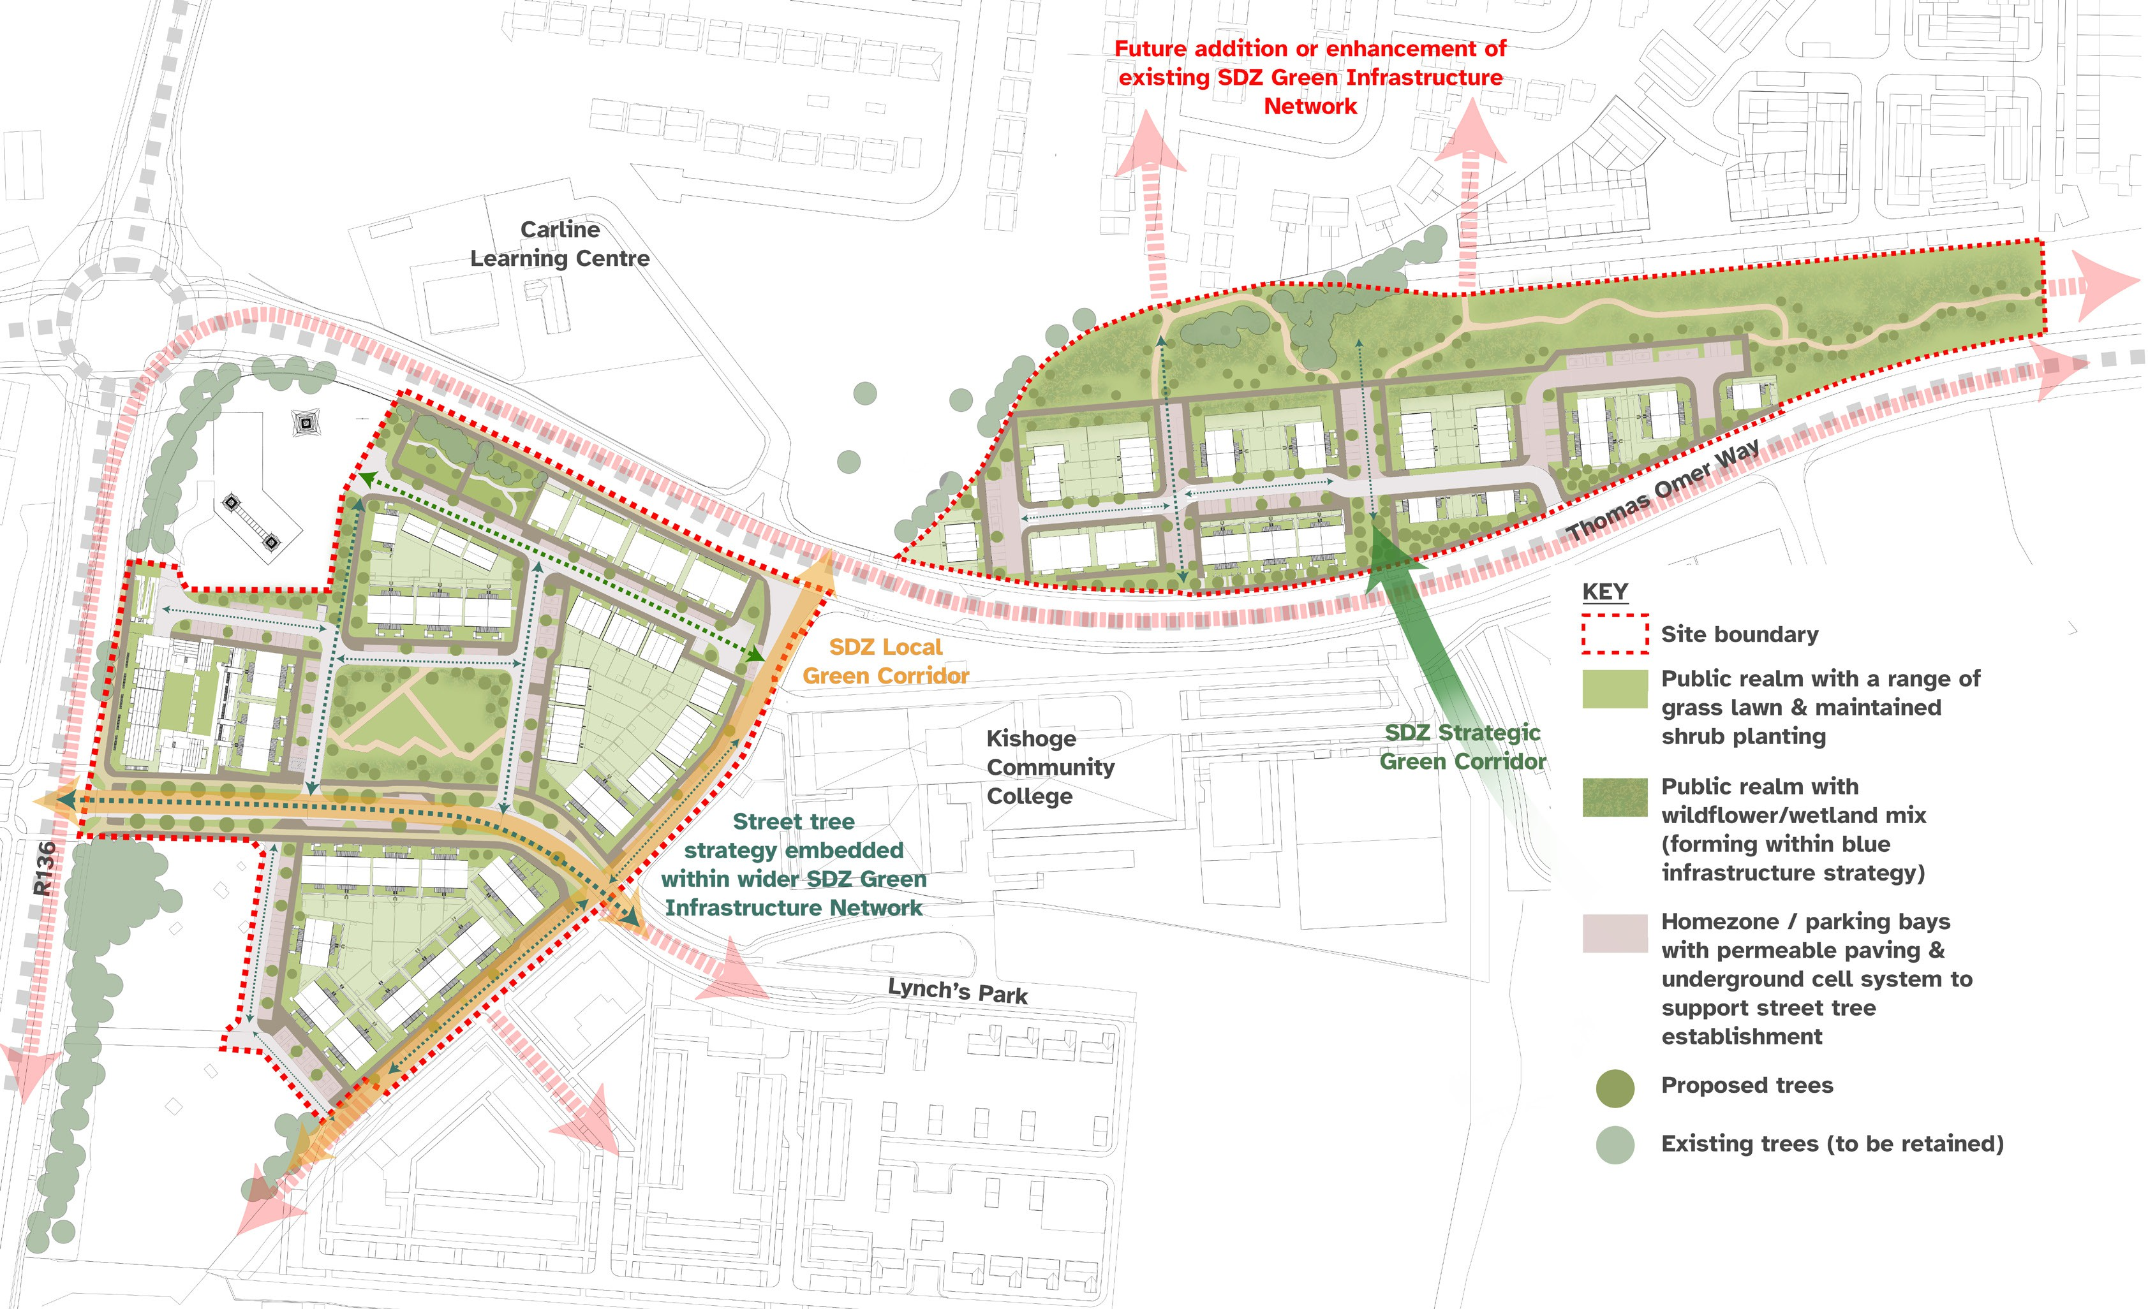
Phase 5: Connectivity & Green Links
Green link connections to:
SDZ green infrastructure network
Lynch’s Park / Kishoge Community College / proposed new school
Existing neighbourhoods to north of site 5B & new residential development to north of site 5B
Kishoge station to south
SUDS included in landscaping proposals for water attenuation
Active travel links, including to Kishoge station

Slide 13
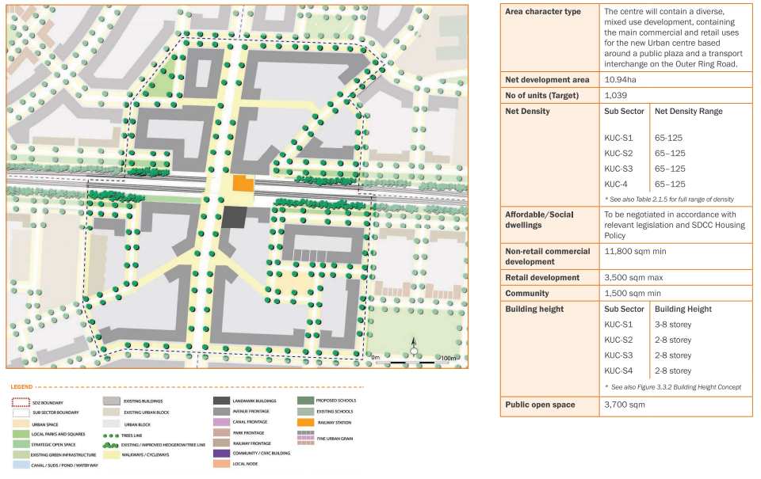
Phase 6: Kishoge Urban Centre
High-density urban centre development (from 2/3 to 8 storeys)
Capacity on Council-owned land for approx. 650 homes with mix of social, affordable purchase & cost rental tenures
7,635m² employment use & ≤ 900m² retail also required
Green infrastructure, gas main, rail corridor and urban core
Complexity & density of site - very challenging for SDCC to manage delivery of this scale & type of development

Slide 14
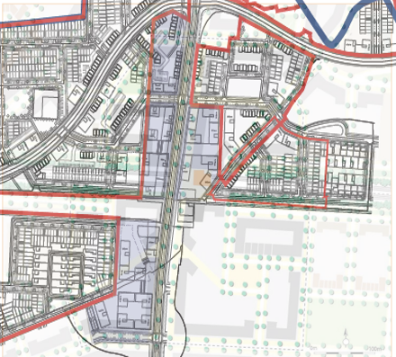
Phase 6: Kishoge Urban Centre
Options:
Procure development partner for detailed design, planning & construction?
Examine possible AHB or LDA partnership?
Wait until phases1-5 are progressed?
Proposed:
Competitive dialogue process to:
Explore cost, tenure mix & delivery timelines
Potential to benefit from market capacity to deliver, expertise & economies of scale which should accelerate delivery
Minimise risk to Council / direct sale process / explore cost rental management options
(s.183 approval required for building licence & land transfer for future sale of affordable housing on Council’s behalf)
Overlay of SDCC owned lands (coloured purple) within Kishoge Urban Centre

