Slide 1


Pavilion Part 8 Processes
Presentation to Council Meeting
11th November 2024

Slide 2

Programme Review proposed locations:
Griffeen Valley Park (Part 8 in place).
Corkagh Park ORR (Part 8 in place).
Dodder Valley Mt Carmel (Part 8 in place).
Kilnamanagh open space
Sean Walsh Park Artificial Grass Pitch
Kiltipper Park
Collinstown Park
Griffeen Valley Arthur Griffith Park
Willsbrook Park
Tymon Park South (Part 8 still under consultation and to be presented at December 2024 Council meeting)
Current Part 8 Locations in Bold

Slide 3
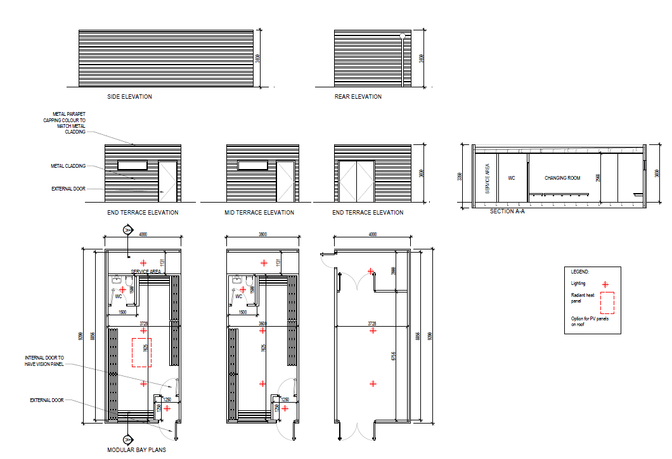
Programme Review modular build:
External Cladding:
Profiled powder coated single skin metal sheeting, mechanically fixed to building perimeter
Structure:
Light gauge steel or similar structure with 100mm Rockwool Insulation with 1 No. layer plasterboard with skim coat.

Slide 4
Funding
Approved Sports Capital Grants: Griffeen Valley Park €610,000
  Corkagh Park ORR €550,000
  Collinstown Park €455,905
      Dodder Valley Mt Carmel €351,487
      Total Sports Capital Grant funding to date: €1,967,392
      Budget Allocation for 10 No. Pavillion buildings:
€2 million SDCC funding in 2024-2026 Capital Programme
Estimate of additional €6m (includes design / tender team and contingency) required for enhanced programme.
Further Sports Capital Grant applications will be made as and if opportunities arise. Funding to be included in 2025-2027 Capital Programme

Slide 5
Locations subject to current Part 8 processes
Kilnamanagh Open Space
Sean Walsh Park Artificial Pitch
Kiltipper Park
Collinstown Park
Griffeen Valley / Arthur Griffith Park
Willsbrook Park

Slide 6
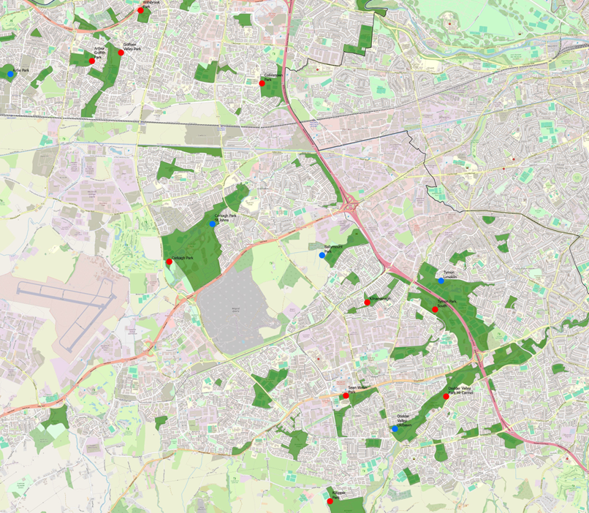
Location Map
Red = proposed locations
Blue = existing locations

Slide 7
Part 8sTime Line
The plans and particulars of the proposed development were available for inspection online on the Council’s Public Consultation Portal website (http://consult.sdublincoco.ie) during the period from 28th September 2024 to 9th November 2024.
Printed plans and particulars were available for inspection or purchase at a fee not exceeding the reasonable cost of making a copy at County Hall, Tallaght, Dublin 24 during office hours from 28th September 2024 to 26th October 2024.
Submissions or observations were made in writing up to 5pm on 9th November 2024
Online Submissions:
http://consult.sdublincoco.ie
Post to:
Senior Executive Officer Environment Water and Climate Change, South Dublin County Council, County Hall, Tallaght, Dublin 24 YNN5.

Slide 8
Kilnamanagh
A proposed Sports Changing Rooms Pavilion at Kilnamanagh Park
One single storey pavilion building consisting of:
Two individual team changing rooms each with one WC area
One club storage area and plant room
Ancillary landscaping works adjacent to the pavilion building
All associated ancillary works in adjacent areas including but not limited to foul & surface water drainage and utility supplies
CCTV
Appropriate Assessment Screening under the Habitats Directive (92/43/EEC)
Screening for Environmental Impact Assessment (EIA) under the EIA Directive 2014/52/EU.

Slide 9
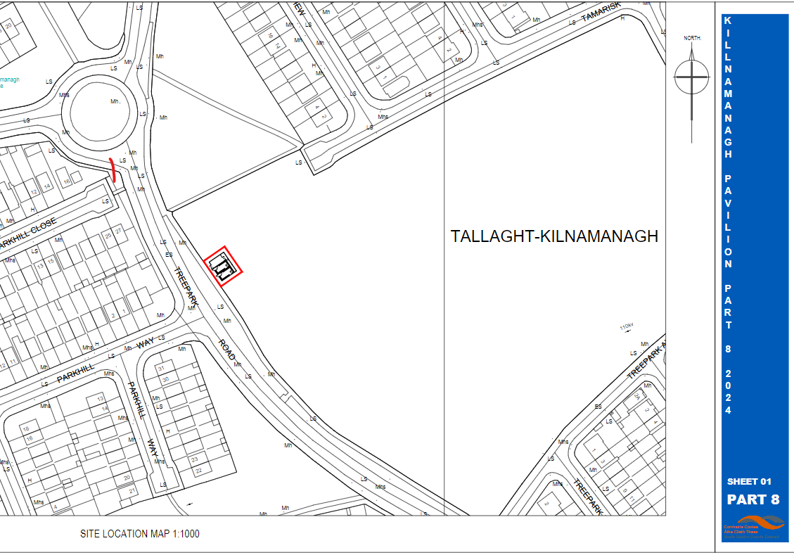
Kilnamanagh Location

Slide 10
Kilnamanagh Process
Submissions:
101 submissions.
Main issues raised:
Proposal Welcomed
Support for the proposal
Proposal will support local sports club which is of great benefit to the community
Long-standing need for these facilities
Recommendation:
It is recommended that, as the proposal is in conformity with proper planning and sustainable development, that the Council proceed with the Part 8 proposal for the Sports Changing Rooms Pavilion at Kilnamanagh Park, Tallaght, Dublin 24

Slide 11
Sean Walsh Park Proposal
A proposed Sports Changing Rooms Pavilion at Sean Walsh Park
One single storey pavilion building consisting of:
Two individual team changing rooms each with one WC area
One storage area and plant room
Ancillary landscaping works adjacent to the pavilion building
All associated ancillary works in adjacent areas including but not limited to foul & surface water drainage and utility supplies
CCTV
Appropriate Assessment Screening under the Habitats Directive (92/43/EEC)
Screening for Environmental Impact Assessment (EIA) under the EIA Directive 2014/52/EU.

Slide 12
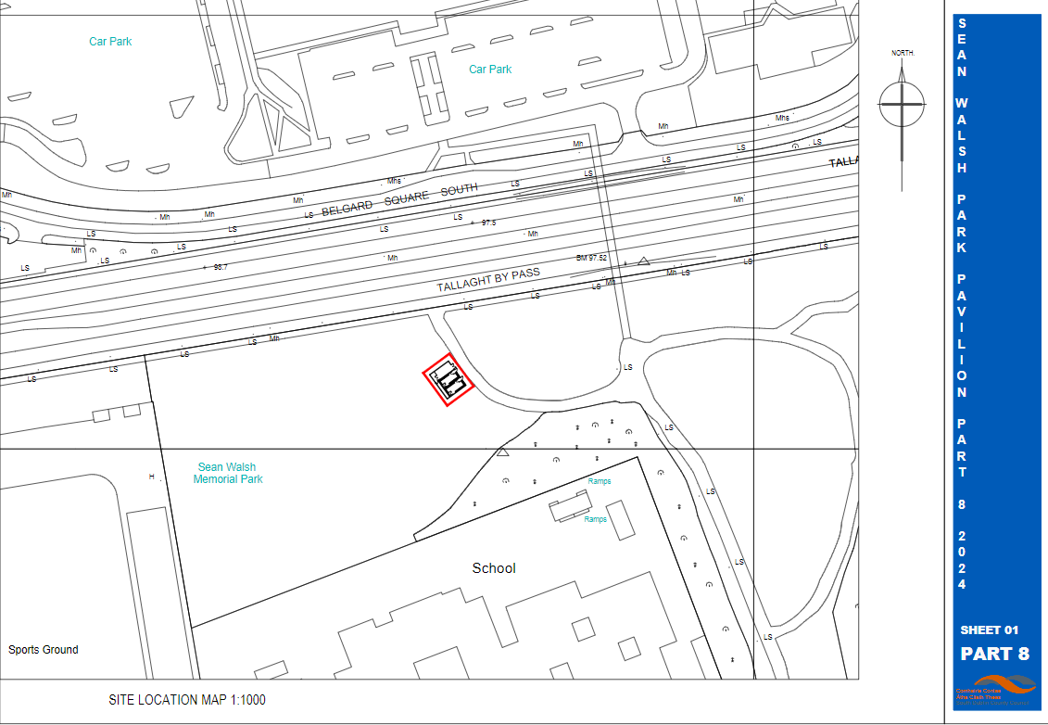
Sean Walsh Park Location

Slide 13
Sean Walsh Park Process
Submissions:
0 submissions.
Recommendation:
It is recommended that, as the proposal is in conformity with proper planning and sustainable development, that the Council proceed with the Part 8 proposal for the Sports Changing Rooms Pavilion at Sean Walsh Park, Tallaght, Dublin 24

Slide 14
Kiltipper Park Proposal
A proposed Sports Changing Rooms Pavilion at Kiltipper Park
One single storey pavilion building consisting of:
Two individual team changing rooms each with one WC area,
One storage facility and plant room
Ancillary landscaping works adjacent to the pavilion building
All associated ancillary works in adjacent areas including but not limited to foul & surface water drainage and utility supplies
CCTV
Appropriate Assessment Screening under the Habitats Directive (92/43/EEC)
Screening for Environmental Impact Assessment (EIA) under the EIA Directive 2014/52/EU.

Slide 15
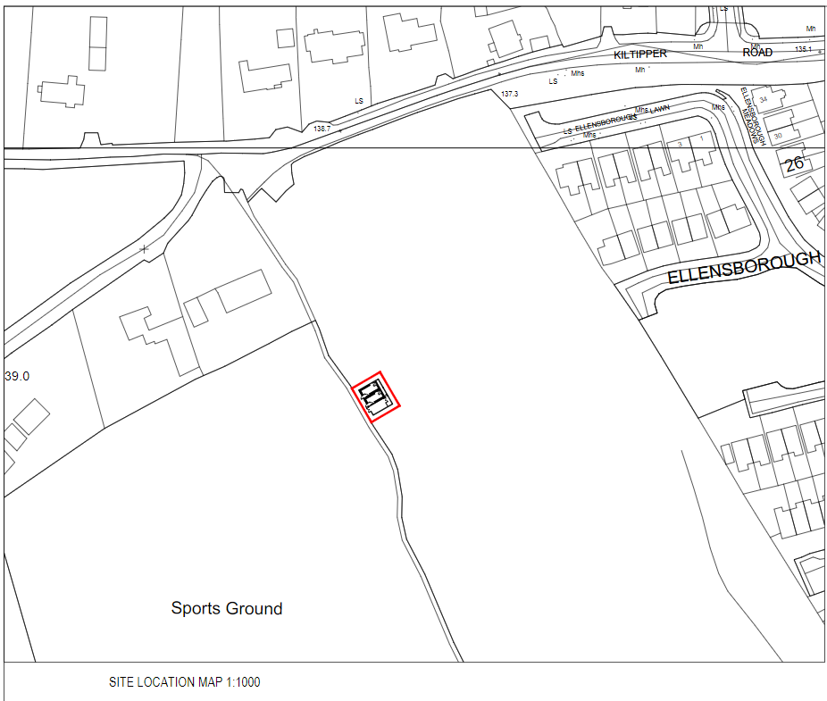
Kiltipper Location

Slide 16
Kiltipper Process
Submissions:
0 submissions.
Recommendation:
It is recommended that, as the proposal is in conformity with proper planning and sustainable development, that the Council proceed with the Part 8 proposal for the Sports Changing Rooms Pavilion at Kiltipper Park, Tallaght, Dublin

Slide 17
Collinstown Proposal
A proposed Sports Changing Rooms Pavilion at Collinstown Park:
One single storey pavilion building consisting of:
Six individual team changing rooms each with one WC area
Storage area and plant room.
Ancillary landscaping works adjacent to the pavilion building
All associated ancillary works in adjacent areas including but not limited to foul & surface water drainage and utility supplies
CCTV
The proposal has undergone Appropriate Assessment Screening under the Habitats Directive (92/43/EEC) and screening for Environmental Impact Assessment (EIA) under the EIA Directive 2014/52/EU.

Slide 18
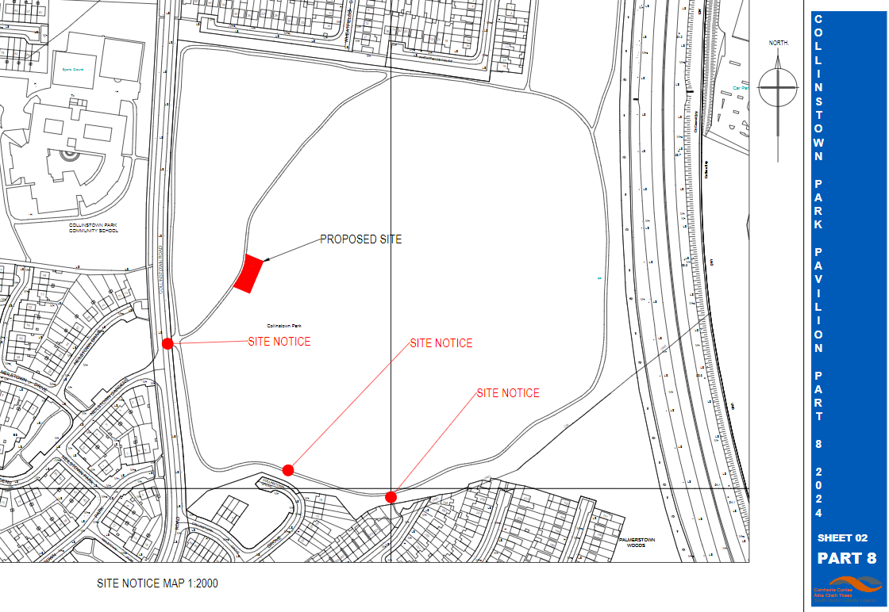
Collinstown location

Slide 19
Collinstown Process
Submissions:
0 submissions.
Recommendation:
It is recommended that, as the proposal is in conformity with proper planning and sustainable development, that the Council proceed with the Part 8 proposal for the Sports Changing Rooms Pavilion at Collinstown Park, Clondalkin, Dublin 22

Slide 20
GVP- AGP Proposal
A proposed Sports Changing Rooms Pavilion at Griffeen Valley Arthur Griffith Park.
One single storey pavilion building consisting of:
Two individual team changing rooms each with one WC
Storage area and plant room
Ancillary landscape works adjacent to the pavilion building
All associated ancillary works in adjacent areas including but not limited to foul & surface water drainage and utility supplies
CCTV
The proposal has undergone Appropriate Assessment Screening under the Habitats Directive (92/43/EEC) and screening for Environmental Impact Assessment (EIA) under the EIA Directive 2014/52/EU.

Slide 21
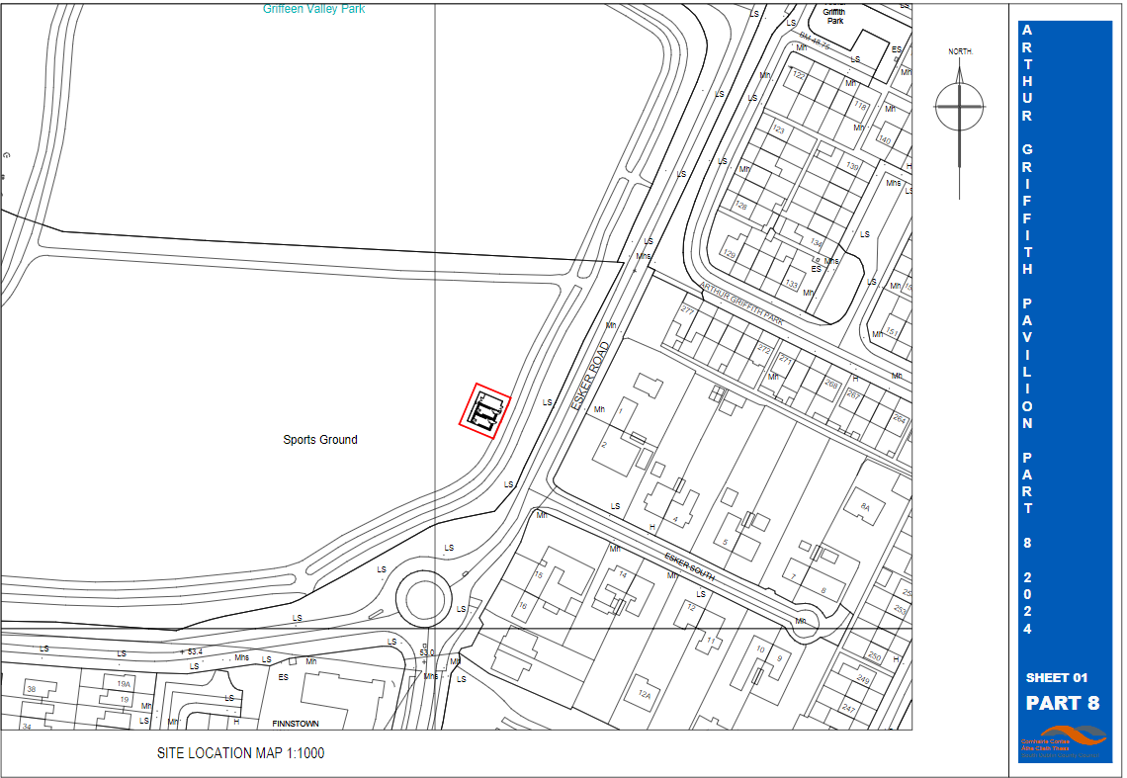
GVP AGP Location

Slide 22
GVP AGP Process
Submissions:
41 submissions.
Main issues raised:
Proposal Welcomed
Number of changing rooms not enough and request revising the proposal and adding more changing rooms (up to six)
Request for additional external storage facilities at pitches elsewhere
Security
Facilities for referee
Additional general public access to toilets
Additional facilities within the park (e.g. seating, water stations, notice boards, defibrillators
Accessibility
Sustainability

Slide 23
GVP AGP Process
Responses:
Additional changing rooms: The proposal for modular changing rooms is based on discussions with local clubs and the existing provision in the area. It is noted that there is already a sports club house / changing facility with toilets in the western section of this park which provides facilities to Weston Hockey, Lucan Harriers and Arthur Griffith Football Club. This proposal will provide a multiuse / flexible changing and toilet facility in the western part of the same park. This is a significant increase in provision. The addition of the booking system and remote access systems increases the use of the facilities and promotes access to them. The proposal for a modular system allows units to be added to the proposal in future years should the need arise, however at present the proposal is based on a reasonable provision of facilities for this area and the funding available. Within the budgetary envelope available, increasing the modular units at this location, would require decreasing the modular units provided at another location. The council aims to provide reasonable provision across the county.
External storage provision: is provided as part of a separate programme and is outside the scope of the part 8 process.
Security: The design and location of the pavilion contributes to the security of the building, with the use of robust materials and external cladding. External lighting will be provided as required as part of the detailed design of the pavilion. The location of the pavilion was chosen to ensure that there was sufficient passive surveillance and it was proposed in an area with high levels of active usage of the park. The plans include for the provision of CCTV as part of the pavilion provision. The single story nature of the building precludes the occlusion of sightlines as much as possible and the pavilion is located in a prominent part of the park.

Slide 24
GVP AGP Process
Responses:
Facilities for Referees: were discussed and agreed with all clubs using pitches in the parks that are subject to the current proposals. The detailed design stage will consider further the facilities being provided for referees, including the size of the area allocated to the referee and the facilities to be provided within the referee area, such as seating / rest area etc. to ensure adequate and comfortable provision.
General toilet access: The pavilion programme is designed for the use of sports clubs and groups using the park. Some events e.g. park runs have also been accommodated, as are school sports days etc. General public access to the toilets is not envisaged, as such use generally is supervised and would incur significant costs that are not allowed for within the budget. SDCC are currently progressing the provision of coffee shops in several parks and this does allow for general public toilet access in a supervised setting. This has worked well in other parks. A coffee shop with toilet access is proposed for Griffeen Valley Park as part of the teenspace programme.
Additional facilities: This request is outside the scope of the proposal /pavilion programme proposals. The provision of the additional proposed facilities do not require Part 8 approval and can be progressed as part of separate operational programmes. The provision of defibrillators within parks tends to be in tandem with a supervisory group (e.g. a sports club), trained in the use of the defibrillator and willing to manage same, it is recommended such proposals be progressed outside of Part 8 processes. No changes are recommended to the proposal.

Slide 25
GVP AGP Process
Responses:
Accessibility: SDCC's sports pavillion programme will provide changing rooms for sports clubs and groups within the park. The pavilions are planned and designed in accordance with the Building Regulations and ensure that the buildings are accessible, the building regulations include the approach to the building entrances and require the use of ramps etc. where required.
Sustainability: Solar panels are proposed as part of the proposals for the pavilions. SDCC considered carefully the use of a green roof but the extensive amount of solar panels proposed precluded the use of the green roof as well. Instead the detailed design stage will examine the use of natural based SuDS to filter and clean as well as attenuate surface water, in addition to the the feasibility of providing a small wetland area to encourage biodiversity. Other measures will also be considered at the detail design stage such as rainwater harvesting.
Recommendation:
It is recommended that, as the proposal is in conformity with proper planning and sustainable development, that the Council proceed with the Part 8 proposal for the Sports Changing Rooms Pavilion at Griffeen Valley Park - Arthur Griffith Park, Esker South, Lucan, Co. Dublin

Slide 26
Willsbrook Proposal
A proposed Sports Changing Rooms Pavilion at Willsbrook Park:
One single storey pavilion building consisting of:
2 No. individual team changing rooms each with one WC area,
1 storage area and plant room
Ancillary landscape works adjacent to the pavilion building
All associated ancillary works in adjacent areas including but not limited to foul & surface water drainage and utility supplies
CCTV
The proposal has undergone Appropriate Assessment Screening under the Habitats Directive (92/43/EEC) and screening for Environmental Impact Assessment (EIA) under the EIA Directive 2014/52/EU.

Slide 27
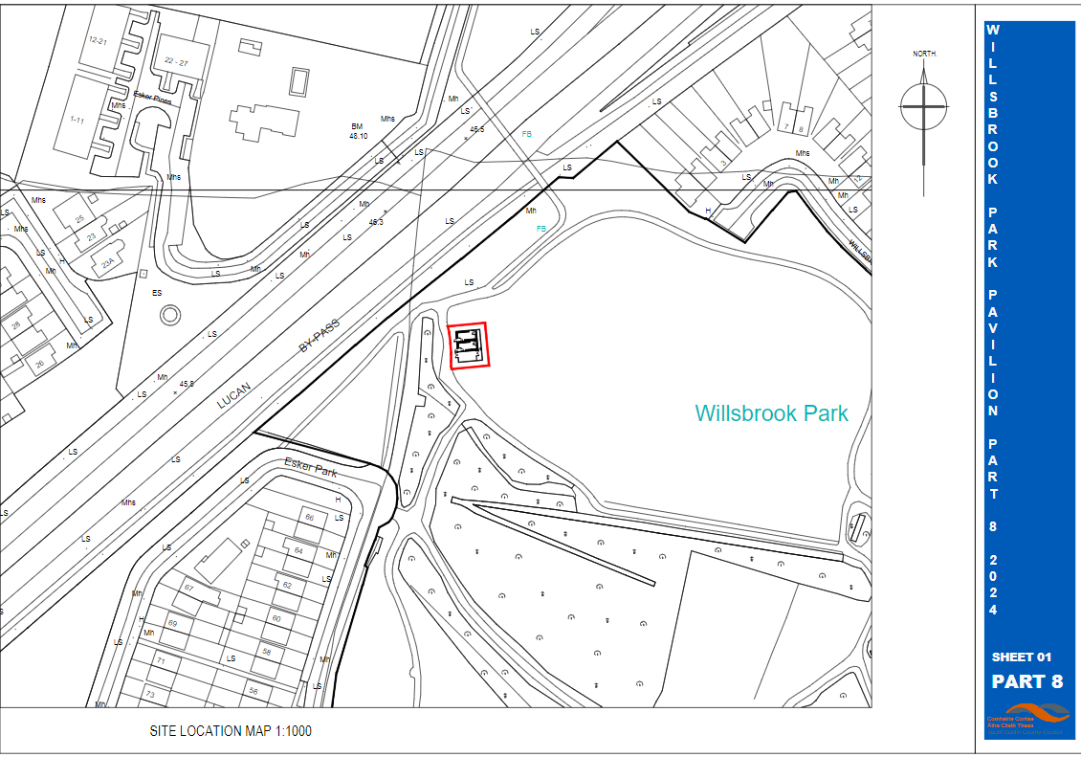
Willsbrook Site Location

Slide 28
Willsbrook Process
Submissions:
3 submissions.
Main issues raised:
Proposal Welcomed and support expressed from local sports club
Request for additional facilities at AGP
Security
Facilities for Referee
Additional general public access to toilets
Additional facilities with the park e.g. seating, water stations, notice boards, defibrillator
Accessibility
Sustainability

Slide 29
Willsbrook Process
Responses:
Additional facilities at AGP: Submission made in error
Security: The design and location of the pavilion contributes to the security of the building, with the use of robust materials and external cladding. External lighting will be provided as required as part of the detailed design of the pavilion. The location of the pavilion was chosen to ensure that there was sufficient passive surveillance and it was proposed in an area with high levels of active usage of the park. The plans include for the provision of CCTV as part of the pavilion provision. The single story nature of the building precludes the occlusion of sightlines as much as possible and the pavilion is located in a prominent part of the park; however it is acknowledged that the park is a wooded one and sightlines are important within the park, as such the detailed design stage will consider further the matter of orientation and possible slight adjustments to the placement of the pavilion to ensure it affects sightlines as little as possible.
Facilities for referees: discussed and agreed with all clubs using pitches in the parks that are subject to the current proposals. However the detailed design stage will consider further the facilities being provided for referees, including the size of the area allocated to the referee and the facilities to be provided within the referee area, such as seating / rest area etc. to ensure adequate and comfortable provision.

Slide 30
Willsbrook Process
Responses:
General public access to toilets: The pavilion programme is designed for the use of sports clubs and groups using the park for active recreation. Some events e.g. park runs have also been accommodated, as are school sports days etc. General public access to the toilets is not envisaged, as such use generally has to be supervised and would incur significant costs that are not allowed for within the budget.
Seating, notice boards, water stations, Defibrillators: This request is outside the scope of the proposal /pavilion programme proposals. The provision of the additional proposed facilities do not require Part 8 approval and can be progressed as part of separate operational programmes. The provision of defibrillators within parks tends to be in tandem with a supervisory group (e.g. a sports club), trained in the use of the defibrillator and willing to manage same, it is recommended such proposals be progressed outside of Part 8 processes. No changes are recommended to the proposal.
Accessibility: SDCC's sports pavillion programme will provide changing rooms for sports clubs and groups within the park. The pavilions are planned and designed in accordance with the Building Regulations and ensure that the buildings are accessible, the building regulations include the approach to the building entrances and require the use of ramps etc. where required.

Slide 31
Willsbrook Process
Responses:
Sustainability: Solar panels are proposed as part of the proposals for the pavilions. SDCC considered carefully the use of a green roof but the extensive amount of solar panels proposed precluded the use of the green roof as well. Instead the detailed design stage will examine the use of natural based SuDS to filter and clean as well as attenuate surface water, in addition to the the feasibility of providing a small wetland area to encourage biodiversity. Other measures will also be considered at the detail design stage such as rainwater harvesting.
Recommendation:
It is recommended that, as the proposal is in conformity with proper planning and sustainable development, that the Council proceed with the Part 8 proposal for the Sports Changing Rooms Pavilion at Willsbrook Park, Lucan, Dublin.

Slide 32
Pavillions Next Steps
Complete:
April 2024: Programme review presented to Council
April-Sept 2024: Environmental frameworks in place and concurrent preliminary design and detail design for modular buildings
November 2024: Civil Works framework in place
November 2024: Decision on Part 8s for Collinstown, Kilnamanagh, Sean Walsh Park, Arthur Griffith Park, Kiltipper & Willsbrook
Next Steps:
November 2024: Issue framework tenders for modular buildings using Corkagh & Griffeen Pavillions
December 2024: Decision on Part 8 for Tymon Park South
Jan / mid Feb 2025: Tender assessment and award with 8-week lead in and mobilization post same.
Mar 2025: Contractor mobilization for civil works at Corkagh & Griffeen and concurrent modular building manufacture with mini competitions for remaining locations to commence post establishment of framework.
Mid April 2025: Modular installation at Griffeen & Corkagh
Further approved locations progressed after initial projects with estimated 28-week delivery timeframe, dates to be advised by contractor.
*Dates subject to change depending on planning, procurement, manufacture, construction etc.

Slide 33
Pavillions Part 8s
Thank you

