Slide 1
Winter Maintenance Plan
2024 – 2025 Season

Slide 2
Recap of 2023 – 2024 Season
39 Salting Runs on all routes
11 Salting Runs on hill routes only
2500 tonnes of rock salt spread
Lowest recorded road temperature: -5.4ºC
2023 - 2024 season would be considered to have been a mild winter overall but with one significant cold spell in mid January that lasted 5 days where daytime temperatures stayed below 0ºC.

Slide 3
2024 – 2025 Season
Starts – Oct 14th
Finishes – April 30th
Gritting Runs will be generally be carried out at 7pm and/or 5am depending on forecast
Standard spread rate will be 10g/m2 but increased in the event of extreme low temperatures or snow.
On routes where brines is being incorporated the standard spread rate will be 8g/m2 and a spray rate of 10ml/m2 of brine.
Snow ploughs available for all routes but snow falls must be greater than 30mm to be effective

Slide 4
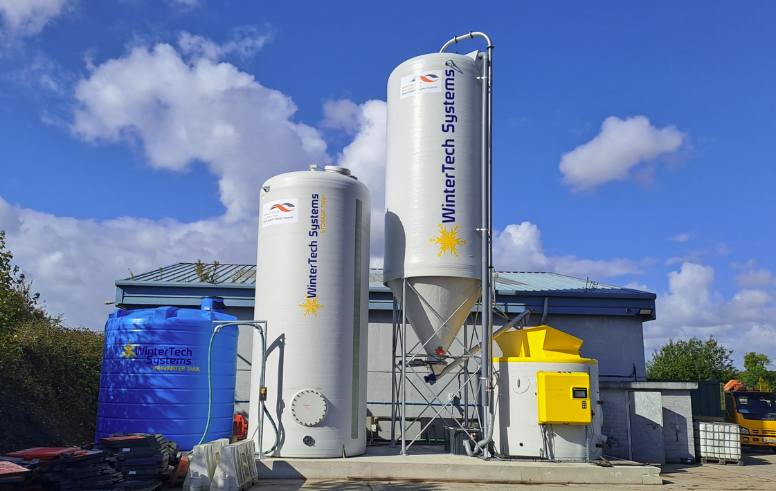
Brine
Brine is a solution consisting of salt and water that is used in conjunction with rock salt for the treatment of roads during cold periods
Benefits of Brine
Provides a faster acting treatment
More efficient use of salt, can spread less while getting the same result
Less salt wasted through bounce off
Environmental benefits through less salt being spread
Increases residual salt on the road
New Brine Facility Installed in Palmerstown

Slide 5
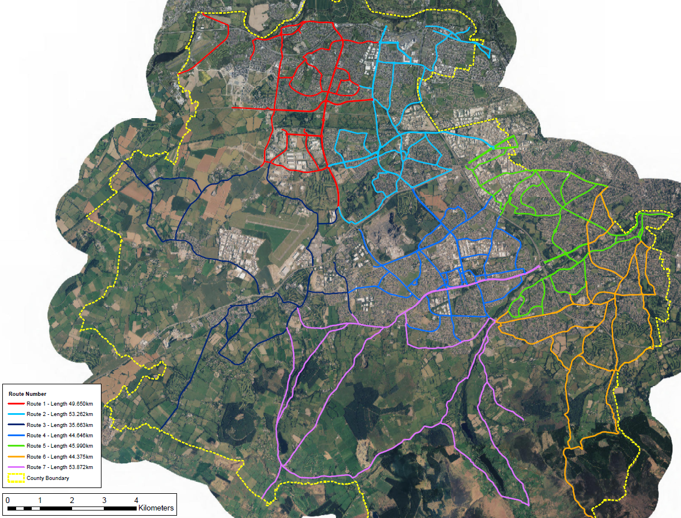
Gritting Routes
7 routes within the county
340km of roads treated

Slide 6
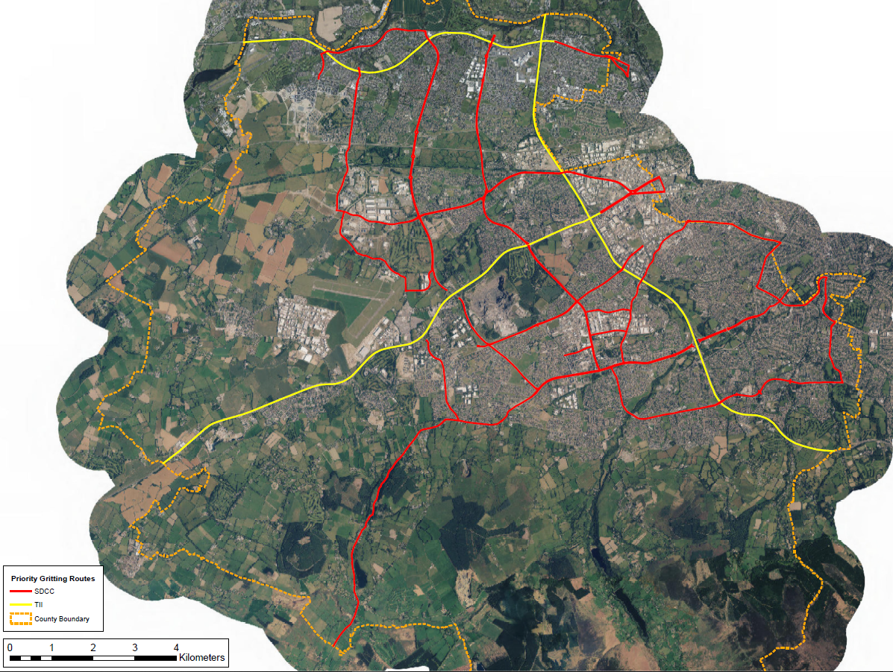
Priority Routes
SDCC Priority Routes
Private Priority Routes
Priority Routes are
the main distributor roads to the county
essential services such as hospitals, airport, emergency services
food distribution points
This is a live document where locations may be added/removed depending on the severity of the weather event

Slide 7
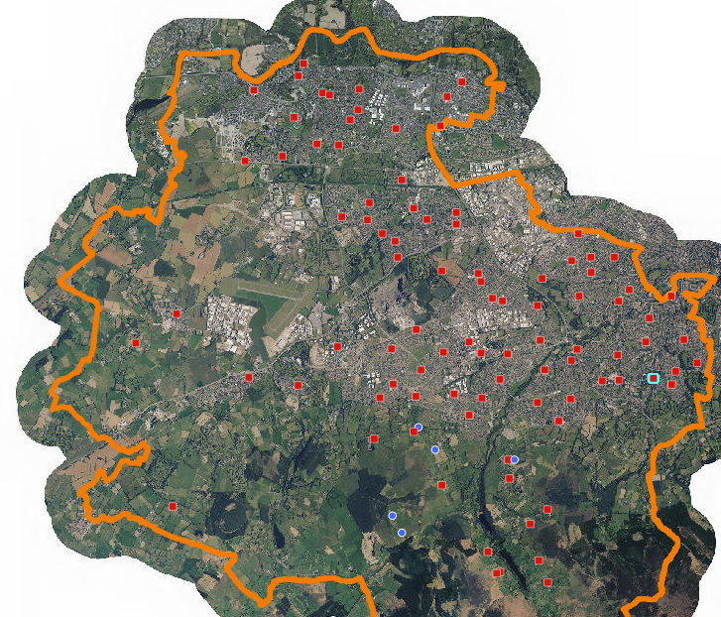
Salt Bin Locations
1 salt bins located throughout the county
Bins restocked at the start of every season and upon request following that
Salt bin locations available on SDCC website
South Dublin Salt Bins 2024 SDCC (arcgis.com)

