Slide 1



Slide 2

Matters to which a local authority must have regard when considering an LPT Adjustment factor variation in accordance with S20 Finance Local Property Tax Act 2012 (as amended):
Estimate of income & expenditure in the period for which the varied rate will have effect
Financial position of the local authority
Financial effect of the varied rate
Feedback from the LPT public consultation process
S.20 allows members to vary the basic rate by a maximum of + / - 15%
The basic rate is adjusted from the 1st November onward for period determined by members

Slide 3
LPT - Provisional Allocation 2025 / 2024 - before any Variation

Slide 4
(1) Estimate of Income & Expenditure - Schedule 1 of Local Property Tax (Local Adjustment Factor) Regulations 2022

Slide 5
(2) Financial Position - Schedule 2 of Local Property Tax (Local Adjustment Factor) Regulations 2022

Slide 6
(3) Impact on Local Funding if 2025 LPT is varied

Slide 7
(4) LPT Public Consultation:
Public consultation from July 3rd to August 9th
Notice placed in:
Irish times
Council website
Members net
Alerts were posted on:
Twitter
Facebook

Slide 8
(5) LPT Public Consultation Response:

Slide 9
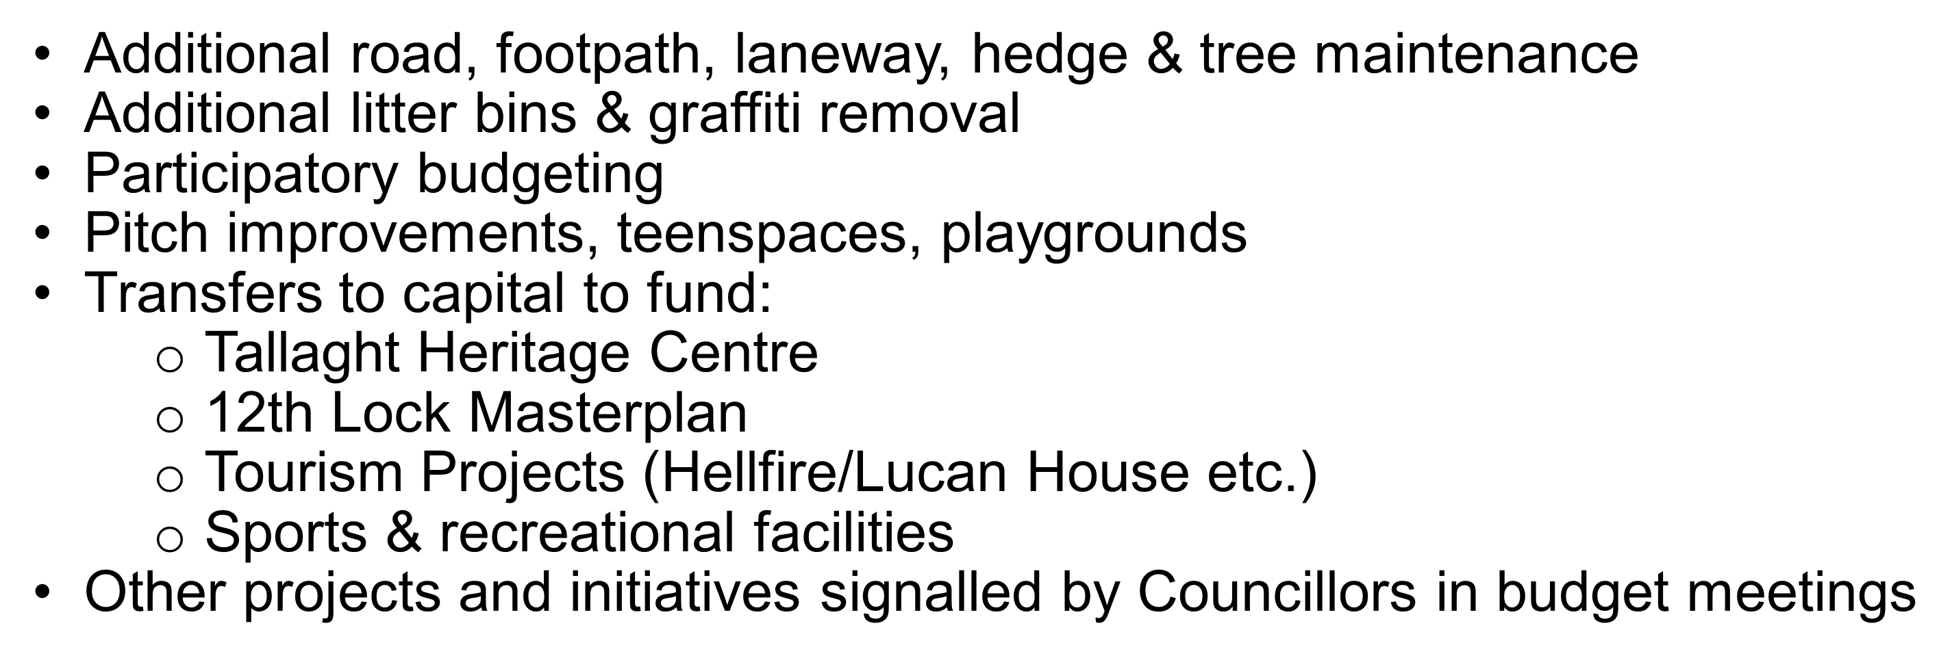
pgarrahan@lgma.ie
Discretionary Expenditure Options
(linked to funding)

Slide 10


